Slide 1
Getting Images from TouchlessLib

Slide 2
Download, unzip.

Slide 3
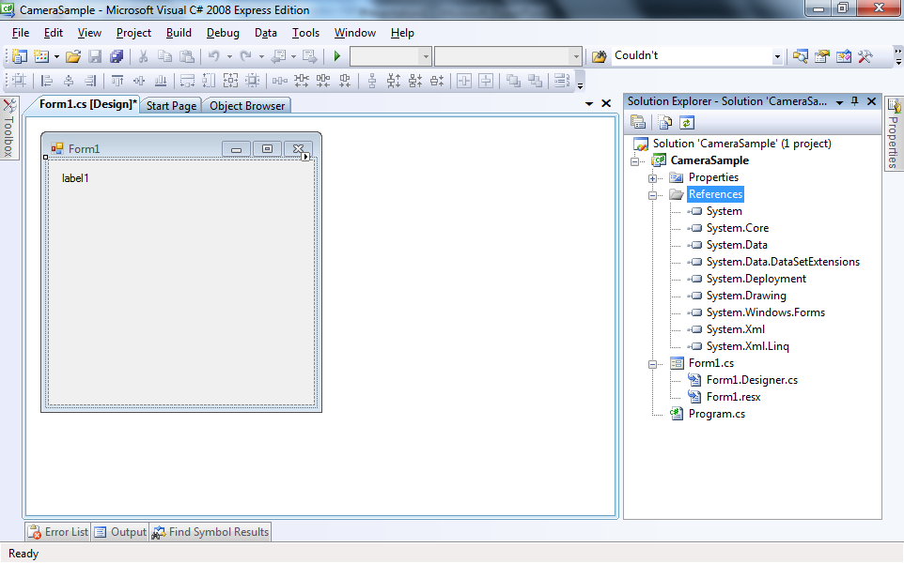
There is a PictureBox component here that was added from the Toolbox (left side of the screen).

Slide 4
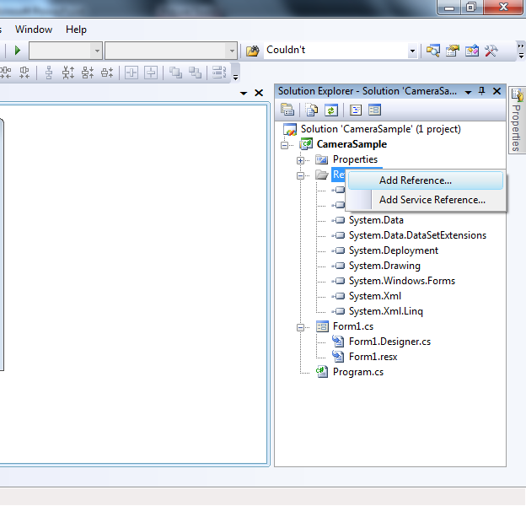
Add a “Reference” to TouchlessLib

Slide 5
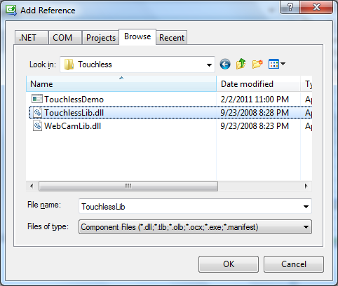

Slide 6
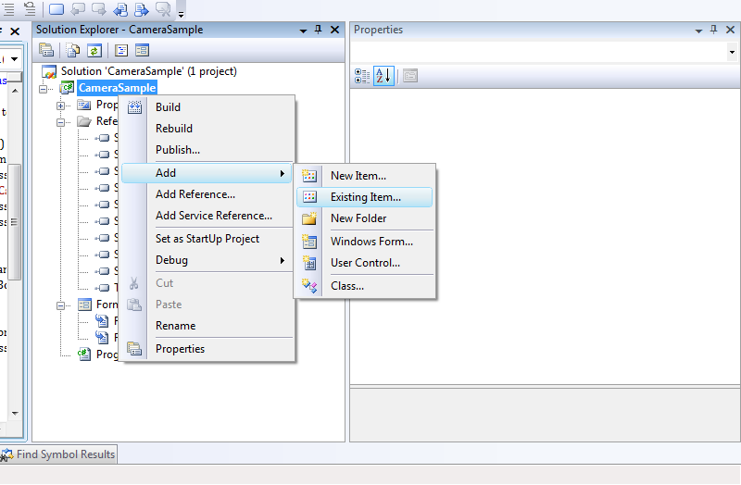
Also, add the WebCamLib library

Slide 7
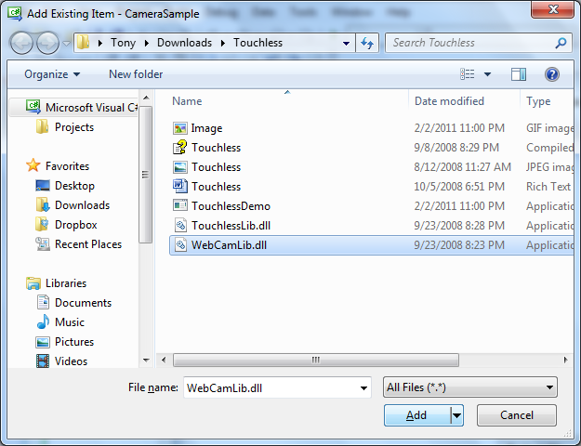

Slide 8
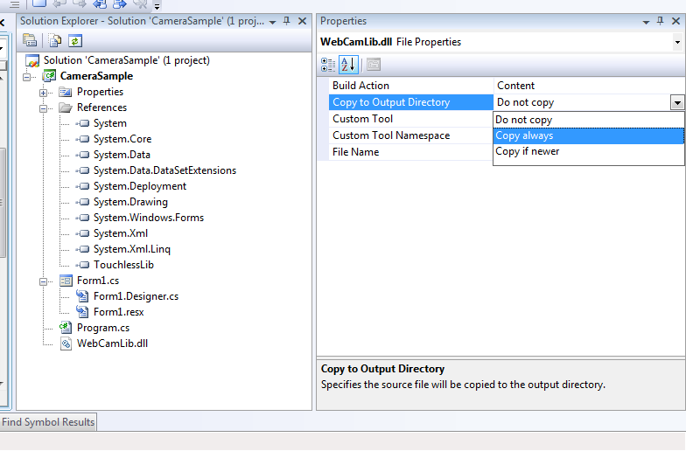
Make sure that it copies the WebCamLib.dll to your Output Directory

Slide 9
TouchlessMgr touchlessManager;
public Form1() {
InitializeComponent();
this.touchlessManager = new TouchlessMgr();
this.Text = "Cameras: " + this.touchlessManager.Cameras.Count;
this.touchlessManager.CurrentCamera = this.touchlessManager.Cameras[0];
this.touchlessManager.CurrentCamera.OnImageCaptured += new EventHandler<CameraEventArgs>(CurrentCamera_OnImageCaptured); }
void CurrentCamera_OnImageCaptured(object sender, CameraEventArgs e) {
this.pictureBox1.Image = e.Image; }
private void Form1_FormClosing(object sender, FormClosingEventArgs e) {
this.touchlessManager.CurrentCamera.OnImageCaptured -= new EventHandler<CameraEventArgs>(CurrentCamera_OnImageCaptured); }
0. Here’s the code. Let’s walk through it.

Slide 10
TouchlessMgr touchlessManager;
public Form1() {
InitializeComponent();
this.touchlessManager = new TouchlessMgr();
this.Text = "Cameras: " + this.touchlessManager.Cameras.Count;
this.touchlessManager.CurrentCamera = this.touchlessManager.Cameras[0];
this.touchlessManager.CurrentCamera.OnImageCaptured += new EventHandler<CameraEventArgs>(CurrentCamera_OnImageCaptured); }
void CurrentCamera_OnImageCaptured(object sender, CameraEventArgs e) {
this.pictureBox1.Image = e.Image; }
private void Form1_FormClosing(object sender, FormClosingEventArgs e) {
this.touchlessManager.CurrentCamera.OnImageCaptured -= new EventHandler<CameraEventArgs>(CurrentCamera_OnImageCaptured); }
1. Set up TouchlessManager and Cameras

Slide 11
TouchlessMgr touchlessManager;
public Form1() {
InitializeComponent();
this.touchlessManager = new TouchlessMgr();
this.Text = "Cameras: " + this.touchlessManager.Cameras.Count;
this.touchlessManager.CurrentCamera = this.touchlessManager.Cameras[0];
this.touchlessManager.CurrentCamera.OnImageCaptured += new EventHandler<CameraEventArgs>(CurrentCamera_OnImageCaptured); }
void CurrentCamera_OnImageCaptured(object sender, CameraEventArgs e) {
this.pictureBox1.Image = e.Image; }
private void Form1_FormClosing(object sender, FormClosingEventArgs e) {
this.touchlessManager.CurrentCamera.OnImageCaptured -= new EventHandler<CameraEventArgs>(CurrentCamera_OnImageCaptured); }
2. C# syntax to set up an EventHandler

Slide 12
TouchlessMgr touchlessManager;
public Form1() {
InitializeComponent();
this.touchlessManager = new TouchlessMgr();
this.Text = "Cameras: " + this.touchlessManager.Cameras.Count;
this.touchlessManager.CurrentCamera = this.touchlessManager.Cameras[0];
this.touchlessManager.CurrentCamera.OnImageCaptured += new EventHandler<CameraEventArgs>(CurrentCamera_OnImageCaptured); }
void CurrentCamera_OnImageCaptured(object sender, CameraEventArgs e) {
this.pictureBox1.Image = e.Image; }
private void Form1_FormClosing(object sender, FormClosingEventArgs e) {
this.touchlessManager.CurrentCamera.OnImageCaptured -= new EventHandler<CameraEventArgs>(CurrentCamera_OnImageCaptured); }
3. C# syntax to remove an EventHandler

Slide 13
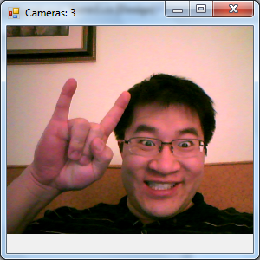
Good to go.

