Slide 1
Grouplab .Networking
A Notification Server

Slide 2
Basic Idea: Shared Dictionary
A dictionary provides mappings between keys and values
In some languages, this is known as a Map: {Key, Value} mappings (e.g. name → age)
e.g. { { “Tony”, 31 }, { “Jill”, 25 }, { “Jon”, 22 } }
Age[“Tony”] = 31
Age[“Fred”] = 10

Slide 3
Shared Dictionary: Notifications
Because someone else can change keys/values in the dictionary, we need to know when it happens.
Set up a subscription to keys of a certain pattern, and get notified when this happens.
subscription.pattern = “/*”; // everything
subscription.notified += my_function;

Slide 4
Notification Server
Shared Dictionary
client 1
client 2
client n
Any message sent from a client to the notification server is propagated to all clients.

Slide 5
Notification Server
Shared Dictionary
client 1
client 2
client n

Slide 6
Notification Server
Shared Dictionary
client 1
client 2
client n

Slide 7
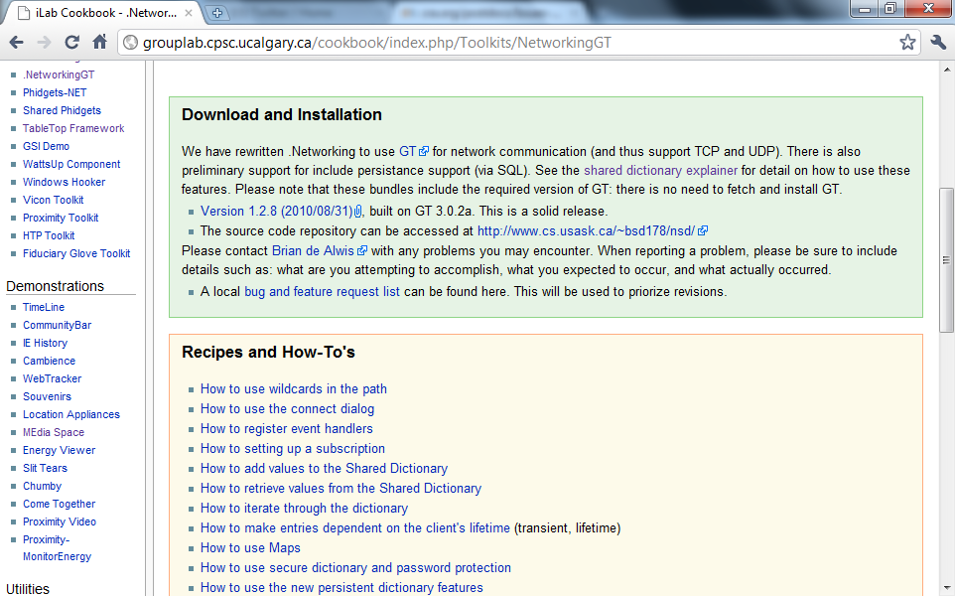
Get the package

Slide 8
Install, and start the server

Slide 9
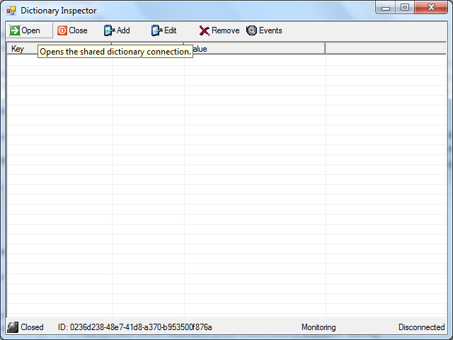
Start it up

Slide 10
One more step: specify the port

Slide 11
Add a reference to the Grouplab.Networking.dll
By default, this installs to:
C:\Program Files\GroupLab\Networking\bin\GroupLab.Networking.dll

Slide 12
Some code to set up the connection
SharedDictionary sd;
this.sd = new SharedDictionary();
this.sd.Url = "tcp://localhost:test";
this.sd.Open();

Slide 13
Create a subscription
this.s = new Subscription();
this.s.Pattern = "/*";
this.s.Dictionary = this.sd;
Other examples of patterns:
“/message/*”
“/video/*”

Slide 14
Set up the notification
this.s.Notified += new SubscriptionEventHandler(s_Notified);
void s_Notified(object sender, SubscriptionEventArgs e) {
MessageBox.Show(
"Key: " + e.Path + " = " + e.Value + "; because: " + e.Reason); }

Slide 15
Modify an entry in the shared dictionary
private void button1_Click(object sender, EventArgs e) {
this.sd["/message"] = this.textBox1.Text; }

Slide 16
Some things that may be useful…
this.sd.Id == provides a unique ID for the shared dictionary instance
this.sd.Status == connection status
Make sure that have a subscription to any key that you decide to modify

