Slide 1
Ethics and User Studies
Tony Tang (with acknowledgements to Saul Greenberg)

Slide 2
Ethical Oversight in Academic Settings
IRB = Institutional Review Board
REB = Research Ethics Board
U of Calgary: Conjoint Faculties Research Ethics Board (CFREB)
Why: balance participant’s rights (i.e. risks) with goals of the research (i.e. benefits)

Slide 3
What constitutes “ethical”?
TCPS 2 Ethics Framework
Guideline 1: Respect for Persons
respecting autonomy
Guideline 2: Concern for Welfare
quality of life
Guideline 3: Justice
vulnerability and burden of participation

Slide 4
Outline
Motivation
Ethics in an HCI context
What you have to do as an HCI researcher (IRISS)
An inside look at CFREB

Slide 5
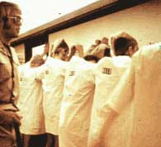
Motivation: Some Classics
Milgram’s Experiments on Obedience
Tuskegee Syphilis Study
Stanford Prison Experiment
Notes:
http://www.prisonexp.org/

Slide 6
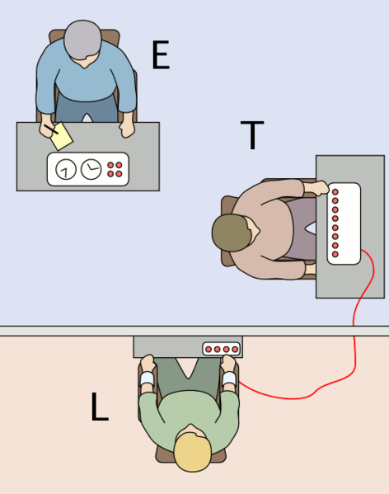
Milgram's Obedience to Authority
(T)eacher gives lessons/tests to (L)earner
If (L) gets it wrong, (T) administers increasing levels of shock.
(E)xperimenter: “you must continue the experiment”
Notes:
http://en.wikipedia.org/wiki/File:Milgram_Experiment_v2.png
http://www.youtube.com/watch?v=yr5cjyokVUs

Slide 7
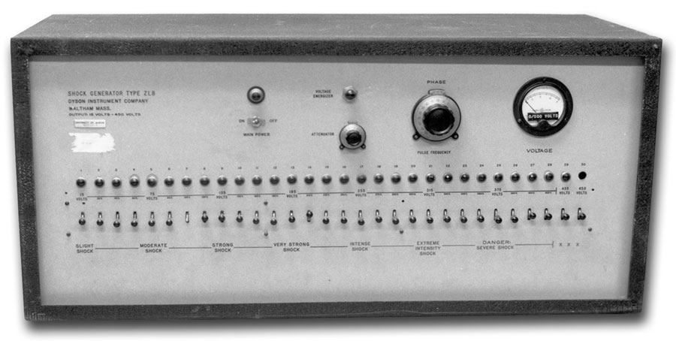
Milgram’s Shock machine
Notes:
http://www.gina-perry.com/2013/01/03/inside-milgrams-shock-machine/

Slide 8
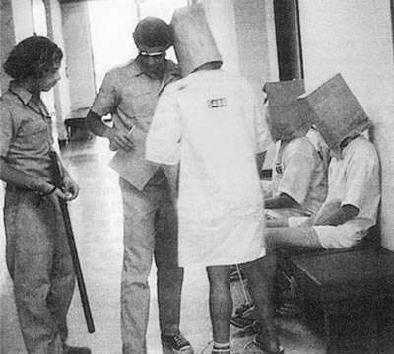
Stanford Prison Experiment
70 students – 24 randomly assigned as “prison guards” (7-14 days; $15/day)
Guards enforced authoritarian measures & subjected participants to psychological torture
Prisoners came to passively accept the abuse, and helped harass other prisoners to prevent it
2 participants quit early, and entire experiment was stopped after 6 days
Notes:
http://www.prisonexp.org/
disorientation, depersonalization and deindividualization in the participants.
searchers provided the guards with wooden batons to establish their status,[5] clothing similar to that of an actual prison guard (khaki shirt and pants from a local military surplus store), and mirrored sunglasses to prevent eye contact. Prisoners wore uncomfortable ill-fitting smocks and stocking caps, as well as a chain around one ankle. Guards were instructed to call prisoners by their assigned numbers, sewn on their uniforms, instead of by name.

Slide 9
Stanford Prison Experiment
Day 2: took off stocking caps; blockaded cell door
Guards volunteer to work extra hours (and attacked prisoners with fire extinguishers)
“privilege cell”
Making prisoners repeated their assigned numbers (to reinforce the new identity)
Harassment (extra exercise).
Sanitation went down tube (only allowed to use a small bucket as punishment) & not allowed to empty it
Punishment: removal of mattress
Guards became more sadistic over time; guards were unhappy the experiment ended early

Slide 10
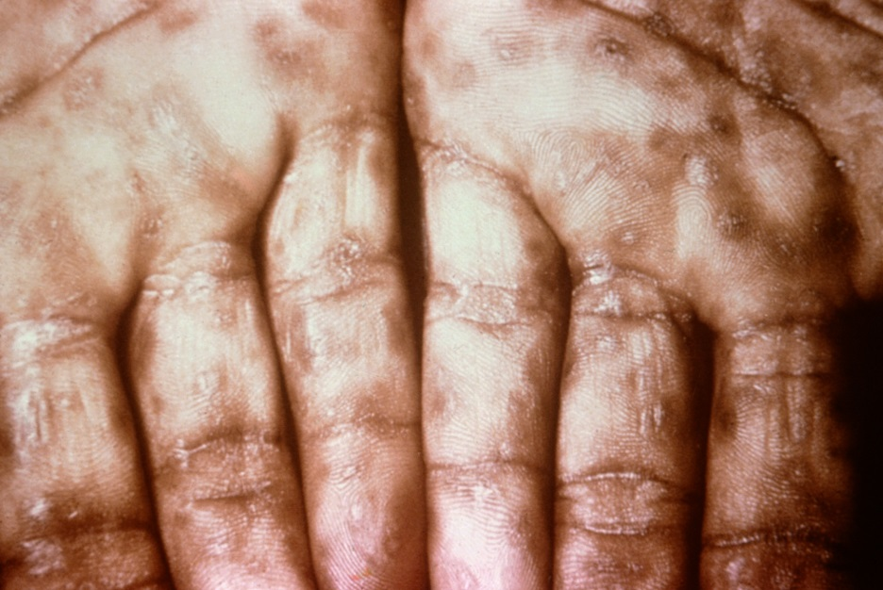
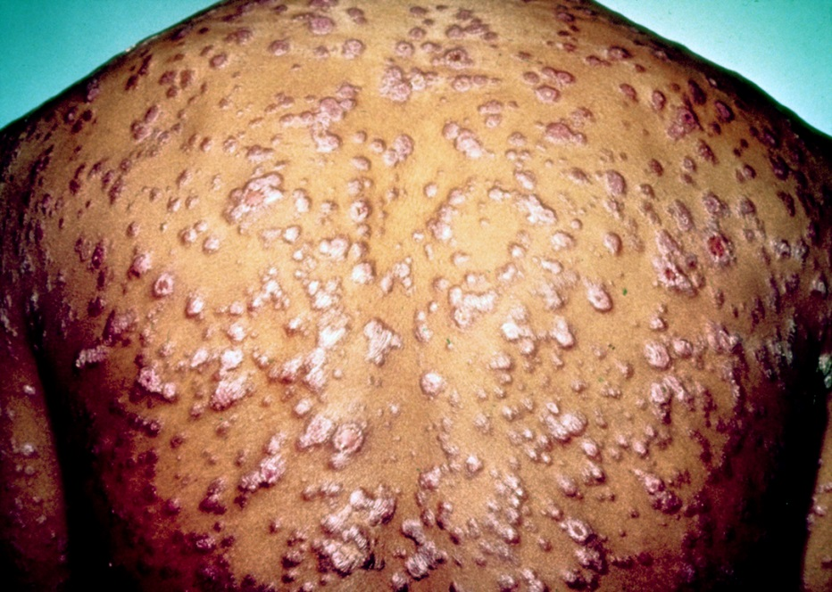
Tuskegee Syphilis Experiment
Watch what happens to people suffering from syphilis (in what ways does it present)
Provide fake treatments (and no treatment) when treatment is available
Notes:
Images from: http://en.wikipedia.org/wiki/Syphilis
http://www.youtube.com/watch?v=BQOD8KIfBu0

Slide 11
Articulated: “Why those were bad”
Risk to participants outweighs benefit
physical and emotional
Deception
without proper debriefing procedure
Taking advantage of certain poor people
i.e. vulnerability
Revealed identity?
confidentiality & privacy

Slide 12
What constitutes “ethical” in an HCI context?
Guideline 1: Respect for Persons
informed consent about procedures and purpose
do not waste their time
Guideline 2: Concern for Welfare
confidentiality and anonymity
ensure that people will not be demeaned as a result of their participation
feelings of inadequacy / stress
Guideline 3: Justice
vulnerable populations – assistive technologies; children; older participants

Slide 13
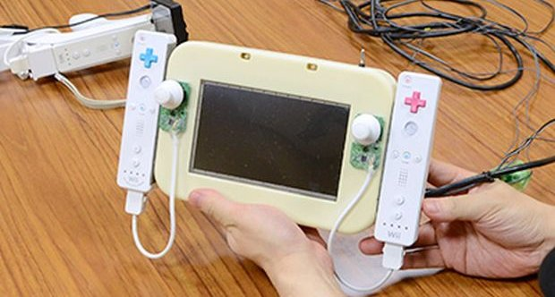
Ethics in Contemporary HCI Research
Testing can be a distressing experience
pressure to perform, errors inevitable
feelings of inadequacy
“testing the interface – NOT you.”
Golden rule
subjects should always be treated with respect
Notes:
http://www.shacknews.com/article/76963/wii-u-prototype-is-literally-a-wii-duct-taped-together
Consider multiple phases:
--preparation before the study
--during the study
--after the study

Slide 14
Ethics – before the test
Don’t waste the user’s time
use pilot tests to debug experiments, questionnaires etc
have everything ready before the user shows up
Make users feel comfortable
emphasize that it is the system that is being tested, not the user
acknowledge that the software may have problems
let users know they can stop at any time
Maintain privacy
tell user that individual test results will be completely confidential
Inform the user
explain any monitoring that is being used
answer all user’s questions (but avoid bias)
Only use volunteers
user must sign an informed consent form

Slide 15
Ethics – during the test
Don’t waste the user’s time
never have the user perform unnecessary tasks
Make users comfortable
try to give user an early success experience
keep a relaxed atmosphere in the room
coffee, breaks, etc
hand out test tasks one at a time
never indicate displeasure with the user’s performance
avoid disruptions
stop the test if it becomes too unpleasant
Maintain privacy
do not allow the user’s management to observe the test

Slide 16
Ethics – after the test
Make the users feel comfortable
state that the user has helped you find areas of improvement
Inform the user
answer particular questions about the experiment that could have biased the results before
Maintain privacy
never report results in a way that individual users can be identified
only show videotapes outside the research group with the user’s permission

Slide 17
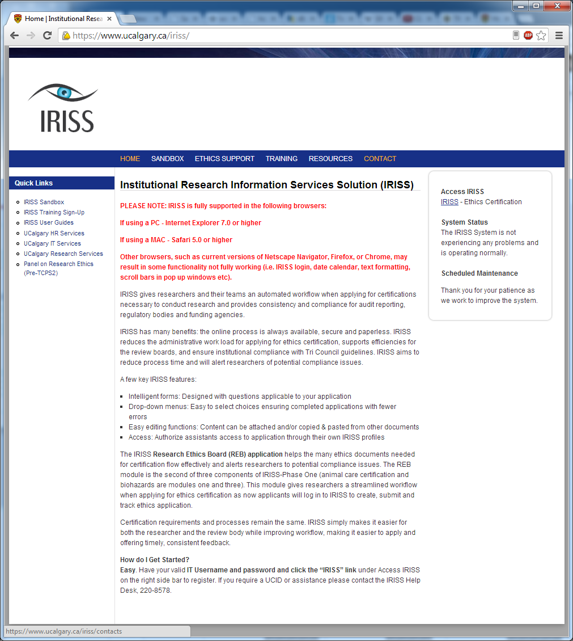
The Ethics Application
Per university / granting agency / industry
but processes are similar
http://iriss.ucalgary.ca
Why?
participant rights
organizational backing
you have to follow your protocol

Slide 18
1. The Applicant
Principal investigator is applicant
Your supervisor
always list
Co-applicants
other people involved in the research

Slide 19
2. Project Details
Title
short but meaningful
Funding
agencies directly funding the specific project
not scholarships, etc.
Title
short but meaningful
List of location(s) where data will be collected
you have to know where you are running your study

Slide 20
2. Project Details
Summary
purpose
objectives / aims
methodology (detailed)
what is required of participants
Include (appendix)
questionnaires
could be samples of seed questions, e.g., if open-ended interview
other test instruments
surveys, etc.

Slide 21
3. Recruitment of Participants
Type
students, children, professionals (which ones), etc.
Renumeration
dollars, food, donuts (if any)…
How
posters, email, snowball sampling, ads, web, etc.
must include example (e.g., email)

Slide 22
4. Informed consent

Slide 23
4. Informed consent
Type
written / signed (the norm), web page checkbox…
Content
researchers, institute, contact information
university ethics contact for complaints
purpose of the study (lay language)
participant expectations
what they will do
benefits (to research, to society)

Slide 24
4. Informed consent
Content (continued)
data collected
measures, observations, quotes, video, audio…
how data will be used e.g.,
anonymity
masked individual information
reported only in aggregate
safe guards for data security…
specific permissions
 I agree to be video taped.
 I agree for video-taped segments to be presented as part of disseminating research results
 I grant permission to be quoted in research reporting …

Slide 25
4. Informed consent
Risks (continued)
no / minimal risk
“there is no known risk associated with your participation in this research”
some risk
discomfort, fatigue, emotional stress, identification,…
high risk
you probably want to talk to the ethics chair
Right to withdraw at any time
what will happen to payment / data
Signature / date

Slide 26
5. Privacy, Confidentiality, Anonymity
Raw data: usually
kept in secure location
password protected accounts, locked offices/file cabinets
kept for 3 – 5 years
accessible only by investigators
does not identify participants (except a master sheet)

Slide 27
5. Privacy, Confidentiality, Anonymity
Processed data: usually reported
reported anonymously
in aggregate form
individually (e.g., quotes) but pseudononymous
e.g., participant 2
potentially revealing data (audio, video)
get explicit permission in consent

Slide 28
6. Estimation of Risks
Psychological or emotional manipulations
Questions that may be upsetting
Potential to identify distressed individuals
Physical risk
Is deception involved
Is any information withheld in informed consent?
Social risk
Any chance of harm
Is there potential for coersion?
e.g., recruitment involves managers dictating employee participation

Slide 29
6. Benefits
To
the researcher
the participant
the research community
society
If no clear benefit, you are wasting people’s time

Slide 30
You now know
Ethics is required to protect participant rights
Ethics in research is not optional
Ethics application requires planning

Slide 31
Homework
Tri-Council Policy Statement: Ethical Conduct for Research Involving Humans (~ 200 pages – good for bathroom reading )
http://www.ethics.gc.ca/eng/policy-politique/initiatives/tcps2-eptc2/Default/
Notes:
http://www.ethics.gc.ca/eng/policy-politique/initiatives/tcps2-eptc2/Default/
http://www.ethics.gc.ca/eng/education/tutorial-didacticiel/

Slide 32
Primary Sources
This slide deck is partly based on the Tri-Council ethics review process at the University of Calgary
http://www.ucalgary.ca/research/ethics/cfreb
TCPS 2
http://www.ethics.gc.ca/eng/policy-politique/initiatives/tcps2-eptc2/Default/
TCPS 2 Core Tutorial
http://www.ethics.gc.ca/eng/education/tutorial-didacticiel/
Stanford Prison Experiment
http://www.prisonexp.org/

Slide 33
Permissions
You are free:
to Share — to copy, distribute and transmit the work
to Remix — to adapt the work
Under the following conditions:
Attribution — You must attribute the work in the manner specified by the author (but not in any way that suggests that they endorse you or your use of the work) by citing:
“Lecture materials by Saul Greenberg, University of Calgary, AB, Canada. http://saul.cpsc.ucalgary.ca/saul/pmwiki.php/HCIResources/HCILectures”
Noncommercial — You may not use this work for commercial purposes, except to assist one’s own teaching and training within commercial organizations.
Share Alike — If you alter, transform, or build upon this work, you may distribute the resulting work only under the same or similar license to this one.
With the understanding that:
Not all material have transferable rights — materials from other sources which are included here are cited
Waiver — Any of the above conditions can be waived if you get permission from the copyright holder.
Public Domain — Where the work or any of its elements is in the public domain under applicable law, that status is in no way affected by the license.
Other Rights — In no way are any of the following rights affected by the license:
Your fair dealing or fair use rights, or other applicable copyright exceptions and limitations;
The author's moral rights;
Rights other persons may have either in the work itself or in how the work is used, such as publicity or privacy rights.
Notice — For any reuse or distribution, you must make clear to others the license terms of this work. The best way to do this is with a link to this web page.

