Slide 1
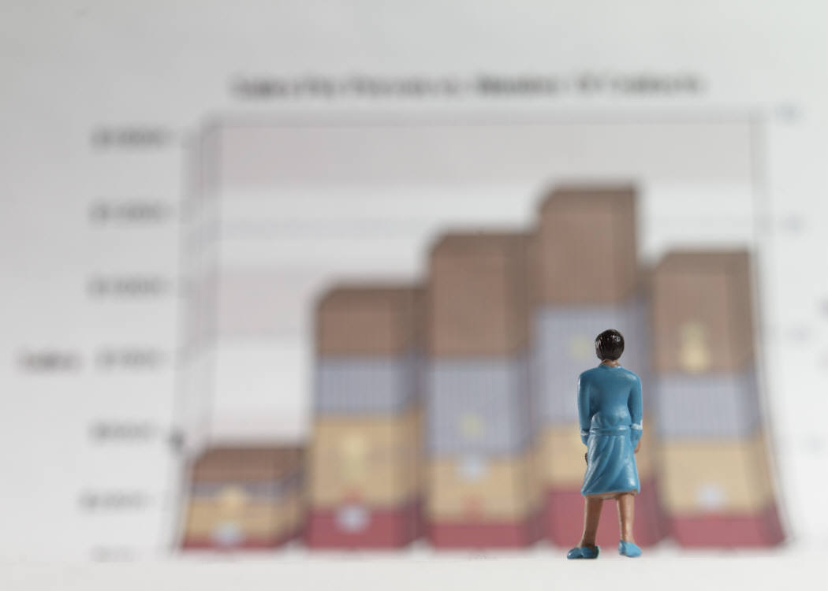
Controlled Experiments
Part 2. Basic Statistical Tests
Lecture /slide deck produced by Saul Greenberg, University of Calgary, Canada
Notice: some material in this deck is used from other sources without permission. Credit to the original source is given if it is known,

Slide 2
Outline
Scales of measurements
Logic of null hypothesis testing

Slide 3
Scales of Measurements
Four major scales of measurements
Nominal
Ordinal
Interval
Ratio

Slide 4
Nominal Scale
Classification into named or numbered unordered categories
country of birth, user groups, gender…
Allowable manipulations
whether an item belongs in a category
counting items in a category
Statistics
number of cases in each category
most frequent category
no means, medians…
With permission of Ron Wardell

Slide 5
Nominal Scale
Sources of error
agreement in labeling, vague labels, vague differences in objects
Testing for error
agreement between different judges for same object
With permission of Ron Wardell

Slide 6
Ordinal Scale
Classification into named or numbered ordered categories
no information on magnitude of differences between categories
e.g. preference, social status, gold/silver/bronze medals
Allowable manipulations
as with interval scale, plus
merge adjacent classes
transitive: if A > B > C, then A > C
Statistics
median (central value)
percentiles, e.g., 30% were less than B
Sources of error
as in nominal
With permission of Ron Wardell

Slide 7
Interval Scale
Classification into ordered categories with equal differences between categories
zero only by convention
e.g. temperature (C or F), time of day
Allowable manipulations
add, subtract
cannot multiply as this needs an absolute zero
Statistics
mean, standard deviation, range, variance
Sources of error
instrument calibration, reproducibility and readability
human error, skill…
With permission of Ron Wardell

Slide 8
Ratio Scale
Interval scale with absolute, non-arbitrary zero
e.g. temperature (K), length, weight, time periods
Allowable manipulations
multiply, divide
With permission of Ron Wardell

Slide 9
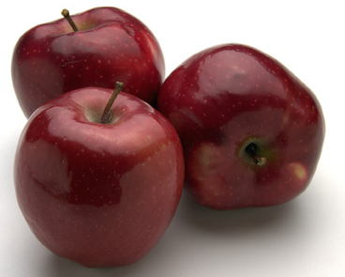
Example: Apples
Nominal:
apple variety
Macintosh, Delicious, Gala…
Ordinal:
apple quality
US. Extra Fancy
U.S. Fancy,
U.S. Combination Extra Fancy / Fancy
U.S. No. 1
U.S. Early
U.S. Utility
U.S. Hail
With permission of Ron Wardell

Slide 10
Example: Apples
Interval:
apple ‘Liking scale’ Marin, A. Consumers’ evaluation of apple quality. Washington Tree Postharvest Conference 2002.
After taking at least 2 bites how much do you like the apple?
Dislike extremely Neither like or dislike Like extremely
Ratio:
apple weight, size, …
With permission of Ron Wardell

Slide 11
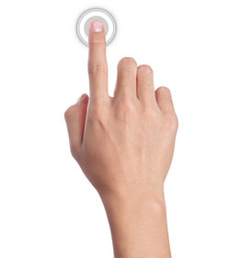
Running Example: which interface is best for tapping (speed)?
“Reciprocal tapping task” – alternately tap these buttons 100 times
Click me!
Click me!
Get 10 people to complete this tapping task for each of the three input techniques.

Slide 12
Statistics
Descriptive Statistics: used to describe the sample
Central tendency: mean, median, mode
Dispersion: range (min, max), standard deviation
… and so on
Median: useful when there are outliers in the sample data

Slide 13
Standard Deviation
σ = standard deviation
N = # of samples you have
μ = mean
x_{i} = data point value
Note: there are slight differences for sample and population standard deviations, but this is the basic idea
Notes:
http://www.mathsisfun.com/data/standard-deviation-formulas.html

Slide 14
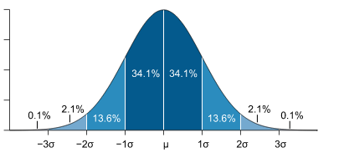

Slide 15
Running Example: which interface is best for tapping (speed)?
“Reciprocal tapping task” – alternately tap these buttons 100 times
Click me!
Click me!
Get 10 people to complete this tapping task for each of the three input techniques.
Average time per click (s) | 1.00s | 1.50s | 1.55s

Slide 16
Statistics
Descriptive Statistics: used to describe the sample
Central tendency: mean, median, mode
Dispersion: range (min, max), standard deviation
… and so on
Inferential Statistics: statistical tests applied to sample data to make inferences about the population || tools that help us to make decisions/make statements about the population based on the sample

Slide 17
Null Hypothesis Testing Procedure
Decide on a null hypothesis
null hypothesis: mouse speed = touch speed
Decide on an alternate hypothesis
alternate hypothesis: mouse speed != touch speed
Decide on an alpha level
alpha = 0.05 ← fairly typical (by convention)
Run your inferential statistics test. If p < alpha, then reject null hypothesis; otherwise, you do not reject the null hypothesis.

Slide 18
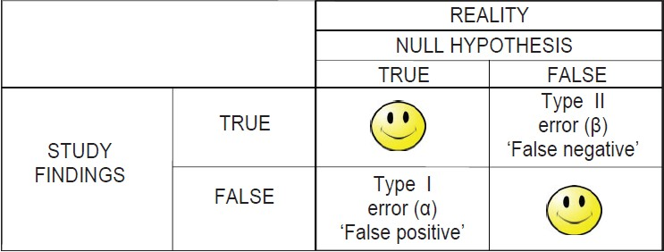
Type I vs. Type II Errors
Note: the mp3 file podcast describes this figure with the axes transposed
Spam filter: decision making on whether an email is good mail (true) or spam (false)
Notes:
Image source: http://medind.nic.in/jay/t13/i5/JIndianSocPeriodontol_2013_17_5_577_119293_u2.jpg

Slide 19
Null Hypothesis Testing Procedure
Decide on a null hypothesis
null hypothesis: mouse speed = touch speed
Decide on an alternate hypothesis
alternate hypothesis: mouse speed != touch speed
Decide on an alpha level
alpha = 0.05 ← fairly typical (by convention)
Run your inferential statistics test. If p < alpha, then reject null hypothesis; otherwise, you do not reject the null hypothesis.
Parametric vs. non-parametric tests

Slide 20
alpha and p-value
alpha value = probability of Type I error (i.e. probability of our rejecting the null hypothesis when it is in fact true) – often 0.05 or 0.01 by convention
p-value = probability of seeing the data if the null hypothesis were true

Slide 21
Running Example: which interface is best for tapping (speed)?
Get 10 people to complete this tapping task for each of the three input techniques.
Is it possible to collect samples of data where the averages work out the way they have here, even if the true values are equivalent (i.e. null hypothesis is true)? YES!
Average time per click (s) | 1.00s | 1.50s | 1.55s

Slide 22
Logic of Null Hypothesis Testing
We have an incumbent theory about the world. We might have something new to try (e.g. new drug, new interaction technique, etc.). The null hypothesis is that these things are basically the same (i.e. we have done no better).
The alternate hypothesis is that they are different.
We need to make a call about how willing we are to be wrong about the decision that we make about the population based on the sample. This is setting the alpha level.
When we run the test, we simply take the p-value (likelihood of having our data if the null hypothesis were true), and compare it to alpha.

Slide 23
Some clarifications about p-value and alpha
p-value and “more significant”. All this means is probability of seeing the data if the null hypothesis were true. p=0.0001 is not “more significant” than p=0.01.
alpha value of 0.05 or 0.01 is not magical. It was completely arbitrary.
If my alpha was 0.05, and my p-value was 0.06, is this “borderline significant”? No. You have failed to reject the null hypothesis. That’s it.
Statistical significance is not the same as practical significance.

Slide 24
Permissions
You are free:
to Share — to copy, distribute and transmit the work
to Remix — to adapt the work
Under the following conditions:
Attribution — You must attribute the work in the manner specified by the author (but not in any way that suggests that they endorse you or your use of the work) by citing:
“Lecture materials by Saul Greenberg, University of Calgary, AB, Canada. http://saul.cpsc.ucalgary.ca/saul/pmwiki.php/HCIResources/HCILectures”
Noncommercial — You may not use this work for commercial purposes, except to assist one’s own teaching and training within commercial organizations.
Share Alike — If you alter, transform, or build upon this work, you may distribute the resulting work only under the same or similar license to this one.
With the understanding that:
Not all material have transferable rights — materials from other sources which are included here are cited
Waiver — Any of the above conditions can be waived if you get permission from the copyright holder.
Public Domain — Where the work or any of its elements is in the public domain under applicable law, that status is in no way affected by the license.
Other Rights — In no way are any of the following rights affected by the license:
Your fair dealing or fair use rights, or other applicable copyright exceptions and limitations;
The author's moral rights;
Rights other persons may have either in the work itself or in how the work is used, such as publicity or privacy rights.
Notice — For any reuse or distribution, you must make clear to others the license terms of this work. The best way to do this is with a link to this web page.

