Slide 1
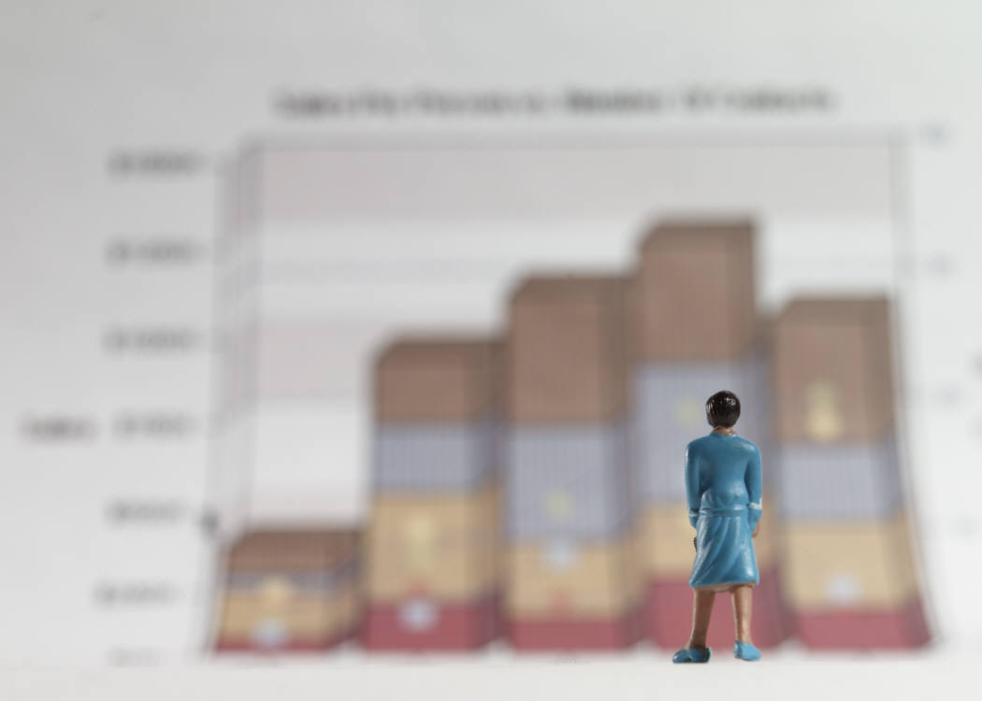
Controlled Experiments
Part 3. Inferential Statistics Tests
Lecture /slide deck produced by Saul Greenberg, University of Calgary, Canada
Notice: some material in this deck is used from other sources without permission. Credit to the original source is given if it is known,

Slide 2
Problem with visual inspection of data
Will almost always see variation in collected data
  normal variation
    two sets of ten tosses with different but fair dice
      differences between data and means are accountable by expected variation
  real differences between data
    two sets of ten tosses for with loaded
    dice and fair dice
      differences between data and means are
      not accountable by expected variation

Slide 3
T-test
A t test is a very standard statistical test to compare the means of two samples, and helps us to decide whether they are the same or different.
Null hypothesis of the T-test:
  no difference exists between the means of two sets of collected data
  Basic intuition:
  -- it is more likely that the two samples are coming from different populations if the means are very different, and each sample’s variances are tight

Slide 4



Running Example: which interface is best for tapping (speed)?
“Reciprocal tapping task” – alternately tap these buttons 100 times
Click me!
Click me!
Get 10 people to complete this tapping task for each of the three input techniques.
Average time per click (s) | 1.00s | 1.50s | 1.55s

Slide 5

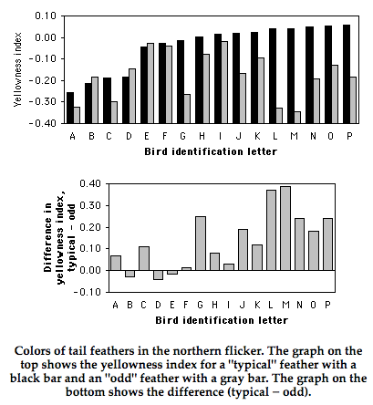
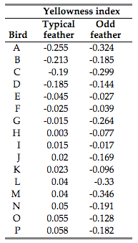
t-test: helping you to build intuition
Notes:
Yellowness indicates that it is a regrown feather
http://www.biostathandbook.com/pairedttest.html

Slide 6
Different types of T-tests: Paired vs. Unpaired
Unpaired (or independent) samples . “between subjects”
different participants in each group
each sample from one group is independent of every sample from the other
    Condition 1 Condition 2
    P1–P20 P21–P43
Paired (or dependent) samples . “within subjects”
each sample from a group has a related sample in the other group
for instance, it is a single group that is studied under both conditions
    Condition 1 Condition 2
    P1–P20 P1–P20
in this case, the t-test calculates the difference from one group to another, and then assesses the difference from 0

Slide 7
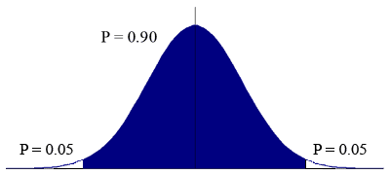
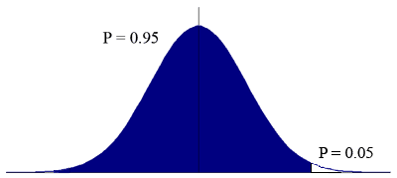
Different types of T-tests: 1-tailed vs. 2-tailed
Non-directional vs directional alternatives
  non-directional (two-tailed)
    no expectation that the direction of difference matters
  directional (one-tailed)
    Only interested if the mean of a given condition is greater than the other
Two-tailed test: acknowledging that your thing may be worse than the existing situation
One-tailed test: stacking your cards in favour of one side of the equation
Notes:
Images from: http://www.chem.utoronto.ca/coursenotes/analsci/StatsTutorial/12tailed.html

Slide 8
T-test Assumptions
data points of each sample are normally distributed
  but t-test very robust in practice
  Q-Q plot (graphical method)
population variances are equal
  t-test reasonably robust for differing variances
  Levene’s test or F-test
individual observations of data points in sample are independent
In practice, you conduct other statistical tests check for the first two assumptions. If they don’t check out, you use other variations of the t-test.

Slide 9
Two-tailed unpaired T-test
N: number of data points in the one sample
ΣX: sum of all data points in one sample
X: mean of data points in sample
Σ(X²): sum of squares of data points in sample
s²: unbiased estimate of population variation
t: t ratio
df = degrees of freedom = N1 + N2 – 2
Formulas

Slide 10
Level of significance for two-tailed test
df .05 .01
1 12.706 63.657
2 4.303 9.925
3 3.182 5.841
4 2.776 4.604
5 2.571 4.032
6 2.447 3.707
7 2.365 3.499
8 2.306 3.355
9 2.262 3.250
10 2.228 3.169
11 2.201 3.106
12 2.179 3.055
13 2.160 3.012
14 2.145 2.977
15 2.131 2.947
df .05 .01
16 2.120 2.921
18 2.101 2.878
20 2.086 2.845
22 2.074 2.819
24 2.064 2.797

Slide 11
Example Calculation
x₁ = 3 4 4 4 5 5 5 6 Hypothesis: there is no significant difference
x₂ = 4 4 5 5 6 6 7 7 between the means at the .05 level

Slide 12
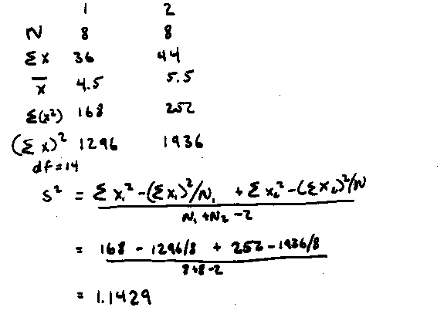
Example Calculation
x₁ = 3 4 4 4 5 5 5 6 Hypothesis: there is no significant difference
x₂ = 4 4 5 5 6 6 7 7 between the means at the .05 level
Step 1. Calculating s²

Slide 13
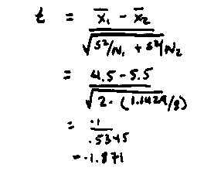
Example Calculation
Step 2. Calculating t

Slide 14
Example Calculation
Step 3: Looking up critical value of t
  use table for two-tailed t-test, at p=.05, df=14
  critical value = 2.145
  because t=1.871 < 2.145, there is no significant difference
  therefore, we cannot reject the null hypothesis
  i.e., there is no difference between the means
df .05 .01
1 12.706 63.657
…
14 2.145 2.977
15 2.131 2.947

Slide 15
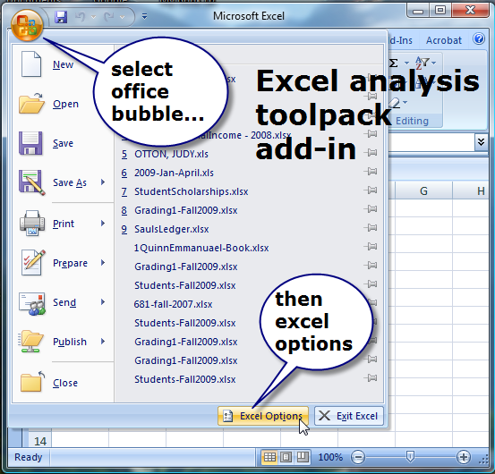
Excel Stats: Analysis toolpack addin

Slide 16
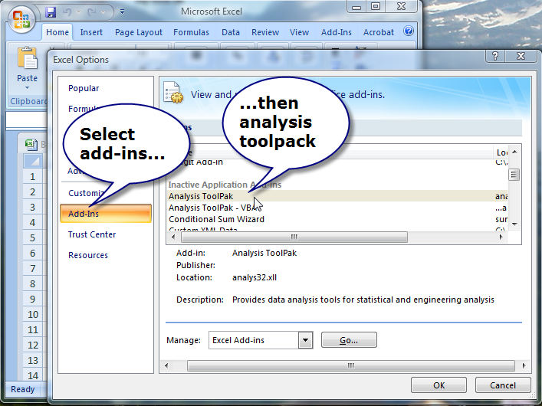

Slide 17
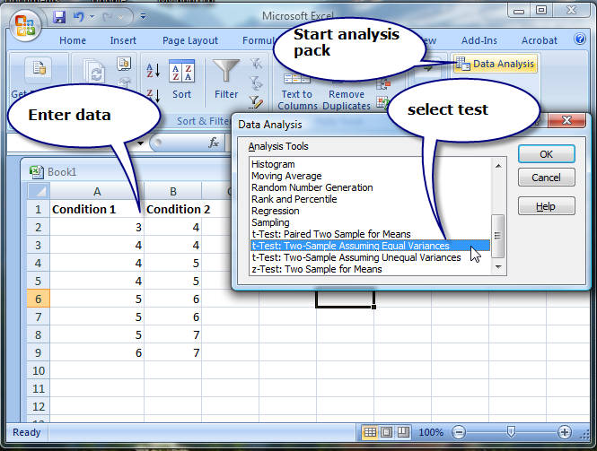

Slide 18
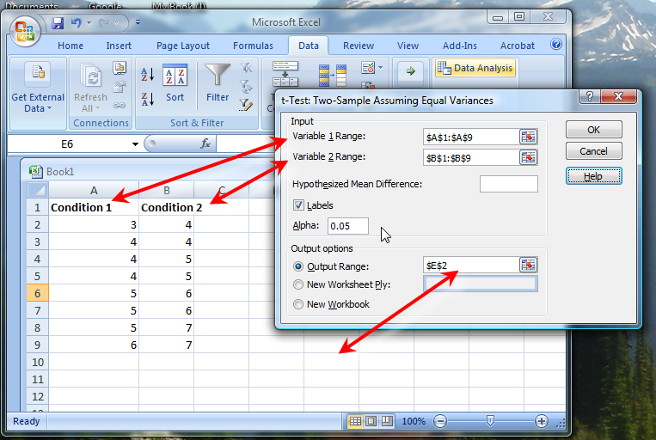

Slide 19
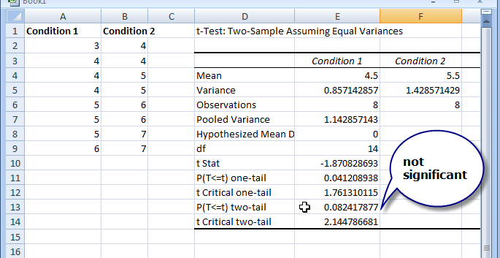

Slide 20
Single Factor Analysis of Variance
Compares three or more means
e.g. comparing click speed between different input techniques:
  Possible results:
    These are all the same
    At least one of these is different from the others
Mouse
Touch
Stylus
P1-P10
P11-P20
P21-P30

Slide 21
Correlation
Measures the extent to which two concepts are related
  years of university training vs computer ownership per capita
  touch vs mouse typing performance
How?
  obtain the two sets of measurements
  calculate correlation coefficient
    +1: positively correlated
    0: no correlation (no relation)
    –1: negatively correlated

Slide 22
Correlation
10
r² = .668
condition 1 condition 2
9
5
4
6
4
5
3
5
4
5
6
6
7
6
7
6
5
7
4
6
5
7
4
7
7
6
7
8
9
8
7
6
5
4
3
2.5
3
3.5
4
4.5
5
5.5
6
6.5
7
7.5
Condition 1
Condition 1

Slide 23
Three ways of calculating correlation
Pearson's product-moment coefficient: It measures how linear the relationship between the two variables are. It is a parametric test (so the data must come from the normal distribution), and the data must be interval or ratio. However, it is known that Pearson's coefficient is a pretty robust metric, so you can use this unless your data are ordinal.
Spearman's rank correlation coefficient: This is a non-parametric test, and you can use this if you cannot assume the normality or your data are ordinal. Similarly to other non-parametric tests, it ranks the data and use the ranking for the test.
Kendall tau rank correlation coefficient: This is also a non-parametric test. You should use this if your data have many ties when you rank them.
Notes:
http://yatani.jp/teaching/doku.php?id=hcistats:correlation
age of the users and average time of their computer usage in a day
Age of users and preference of system

Slide 24
Correlation
Dangers
  attributing causality
    a correlation does not imply cause and effect
    cause may be due to a third “hidden” variable related to both other variables
  drawing strong conclusion from small numbers
    unreliable with small groups
    be wary of accepting anything more than the direction of correlation unless you have at least 40 subjects

Slide 25
Correlation
10
Pickles eaten
per month
Salary per year
(*10,000)
r² = .668
9
5
6
4
5
8
6
7
4
4
5
6
7
3
5
5
7
Salary per year (*10,000)
4
4
6
5
7
6
7
6
6
5
7
7
6
8
4
7
9
3
Which conclusion could be correct?
-Eating pickles causes your salary to increase
-Making more money causes you to eat more pickles
-Pickle consumption predicts higher salaries because
older people tend to like pickles better than younger
people, and older people tend to make more money than
younger people
2.5
3
3.5
4
4.5
5
5.5
6
6.5
7
7.5
Pickles eaten per month

Slide 26
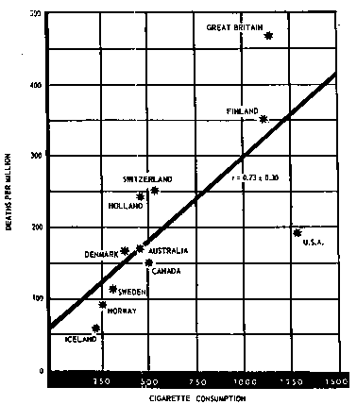
Correlation
Cigarette Consumption
Crude Male death rate for lung cancer in 1950 per capita consumption of cigarettes in 1930 in various countries.
While strong correlation (.73), can you prove that cigarette smoking causes death from this data?
Possible hidden variables:
  age
  poverty

Slide 27
Other Tests: Regression
Calculates a line of “best fit”
Use value of one variable to predict value of the other
    e.g., 60% of people with 3 years of university own a computer
10
y = .988x + 1.132, r2 = .668
y = .988x + 1.132, r2 = .668
9
condition 1 condition 2
5
6
8
4
5
6
7
7
4
4
5
6
Condition 2
3
5
6
5
7
4
4
5
7
5
6
7
6
6
7
7
4
6
8
7
9
3
3
4
5
6
7
Condition 1

Slide 28
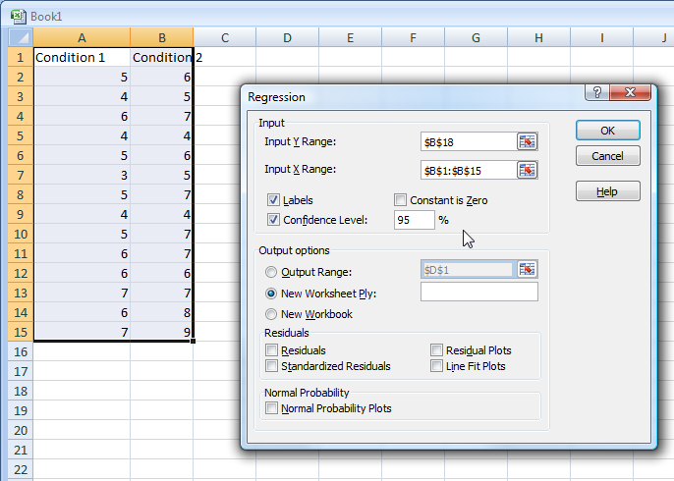
Regression with Excel analysis pack

Slide 29
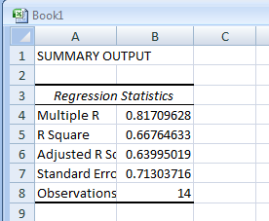
Regression with Excel analysis pack

Slide 30
You know now
Controlled experiments can provide clear convincing result on specific issues
Creating testable hypotheses are critical to good experimental design
Experimental design requires a great deal of planning

Slide 31
You know now
Statistics inform us about
  mathematical attributes about our data sets
  how data sets relate to each other
  the probability that our claims are correct
There are many statistical methods that can be applied to different experimental designs
  t-tests
  correlation and regression
  single factor anova
  anova

Slide 32



Permissions
You are free:
  to Share — to copy, distribute and transmit the work
  to Remix — to adapt the work
Under the following conditions:
Attribution — You must attribute the work in the manner specified by the author (but not in any way that suggests that they endorse you or your use of the work) by citing:
  “Lecture materials by Saul Greenberg, University of Calgary, AB, Canada. http://saul.cpsc.ucalgary.ca/saul/pmwiki.php/HCIResources/HCILectures”
Noncommercial — You may not use this work for commercial purposes, except to assist one’s own teaching and training within commercial organizations.
Share Alike — If you alter, transform, or build upon this work, you may distribute the resulting work only under the same or similar license to this one.
With the understanding that:
Not all material have transferable rights — materials from other sources which are included here are cited
Waiver — Any of the above conditions can be waived if you get permission from the copyright holder.
Public Domain — Where the work or any of its elements is in the public domain under applicable law, that status is in no way affected by the license.
Other Rights — In no way are any of the following rights affected by the license:
  Your fair dealing or fair use rights, or other applicable copyright exceptions and limitations;
  The author's moral rights;
  Rights other persons may have either in the work itself or in how the work is used, such as publicity or privacy rights.
Notice — For any reuse or distribution, you must make clear to others the license terms of this work. The best way to do this is with a link to this web page.

