Slide 1
Topics
Generally, look good
Be narrow in your focus (if you’re not sure if you’re being too narrow or too broad, speak to me)
Deliverables: a webpage handout (with a simple worked example suitable for teaching); a presentation
Wed – Oct 8: Draft report (tutorial material) and presentation for early feedback

Slide 2
Lecture 4 – Experimental Design
Notes:
Lots of material from here:
http://groups.csail.mit.edu/graphics/classes/6.893/F03/lectures/L13.pdf

Slide 3
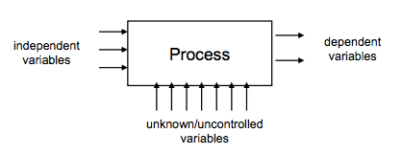
Schematic View of Experiment Design
Levels of IV: different settings on the knobs

Slide 4
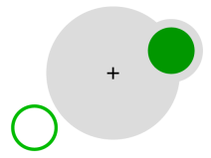
Evaluating Bubble Cursor Grossman & Balakrishnan (200x)
How would you set up the experiment to evaluate whether this is a good idea?
What is your hypothesis?
What are your IVs?
What are your DVs?
What is the actual task?
How would you select participants?
What kind of bias do you need to be aware of? How would you control for these?

Slide 5
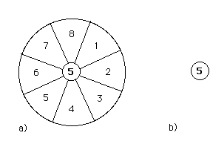
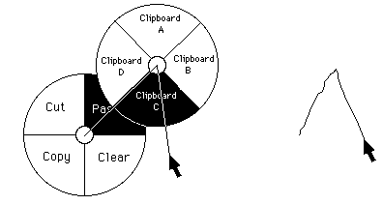
Pie Menus/Marking Menus

Slide 6
Evaluating Pie Menus
How would you set up the experiment to evaluate whether this is a good idea?
What is your hypothesis?
What are your IVs?
What are your DVs?
What is the actual task?
How would you select participants?
What kind of bias do you need to be aware of? How would you control for these?

Slide 7
Experimental Design Concerns
Internal validity
Are observed results actually caused by the independent variables?
Are we confident that the experiment was conducted properly?
External validity
Are we confident that we would see these results generalized beyond the lab?
Reliability
Are we confident that we could repeat this experiment and get consistent results?

Slide 8
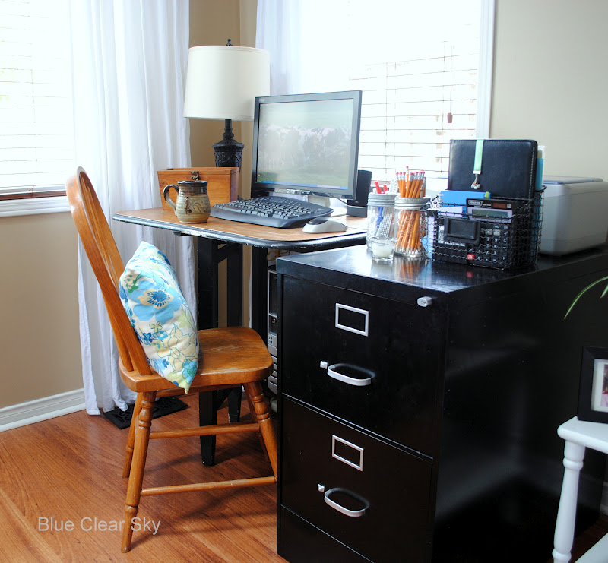
Imagine this test…
You are designing a colour scheme for your interface, and recruit participants for the entire day. For morning participants, you use interface A; for afternoon participants, you use interface B.
Morning participants seem to have no problems with the interface, but participants take a lot more time to complete the task
Notes:
http://3.bp.blogspot.com/-d3Z2sX-Dv60/UDFDEUwe4pI/AAAAAAAAIM4/Dj8dMzS9jfI/s1600/2012+08+family+room+office+area9.jpg

Slide 9
Internal Validity » Confound
When you are testing something, and changing one aspect of the test (i.e. a variable), if something else changes along with that variable, then you have a confound.
This means that you cannot tell what is causing the difference.
E.g. When you do not eat cereal in the morning, you are fine, but if you do, then you get sick. You conclude that you are allergic to cereal.

Slide 10
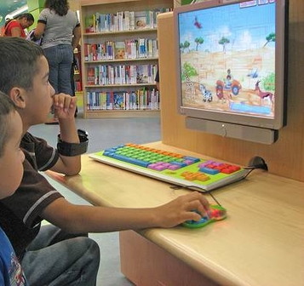
Imagine this test…
You design two computer games for children, and bring it to a school to test.
The first 10 students that complete their homework are sent to your testing office for the first game.
The next 10 students that complete their homework are sent to play the second game.

Slide 11
Imagine this test…
You design two computer games for children, and bring it to a school to test.
The first 10 students that complete their homework are sent to your testing office for the first game.
They find the game easy to play.

Slide 12
Internal Validity » Selection Bias
Systematic, non-random sampling of the population distorts your ability to generalize from the results.
Notes:
http://c.suite101.com/files/styles/article_full/public/000/105/000105936.jpg

Slide 13
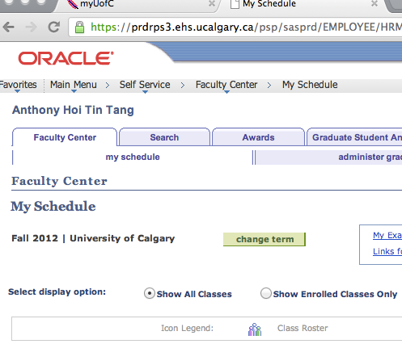
Imagine this test…
You have designed two new interfaces for PeopleSoft. You recruit students to test your interface.
For each participant, you give them your least favourite interface first to complete the task, and then you give them your favourite interface second.

Slide 14
Internal Validity » Learning | Fatigue Effects
Experience gained from using the first interface (to conceptual model) affects how they think about and use the second interface.
Too much testing means participants get tired of testing.
Mix it up: for some participants, A then B; for others, B then A.

Slide 15
Internal Validity » Experimenter Bias
Notes:
http://blog.lib.umn.edu/paldr001/myblog/2011/12/

Slide 16
Internal Validity » Demand Characteristics
If participants know what your hypothesis is, they will actively try to be “good participants” and help you.
Notes:
Pepsi Challenge?

Slide 17
Potential Internal Validity Problems
Confounds: variable systematically varies with different levels of IV
Ordering effects: learning, getting tired
Selection effects
Experimenter bias
Other problems?
How to address each of these?
Notes:
Double-blind tests
Controlling protocol
Novelty effects

Slide 18
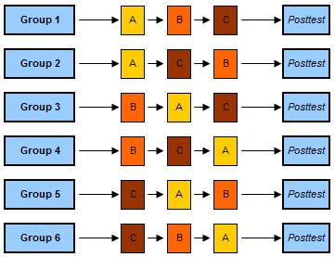
Counter balancing
Notes:
https://explorable.com/counterbalanced-measures-design

Slide 19
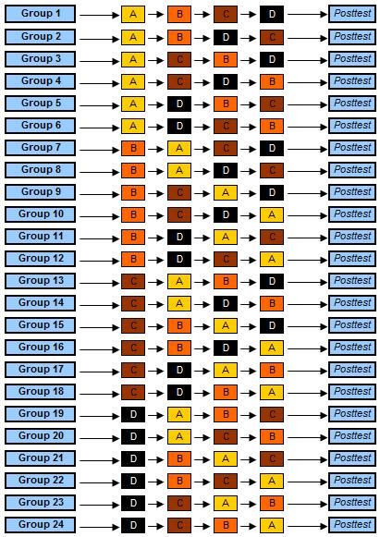
Counter balancing

Slide 20
Incomplete Counterbalanced Measure Designs
Balanced Latin square designs
Google it
Subjects 1st 2nd 3rd 4th 5th 6th
A 1 2 6 3 5 4
B 2 3 1 4 6 5
C 3 4 2 5 1 6
D 4 5 3 6 2 1
E 5 6 4 1 3 2
F 6 1 5 2 4 3
Notes:
balance the strengths of counterbalancing with financial and practical reality

Slide 21
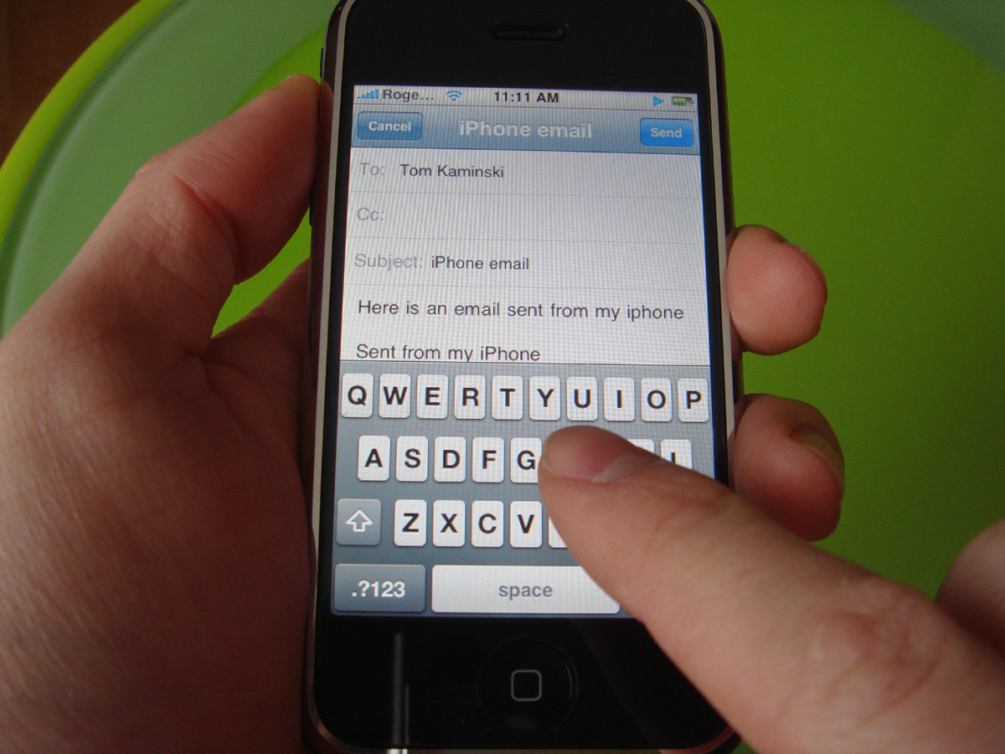
Imagine this test…
Design a typing interface for use while driving cars.
Bring people into the lab, put them at a desk.
Ask them to write an email, and time how long it takes.
Notes:
http://crackberry.com/files/u3/roundrobin/iphone/iphone6.jpg
At least one hand needed to drive!
What about attention and distractedness?
How will the device be held?

Slide 22
External Validity » Across Situations
Does the test situation match the situation that the design will be used in?
Does it match at least in critical ways?
What are aspects that are different?
Artificiality

Slide 23
Imagine this test…
Recruiting developers of PeopleSoft, ask them to register for courses.
Because they can register for their courses within 5 minutes, the interface is deemed usable.

Slide 24
External Validity » Across People
Are test subjects representative of the target user population?
Is it a randomly selected group, or are there constraints on how the group is selected that may affect test results?
Generalizability across a population.

Slide 25
External Validity
Sample :: Population → Draw a random sample from your real target population (recruitment)
Ecological → make lab conditions as realistic as possible in important respects
Task → Base your tasks on real tasks (through, say, task analysis)
Notes:
Self-selection

Slide 26
Reliability
Uncontrolled variation
Previous experience
User differences
Task design
Measurement error
Solutions
Eliminate uncontrolled variation (e.g. through selection; through analysis)
Repetition (more people!)
Notes:
Bulls-eye shooter –

Slide 27
Between & Within-Subjects Designs
Between subjects: people are separated into groups, and each group is subject to different conditions. DVs are compared between groups.
Within subjects: people experience both/all conditions, and DVs are compared “within” each individual

Slide 28
You now know…
What IVs and DVs are
Threats to experimental design (internal and external validity; reliability)
Ways to address these concerns
Difference between within-subjects and between-subjects designs

