Slide 1
CPSC 599.81: Interactive Collaborative Computing
Introduction

Slide 2
What is this class about?
computer supported cooperative work
traditionally: systems for communication, collaboration and coordination
today: everyday use of computation in collaboration, coordination and competition
What are some CSCW systems you used today?

Slide 3
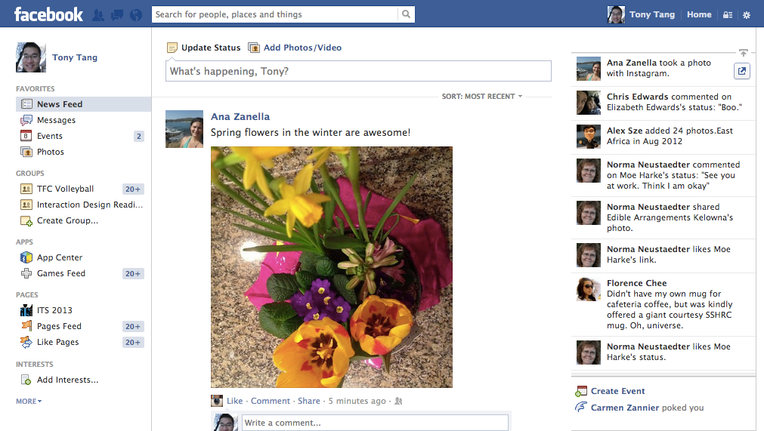

Slide 4
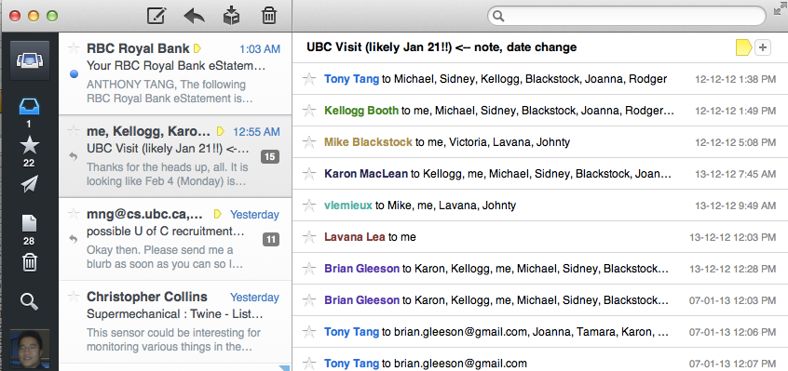

Slide 5
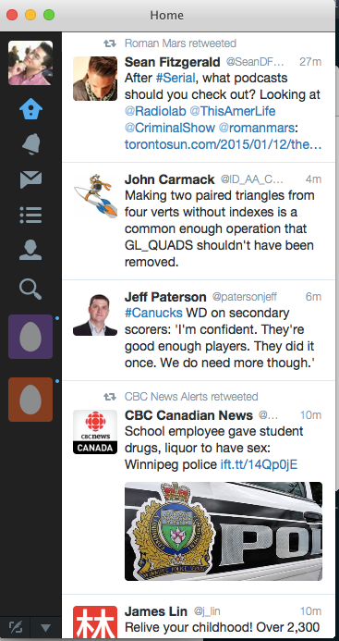

Slide 6
what is this class about?
introduction
How do people interact with and through computation?

Slide 7
Learning objectives
build collaborative software using existing toolkits
understand the unique challenges that exist for studying and designing collaborative technologies
analyze and critically reflect on the design and use of collaborative technologies
conduct informed presentations of collaborative technology design and use

Slide 8
Administrivia
Meetings
Mondays and Wednesdays @ 2pm-3:15pm
MS680A (usually)
Office Hours
by appointment
Course Webpage:
http://hcitang.org/599/
Bring a laptop to class

Slide 9
Class (1 / 3)
Seminar-style class (50%)
Lots of reading
Note: no textbook, but I expect you to PRINT OUT every one of the papers (still works out to be cheaper than a text)
Lots of discussion (15% - in-class participation), supported by online responses (15% - D2L responses to readings)
Some discussions will be led by me; others (later on) will be led by you and your classmates (10% - topic presentation). These presentations will be supported by a topic summary/literature review (10%)

Slide 10
Class (2 / 3)
Assignments (10%)
The purpose of these is to understand how to code some basic collaborative systems
» A0 (1%): familiarize yourself with node.js
» A1 (4%): build some serious chat servers with node.js
» A2 (5%): build an electronic whiteboard system with recorded playback

Slide 11
Class (3 / 3)
Project (40%): Design project or Study project
Suggested theme: Play
You can work by yourself or with a partner.
How can play be supported through technology?
Study project: understand a particular technology, or a type of interaction/context that could be supported through technology
Design project: build something that supports play, and provide a rationale for the design of the system

Slide 13
Preparing for class…
read the papers
think about the papers
jot down some thoughts about the papers as you read them
write questions in the margins
prepare questions for discussion

Slide 14
Online Responses
response: a few paragraphs about the papers – summarize briefly, then give your thoughts on the ideas presented in the papers. (no real formula)
» what did it make you think about?
» can you relate to the ideas in the papers?
» in ways are they right / in what ways are they wrong?
» what was interesting?
» what are some weaknesses / strengths?
» how can you extend the work / what would you do differently?
Notes:
Mulligan

Slide 16
groupware matrix
introduction
 |  | Time
 |  | Same | Different
Place | Same
 | Different
(Johansen 1988)
Notes:
Letters
Telephone
Bulletin board
Whiteboard
Fridge
Calendar
Post-it notes
-=-=-=-
Google Docs
SharePoint
Facebook
Twitter
FourSquare
FPS game
Dark Souls
RTS game
Turn-based email chess game

Slide 17
groupware matrix
introduction
 |  | Time
 |  | Same | Different
Place | Same | Face-to-Face Meetings (electronic whiteboards) | Ongoing Shift Work (e.g nursing station) (team room tools)
 | Different | Distance Meetings (teleconferencing tools) | Ongoing Coordination (voice mail, email, bulletin boards)
(Johansen 1988)

Slide 18
what is this class about?
introduction
How do people interact with and through computation?
How does the design of technology affect those interactions?

Slide 19
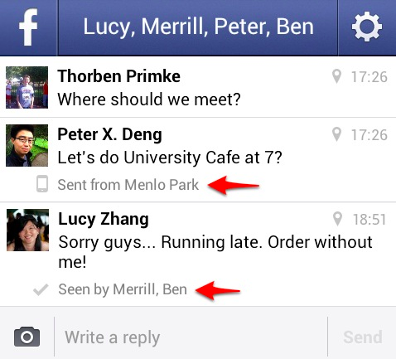
Notes:
No response.. No one cares?

Slide 20
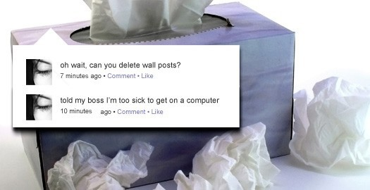
Notes:
http://www.switched.com/2009/04/27/woman-fired-for-logging-on-to-facebook-while-sick/

Slide 21
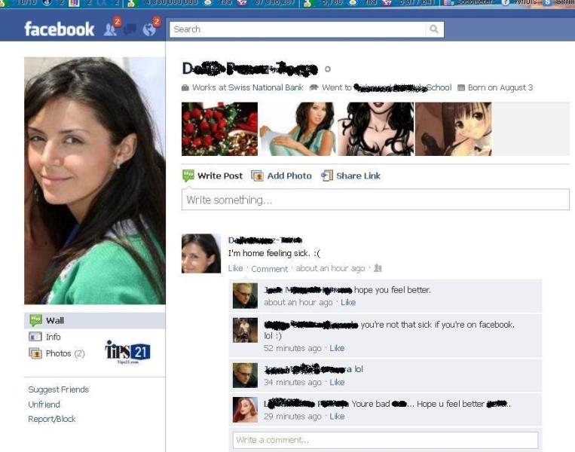
Friending your boss…
Notes:
http://tips21.com/fired-over-facebook-sick-for-work-but-not-for-facebook.html
She said she would be "Unable to work in front of a computer and needed to be able to lie in the dark"

Slide 22
Plausible deniability on IM

