Slide 1
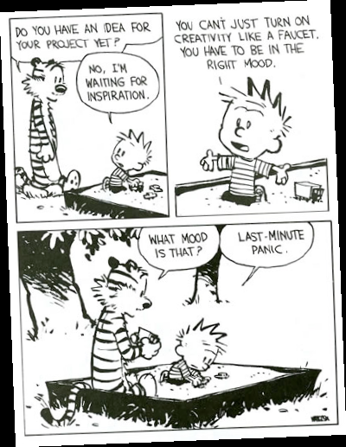

Slide 2
Ideation
CPSC 481: HCI I
Fall 2014
Anthony Tang, with acknowledgements to Julie Kientz, Jake Wobbrock, Dave Hendry, Andy Ko, Jennifer Turns, and Mark Zachry

Slide 3
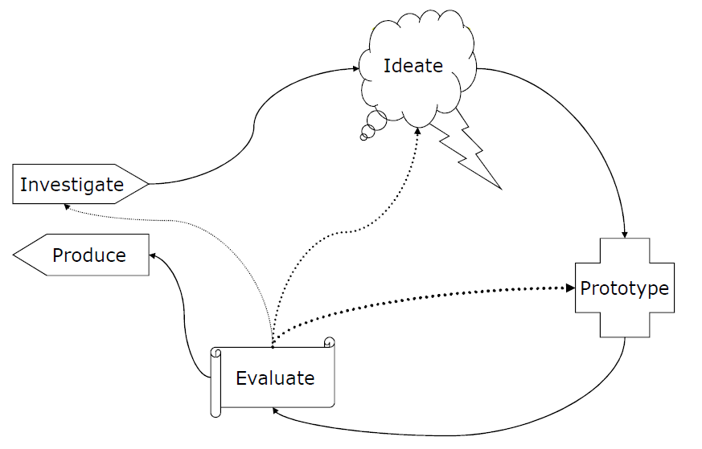
User Centered Design Process
Generate lots of ideas
Grasp issues and
potential solutions

Slide 4
Problem
“I’m not creative!”
Today: techniques that will help you (and your team) be creative together.

Slide 5
Ideation
How do we come up with great ideas?
How do we come up with lots of ideas?
How do we come up with big ideas?
How do we refine ideas?
How do we organize ideas?
Notes:
Tutorial 10+10 techniques

Slide 6
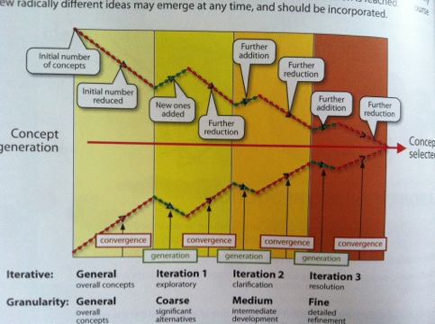
Design Funnel

Slide 7
Role of Creativity in Design
Design is about making choices, and compromises
There are three places where there is room for creativity in design:
  determining the methods you choose to investigate a problem
  enumerating distinct options from which to choose
  defining the criteria, or heuristics, according to which you make your choices

Slide 8
Creativity as a Designer
Immerse yourself in the world you are designing for (gathering inspiration)
  Collect examples from existing systems
  Collect things that irritate you
  Collect things that seem really good
  Sample things that inspire you

Slide 9
Existing Systems
What’s so good about this? (Why is it good?)
What is the general problem that this solves?
Where else could I use it?
Practice articulating what makes something good.

Slide 10
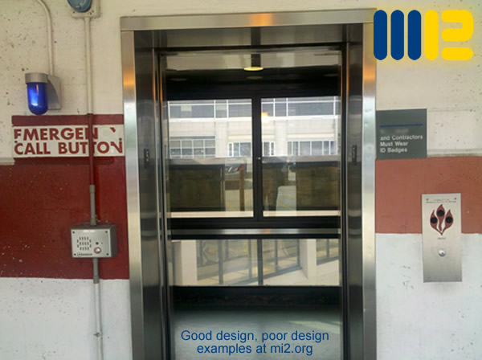
Things that irritate
Articulate and understand what makes something irritating.
Why are mistakes happening?
How can it be done better?
Notes:
http://mi2.org/building-science-healthcare/good-design-poor-design-we-see-examples-every-day

Slide 11

Things that seem really good
Real life things too!
What are the principles that drive this design?

Slide 12

Sample the inspiring
How has the world solved these problems?
How have others solved these problems?
What is nice to look at?

Slide 13
Creativity as a Designer
Explain ideas to others
Take an outsider’s perspective on something you know well
  Helps to simplify your language/understanding
Take an insider’s perspective you don’t know well
  Helps you to identify your assumptions

Slide 14
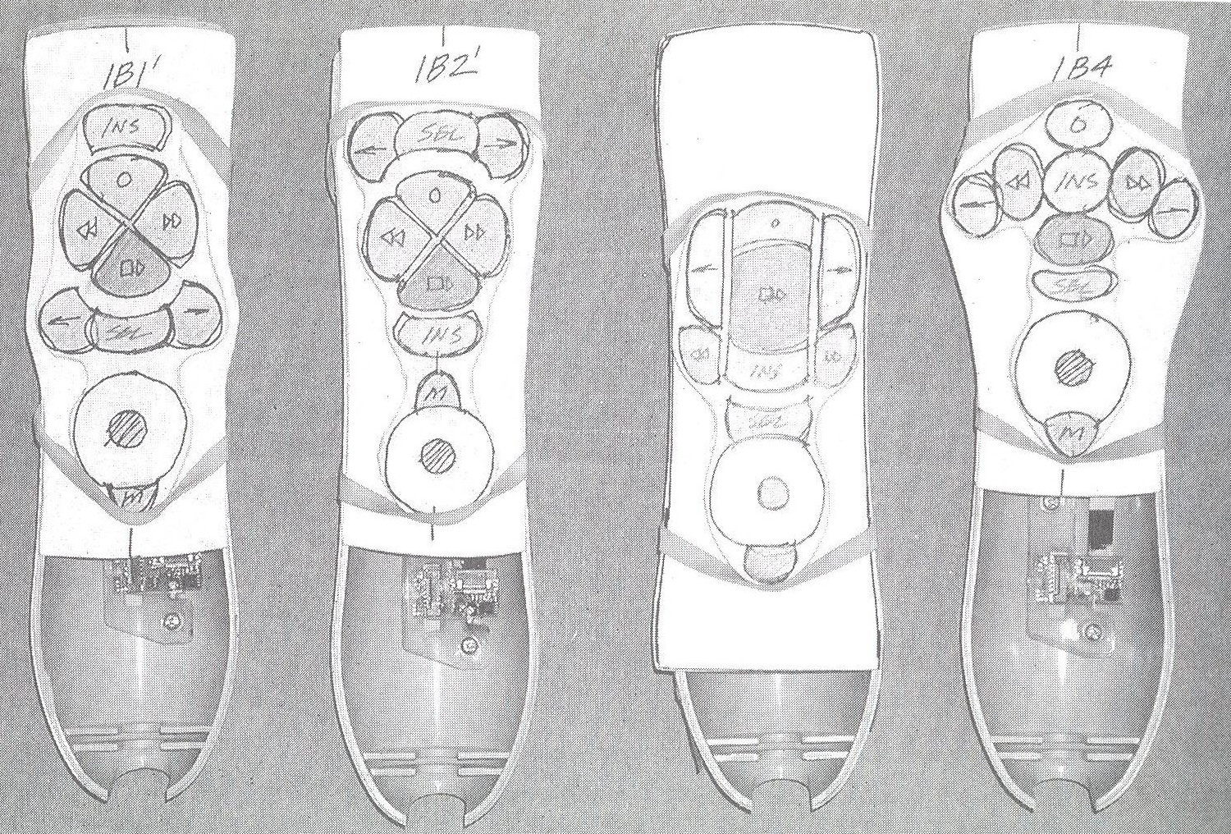
Sketch constantly
Generate ideas constantly (keep a sketchbook)
Sketch vague ideas to help think more clearly
From Carloyn Snyder’s Book: Paper Prototyping (2003) Morgan Kaufmann, p350

Slide 15

Creativity as a Designer
Take risks (early on, it doesn’t hurt!)
Notes:
http://tobiasmastgrave.wordpress.com/tag/throw-off-cliff/

Slide 16

Kids and creativity
Kids are creative because they don’t know the rules, so they feel free to break them
Kids don’t know the consequences, so they take risks

Slide 17
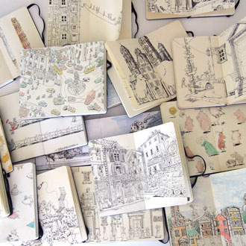
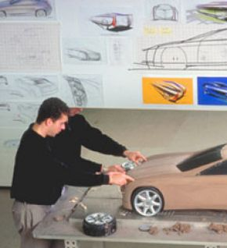
What to do with your collection
Keep a sketchbook
Wallpaper it
Notes:
http://luciano63.hubpages.com/hub/Car-designers-at-work-how-is-it

Slide 18
Brainstorming
Works best in groups
Can be useful and fun
Keep the results of user research handy during the process (e.g. scenarios, lists of design requirements, etc.)

Slide 19
Brainstorming for Design
be visual
defer judgment
encourage wild ideas
build on others
go for quantity
one conversation at a time
stay focused on topic
Notes:
Brainstorming Dos
1. Sharpen the focus
2. Write playful rules
3. Number your ideas
4. Build and jump
5. Make the space remember
6. Stretch your mental muscles
7. Get physical
Brainstorming Don'ts
1. Let the boss speak first
2. Give everybody a turn
3. Ask the experts only
4. Go off-site
5. No silly stuff
6. Write down everything

Slide 20
Summary
Find things that x you
  where x = { inspire, interest, irritate, amuse }
Find things that you y
  where y = { can improve, relate to }
Break the rules, and think freely

Slide 21
What you now know
The role of creativity in design
Techniques to inspire creativity—point: apply these lessons as you engage with your project work.

