Slide 1
STUFF
Hand in your P0
P1 is now considered “assigned.”
A2 is now considered “assigned.”
Questions?

Slide 2
Lecture 9 – Ideation Exercises

Slide 3
Questions
What are three roles that creativity has in design?
Describe the design funnel.
From your A1: what is something that inspires you (in relation to interaction design)?
From your A1: what is something that irritates you (in relation to interaction design)?
Notes:
determining the methods you choose to investigate a problem
enumerating distinct options from which to choose
defining the criteria, or heuristics, according to which you make your choices

Slide 4
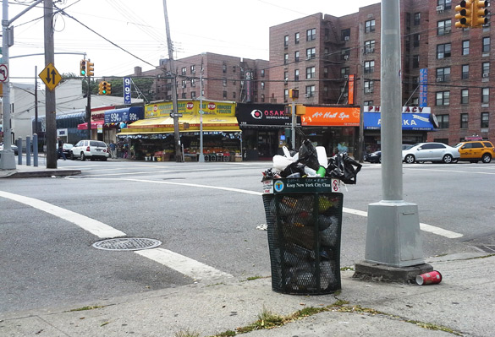

Slide 5
Activity (10 mins)
Scenario: City of Calgary is going to put a bin on every street corner in the city. Design the bin. What do you do to support this design?
Break into groups of 3-4 for this. Select an interesting idea and be prepared to discuss aloud with the class.
Consider:
How would you find out who are the users? Who are the stakeholders? What are their needs? What IDEO methods would you use to understand this design problem? (5 mins)
2. What are important design considerations? Create a list of at least five. Then, pick one that you think is important, and what the justification for picking this one is. (5 mins)

Slide 6
Research
Stakeout some current trash cans to see how people use them
Watch people use it
Interview the people that maintain it
Find out wherwhich garbaghotspots for garbage
Do people actually use the bins that have multiple holes
What happens when the bins are full?
Be a garbage can
Timelapse video of the bin – “test bin”
Cost this out
Users: also garbage collectors, homeless person – follow them around
Find people that litter and ask why
Design ideas
* easy to see
Use lasers to classify garbage types
Prevent theft of the bins
Closed on top
Low cost, easy to replac
Vandalaizm
Cemented
Goes into the ground
Clamped down or not
Durability
Accessibility for cleaner
Size: --- big enough – big
Same as robot arm

