Slide 1
Design Methods: TRY
CPSC 481: HCI I
Fall 2014
Anthony Tang, with acknowledgements to Julie Kientz, Saul Greenberg, Ehud Sharlin, Jake Wobbrock, Dave Hendry, Andy Ko, Jennifer Turns, & Mark Zachry

Slide 2
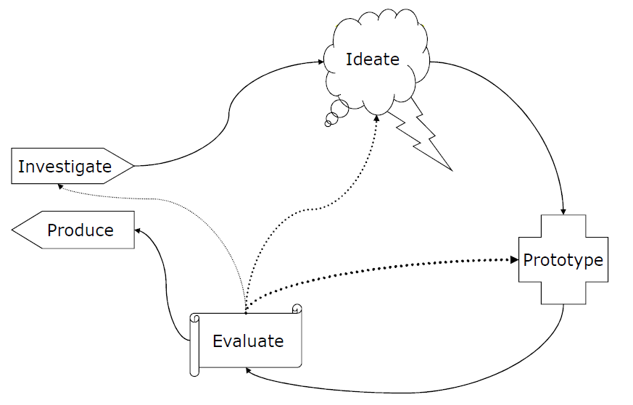
IDEO Methods in the UCD Process
Try
Learn
Look, Ask

Slide 3
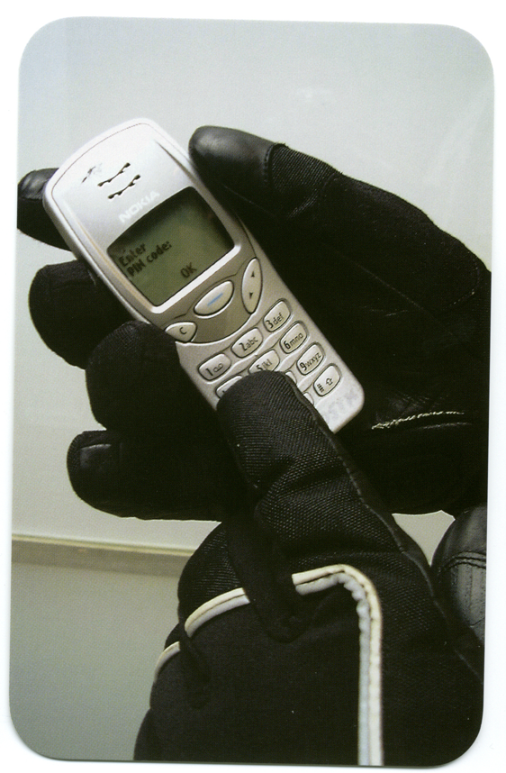
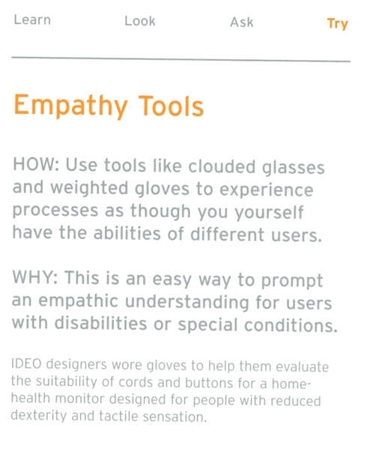

Slide 4
Empathy Tools in Vancouver
Three teams: wheelchair team, double stroller (twins), and blurred glasses+wonky joints.
Each assigned basic tasks. For example, go to the store and buy something; take the Skytrain station from one stop to another, etc.
Result: Vancouver still kind of stinks for people who are not fully able-bodied.
Notes:
http://uxdesignstrategy.com/empathy-and-user-centered-design

Slide 5
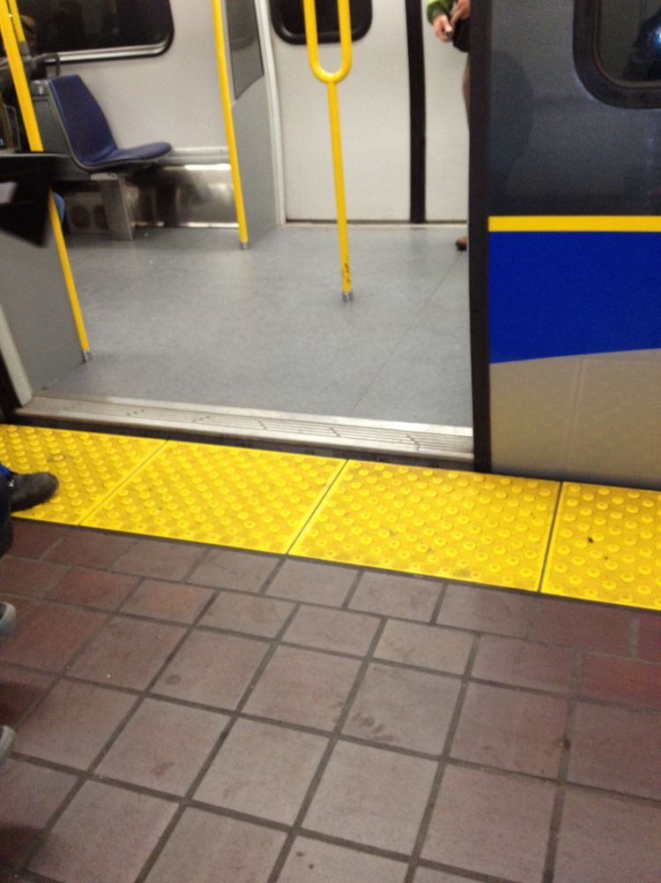
Team Wheelchair: SkyTrain Bail

Slide 6
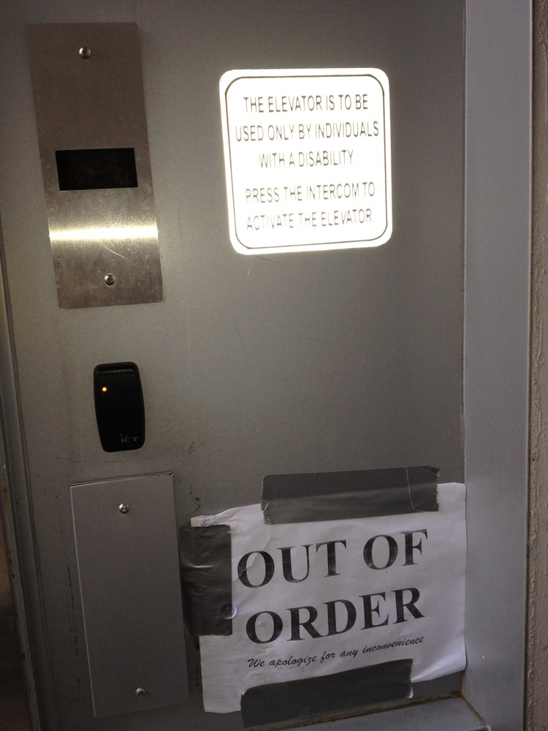
Team Wheelchair: SkyTrain Fail

Slide 7
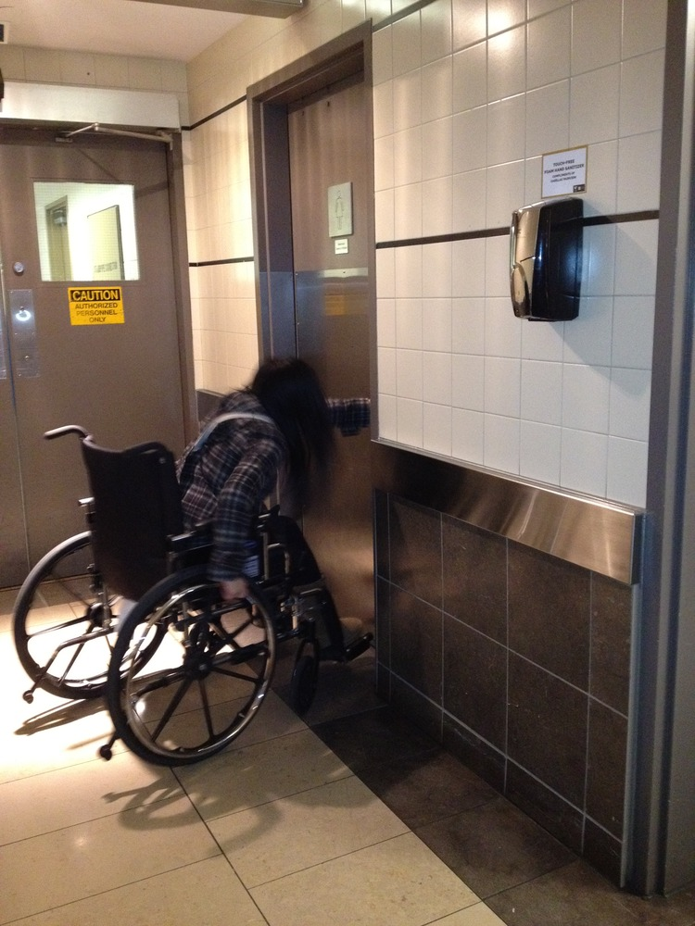
Team Wheelchair: Bathroom Fail

Slide 8
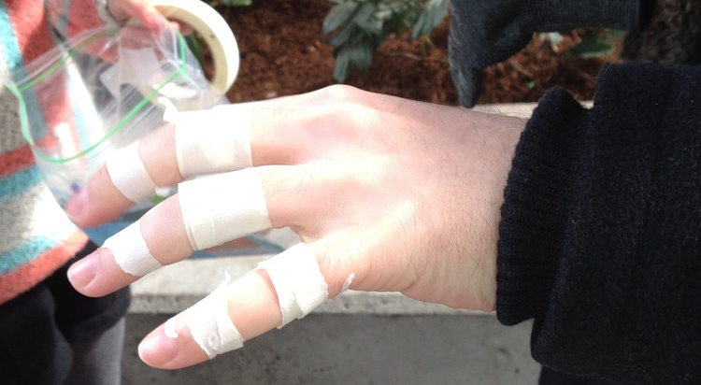
Team Elderly

Slide 9
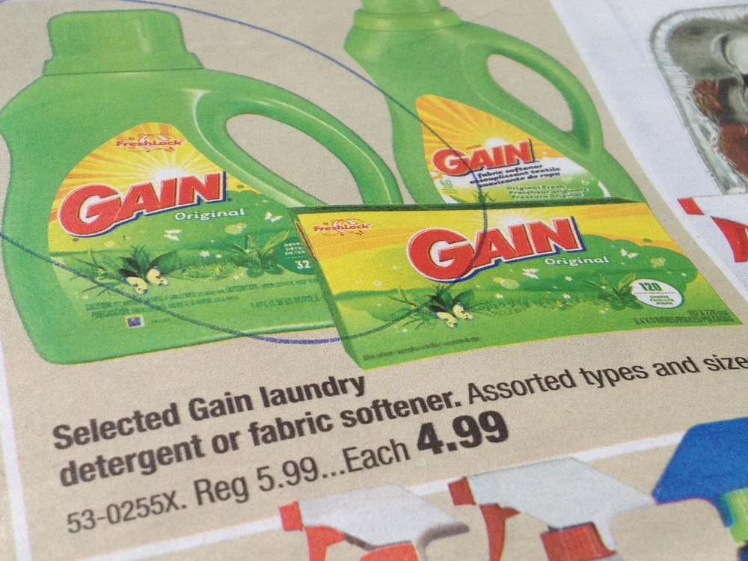
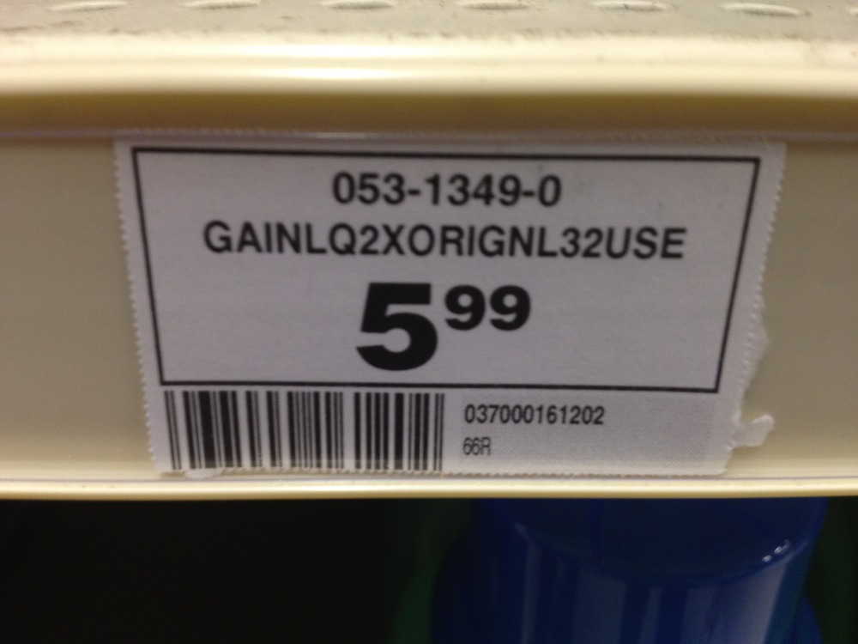
Team Elderly: Shopping Fail

Slide 10
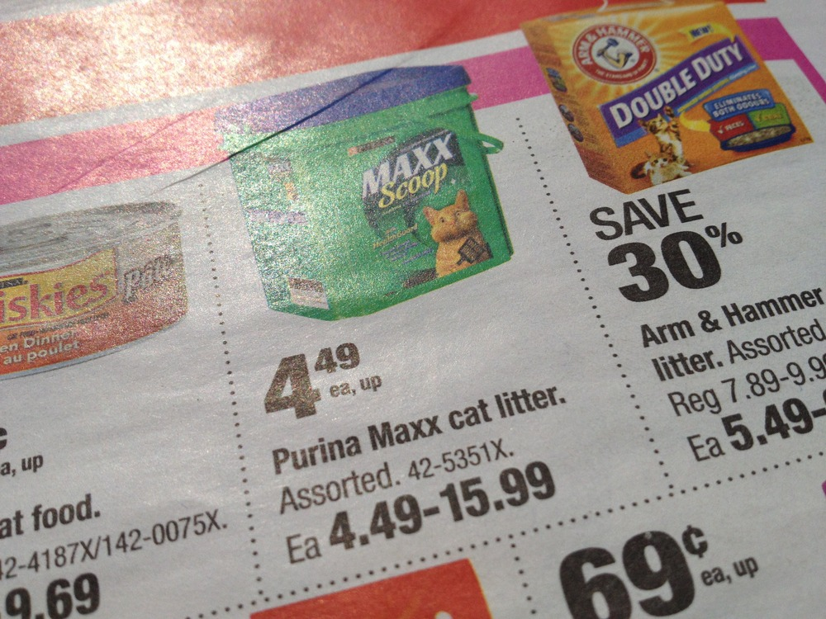
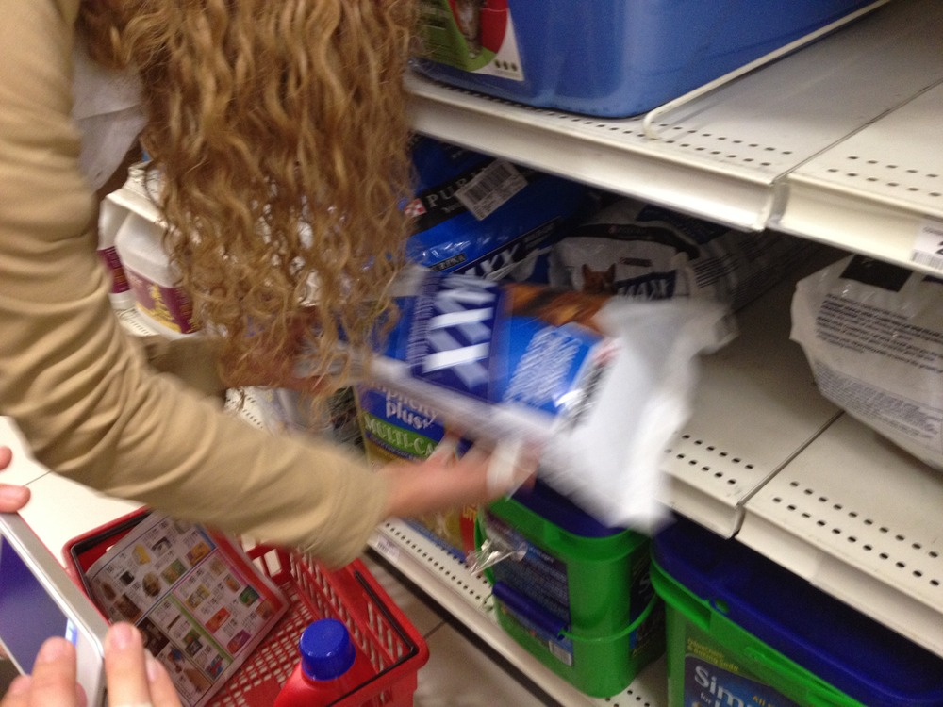
Team Elderly: Shopping Fail

Slide 11
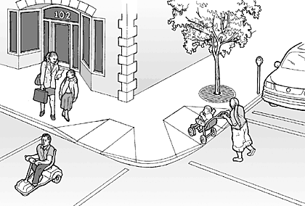
Why design for the most extreme conditions?
The designs can benefit everyone
Notes:
Think for a moment:
When are you sometimes blind?
When is it that you sometimes have mobility problems?
When is it that you have attentional issues?
http://www.lawalks.org/pedSurv/4V02.htm

Slide 12
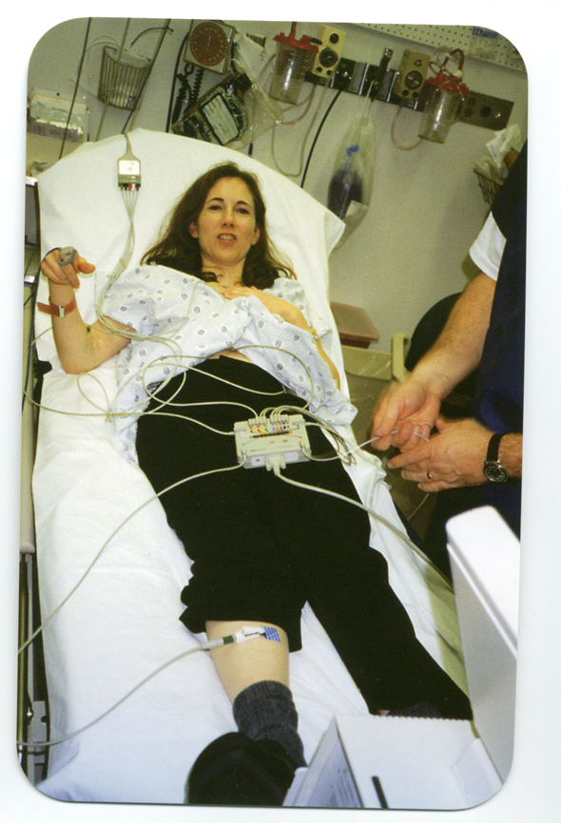
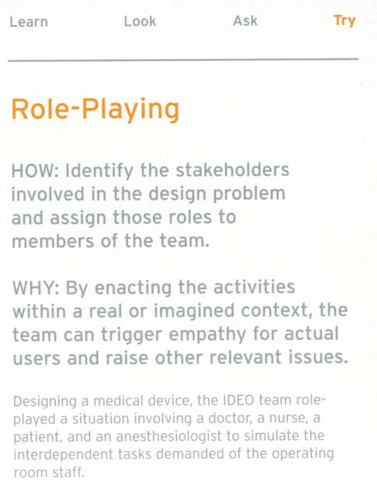

Slide 13

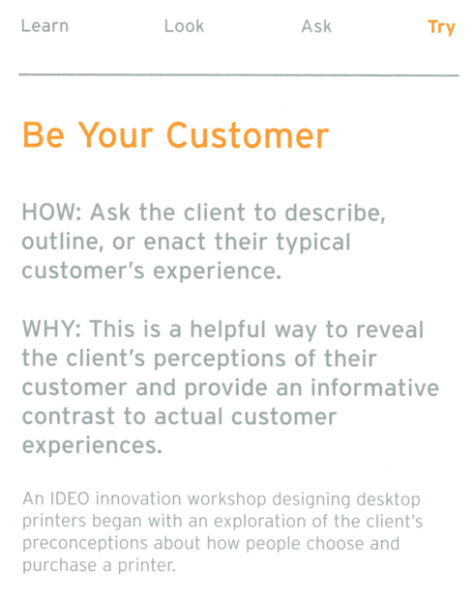

Slide 14
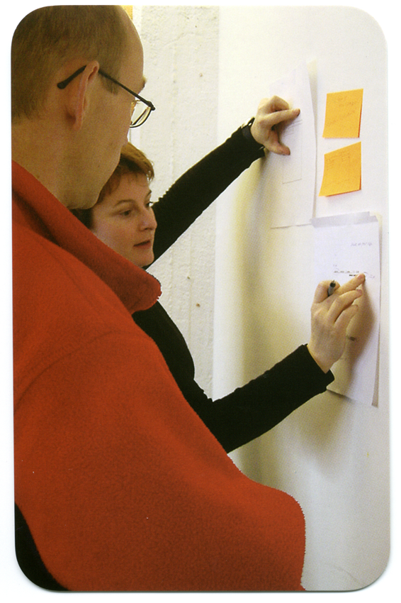
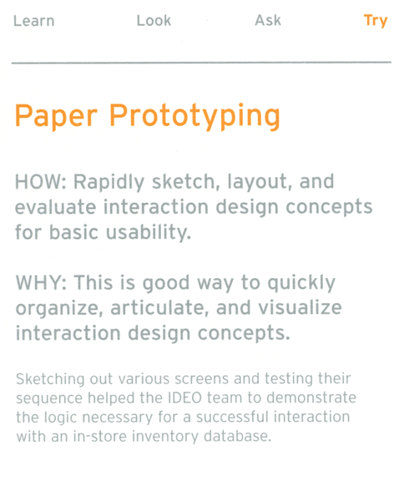

Slide 15
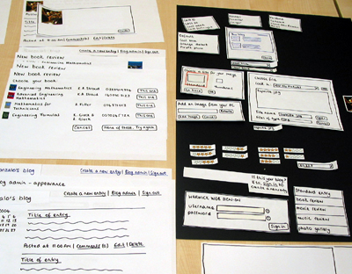
Notes:
http://speckyboy.com/2010/06/24/10-effective-video-examples-of-paper-prototyping/

Slide 16
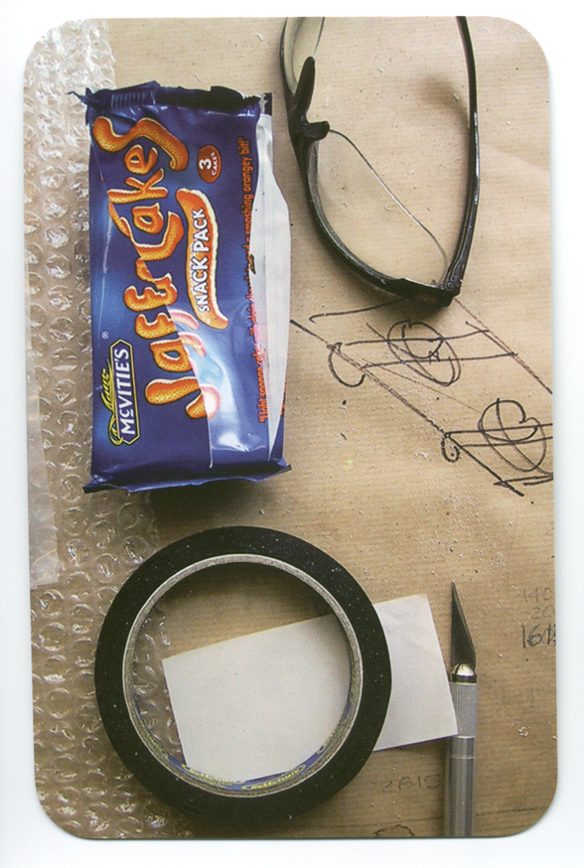
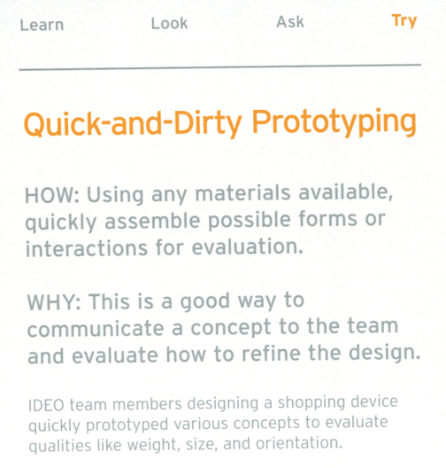

Slide 17
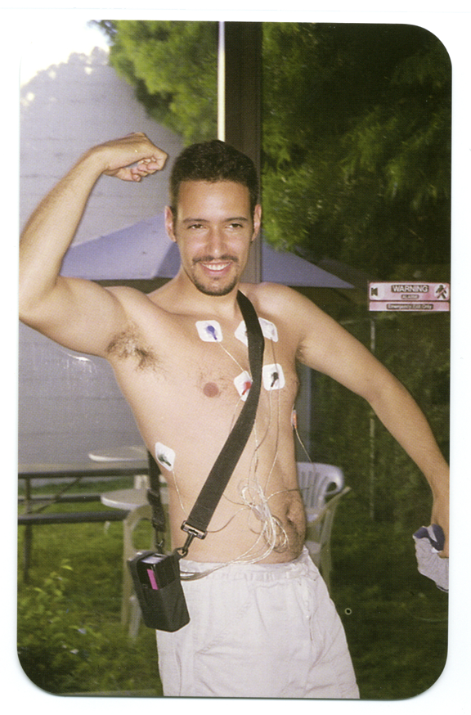
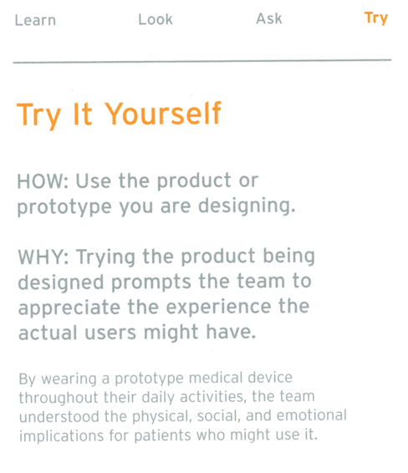

Slide 18

Notes:
http://www.wired.com/science/discoveries/news/1999/10/32010
Jeff Hawkins
http://uselog.blogspot.ca/2005/10/user-centered-design-immerse-yourself.html

Slide 19
Summary - Try
Apply “Try” techniques once you start getting ideas to test them early for their feasibility
  Can lead to more robust prototypes later
Techniques worth thinking about/remembering
  Empathy tools; role playing; be your customer; paper prototyping; quick and dirty prototyping; try it out

Slide 20
Summary – Design Methods
Choosing the right techniques can end up being trial and error
  Some will give you good insights, others might not
Try to recognize early on if you're not learning anything and move on to something else
Remember that above all, you should triangulate
  Use multiple, complementary methods to gain both a broad and deep understanding from multiple angles

