Slide 1
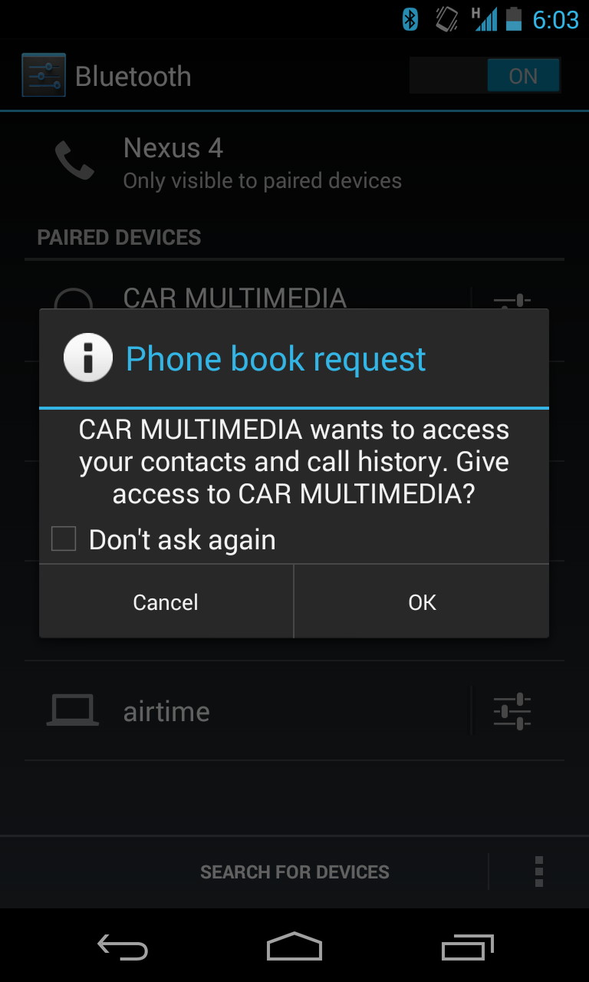

Slide 2
481 – 8 - try

Slide 3
Questions
Explain two distinct roles of the TRY IDEO techniques—both early on in the design process, and later in the design process.
Contrast how you might use empathy tools vs. the use of paper prototypes.
In regard to the IDEO design methods as a whole set, what does the term “triangulate” mean?

Slide 4
Team Elderly: Coke Fail?
video

Slide 5
Quick Activity: Need 1 volunteer who has their cell phone with them that has (free) text messaging
Stand up, with one hand holding the table in front of you. With your eyes focused on the board, try to send a text message to 403-805-6436
You have one minute.

Slide 7
Quick exercise
Imagine that you are going to build a registration system for a library.
Who would you role-play? How would you role-play?
Take two minutes, and work with a neighbor, discussing these ideas.

Slide 8
Paper Prototypes
Two videos

Slide 9
Two videos on paper prototypes
Notes:
http://speckyboy.com/2010/06/24/10-effective-video-examples-of-paper-prototyping/

Slide 10
A2
Consider three different design scenarios.
For each scenario, choose one method from each of the four IDEO categories (look, ask, learn, try) that you would use to address the design scenario. Provide some detail as to how you would apply these methods, and importantly, justify your choice of methods.
Choose methods that allow you to triangulate your understanding of the situation—that is, the methods should all complement each other.

Slide 11
P0 (Refined) due Friday
In a binder – 1” – 1 ½” thick.

Slide 12
Quick & Dirty Prototyping
Quick Activity: Need 1 volunteer
Using this marker, paper, and tape, prototype a barcode scanner in 1 minute or less

