Slide 1
Design Methods: LEARN
CPSC 481: HCI I
Fall 2014
Anthony Tang, with acknowledgements to Julie Kientz, Saul Greenberg, Ehud Sharlin, Jake Wobbrock, Dave Hendry, Andy Ko, Jennifer Turns, & Mark Zachry

Slide 2
LEARN from your data
Now that you have a huge stack of notes and ideas from all of your LOOKing and ASKing, it’s time to make some sense of the data
Methods are intended to help you organize your thinking, and express it to help make it concrete and real

Slide 3
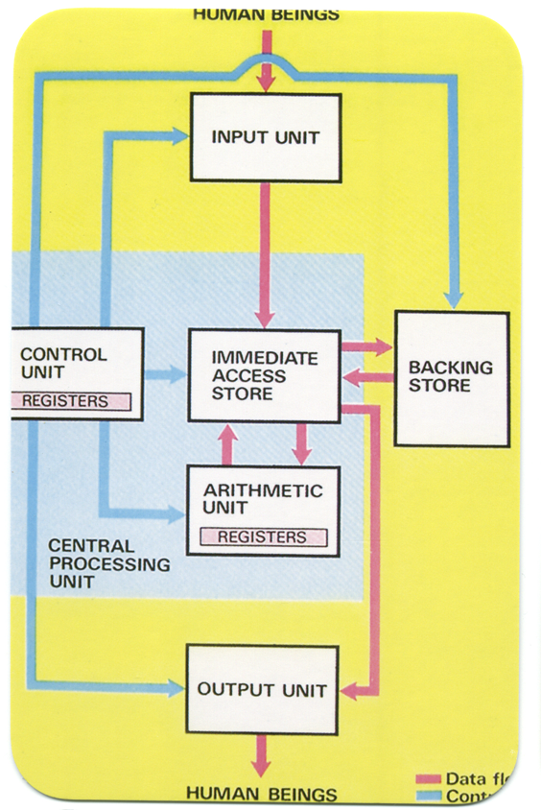

Slide 4
Notes:
http://www.zazzle.ca/thank_you_cards_red_daisy-137447214949027033

Slide 5
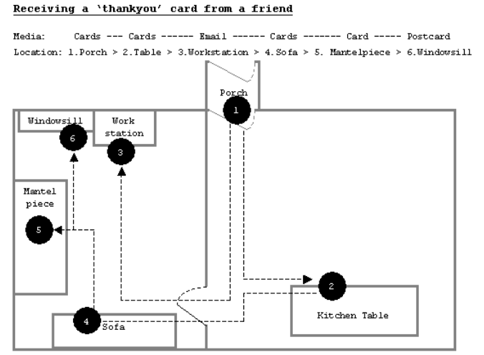
Notes:
Finding a Place for UbiComp in the Home *
Andy Crabtree, Tom Rodden, Terry Hemmings and Steve Benford
-- Ubicomp 2003

Slide 6
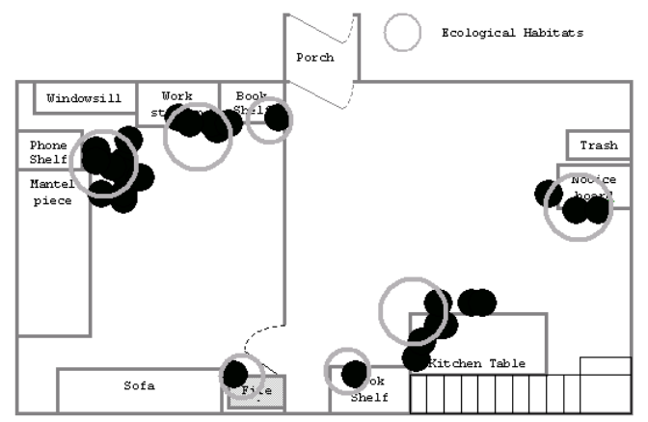
Notes:
Over time, can tell us where technology is used, and what it might be used for

Slide 7
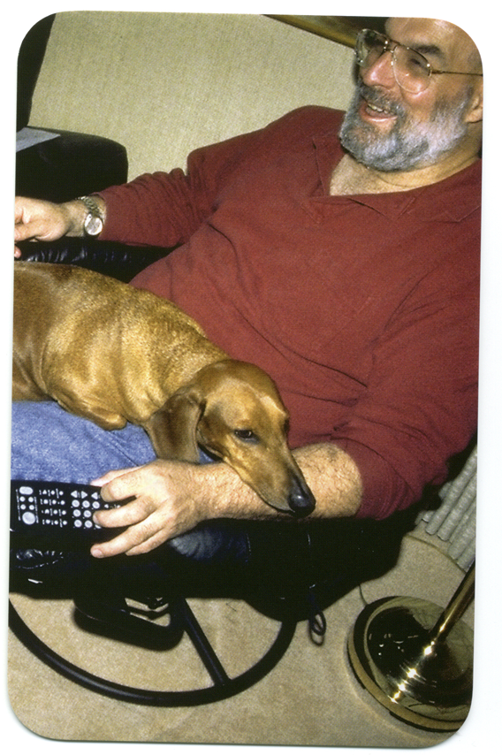

Slide 8
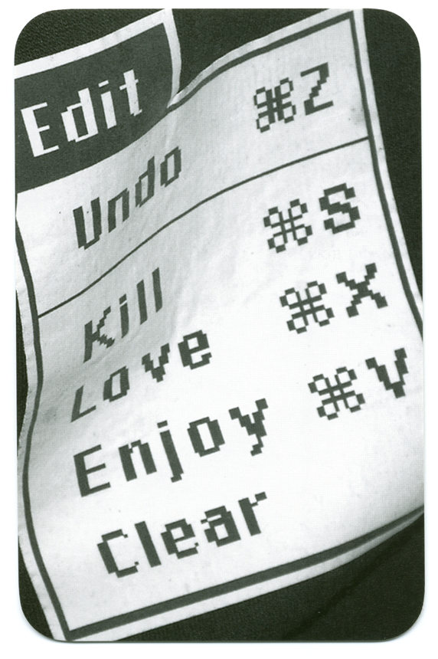

Slide 9
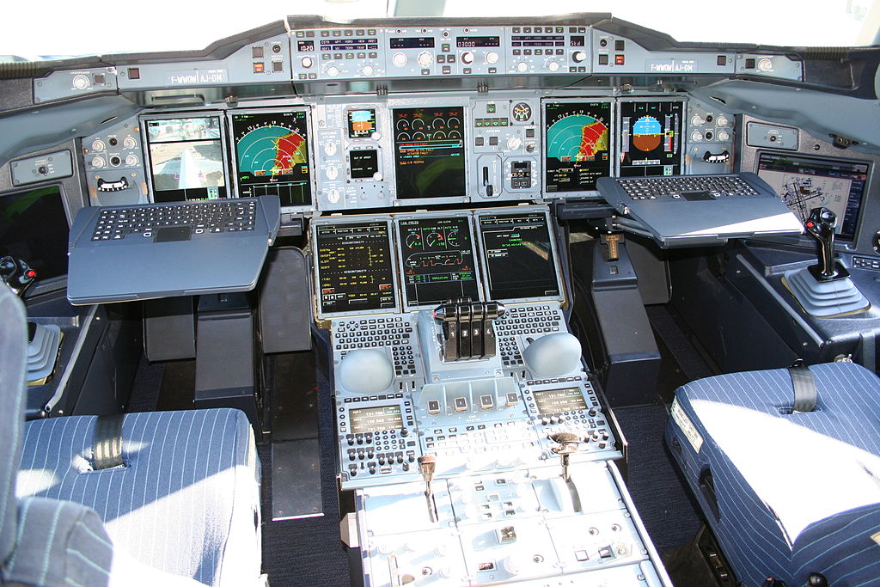
Notes:
Airbus A380 cockpit

Slide 10
Task-Centered System Design (technique related to Cognitive Task Analysis)
(see readings)
For each step of the interface, ask yourself the question: Does the user know what they are supposed to do? Is the user motivated to complete this step?

Slide 11
Notes:
Take this one out. It sucks

Slide 13
Personas
Constructions that represent different kinds of users. These are based off user research, and represent general classes of people

Slide 14
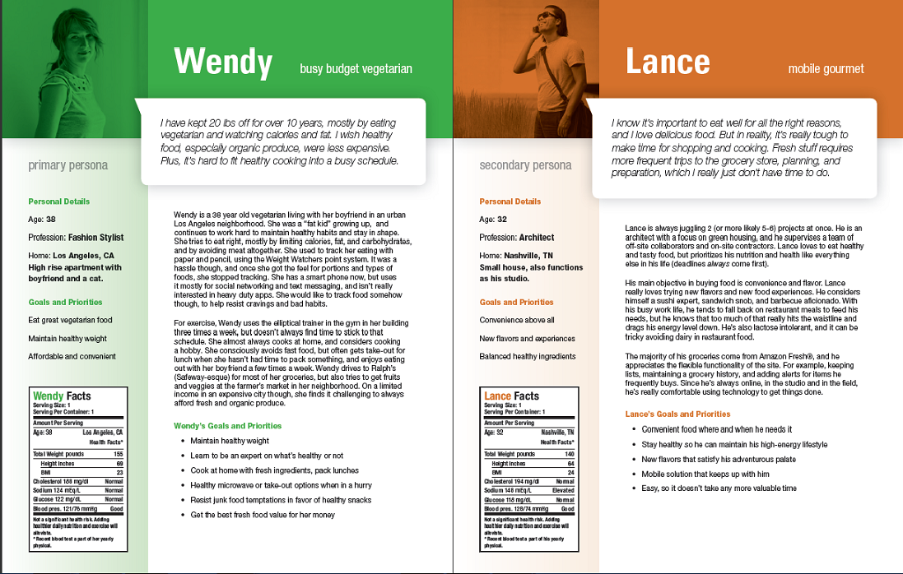

Slide 16
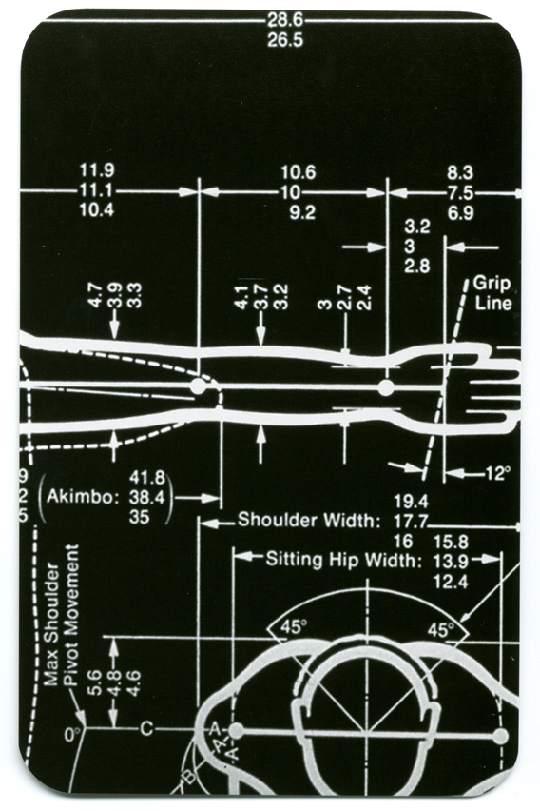

Slide 17
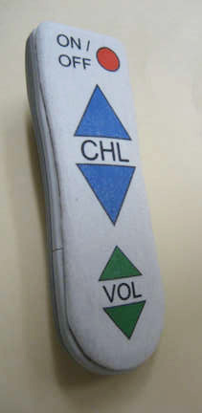
Notes:
http://theformer786.blogspot.ca/2010/05/life-is-so-hard-without-stuff.html and
Reddit.com

Slide 18
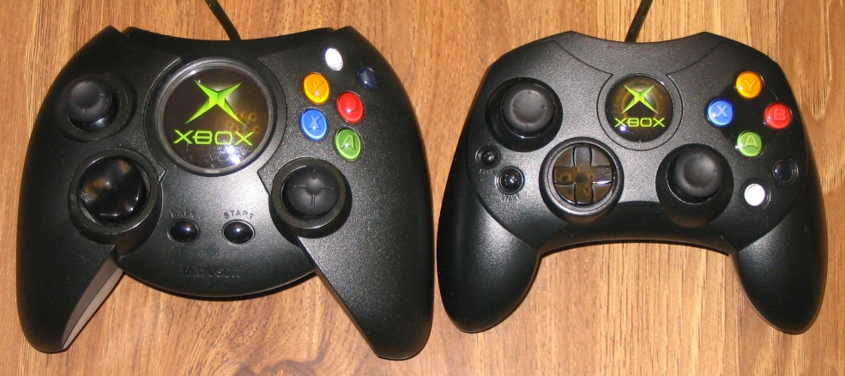

Slide 19
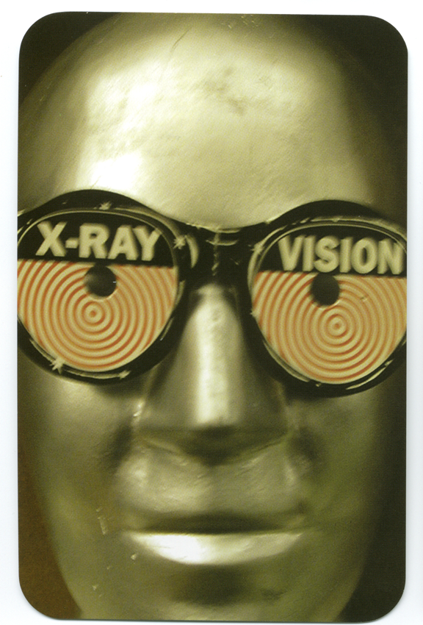
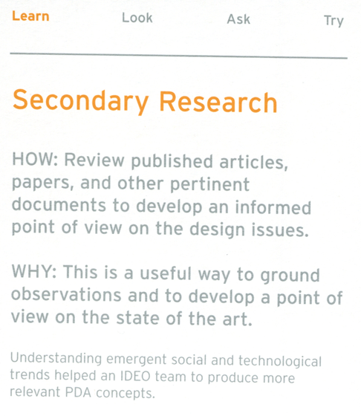

Slide 20
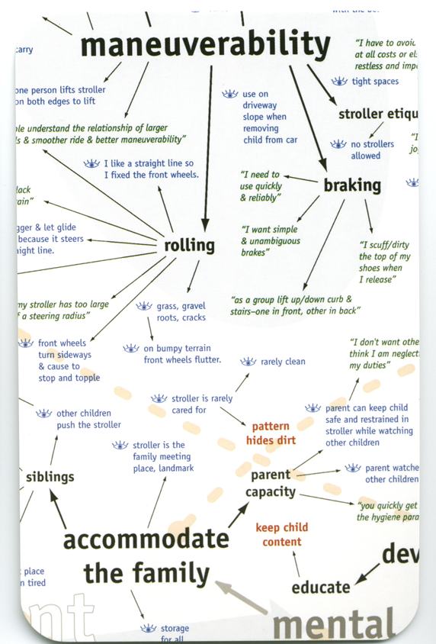

Slide 21
Summary
Apply “Learn” techniques as a way to process the data you gather from “Ask” and “Look”
Affinity diagrams; secondary research; flow analysis; cognitive task analysis; error analysis; character profiles
Some learning tasks can help you figure out who to talk to for “Ask” and “Look”
e.g., secondary research, cultural comparisons

