Slide 1
A1 Hand in NOW

Slide 2
481 – 7 – IDEO: Learn Exercises

Slide 3
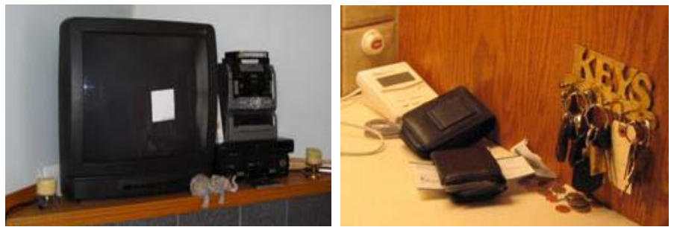
Notice the sticky note on the TV, and the mail stuck in the wallet. Why are they there?
Notes:
Kathryn Elliot, Carman Neustaedter, Saul Greenberg: Time, Ownership and Awareness: The Value of Contextual Locations in the Home. Ubicomp 2005: 251-268
Consider: who are the messages left for?
Do you have locations in your home that are like this? How do you send messages [explicit or otherwise] to other inhabitants of your home? What if it’s urgent?
Do certain locations have owners?
People are unlikely to /tell/ you about these. You have to go look, and discover them for yourself. The meaning and function are all embedded in how these things are used.

Slide 4
Questions
Contrast a flow analysis with an error analysis. [What are each for? What kinds of scenarios would each be appropriate for?]
For your project, what might be appropriate secondary sources to consider? Why?

Slide 5
Designing Mobile Phone Interface
What are things to consider?
Notes:
http://www.uxmatters.com/mt/archives/2013/02/how-do-users-really-hold-mobile-devices.php

Slide 6
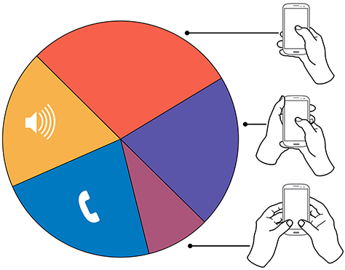
Notes:
http://www.uxmatters.com/mt/archives/2013/02/how-do-users-really-hold-mobile-devices.php

Slide 7
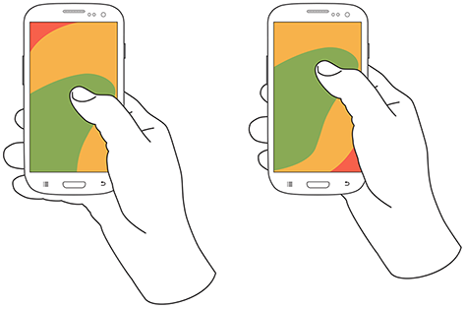
One-handed ~ 49%
Notes:
49% if we consider only the non-calling/music times

Slide 8
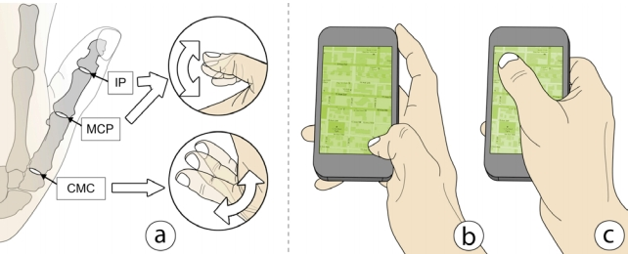
Your thumb: What different joints are good at

Slide 9
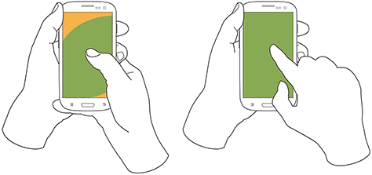
Cradled – 36%

Slide 10
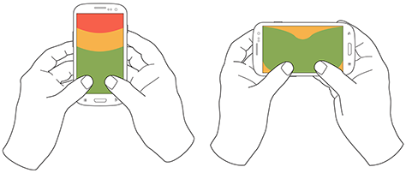
Two-handed use - 15%

Slide 11
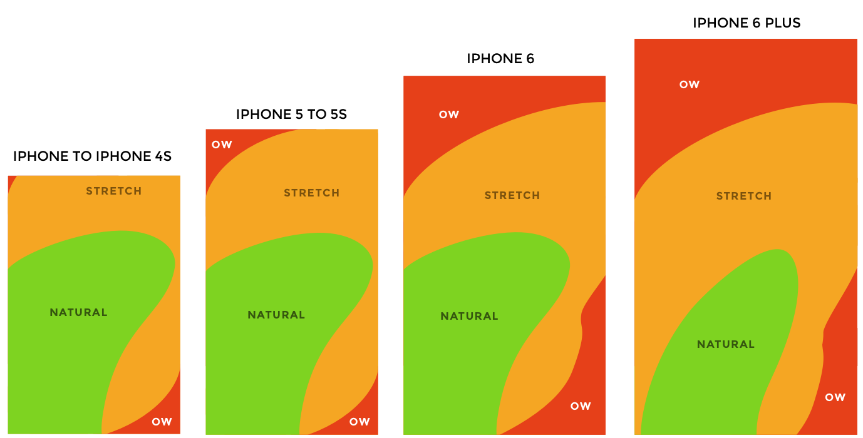
iPhones… (anthropomorphic analysis)
Notes:
http://www.sciencedirect.com/science/article/pii/S107158190800027X
http://imgur.com/

Slide 12
Demo: PeopleSoft
Conference travel: $100 airplane ticket
Ticket was purchased on April 23, 2014
Accounting string: 11-1201-UCP01-10000499
Notes:
Show at each step: do I know what to do? am I motivated to do what I need to do? (is my attention diverted)?

Slide 13
Error Analysis
Create two columns: error, why does the error occur
Activity 1: List all of the errors that could happen when getting into a car and starting it.
Activity 2: Why does that error occur?

Slide 14
P0 – Due Friday
Make sure it is in a binder: 1” – 1 ½” thick
Make sure it is labeled with your tutorial #, team #, names, and student IDs

