Slide 1
Design Methods: ASK
CPSC 481: HCI I
Fall 2012
Anthony Tang, with acknowledgements to Julie Kientz, Saul Greenberg, Ehud Sharlin, Jake Wobbrock, Dave Hendry, Andy Ko, Jennifer Turns, & Mark Zachry

Slide 2
When LOOKing is not enough…
LOOKing gives you great insight into the state of the world
But it doesn’t tell you why people are acting the way they do, or what their goals, needs, or feelings are

Slide 3
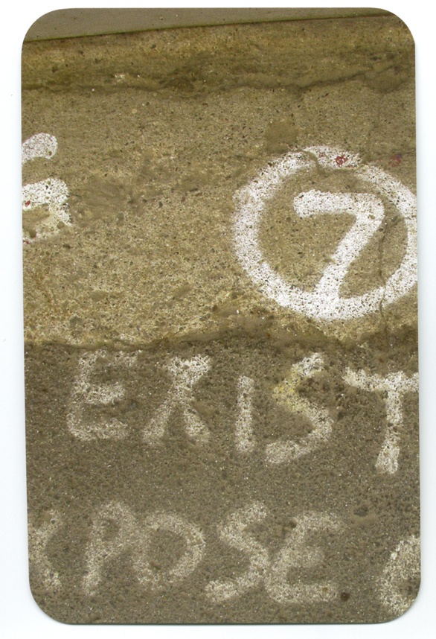

Slide 4
Questionnaires
Be clear on the goal
Open and closed questions
What do you think about X?
Which of the following are things you might use?
a, b, c, d, e
Rating scales
I think X is a good idea
1 strongly disagree to 5 strongly agree
Be sure to pilot your questionnaire

Slide 5
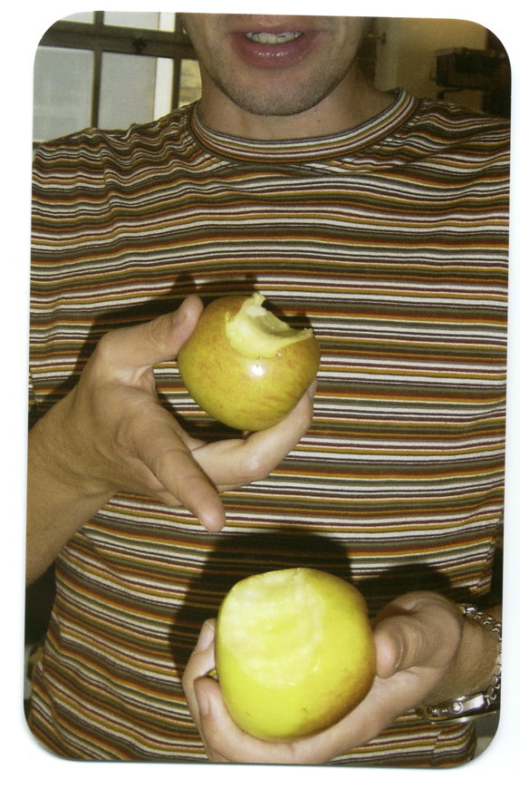

Slide 6
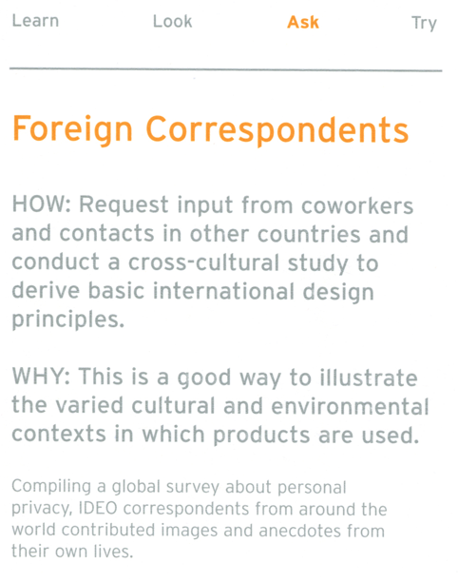
Notes:
Essentially, an outside view of things, of culture, of the way in which we do things , our routines, and our patterns, our values

Slide 7
Notes:
Rakuten.co.jp
This is a shopping website
Note the use of the colours, the icons, etc.
The business is
http://www.quora.com/Why-are-popular-Japanese-websites-visually-busy
Conclusion vs. story

Slide 8
Online shopping experiences

Slide 9
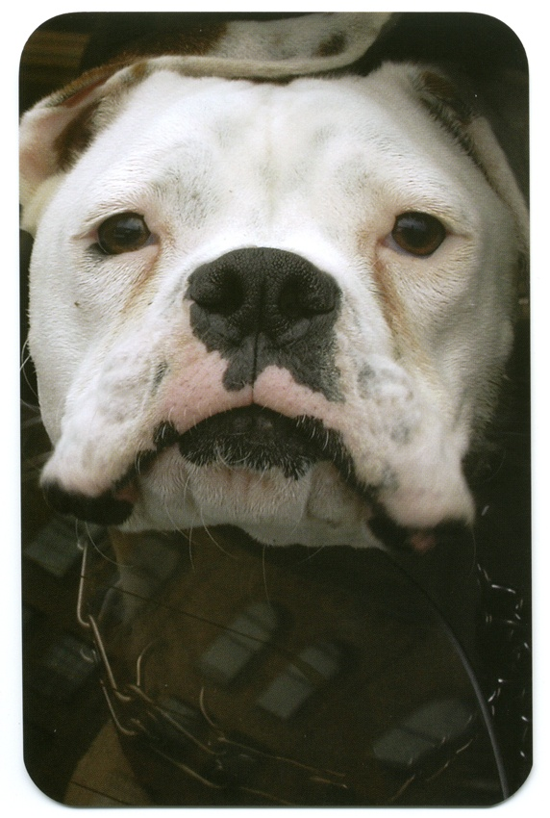
Notes:
You can’t always be there
Rich understanding of context and environment
Difficult to observe situations

Slide 10
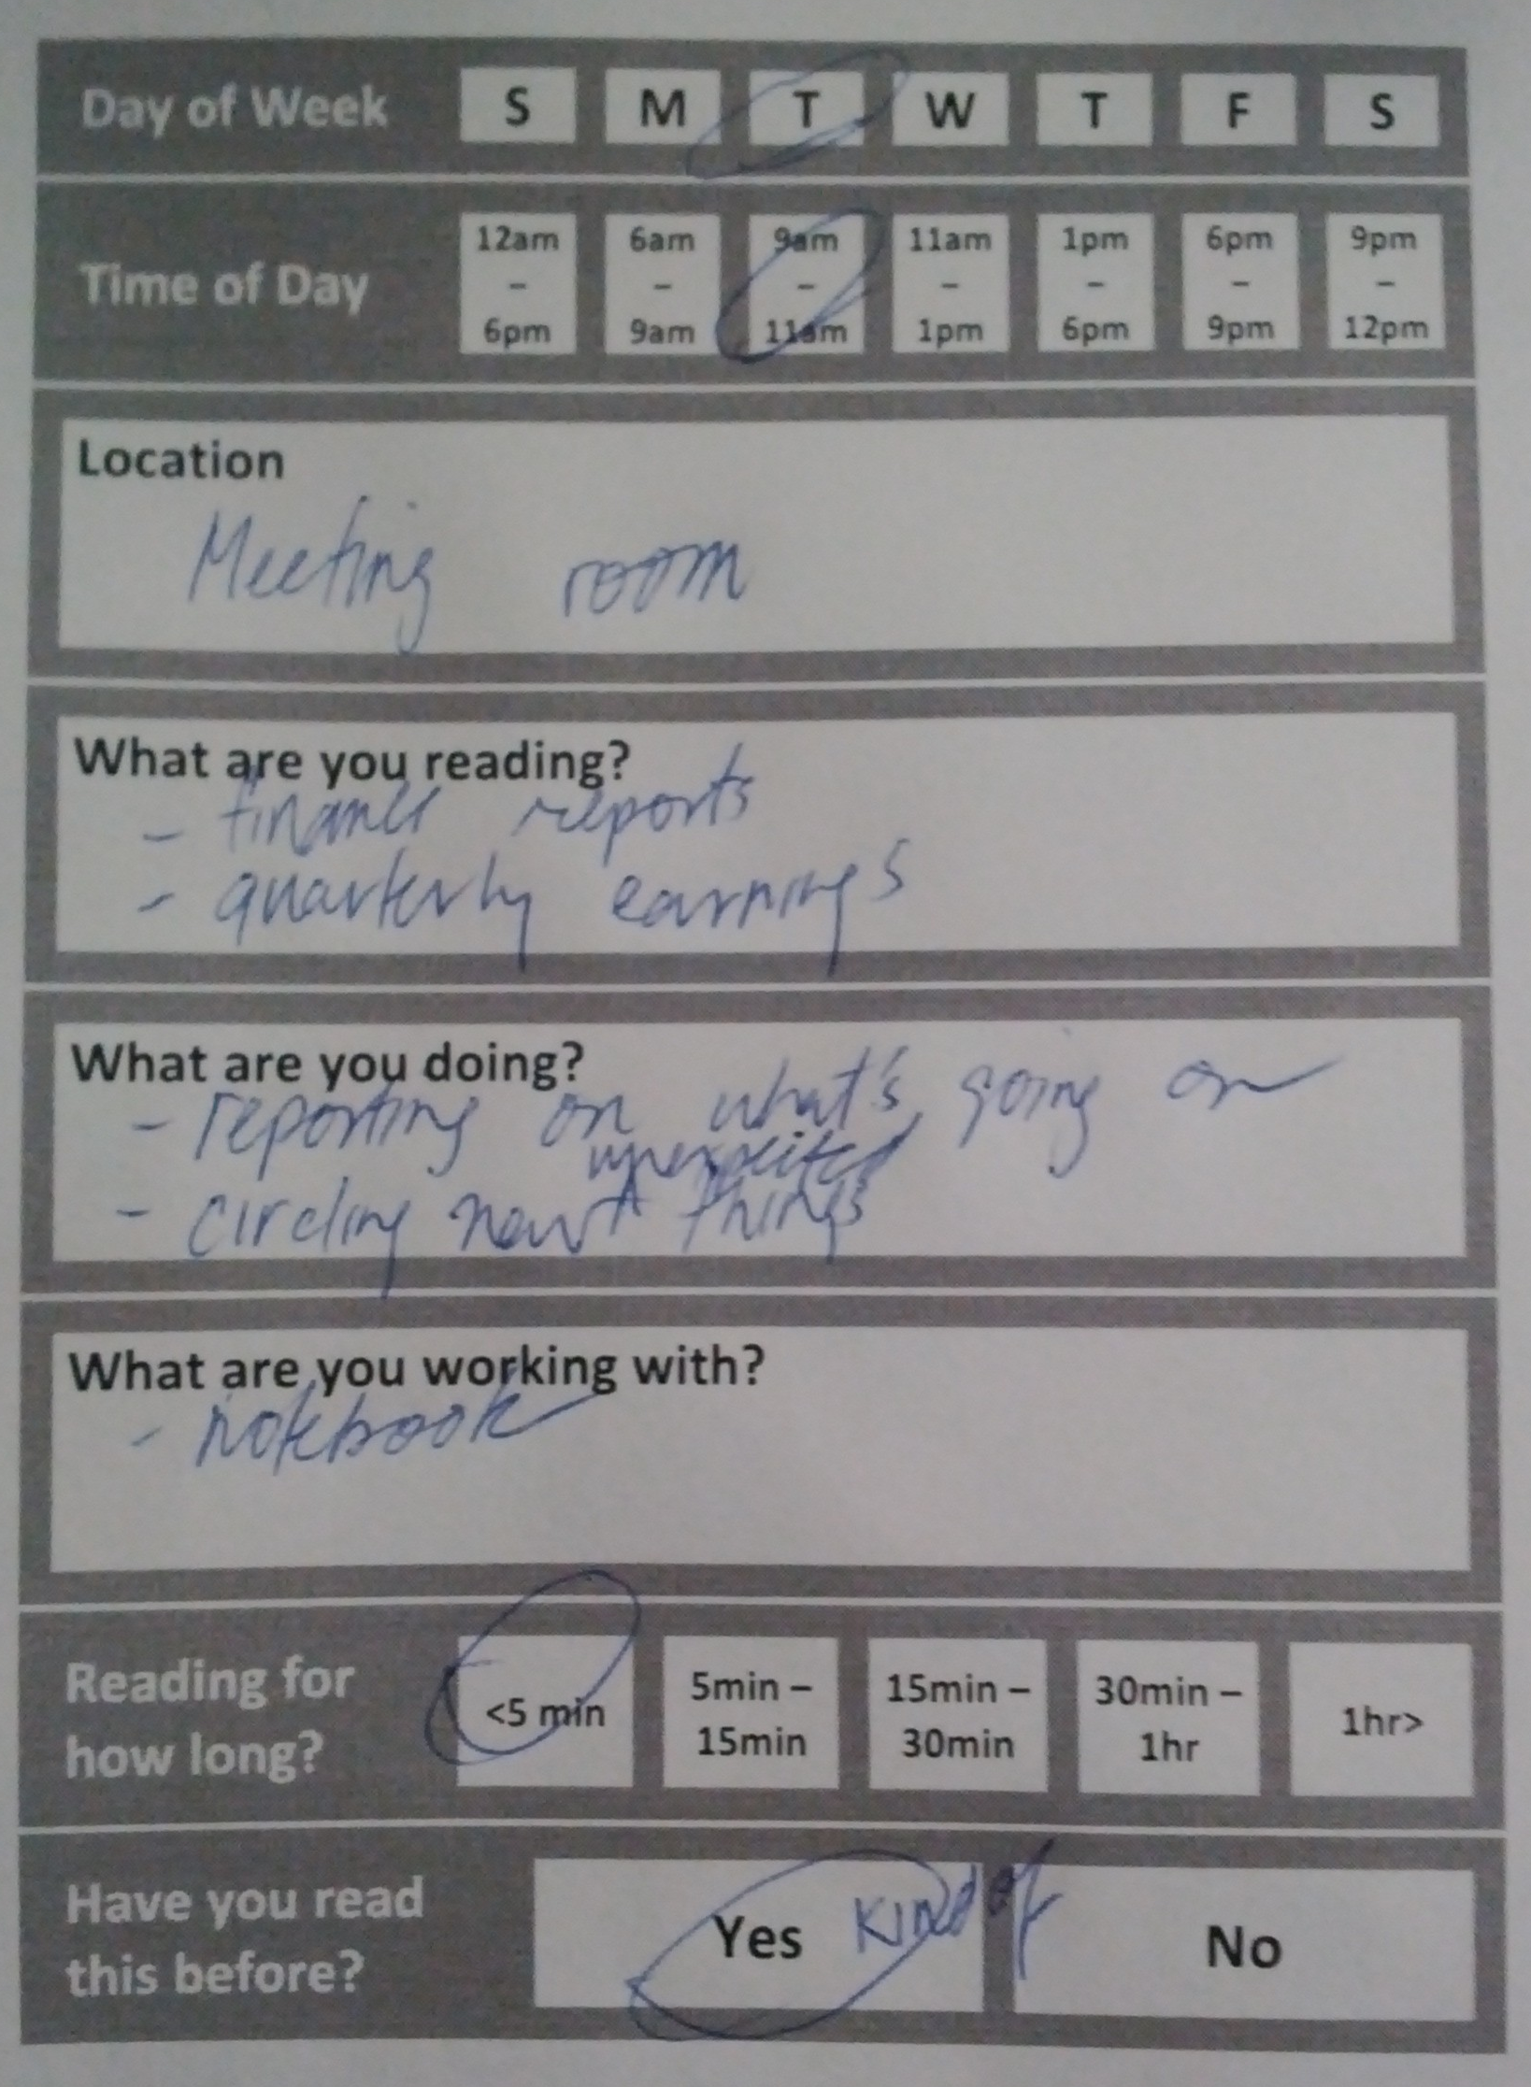
Diary Studies
Are Kindles/Nooks good for work-related reading?
Paper logs – fit in a pocket
Log reading activity
What else is going on
Findings
People write while reading
Searching/finding is frequent
Annotations are common
Single displays may be inadequate
Notes:
Annette Adler, Anuj Gujar, Beverly L. Harrison, Kenton O'Hara, Abigail Sellen: A Diary Study of Work-Related Reading: Design Implications for Digital Reading Devices. CHI 1998: 241-248
http://www.slideshare.net/qt1p/mobile-video-user-study-hp-labs
http://research.microsoft.com/en-us/um/people/horvitz/taskdiary.pdf
http://www.slideshare.net/leemcivor/diary-studies-for-ux
http://www.slideshare.net/UPABoston/diary-studies-in-hci-psychology

Slide 11
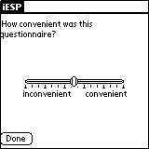
Experience Sampling
Have users carry around a device that has them answer questions at given intervals
Cell phone, PDA, Pager
Example: page user once every 3 hours and ask them to fill out a short survey on their current activity and rate sleepiness level on a scale from 1 to 7

Slide 12
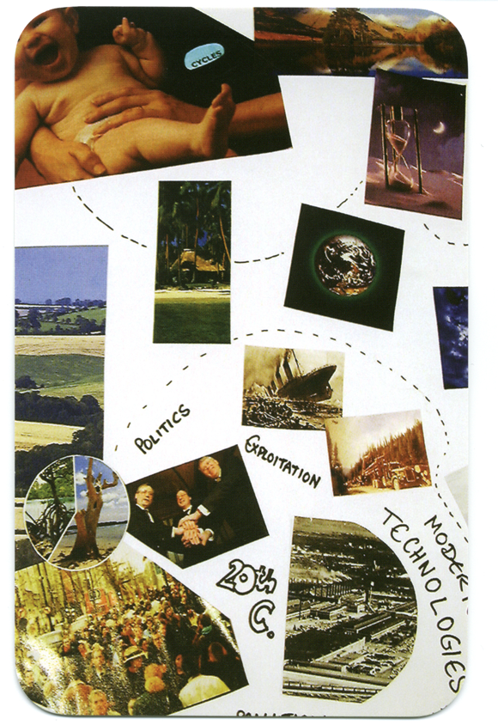
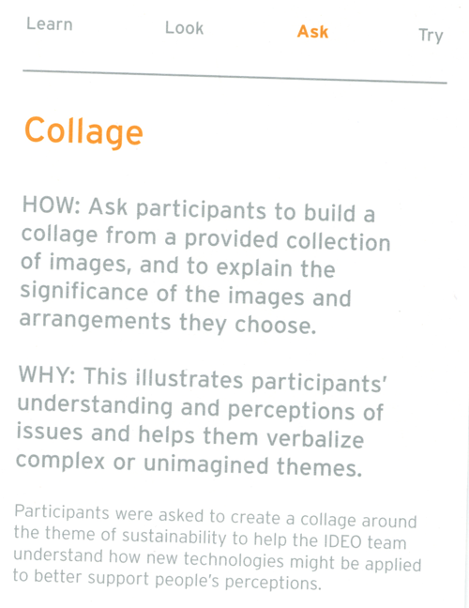
Notes:
Mental picture of how things are organized in their heads

Slide 13
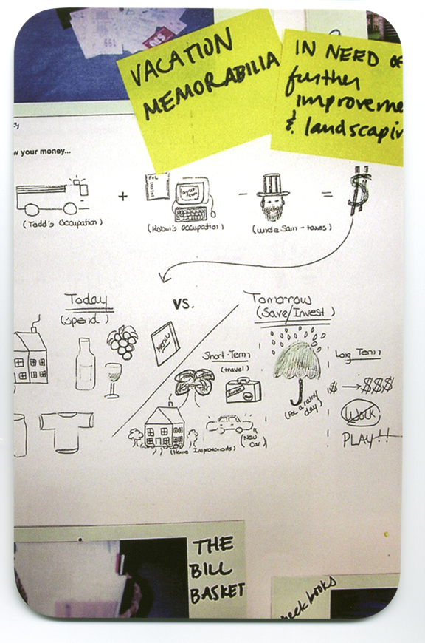

Slide 14
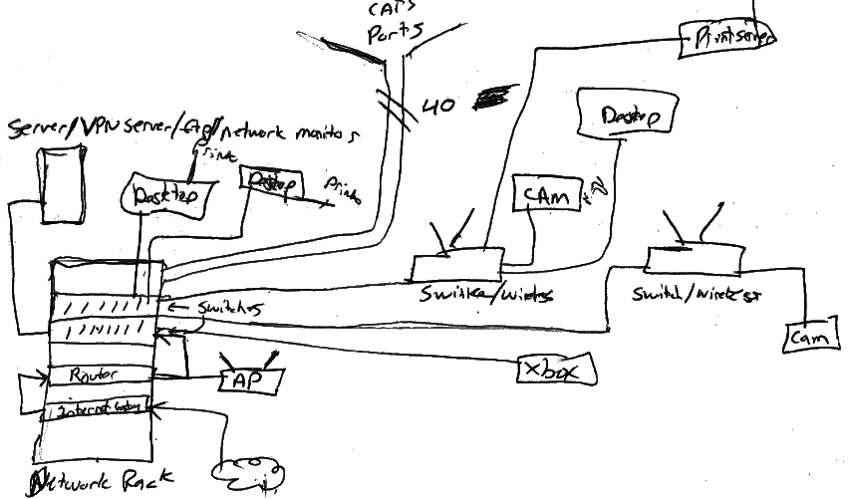
Poole, et al., DIS 2008

Slide 15
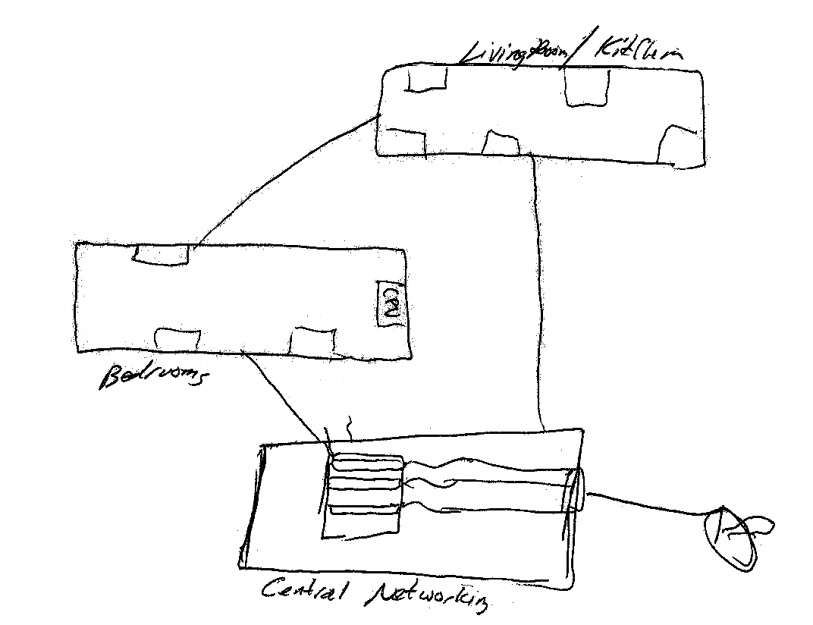
Poole, et al., DIS 2008

Slide 16
Archie Archambault: “Maps that help you navigate better than Google Maps”
Notes:
http://www.slate.com/blogs/the_eye/2013/12/02/circular_city_maps_archie_archambault_designs_minimalist_city_maps_printed.html – next four slides have images from this page

Slide 17
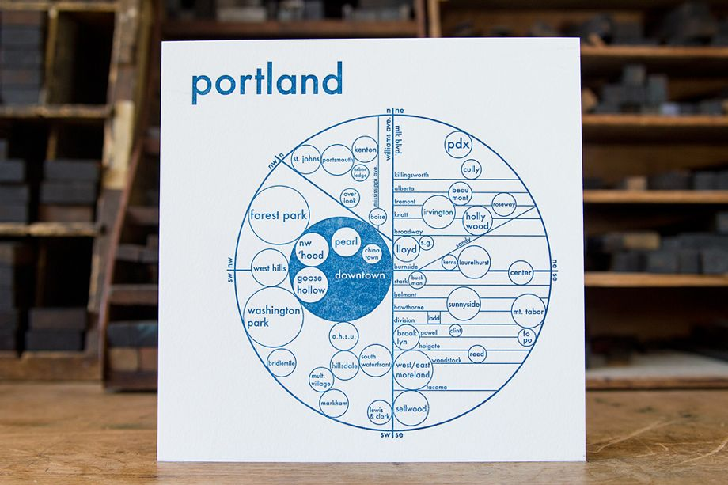

Slide 18
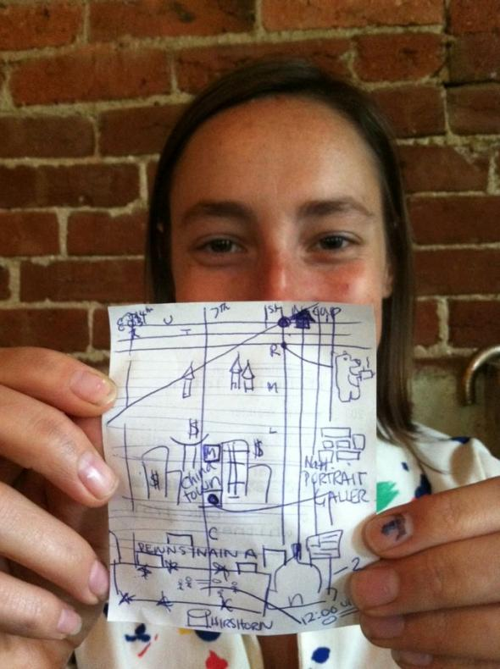

Slide 19
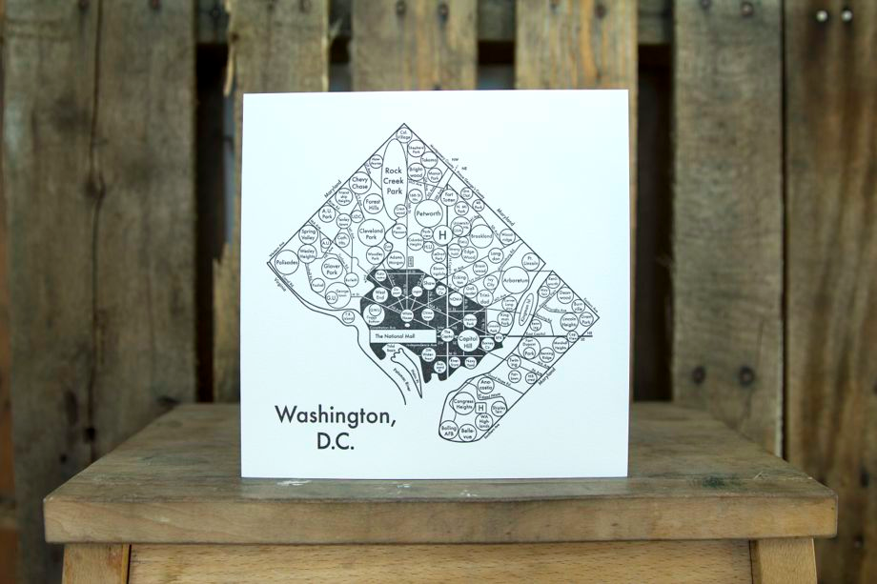

Slide 20
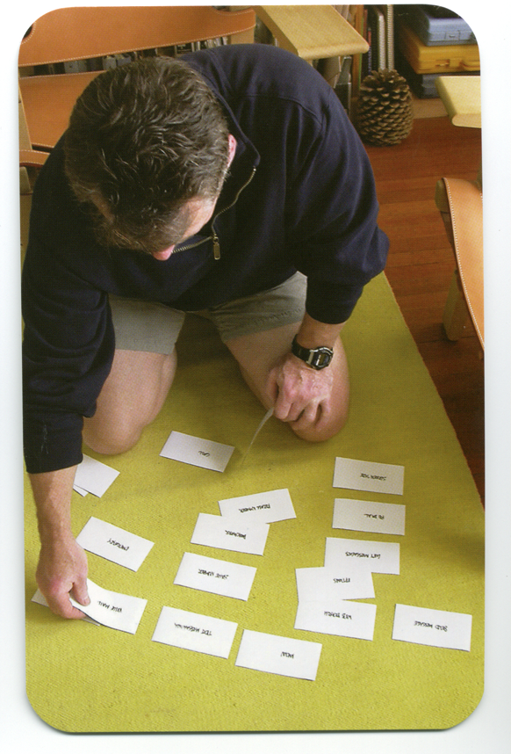
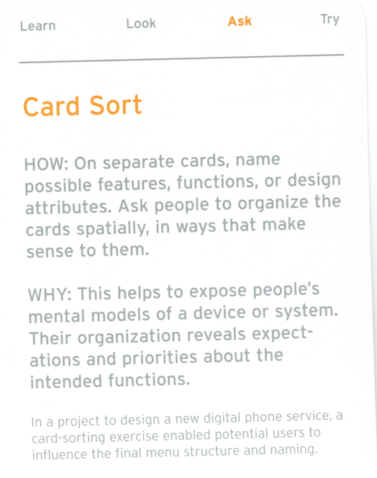

Slide 21
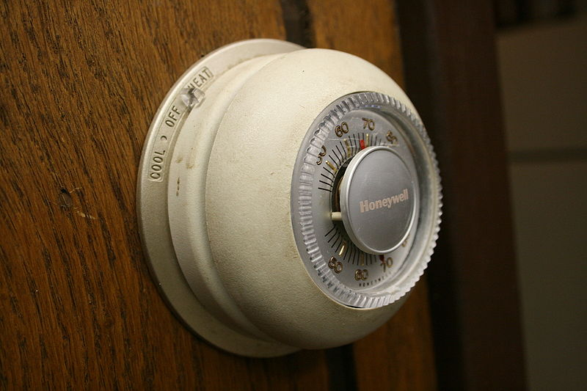
Some Concepts…
mental model
thought process or understanding of how something works

Slide 22
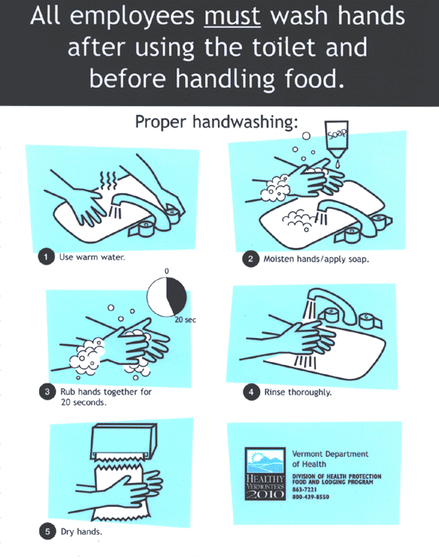
Some Concepts…
work processes
formal articulation of how to get something done
work practices
informal ways in which people get something done in the context

Slide 23
Contextual Inquiry
Combining “looking” and “asking” by immersing oneself into a particular context/culture: understand mental models and work practices
“The core premise of Contextual Inquiry is very simple: go where the customer works, observe the customer as he or she works, and talk to the customer about the work. Do that, and you can’t help but gain a better understanding of your customer.”

Slide 24
Contextual Inquiry: Principles
Context: in the setting of the participant
Relationship: you are the apprentice, participant is the expert
Interpretation: observed facts must be considered for design implications
Focus: lots of themes will emerge, but this helps to orient the team

Slide 25
Expert/Apprentice
You are the noob
What does this mean?
Be a keen observer
Ask questions
Be eager to learn
Admire the master
Aspire to see the world as the expert does

Slide 26
Interviewing
Summaries vs. ongoing experience
“I got to work, checked my email and had a cup of coffee” [abstract summary]
“I got to work, looked over my email, answered messages from my boss, decided to have some coffee, walked to the coffee machine, found there was no coffee, so I made coffee…” [concrete detail]

Slide 27
Summary
Broad assumption in user-centered design: as designers, we know very little
ASK methods complement LOOK methods to help us discover what is happening and why
Survey & questionnaire; interview; narration; camera journal; experience sampling; diary studies; collage; draw the experience; card sort
Concepts: mental model; work processes; work practices
Contextual Inquiry combines these ideas into one technique

