Slide 1
Questions about A0?

Slide 2
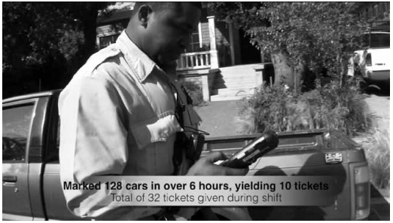
Rapid Ethnography: Parking Enforcement & Sensors
Notes:
http://www.izix.com/pubs/Isaacs-RapidEthnography-2013.pdf
Sensors actually hindered productivity because it means chasing these things down
You can “mark off” a car that is actually handicap, but the system resets itself, and so now it’ll trigger again, etc.

Slide 3
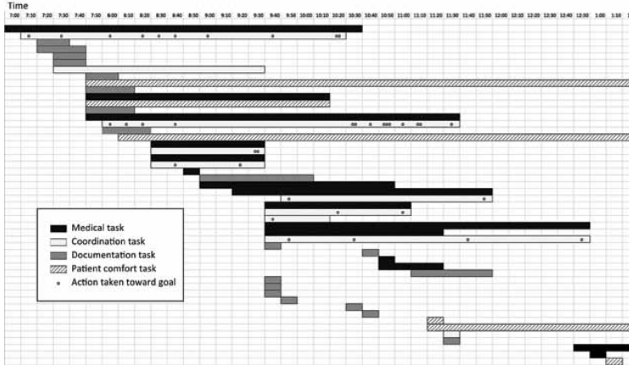
Rapid Ethnography: Nursing Efficiency
Notes:
Original goal: scheduling system
Tracking the progress of something: e.g. contact doctor, contact doctor, text doctor, text doctor, page doctor, find phone number, call doctor
Interruptions and coordination becomes a more central issue – remembering to do all these things each time

Slide 4
Lecture 6 – Design Methods: IDEO Ask

Slide 5
Questions
Why should we complement the LOOK techniques with ASK techniques?
When constructing a questionnaire, what is the distinction between open and closed questions?
What is the rationale for using camera journals/experience sampling techniques?
What is a mental model?
What is the difference between work practice and work process?

Slide 6
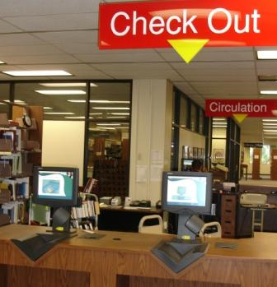
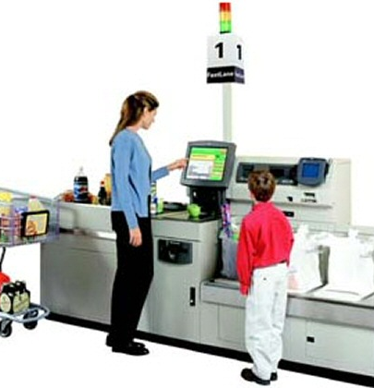
Why did they install these?
Notes:
Ostensibly, solving same problem
Actually, solving different ones
Library – frees librarian to do what they’ve been trained to do
Self-checkout at grocery store – cheaper than having an actual person;
I think self-checkout makes you feel like you’re going faster
→ Trick is that you’re not

Slide 7
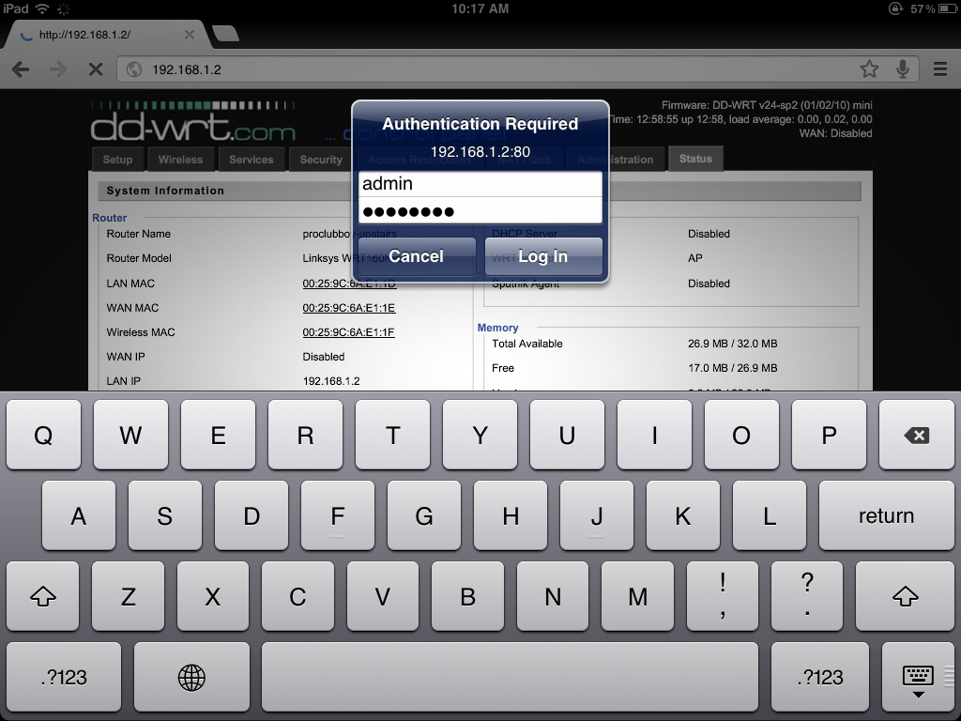
Notes:
I watched someone try to log into his router once from his ipad
He kept staring at this and said, “This is taking longer than usual”
Why?
Turns out that pressing “RETURN” just toggles between the two fields
Slip or mistake?
Whose fault?

Slide 8
Volunteer
Requirements
Basic computing skills
Internet skills

Slide 9
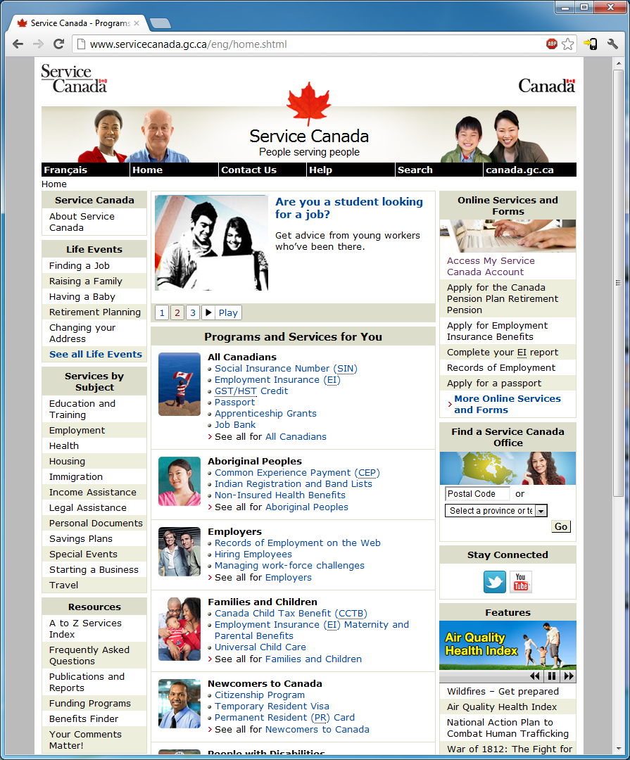
Notes:
http://www.servicecanada.gc.ca/eng/home.shtml
How do I demonstrate residency for the purpose of Old Age Security?
What percentage of my salary is covered by employment insurance when I go on maternity leave?
Old Age Security… what do you do here?
What are you looking for?
What words are you looking at?
“I want to do…”
“I’m looking at the UI, and I think it does…”
‘Hmm, that’s not what I expected; I thought it was going to…”
“That took longer than I expected.”
In this case, I’ve given you a specific thing someone is looking for. In real life, they’re often doing multi-step things, and what you want to do is understand what they think those intermediary steps are.

Slide 10
Expectations
Assignments
You may talk to other people, you may look stuff up on the web; however CITE (indicate) who you talked to, and where you found material on the web (or in a paper/book)
Projects
You are to work with your teammates, and you may look stuff up on the web; however CITE (indicate) who you talked to (outside of the group), and where you found the material on the web (or in a paper/book)
Forbidden
You are NOT allowed to copy and paste
If you use an idea that you found online, then you must cite it—that is, indicate that it is from an online source as a footnote, and include a link to it (still no copy and paste)

Slide 11
Career Fair
Solium – Nancy Lopez

Slide 12
Randy Pausch’s Tips for Working in a Group
Meet people properly.
Find things you have in common.
Make meeting conditions good.
Let everyone talk.
Check your egos at the door.
Praise each other.
Put it in writing. Remember that “politics is when you have more than 2 people” – with that in mind, always CC (carbon copy) any piece of email within the group, or to me, to all members of the group. This rule should never be violated; don’t try to guess what your group mates might or might not want to hear about.
Be open and honest.
Avoid conflict at all costs.
Phrase alternatives as questions.
http://www.cs.cmu.edu/~pausch/Randy/tipoForGroups.html
Notes:
It all starts with the introduction. Then, exchange contact information, and make sure you know how to pronounce everyone’s names. Exchange phone #s, and find out what hours are acceptable to call during.
You can almost always find something in common with another person, and starting from that baseline, it’s much easier to then address issues where you have differences. This is why cities like professional sports teams, which are socially galvanizing forces that cut across boundaries of race and wealth. If nothing else, you probably have in common things like the weather.
Have a large surface to write on, make sure the room is quiet and warm enough, and that there aren’t lots of distractions. Make sure no one is hungry, cold, or tired. Meet over a meal if you can; food softens a meeting. That’s why they “do lunch” in Hollywood.
Even if you think what they’re saying is stupid. Cutting someone off is rude, and not worth whatever small time gain you might make. Don’t finish someone’s sentences for him or her; they can do it for themselves. And remember: talking louder or faster doesn’t make your idea any better.
When you discuss ideas, immediately label them and write them down. The labels should be descriptive of the idea, not the originator: “the troll bridge story,” not “Jane’s story.”
Find something nice to say, even if it’s a stretch. Even the worst of ideas has a silver lining inside it, if you just look hard enough. Focus on the good, praise it, and then raise any objections or concerns you have about the rest of it.
Talk with your group members if there’s a problem, and talk with me if you think you need help. The whole point of this course is that it’s tough to work across cultures. If we all go into it knowing that’s an issue, we should be comfortable discussing problems when they arise -- after all, that’s what this course is really about. Be forgiving when people make mistakes, but don’t be afraid to raise the issues when they come up,
When stress occurs and tempers flare, take a short break. Clear your heads, apologize, and take another stab at it. Apologize for upsetting your peers, even if you think someone else was primarily at fault; the goal is to work together, not start a legal battle over whose transgressions were worse. It takes two to have an argument, so be the peacemaker.
Instead of “I think we should do A, not B,” try “What if we did A, instead of B?” That allows people to offer comments, rather than defend one choice.

