Slide 1
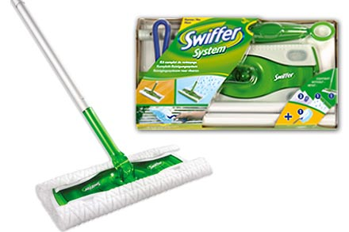
Notes:
http://letter-english.wikispaces.com/file/view/swiffer_system_bottom.jpg/33841133/swiffer_system_bottom.jpg
Story about Swiffer
What people say they want vs. what they actually do
P & G thought they needed to make a more powerful cleaner (that’s what people said they wanted)
They outsourced the design of this to a design firm
Design firm discovered
-- mops are a pain. People don’t like them
-- People cleaned up their houses before the interview team showed up
-- So they had to drop a coffee onto the ground to get them to clean
-- When people clean, they grab a paper towel and just mop up.
-- Inspired the design of the swiffer
Difference between what people say they want, and what they want
Difference between what people say and do

Slide 2
Design Methods: LOOK
CPSC 481: HCI I
Fall 2012
Anthony Tang, with acknowledgements to Julie Kientz, Saul Greenberg, Ehud Sharlin, Jake Wobbrock, Dave Hendry, Andy Ko, Jennifer Turns, & Mark Zachry

Slide 3
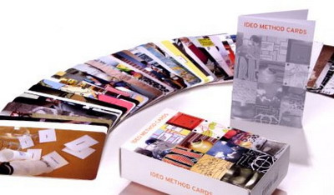
IDEO Method Cards: Course Site > Readings
Available from William Stout publishers ($49)

Slide 4
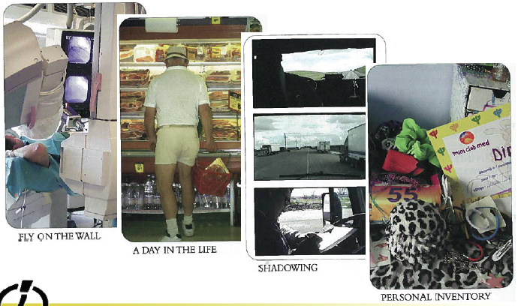
LOOK at what people really do

Slide 5
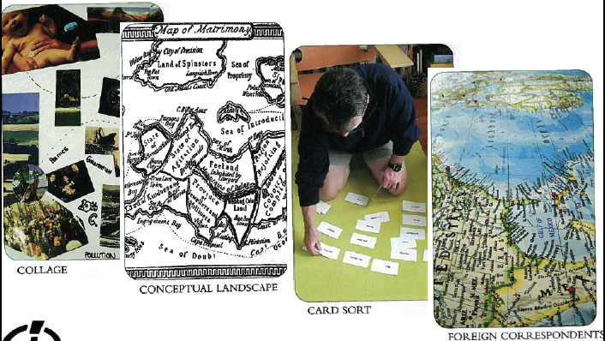
ASK users for help

Slide 6
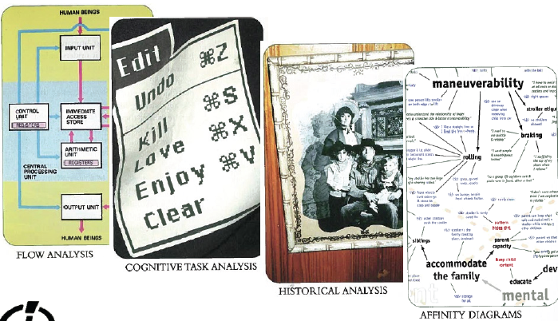
LEARN from the facts you gather

Slide 7
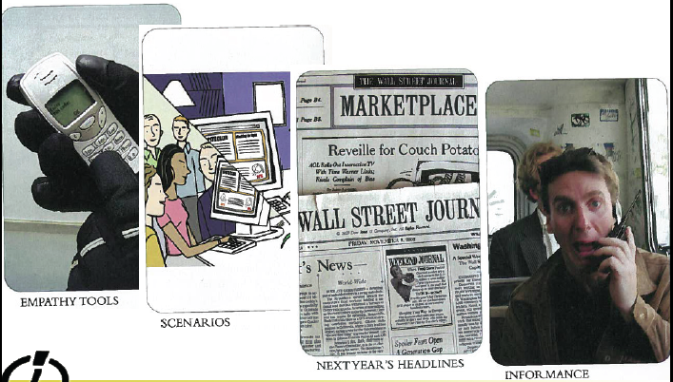
TRY it yourself

Slide 8
LOOK at what people really do

Slide 9
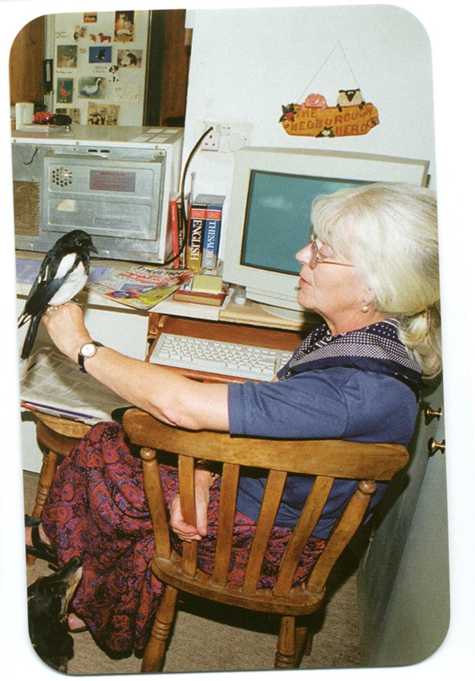
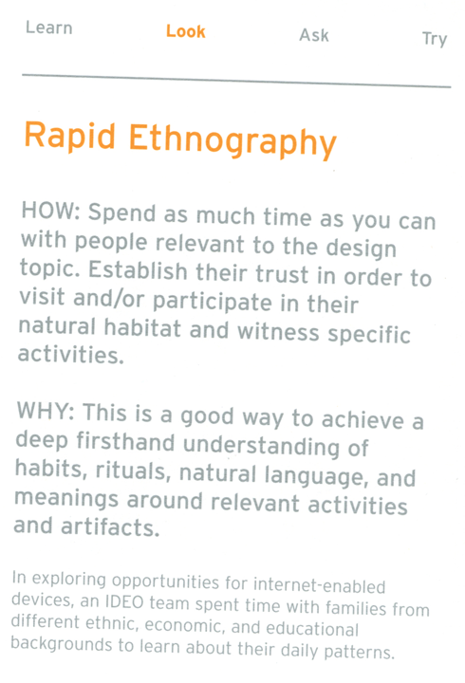

Slide 10
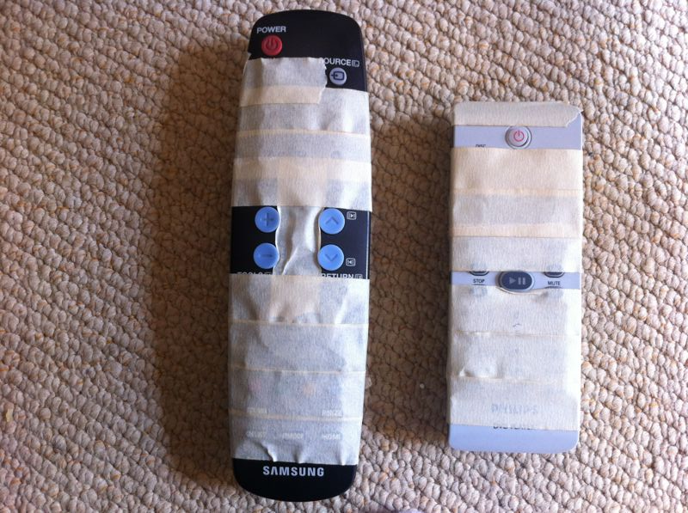
Notes:
Reddit.com
Found this on Reddit. The poster had done this for his/her grandma.
What makes this design good? What makes this design effective? What makes it ineffective?
What were the values of grandma? What were values of kid solving the problem?

Slide 11
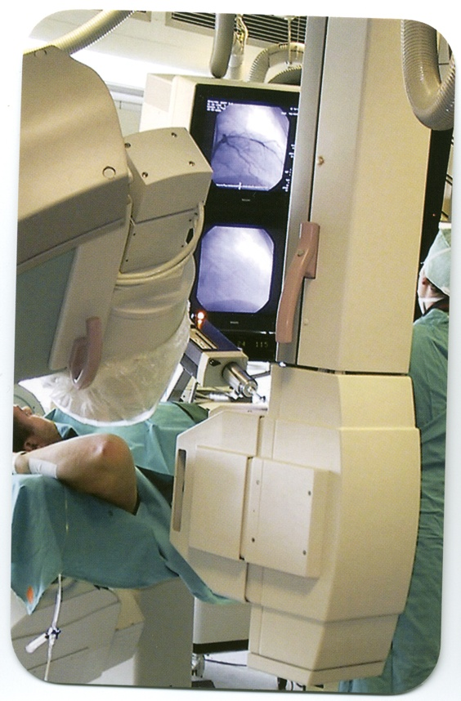
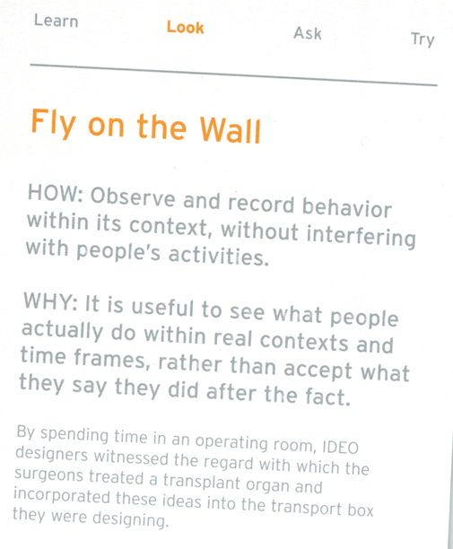
Notes:
So, let’s think about building a good coffee house. What is important about a coffee house?

Slide 12
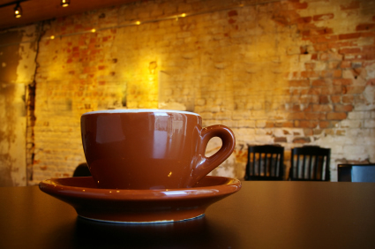
Notes:
http://www.ifood.tv/blog/the-evolution-of-the-coffee-house
Think about building a coffee house, and trying to build a good coffee house experience. What would you do? What would you be looking for?
What makes a good coffee house experience?
How would this differ in a different part of town?
In a different country?

Slide 13

Notes:
http://jeffreyorloff.com/wp-content/uploads/2011/07/friends_having_coffee.s600x600.jpg

Slide 14
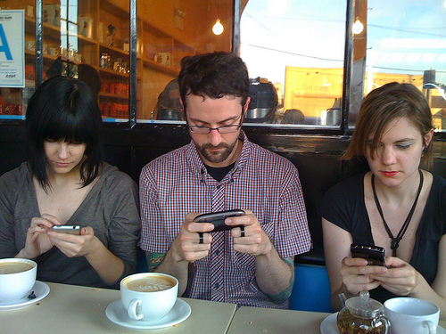
Notes:
http://www.advancingthestory.com/2010/12/14/new-mobile-news-consumption-research/

Slide 15
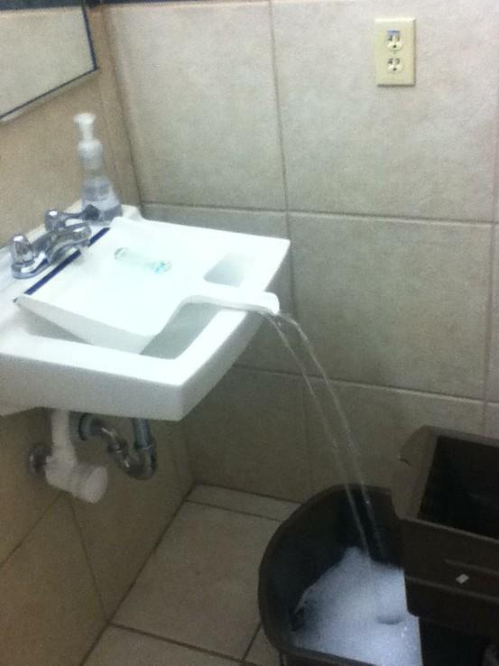
Designing a mop/dustpan
It’s important to know what people do so that you don’t inadvertently bust something/take something away that they expected to do.
Notes:
http://lifehacker.com/5876167/use-a-dustpan-to-fill-containers-that-dont-fit-in-your-sink

Slide 16
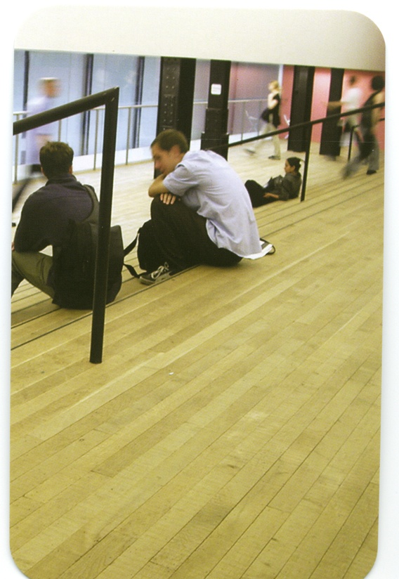
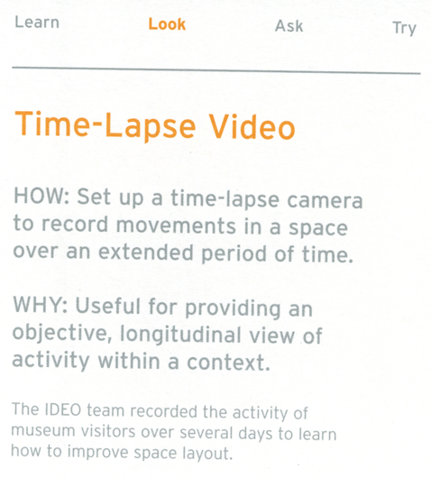

Slide 17
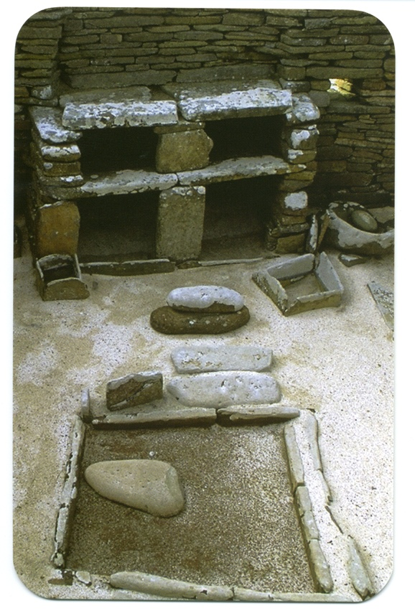
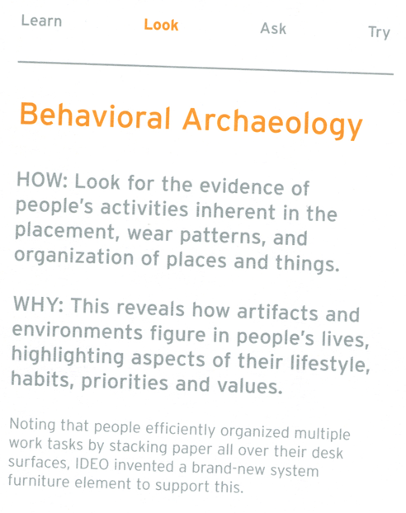

Slide 18
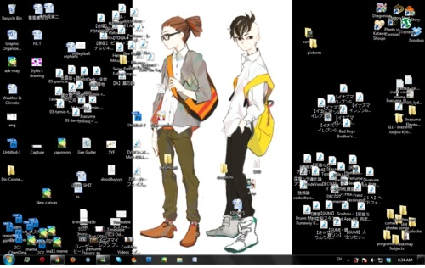
Notes:
http://ask-may.tumblr.com/

Slide 19
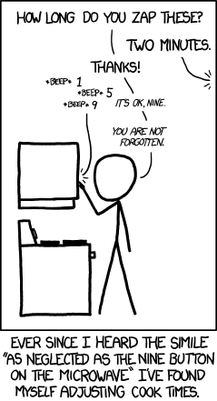
Microwave
“As neglected as the 9 button on a microwave”
XKCD Comic: http://xkcd.com/1103/

Slide 20
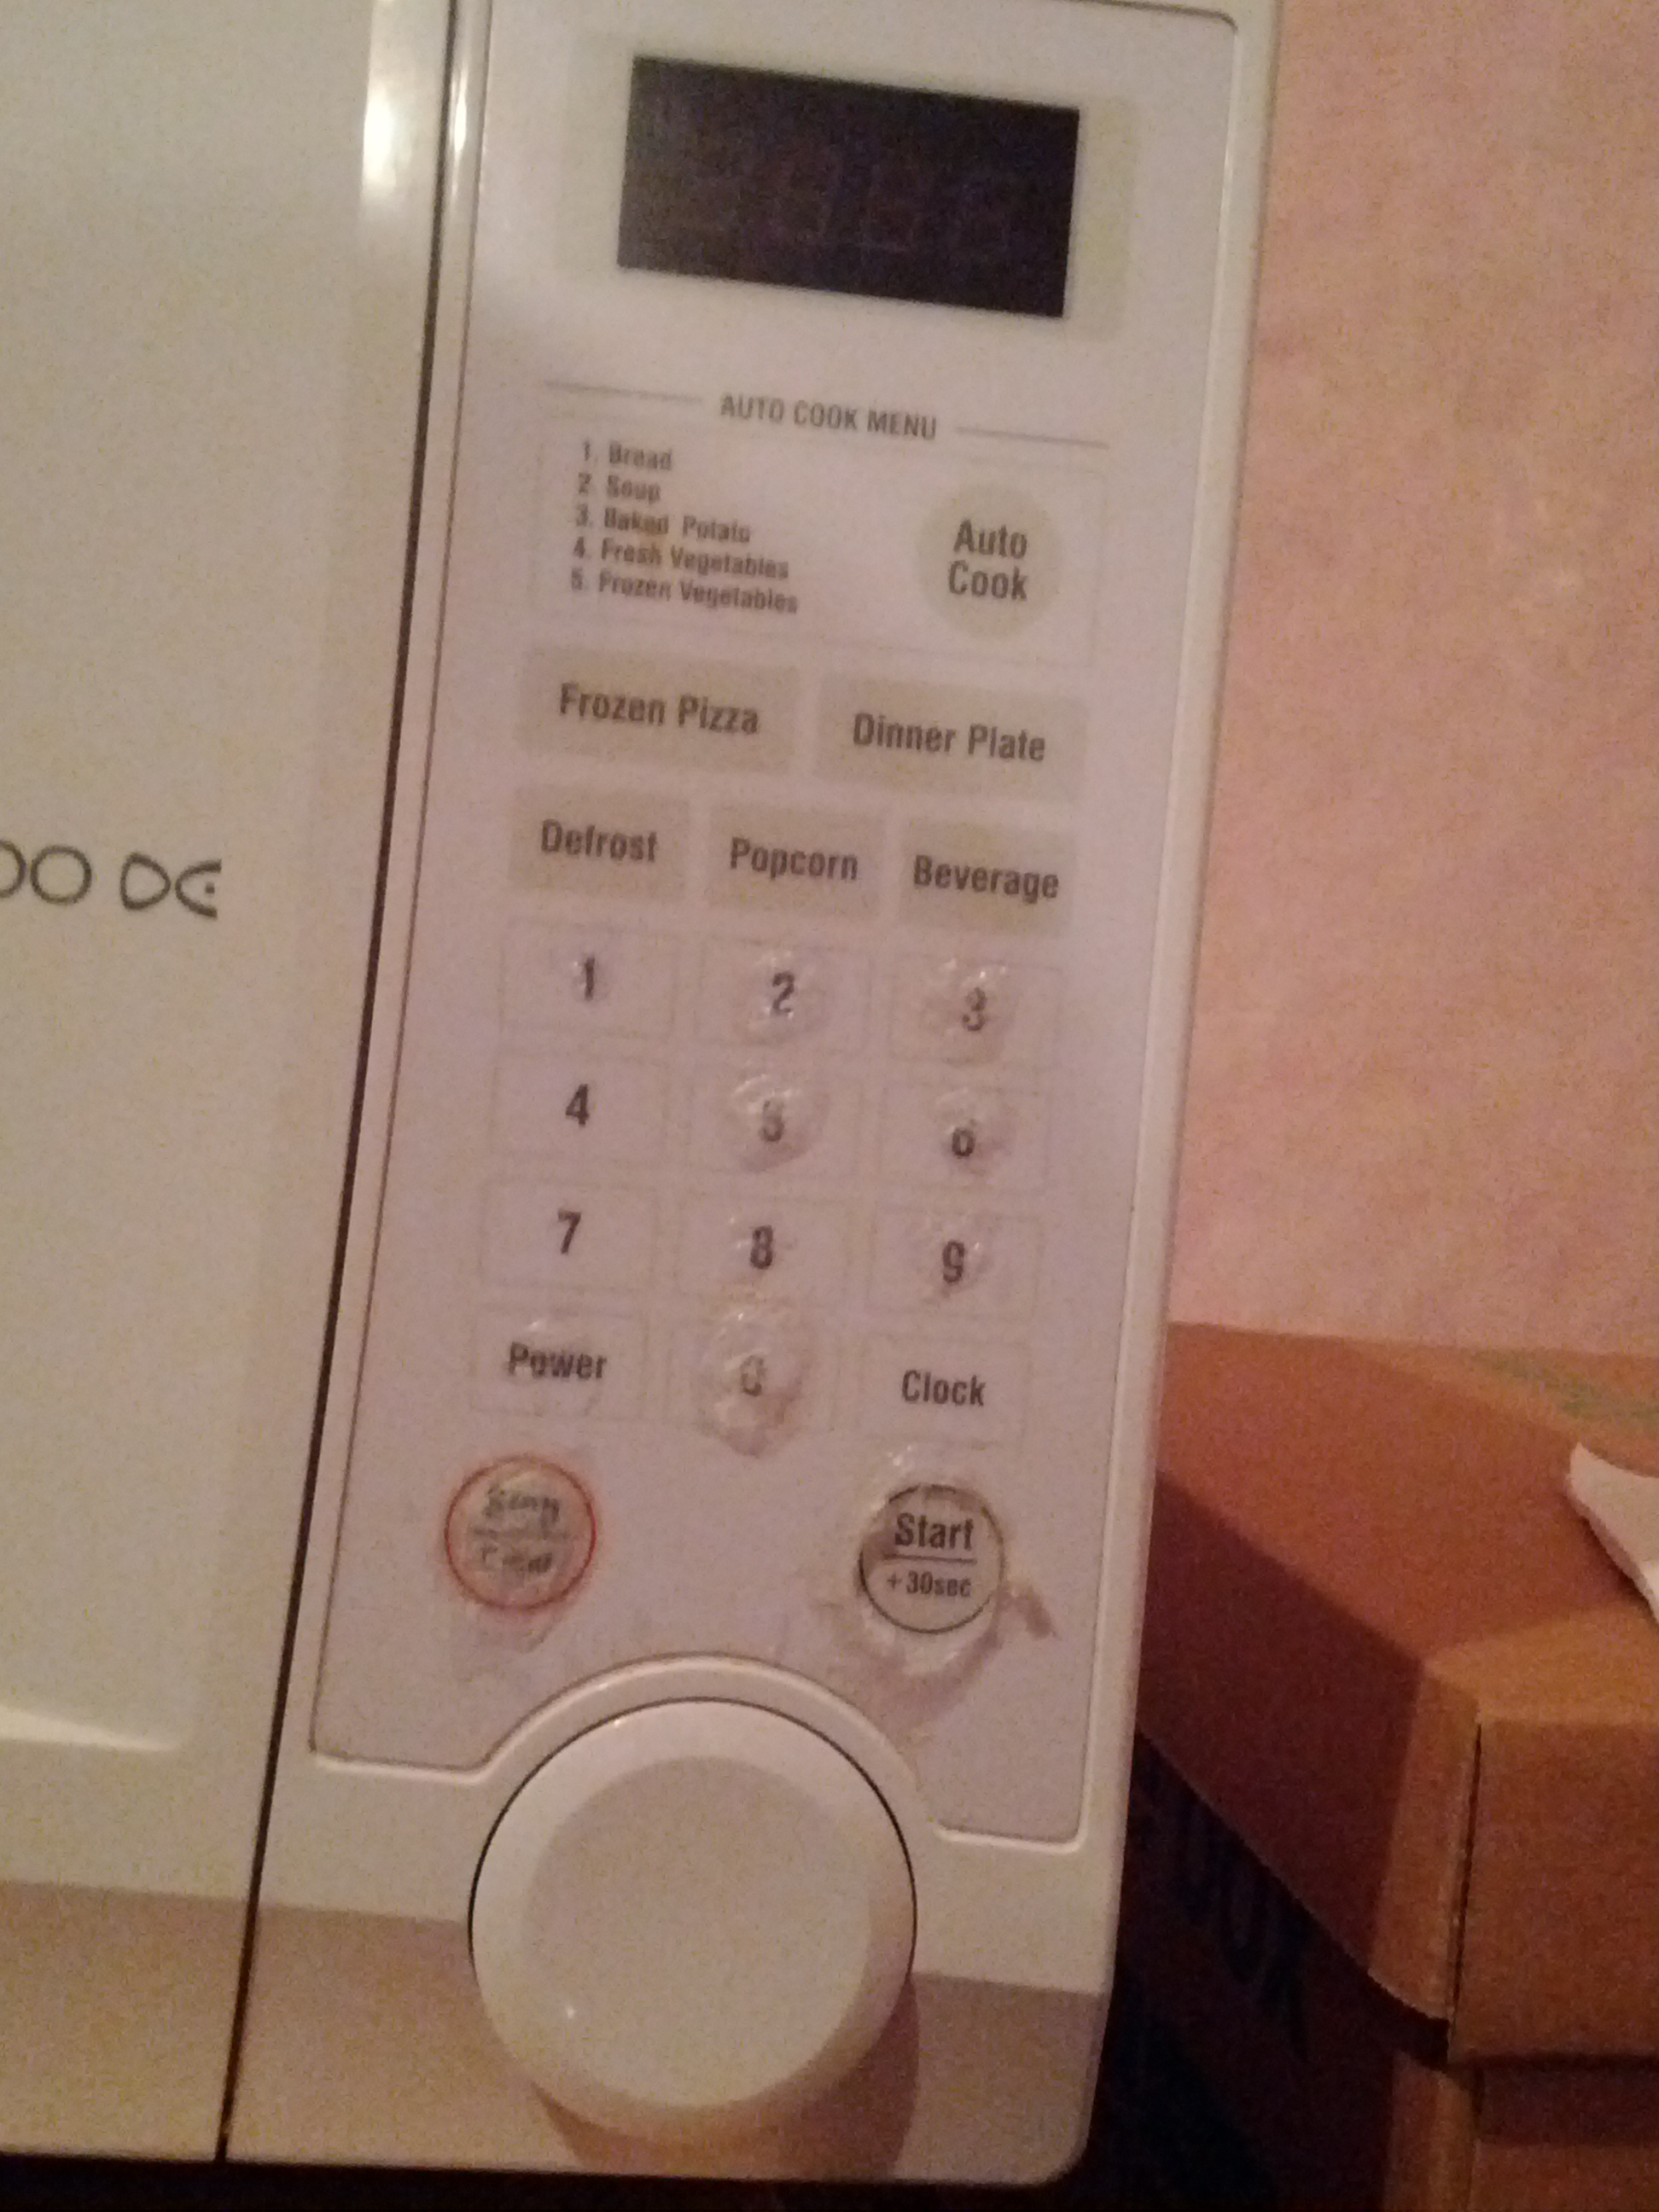
Which buttons are used most?
I mostly pressed the +30s button once I discovered it (before that, :30, 1:00, 1:30, 2:00, 2:30, 5:00 were common for me)
Wife presses the 9 button to get “99 seconds”, which is optimal in some way—fast, and a reasonable cook time, I guess.

Slide 21
What to pay attention to
Key features
  Space
  Actors
  Activities
  Objects
  Workarounds
  Acts
  Events / triggers
  Time
  Goals
  Feelings
Questions
  How is the physical space adapted to the task?
  What are the key constraints on the task?
  Where are decisions made?

Slide 22
Assume you are wrong.
Go and figure out in what ways, and how much you’re wrong.

