Slide 2
In your home…
What is something weird you’ve discovered about your roommates?
Do you and your roommates do the same things?
What would you expect to see at their childhood homes?
What are some of your routines?
Are there “rituals” that you do at home?
What is your pattern of movement through your home?

Slide 3
Notes:
How do we design a remote control for an entertainment system?
What should we do?
What should we look for?

Slide 4
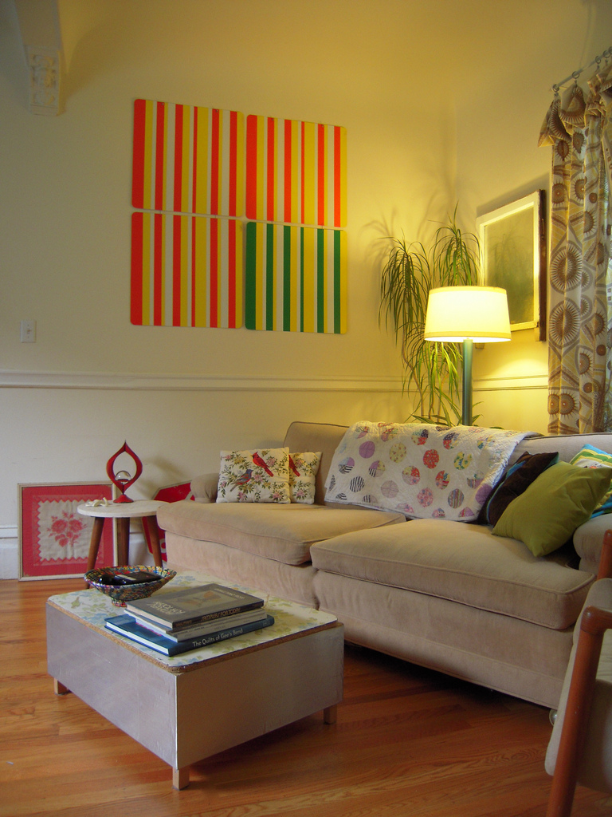
Notes:
http://www.flickr.com/photos/brianinsanfran/4834666901/sizes/l/in/photostream/
What does this tell us?
What does this tell us about the people that live here?
About their values?
About their aesthetics?
How is the space designed?
How many people’s homes look like this?
How many people’s homes ACTUALLY look like this?

Slide 5
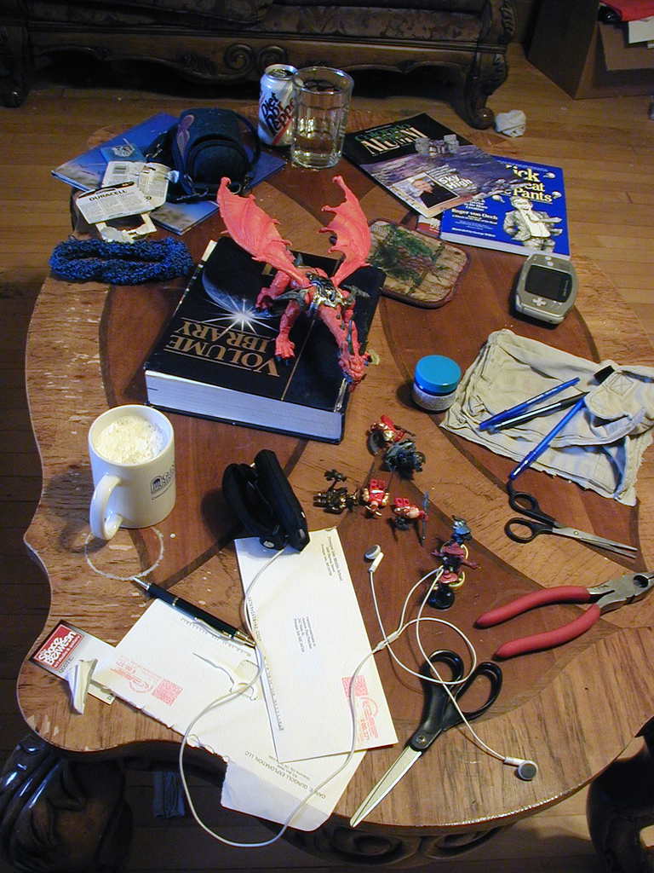
Notes:
http://www.flickr.com/photos/zabethanne/53765085/sizes/l/in/photostream/
This is more like it
And this is what you get when you drop by a friend’s house uninvited… they haven’t had time to clean up and show you what’s going on in their house
What do you see here that tells you about who these people are?
What about their routines?
Doing this in their environment tells you more than what you’d get from observing them outside

Slide 6
Notes:
http://www.useit.com/alertbox/20040607.html
What are the kinds of things our remote control needs to do?
What does it need to control?
How much “control” should it have?
What are some problems with these?
What do the values of our family tell us about them?
What would THEY want to have?
What would be important to them?

Slide 7
So consider…
You’re trying to improve the library.
What does this mean?
What would you LOOK for?

Slide 8
Casual Interaction in a hallway
http://grouplab.cpsc.ucalgary.ca/Publications/1990-Hallways.VideoReport
Notes:
What is interestinga bout what’s going on here?

Slide 9
Assignment 1 due Wednesday
Remember: due right at the beginning of class in the correct tutorial section folder. You have a 10 minute window, and then it’s over. OVER.
Questions?

Slide 10
Tutorials
Participation (aka attendance) is worth 5% of your grade
Project work happening inside tutorials
Get in touch with your deep dive teammates, and get together with them outside of class
Project components are already up. You can get a head start if you like. As you’ve heard in the past, the project is a bear, so get on it.

Slide 11
Randy Pausch’s Tips for Working in a Group
Meet people properly.
Find things you have in common.
Make meeting conditions good.
Let everyone talk.
Check your egos at the door.
Praise each other.
Put it in writing. Remember that “politics is when you have more than 2 people” – with that in mind, always CC (carbon copy) any piece of email within the group, or to me, to all members of the group. This rule should never be violated; don’t try to guess what your group mates might or might not want to hear about.
Be open and honest.
Avoid conflict at all costs.
Phrase alternatives as questions.
http://www.cs.cmu.edu/~pausch/Randy/tipoForGroups.html
Notes:
It all starts with the introduction. Then, exchange contact information, and make sure you know how to pronounce everyone’s names. Exchange phone #s, and find out what hours are acceptable to call during.
You can almost always find something in common with another person, and starting from that baseline, it’s much easier to then address issues where you have differences. This is why cities like professional sports teams, which are socially galvanizing forces that cut across boundaries of race and wealth. If nothing else, you probably have in common things like the weather.
Have a large surface to write on, make sure the room is quiet and warm enough, and that there aren’t lots of distractions. Make sure no one is hungry, cold, or tired. Meet over a meal if you can; food softens a meeting. That’s why they “do lunch” in Hollywood.
Even if you think what they’re saying is stupid. Cutting someone off is rude, and not worth whatever small time gain you might make. Don’t finish someone’s sentences for him or her; they can do it for themselves. And remember: talking louder or faster doesn’t make your idea any better.
When you discuss ideas, immediately label them and write them down. The labels should be descriptive of the idea, not the originator: “the troll bridge story,” not “Jane’s story.”
Find something nice to say, even if it’s a stretch. Even the worst of ideas has a silver lining inside it, if you just look hard enough. Focus on the good, praise it, and then raise any objections or concerns you have about the rest of it.
Talk with your group members if there’s a problem, and talk with me if you think you need help. The whole point of this course is that it’s tough to work across cultures. If we all go into it knowing that’s an issue, we should be comfortable discussing problems when they arise -- after all, that’s what this course is really about. Be forgiving when people make mistakes, but don’t be afraid to raise the issues when they come up,
When stress occurs and tempers flare, take a short break. Clear your heads, apologize, and take another stab at it. Apologize for upsetting your peers, even if you think someone else was primarily at fault; the goal is to work together, not start a legal battle over whose transgressions were worse. It takes two to have an argument, so be the peacemaker.
Instead of “I think we should do A, not B,” try “What if we did A, instead of B?” That allows people to offer comments, rather than defend one choice.

