Slide 1
Investigation…
CPSC 481: HCI I

Slide 2
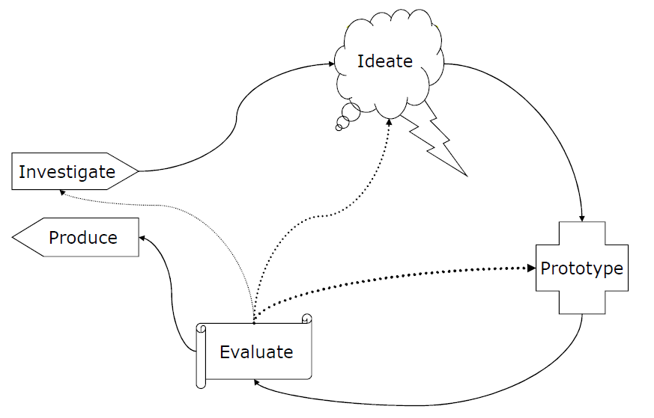
Notes:
Next few lectures, focus on the “investigate” thing

Slide 3
Investigate Phase Goals
Understand the state of the world, the state of our users, and what the problem is.
How can we go about doing this?

Slide 4
What people say…
Can we rely on what people say about what they want in a new design?
  Only kind of: people are really only good at framing their needs within the language of their current designs
  Henry Ford: “If I had asked my customers what they wanted, they would have said a faster horse.”
Often, people can’t see past their immediate problems to the possibilities

Slide 5
What people say…
How many hours did you sleep last night?
How many hours did you sleep last Monday night?
People have a bad memory

Slide 6
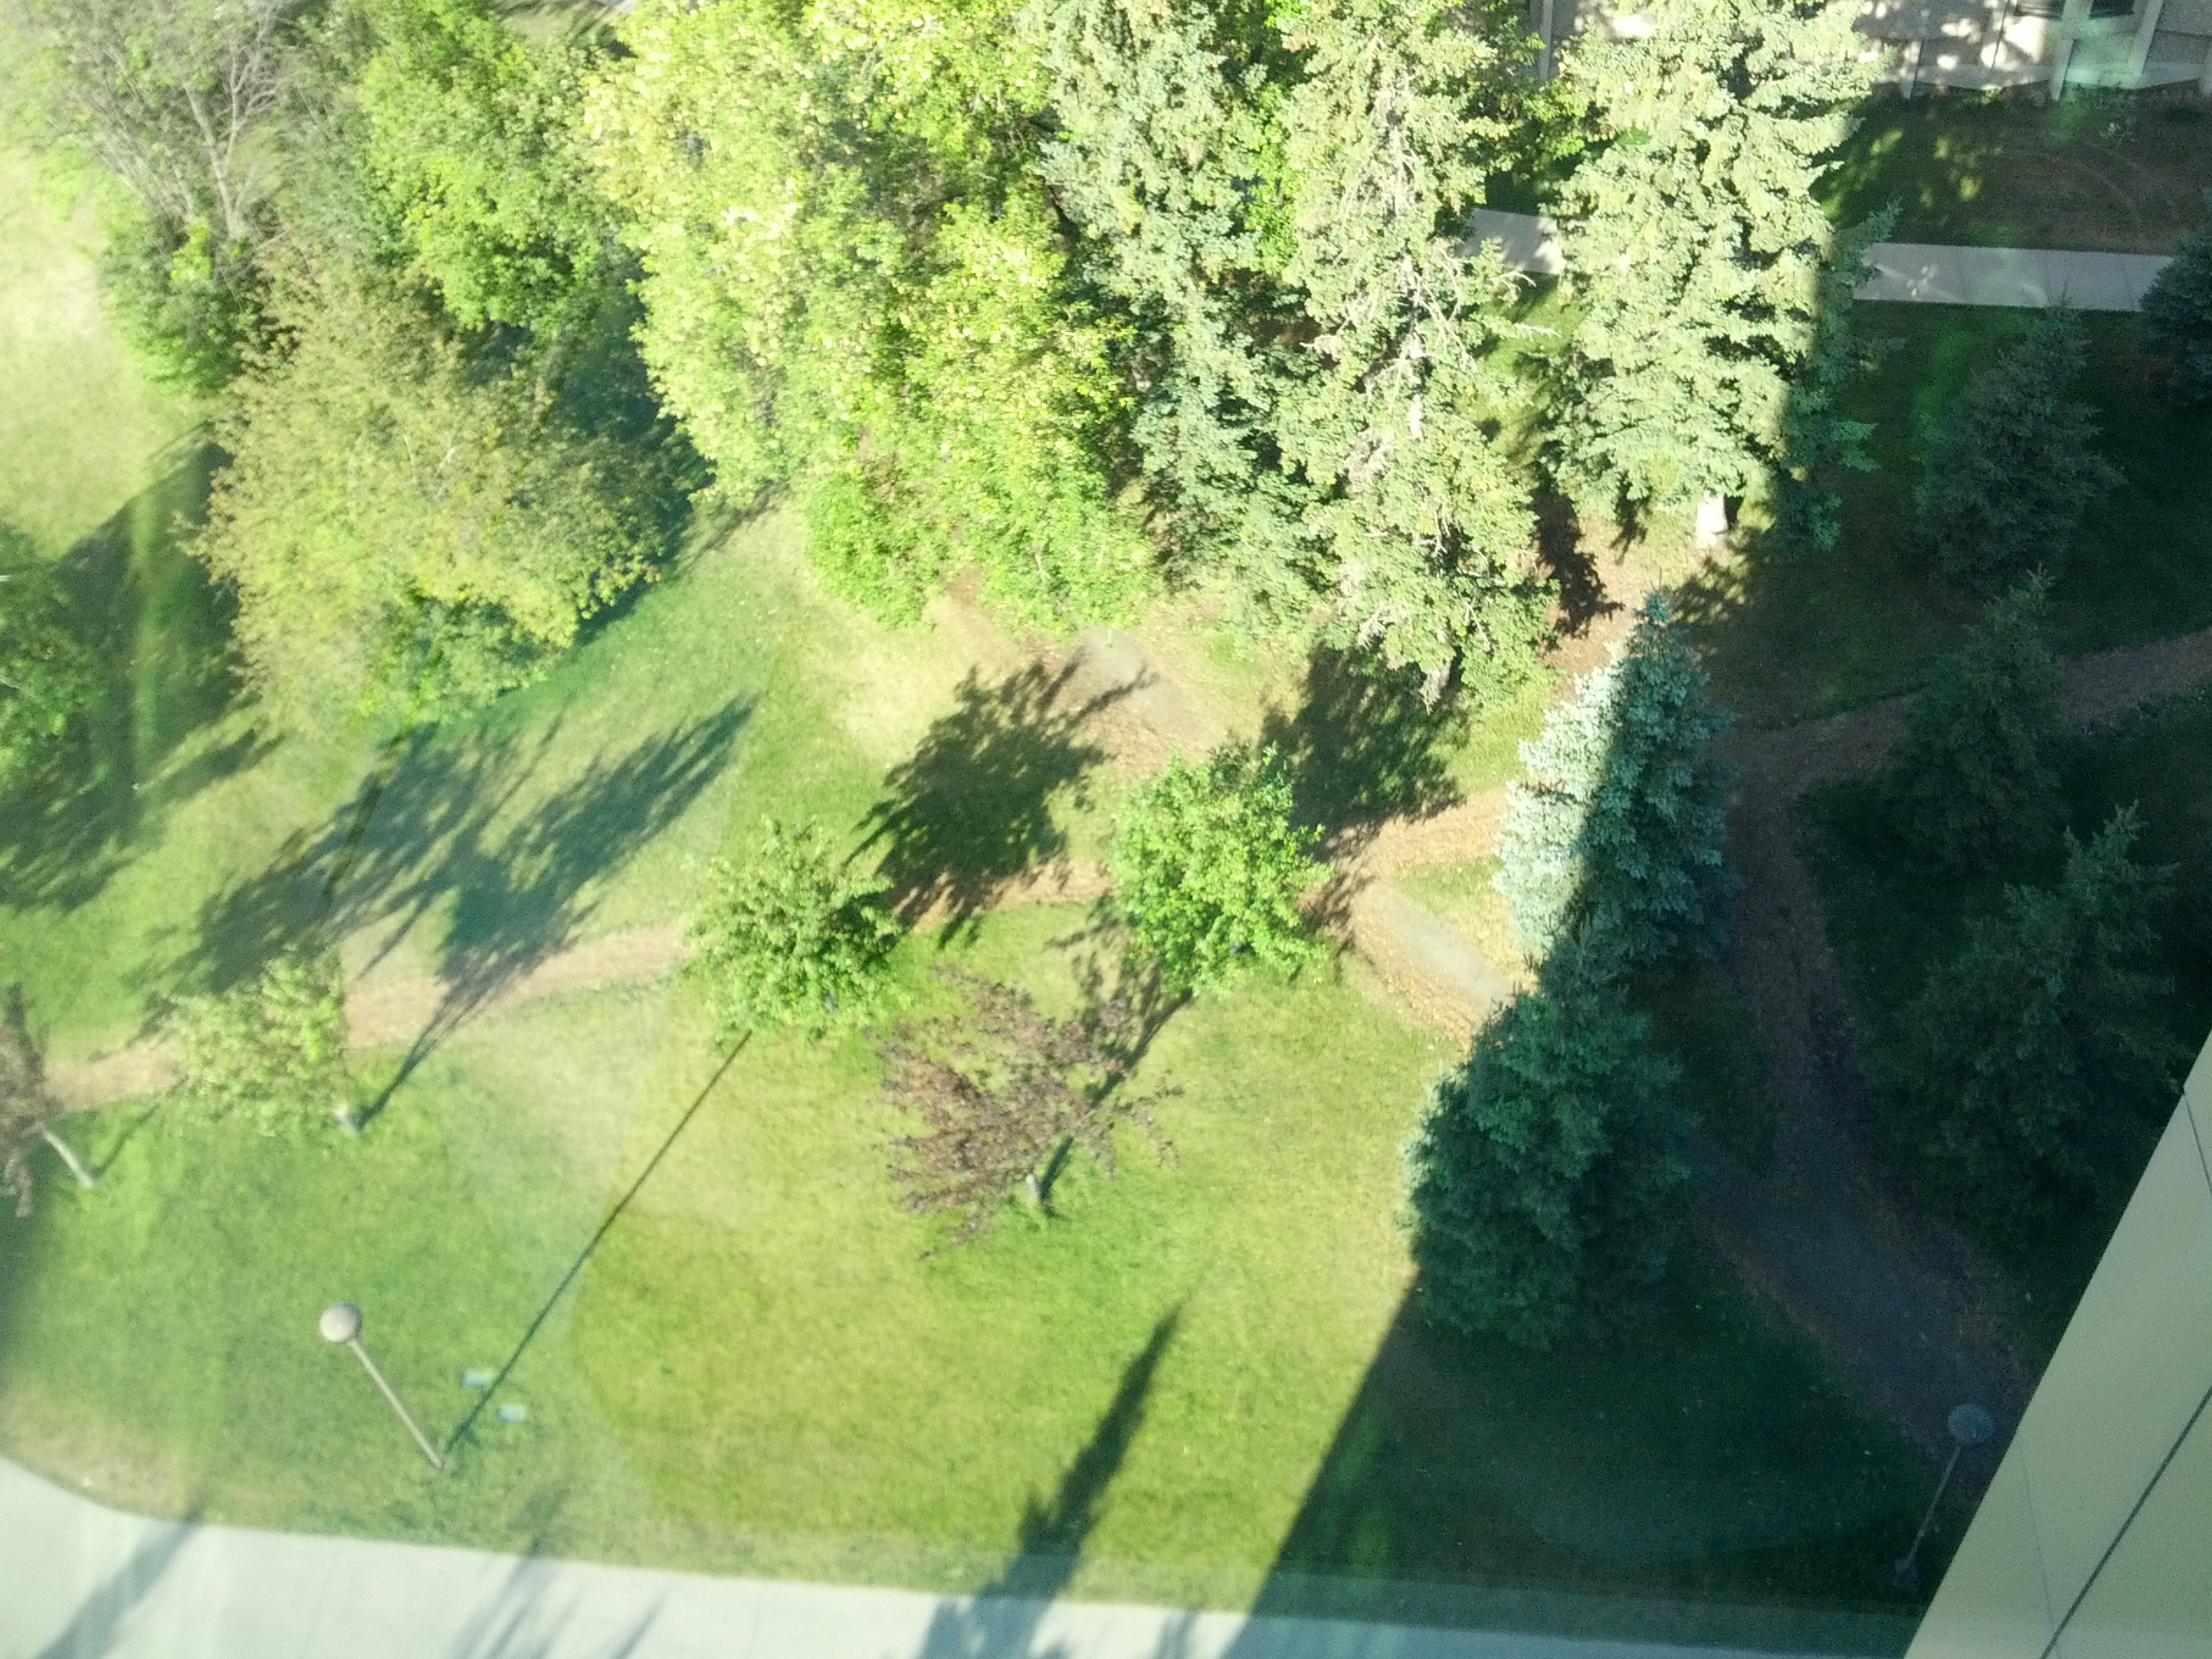
What people say…
Where do people need to walk around campus?

Slide 7
What people say…
7
Sometimes, people forget workarounds that they have already established to solve problems

Slide 8
What people say…
Where should we put the hand sanitizer?
On the way out the door, after we turn off the computer, after we turn off the printer, turn off the lights, etc., etc.

Slide 9
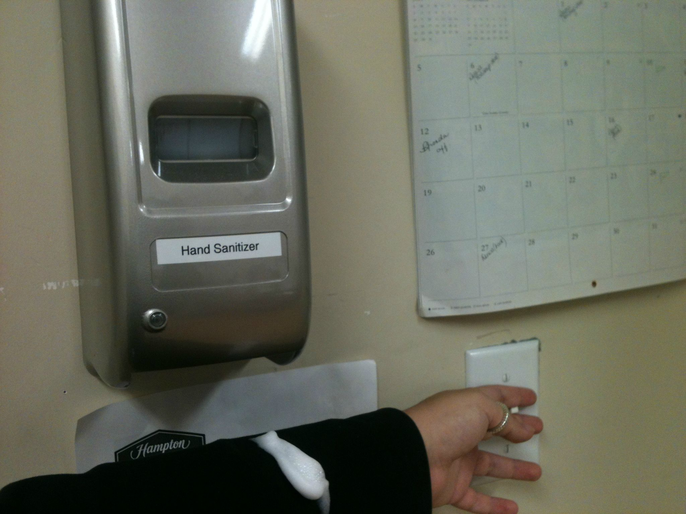
What people say…
People can be bad at predicting what they’d prefer if it is only hypothetical.

Slide 10

What people say…
Mismatches between what they say and do = GOLD
Notes:
Story about bloomingdales research
Trying to up the sales of bed sheets
Brought in focus groups, lined up a bunch of bed sheets: pick which ones you like the best
Only sold those for a while, but sales didn’t pick up
Brought them back in, and asked the same thing. At the end, they said to people, “So, we don’t need these any more, feel free to take one home with you.” They picked a different one.
Why?
Task asked: which do you like; task didn’t ask, “which would you use at home.”

Slide 11
Wait, are people completely useless?
People are really good at telling us a few things:
  What they are doing right now.
  How they are feeling right now.
  What their goal is right now.

Slide 12
Combine Interview with Observation
Watch people in their own environment
Watch people do everyday tasks
Opportunities for new designs arise from:
  Workarounds
  Breakdowns
  Unexpected uses of existing tools

Slide 13
Two Messages
Using a combination of what they are good at telling us, and observing them can tell us a lot → mismatches between what they say and what they do often lead keys to new designs
Your assumptions are likely to be wrong. To discover more, assume that your assumptions are always wrong.

Slide 14
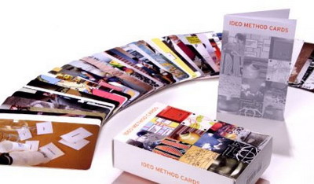
IDEO Method Cards: Course Site > Readings
Available from William Stout publishers ($49)

Slide 15
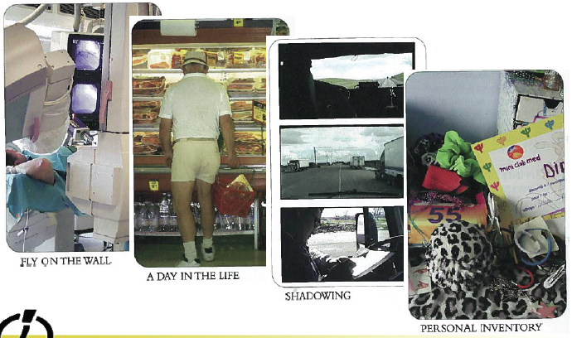
LOOK at what people really do

Slide 16
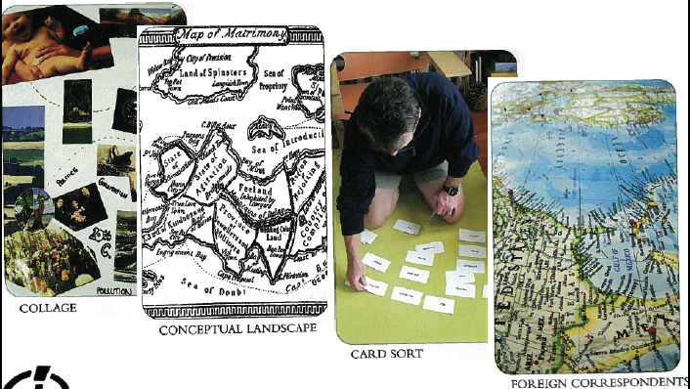
ASK users for help

Slide 17
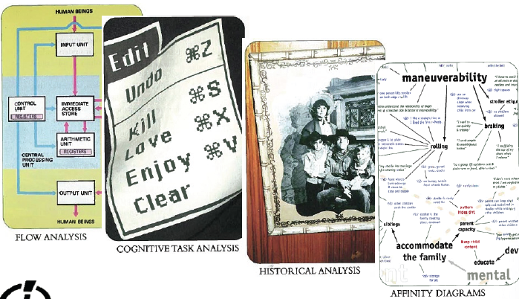
LEARN from the facts you gather

Slide 18
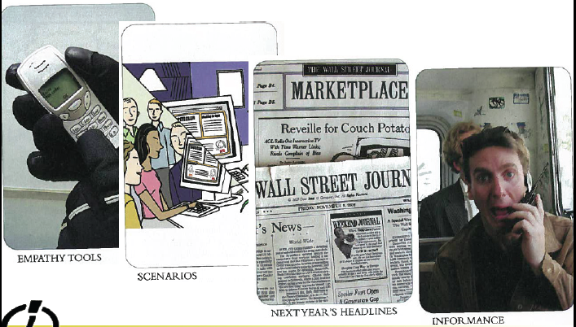
TRY it yourself

Slide 19
Assume you are wrong.

