Slide 1
Lecture 4: Investigation

Slide 2
Questions
What is the goal of the investigate phase?
What are some reasons we should be cautious of simply asking people questions?
What are some things that people are really good at telling us about?
Give me an example of a breakdown. Give me an example of a workaround.
Notes:
Understand state of the world
Mismatches between what is said & done; people are bad at predicting; people have a bad memory; people can’t see pass their immediate problems;
What they are doing; what they are feeling; what their goal is

Slide 3
Iphone 5

Slide 4
Imagine…
You are trying to design a tool that helps people to repair a flat car tire.
What do we need to find out?
How are we going to do that?
Notes:
How do people use mops?
What do they use them to clean up?
What is the purpose of mops?
When do they decide not to use them?
How big does the mess have to be before they use it?
What else do they use it with?
How often do they use them?
How do they use them?

Slide 5
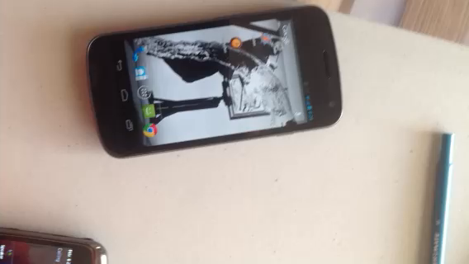

Slide 6
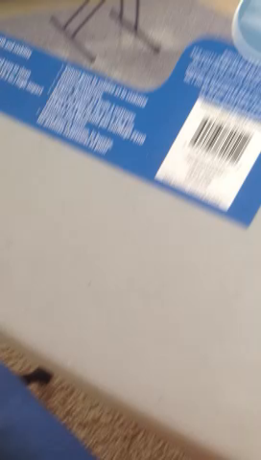

Slide 7
Thumb-meat example on phone
Main message: you don’t know who your users are, and often, you need to test your interface in the field to see if it’s going to work

Slide 8
Think about my “thumb-meat” example…
What does it tell you?
  Breakdowns
  Opportunities for a new design
  Workarounds
  Mismatches between what users say and do
This is what observing people can help you discover

Slide 9
Imagine…
You are trying to design a better mop.
What do we need to find out?
How are we going to do that?
Notes:
How do people use mops?
What do they use them to clean up?
What is the purpose of mops?
When do they decide not to use them?
How big does the mess have to be before they use it?
What else do they use it with?
How often do they use them?
How do they use them?

Slide 10
P0 Draft: Due Friday
Team contract project component: one per team
Due at the beginning of class (10 min grace period)
I’ll provide you with feedback for Monday
Notes:
Rules your team will live by

Slide 11
A1: Due on Monday
Individual assignment that asks you to be critical and think about design.
Three pieces:
  Examples of interactions that are good and bad (e.g. environment, tools, computer things) [pictures help to tell the story]
  Come up with 5 design principles that you think good experiences and bad experiences come from. For each of these, relate them to your examples from the previous step.
  Artefact: tell me about something you absolutely love or hate to interact with. Relate these again to the design principles.

Slide 12
Projects- decide on this by Monday next week
Kid-friendly Web Browser: design a web browser for young children.
Cooking Instructor: design a system that can be used to prepare and cook a recipe.
Bus ticking kiosk: design a system for travellers in the terminal building.
Course registration system: redesign PeopleSoft!
Or, something else you decide…
Notes:
Feedback is being provided by TAs on Piazza
Re: scope, difficulty level, etc.

