Slide 1
Final Exam
Friday, Dec 12
8:00am – 10:00am
ST 145
Beyond rote memorization, concepts!
  » understand the terms
  » compare and contrast
  » apply
Emphasis on latter half of course (post-midterm)
  » only one or two questions on pre-midterm stuff
Anything I asked you to write down in class! Fair game! (hint hint)
Revise your lecture notes
Revise your tutorial notes
Highlight and summarize important terms and concepts

Slide 2
Questions about final?

Slide 3
Last Lecture & NUIs
CPSC 481: HCI I
Fall 2014
Anthony Tang

Slide 4
Outline
NUIs & Reality-based interfaces
Future of User Interfaces
My thoughts and goals
Research in HCI

Slide 5
Natural User Interfaces
NUI = f(input / output capabilities, human capabilities)
NUI = feelings of efficacy

Slide 6
Scything
Notes:
http://www.youtube.com/watch?v=49NqwfaiMt8
http://www.youtube.com/watch?v=ns2Hbbw3RQE
Taking advantage of physical capabilities, naïve physics, understanding of the world
Allows

Slide 7
Reality-Based Interfaces
One way of thinking about “Natural User Interfaces” -> ‘Reality-based interfaces’
  » Robert Jacob et al., 2008
In spite of the name, they are not advocating necessarily re-creating reality; instead, advocating leveraging our understanding of “reality” for design
Notes:
http://www.cs.tufts.edu/~jacob/papers/chi08.pdf

Slide 8
Reality-Based Interfaces - Themes
We are good at the following things already, so design/build interfaces that leverage these skills!!
Naïve physics
Body awareness & skills
Environment awareness & skills
Social awareness & skills
Notes:
http://www.cs.tufts.edu/~jacob/papers/chi08.pdf

Slide 9
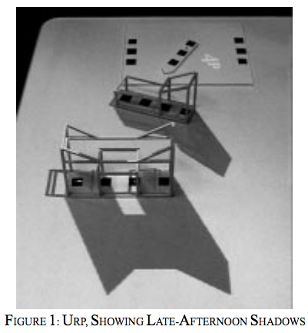
Urban Resource Planner
Makes use of naïve physics, and knowledge/understanding of environment and physical space
Moves body to change viewpoints
No need to share “a screen”, it is a physical workspace
Notes:
Trade-offs
Building material is manipualted with a wand – reality & expressive power trade off
Easy to change position, but difficult to change the shape of buildings (reality/practicality; reality/expressive power)
http://tangible.media.mit.edu/project/io-bulb-and-luminous-room/

Slide 10
Tradeoffs
Expressive Power: people can perform a variety of tasks in the application domain
Efficiency: users can perform a task quickly
Versatility: users can perform many tasks from different application domains

Slide 11
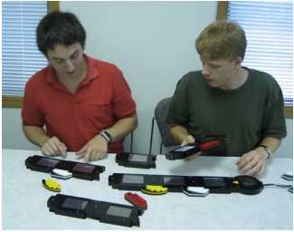
Tangible Video Editor
Each block represents a video clip
Videos can be edited by physically moving blocks around
Notes:
http://www.cs.tufts.edu/~jacob/papers/tei07.zigelbaum.pdf

Slide 12
Trade-offs
URP
Versatility: With URP, users cannot perform many tasks from different application domains – they are limited to the one domain that URP supports.
Tangible Video Editor
Expressive Power: people are limited to very simple types of video editing operations
Efficiency: while perhaps useful for a novice, this would slow down an expert
Versatility: only good for video editing! :-\

Slide 13
Questions about final?

Slide 14
Future of User Interfaces
Which of the interfaces in these video are probable to be used in five years? In ten years?
Which of the interfaces looks most useful? Least useful?
What does this make you think of?

Slide 15
Microsoft Productivity Future Vision (2011)
Notes:
http://www.youtube.com/watch?v=t5X2PxtvMsU
https://www.youtube.com/watch?v=a6cNdhOKwi0

Slide 16
i/o Brush
Notes:
http://web.media.mit.edu/~kimiko/iobrush/

Slide 17
Questions about final?

Slide 18
My Thoughts
Sensitivity
Spaces for possible designs
Motivating good design practices
Notes:
Sensitivity to good/bad design → things you “know”, but it wasn’t pointed out
Showing you that even with simple projects, there are a wide space of possible designs
--working in teams
--across teams, same project
--communication to users, but also about and of ourselves
When asked, there are no “right” answers. There are definite “wrong” answers. Goal: teach you to identify the tradeoffs in different possible designs
Motivating good design practices
-- helping you to identify these tradeoffs

Slide 19
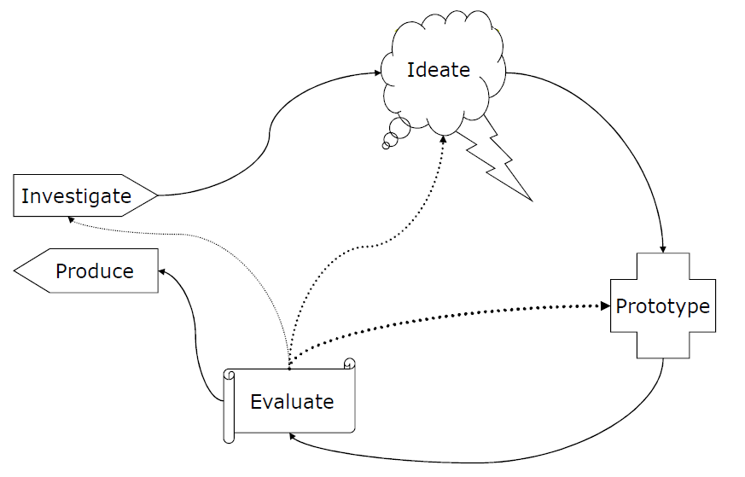
More Thoughts
Humbling you and your intuitions
Teaching a certain “logic” to design
Notes:
Showing that even your best efforts are sometimes not good enough
--Showing your interface to real users: what do they think?
Backing up the logic with foundation knowledge

Slide 20
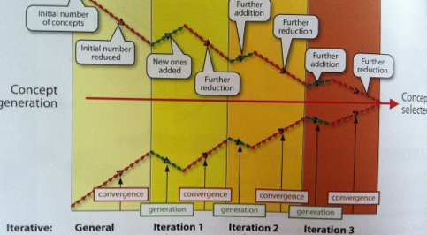
Another thought
Notes:
Design is as much about figuring out how to fit a set of features into a system as it is about reducing the feature set – not just visual feature set, but also which features to actually include

Slide 21
In the “real” world…
Identify and test assumptions about design/use
Design, even in little ways, with a deeper understanding of who your users may be
  » not always “end-user” as in consumers

Slide 22
Questions about final?

Slide 23
Thanks!
We’re done! ☺

