Slide 1
481 – 30 – direct manipulation exercises

Slide 2
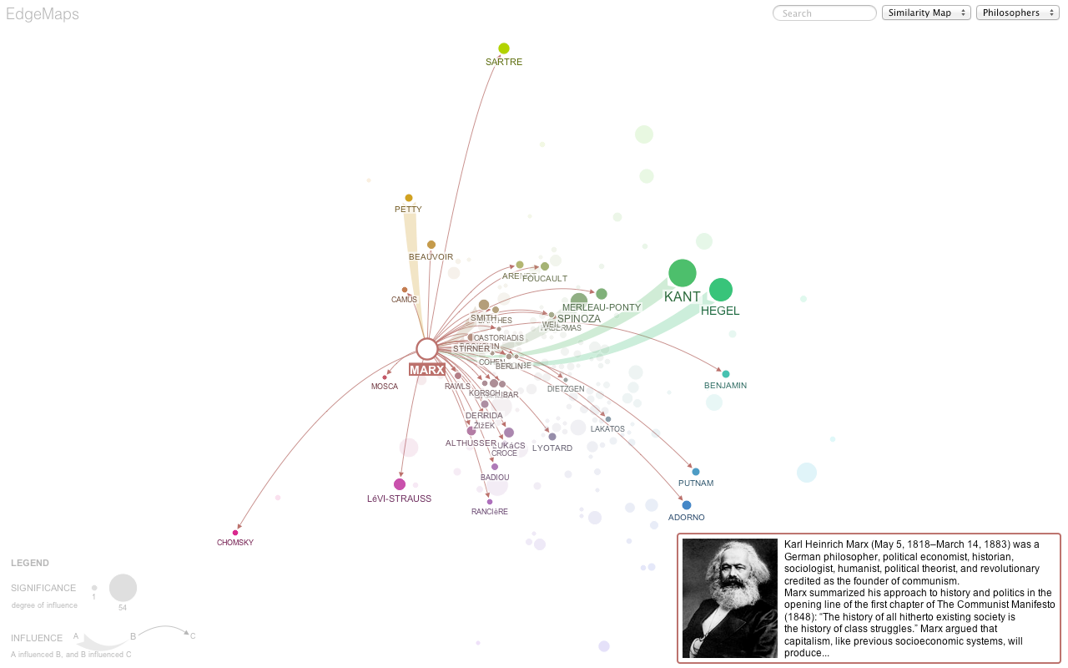
EdgeMaps
Notes:
What are some properties that make EdgeMaps interesting?
-- what are the marks that they have used?
-- what are the attributes that they have used?
-- what are some of the mappings?
How does one interact with this visualization?
-- combination of what’s known as “Multi Dimensional Scaling” and Node-edge graphs
http://mariandoerk.de/edgemaps/

Slide 3
Notes:
https://courses.csail.mit.edu/6.831/archive/2008/lectures/L4-learnability/image013.png

Slide 4
“Directness” more abstractly…
DIRECTNESS = ENGAGEMENT + minimal DISTANCE
Engagement: feeling of power/control
Distance: effort to communicate/execute one’s goals, and to evaluate system state
Notes:
Think about gestural interactions, voice interactions, etc.

Slide 5
BumpTop

Slide 6
DIMP
Notes:
https://www.lri.fr/~dragice/dimp/

Slide 7
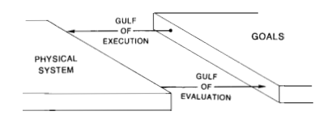
Distance and the Gulfs…
Gulf of execution: ability to express my desires/intentions to the system
Gulf of evaluation: ability to understand what system is communicating to me
Notes:
What’s important here:
It’s about a dialogue between the user and the system
It’s a TWO WAY THING
So, on the one hand, it does have a little to do with a person’s capacity: reaction, eye-hand coordination, knowledge
But it also has to do with the system’s capacity to: speak in the person’s language, efficiency, expressivity.

Slide 8
QWOP
Notes:
http://www.foddy.net/Athletics.html
Gulf of evaluation
Gulf of execution

Slide 9
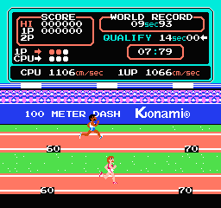
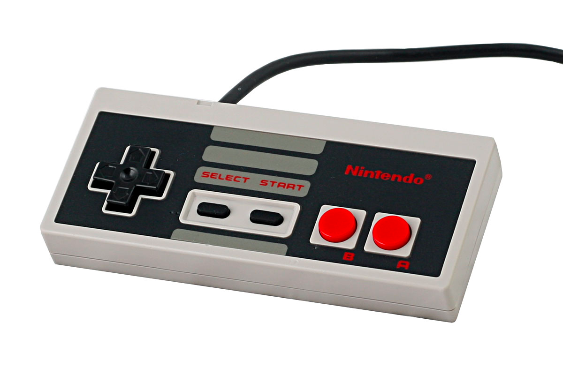
Summer Olympics NES

Slide 10
Robustness of handwriting recognition systems
Is this about gulf of execution or gulf of evaluation?
Notes:
http://images.ucomics.com/comics/db/1993/db930827.gif

Slide 11
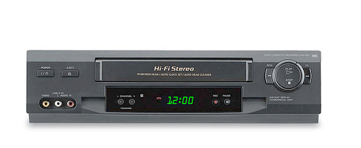
Gulfs

Slide 12
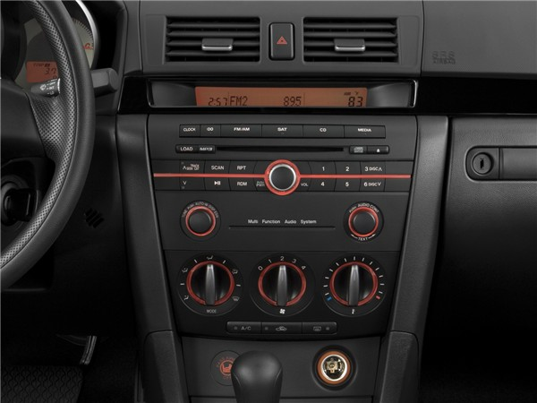
Gulfs
Notes:
How to change degrees F to degrees C
http://mps.drfugazi.eu.org/en/tips-tricks/how-change-temperature-unit-mazdaspeed3
Put a key in ignision and turn to first position
Simultaneously press the Power/Volume button on the radio and MEDIA (rightmost source selection button) and hold for 5 seconds Temperature unit will be changed from Fahrenheit to Celsius (or vice versa)

