Slide 1
Lecture 3: User Centred Design

Slide 2
Questions
List four ways in which the user may not be like you as a system builder
Draw the user-centered design process
What are the five phases?
List one goal of each of the phases
Why is this called a cycle?
Notes:
Perceptual
Motor
Cognitive
Domain knowledge
Investigate, ideate, prototype, evaluate, produce

Slide 3
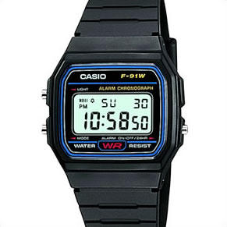
Notes:
How do you test the usability of this watch?
What are the primary tasks for this watch?
What are secondary tasks for this watch?
How would you evaluate whether this watch worked well?
-- who would you ask/find out from
-- what would you have them do/ how would you test the usability

Slide 4
Design
You are being contracted to design a new “PeopleSoft” to help with course registration.
Teams of 4
Discuss ideas for 6 minutes; share your ideas with the broader class
Imagine you are to going to do the “Investigate” phase. What will you do?
Imagine you are going to do the “evaluation” phase. What will you do?

