Slide 1
Designing for people
CPSC 481: HCI I

Slide 2
Agenda
User is not like me → So… what should we do?
User-centred design process
Rationale
Major components: investigate, ideate, prototype, evaluate, produce
Role of iteration

Slide 3
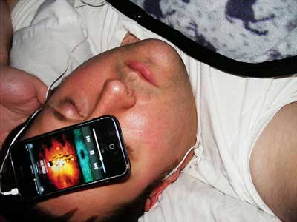
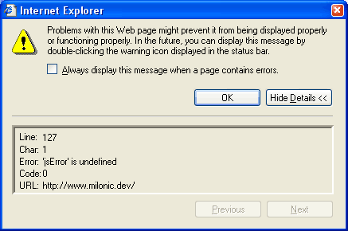
Last time… “User is not like me”
Perceptual capacity
Motor capacity
Cognitive capacity
Domain knowledge
Notes:
http://www.businessinsider.com/harvard-business-school-professor-heres-how-to-stop-sleeping-with-your-smartphone-2012-6

Slide 4
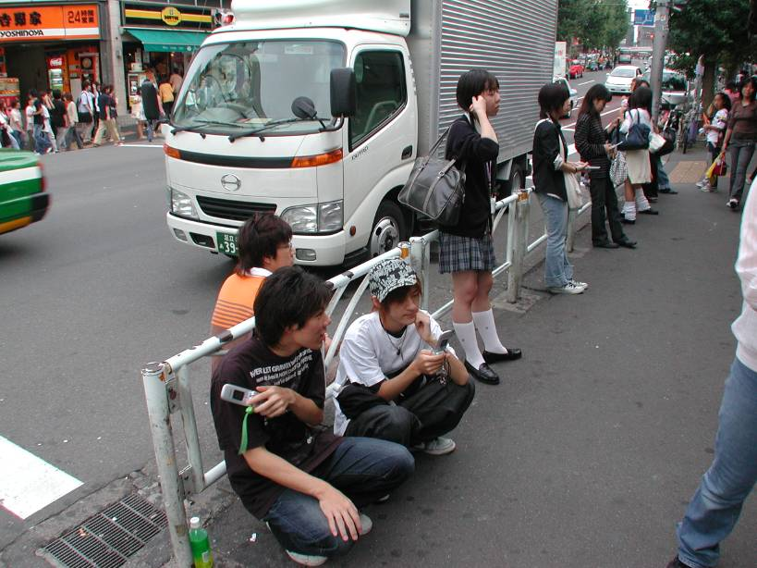
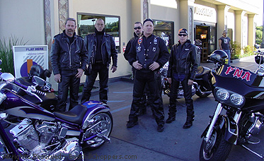
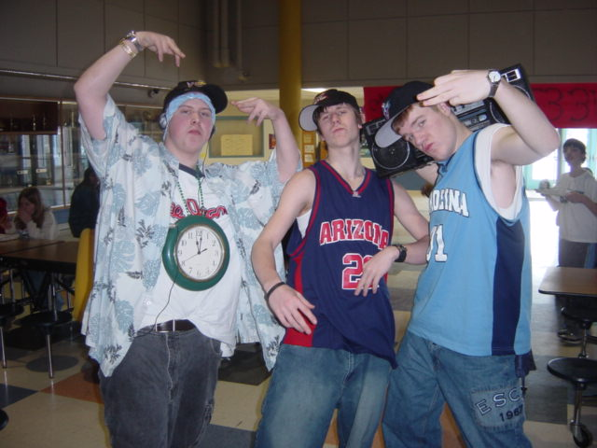
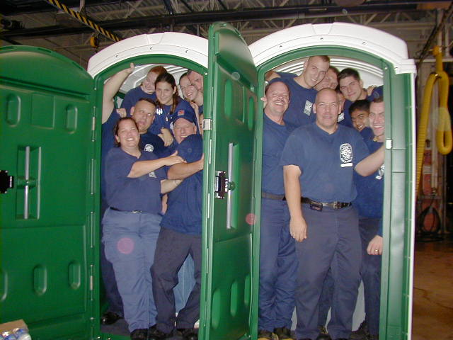
“Know your user!”
Notes:
What do we do when we aren't the ones using it?
o we find out about the people that will be using it!!
o user-centred design (generally)

Slide 5
“Know your user!”
You are not (usually) your user.
Notes:
What do we do when we aren't the ones using it?
o we find out about the people that will be using it!!
o user-centred design (generally)

Slide 6
User Centered Design Process
An iterative design process that makes use of knowledge through investigation of a domain of work/play to create ideas and prototypes.
Prototypes are used for evaluation, and to further stimulate investigation, and idea and prototype generation.
These prototypes and evaluations are used to aid in production.

Slide 7
Why a process?
Get started in a proven tack
Prevents “designer’s block”
Directs us toward final product
Helps us stay on schedule and on cost
Helps us to communicate with others
More reliable than intuition
Forces us to iterate
Helps to keep the users first

Slide 8
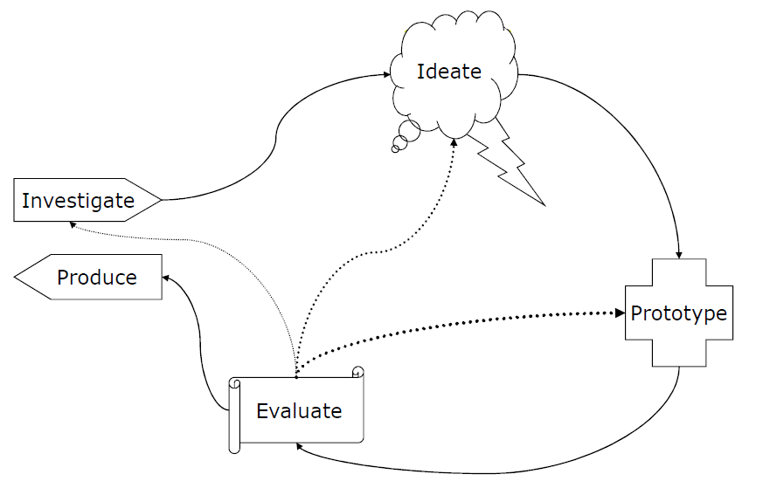
User Centered Design Process

Slide 9
Stage Goals
Generate lots of ideas
Grasp issues and
potential solutions
Learn about stakeholders
Discover goals and needs
How is it done now?
What is wanted?
What else has been tried?
Build final product
Ramp up marketing,
support, and
maintenance
Produce something tangible
Identify challenges
Uncover subtleties
Discover problems
Assess progress
Determine next steps

Slide 10
Investigate

Slide 11
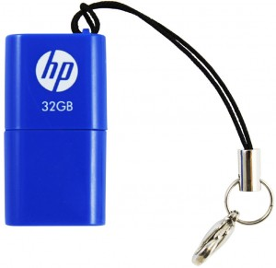
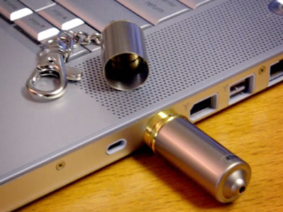
Why investigate?
You cannot design apart from the world where your users and design will live
Notes:
Real world is different than the world that you imagine
The only time I ever saw the cap on my USB key
On the right, better…
Is it the best design?

Slide 12
Investigation Questions
Identify users
Identify stakeholders
What are the requirements?
How do they do it now?
How long does it take?
What do they want?
What do they need?
What have they already tried?
Is there another solution?

Slide 13
Investigation Methods
Interviews
Focus groups
User surveys
…
[More on this next lecture]

Slide 14
Ideate

Slide 15
Ideation -> idea generation
“To get good ideas…
Get lots of ideas”

Slide 16
Ideation
One of the worst things: go with the first one you have
You can always come back to it later
Volume matters the most
Increase chance of success by considering a huge volume of ideas in a systematic way

Slide 21
Ideation
Structured brainstorming
Sketching
Affinity diagramming
Card sorting
Personas
Role-playing, play-acting
[More in the next couple lectures]

Slide 22
Prototype

Slide 23
Why prototype?
It’s cheap and fast
Easier for users to react to concrete things rather than abstract concepts
Prototyping brings subtleties and nuances to light
Working against some technical constraints is good

Slide 24
Prototyping Techniques
Paper prototypes
Screenshots
Flip books
Video mock-ups
Hyperlink prototypes
Functional prototypes
[More next week]

Slide 25
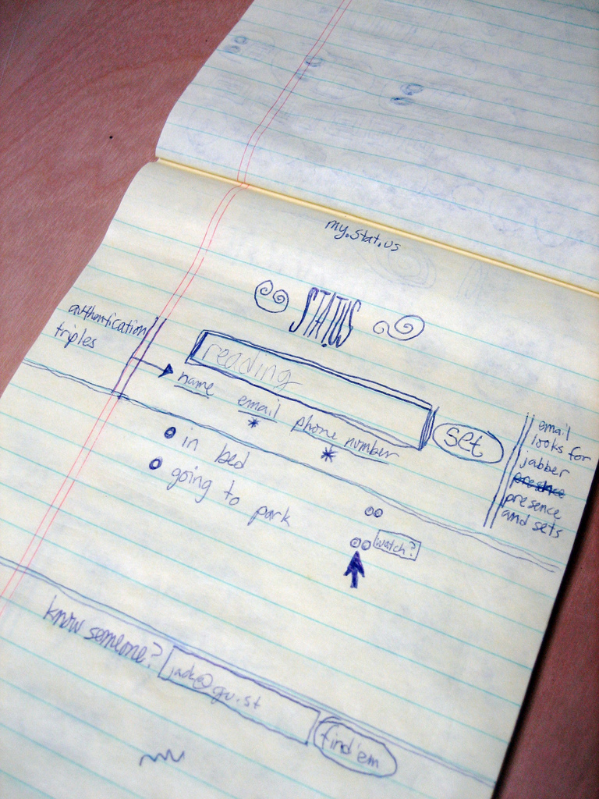
Notes:
http://www.flickr.com/photos/95728450@N00/182613360

Slide 26
Prototyping Fundamentals
Build it fast
Concentrate on unknowns
Don’t be attached to them
Build multiple concurrently
easier to compare pros/cons

Slide 27
Evaluate

Slide 28
Why evaluation?
Automated processes can find bugs, but not usability issues
Evaluation gives you a way to move forward
What needs to be fixed, added, removed?
Answers to two questions:
Did we build the right thing?
Did we build the thing right?

Slide 29
Evaluation Methods
Usability testing
Laboratory experiments
Real-world deployments
Heuristic evaluation
[More on this in the coming weeks]

Slide 30
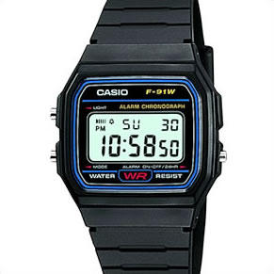
Notes:
How would you evaluate whether this watch worked well?
What are the primary tasks?
What are secondary tasks?

Slide 31
Evaluation Drives Iteration
Problem: usefulness/appropriateness
Return to investigation phase
Problem: users don’t understand
Return to ideation phase
Problem: user performance
Return to prototyping phase

Slide 32
Produce

Slide 33
Production
These are steps required to go from functional prototype to release candidate
Software architecture
Programming, building
Manufacturing
Help systems
Manuals
Training
Customer support
Marketing
Branding
Distribution

Slide 34
User Centered Design: Conclusions
Design starts with understanding your user, and should keep users’ interests central
Design is iterative -> trade-offs are difficult to see in advance
Designs are never “perfect” -> usually, they can be improved

