Slide 1
P4: Write-Up
Write this as if it’s going to be sent to the boss of your company (boss of your boss)
What was the design problem?
What did you do for user research/what did you learn from your user research?
What is your design? What did you discard? How do you justify it?
Heuristic evaluation: what did you find; how would you iterate on the design?

Slide 2
P4: Presentation
Give this as if it’s going to be sent to the boss of your company (boss of your boss)
What was the design problem?
What did you do for user research/what did you learn from your user research?
What is your design? What did you discard? How do you justify it?
Heuristic evaluation: what did you find; how would you iterate on the design?

Slide 3
P4: Presentation
Presentations in tutorial (10 mins + 5 mins Q)
Give it a go in PowerPoint
Suggestion: practice
No need to demo (we saw that last week); give a quick tour of some highlights (say as screenshots)

Slide 4
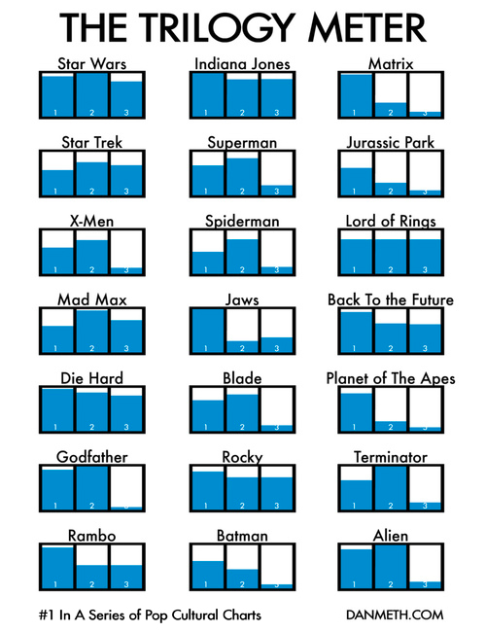
Notes:
http://media.juiceanalytics.com/images/smallmultiples2.jpg

Slide 5
29 information visualization 2 exercises

Slide 6
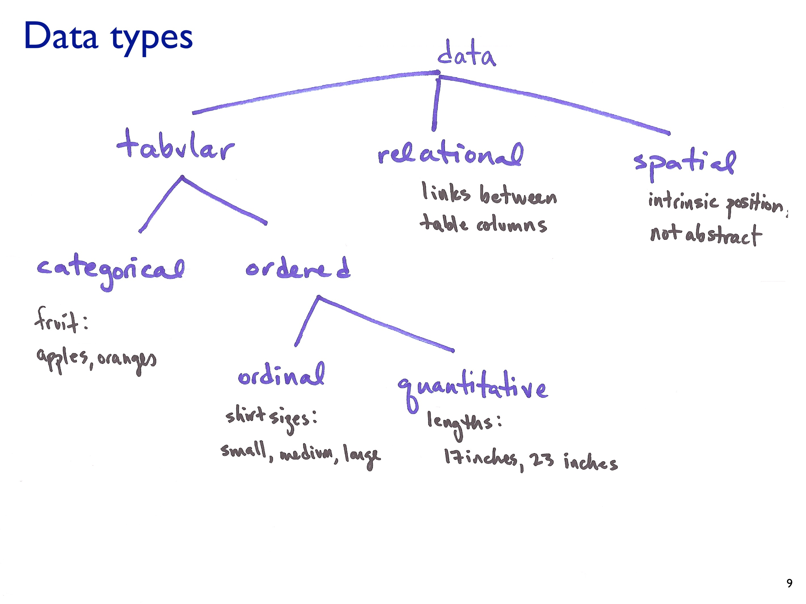

Slide 7
So what types of Facebook data are each of these?
Ages of your friends
Gender of your friends
How many friends you have?
The first names of your friends
All of your status updates
Consider a group of friends: the links between those friends
The hometowns of all of your friends

Slide 8
Notes:
http://visual.ly/halloween-spending-trend-2014-mageworld

Slide 9
Notes:
https://www.cs.ubc.ca/~tmm/courses/cpsc533c-05-fall/a1/rudenko/

Slide 11
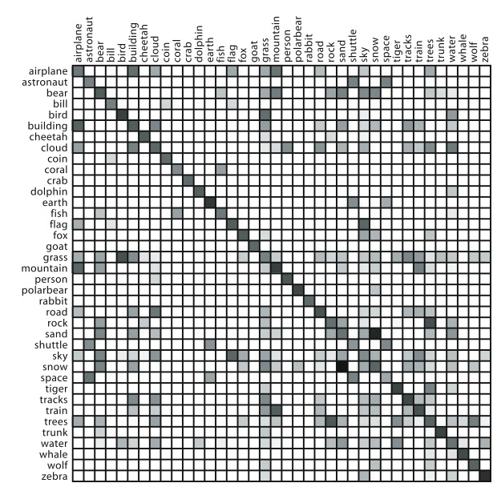
Notes:
Shades and colours can be hard to distinguish
“darker squares indicate a closer association”
https://www.cs.ubc.ca/~tmm/courses/cpsc533c-05-fall/a1/acarbo/

Slide 12
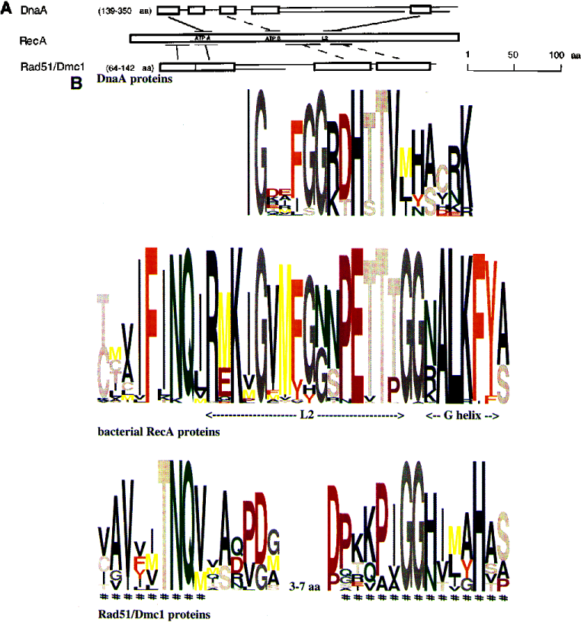
Notes:
https://www.cs.ubc.ca/~tmm/courses/cpsc533c-05-fall/a1/mddibern/

Slide 13
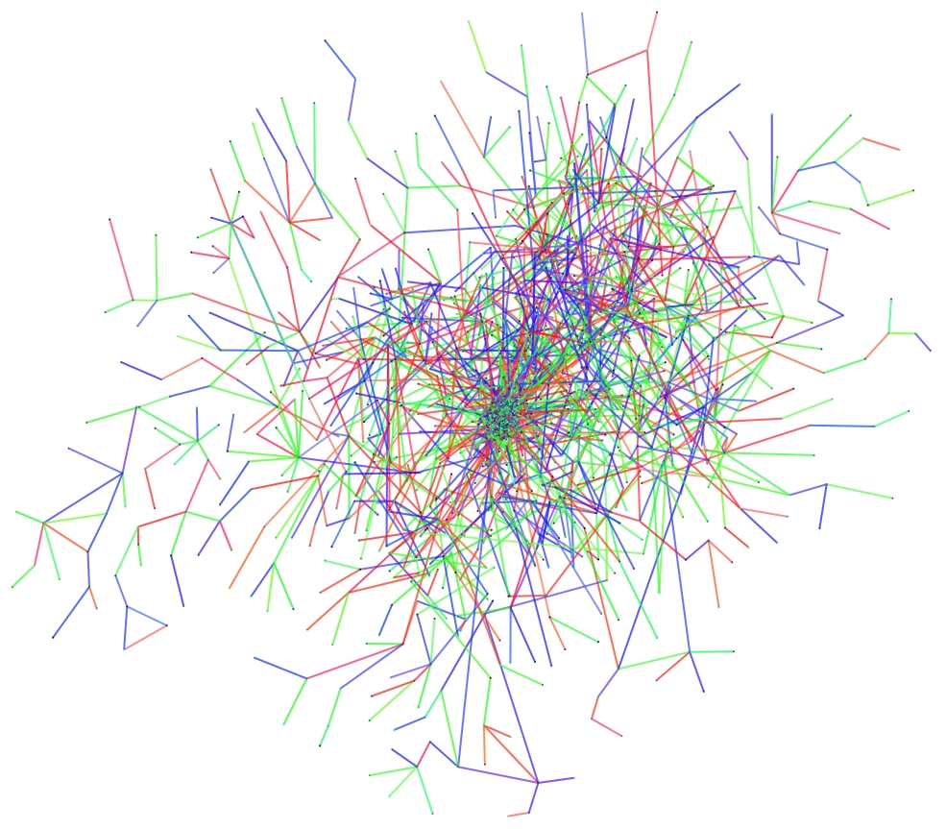
Notes:
None of the nodes are labelled, so the viewer cannot determine who is adjacent to whom. The colours were not well chosen. Both red and green are present, but color blind users may not be able to discern between them. In my opinion, the dark blue colour tends to dominate the view of the graph. Furthermore, the use of colour in the graph appears to have no meaning or pattern.
https://www.cs.ubc.ca/~tmm/courses/cpsc533c-05-fall/a1/jthillik/

Slide 14
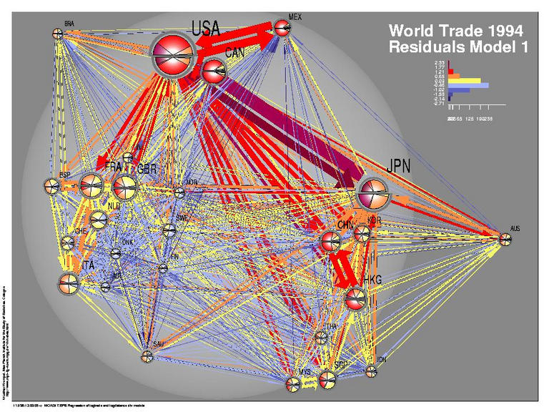
Notes:
https://www.cs.ubc.ca/~tmm/courses/cpsc533c-05-fall/a1/sminto/
This image shows the trade relationships in 1994 between the 26 biggest trading countries in the world. The arrows represent trade in the direction that they are pointing and their thickness represents the volume of the trade. The distance between the country nodes represents the distance between the capitals of the countries. Finally, the different colors of the connections represent the error in the trade flow estimates.

Slide 15
Notes:
https://www.cs.ubc.ca/~tmm/courses/cpsc533c-05-fall/a1/rostokec/

Slide 18
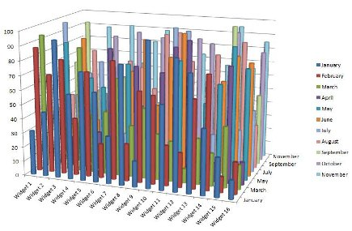
Notes:
http://data-visualization-software.com/wp-content/uploads/2014/02/dangers-of-data-visualization-3.png

Slide 22
Notes:
http://www.datavis.ca/gallery/images/galvanic-3D.png
horrific use of 3D,
undesirable optical effect of the gridlines,
incorrect display of the data as a series of connected boxes,
item labels misaligned with the tick marks, and taking up far too much of the graphic display area

Slide 23
NY Times – Interactive Visualizations
http://www.nytimes.com/interactive/2013/10/09/us/yellen-fed-chart.html
http://www.nytimes.com/interactive/2013/05/25/sunday-review/corporate-taxes.html?ref=sunday
http://www.nytimes.com/interactive/2014/01/23/business/case-shiller-slider.html?_r=0
http://www.nytimes.com/interactive/2013/12/10/us/state-gun-laws-enacted-in-the-year-since-newtown.html

