Slide 1
Notes:
http://originaldave77.files.wordpress.com/2011/10/super-mario-3-calgary-c-train-map-2011-2012-davesgeekyideas-wallpaper1.png

Slide 2
481 – 28 - Infovis 1 - exercises

Slide 3
P4
Presentations next week in tutorial. 10+5
Submit your hardcopy P4s in two ways:
Wednesday, Dec 3, in class
Friday, Dec 5 from 10am-11am, in MS 680
Grades for everything (incl P4) will be made available by Thu, Dec 11 at the latest

Slide 4
Notes:
http://guidestarinternational.files.wordpress.com/2011/08/florence-nightingale-diagram2.jpg
Florence Nightengale
Crimean war begins, and you can see the different types of death
She was able to do something starting in march 1885
» sanitation
» food quality
» cleanliness, etc.
Convinced people of what was going on, and many of these couldn’t read
The data told the story, but particularly as presented in this way
Impressive but, also, lies a bit.
Why?
Sectors are too fat

Slide 5
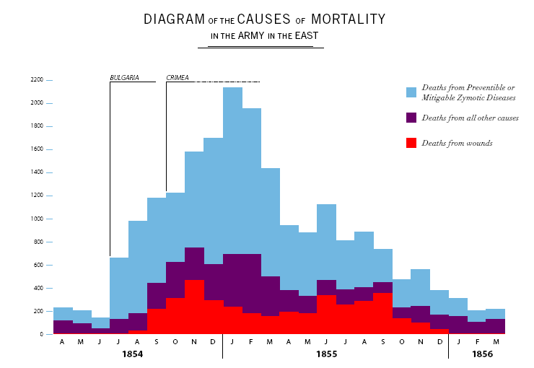
Notes:
Here’s another representation
Shows the same data.
How does this compare to the previous visualization?

Slide 6
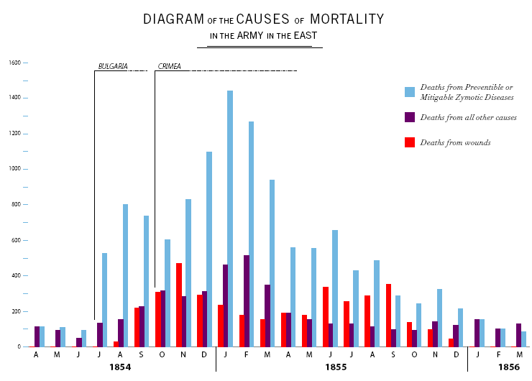
Notes:
One more time. How does this compare?
(Non-stacked allow for easier comparison across the relevant cases

Slide 7
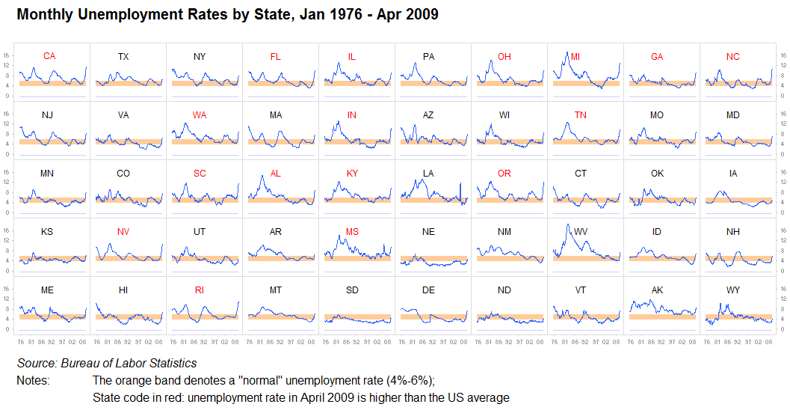
Small Multiples Illustrated

Slide 8
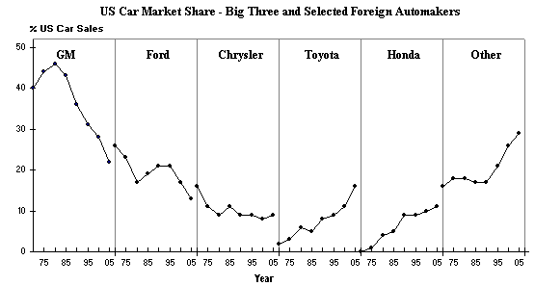
More Small Multiples

Slide 9
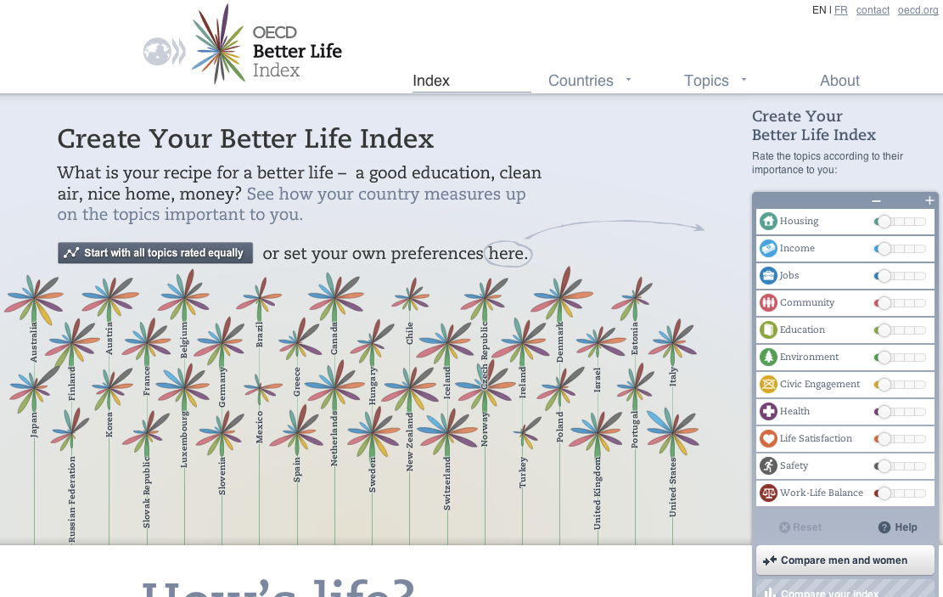
http://www.oecdbetterlifeindex.org/
Notes:
http://www.oecdbetterlifeindex.org/

Slide 10
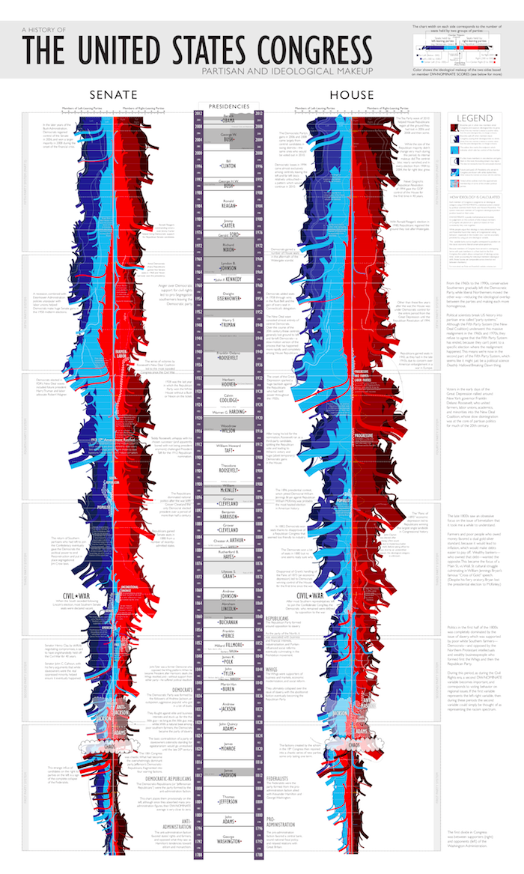
xkcd: the “shape” of US Congress
http://xkcd.com/1127/

Slide 12
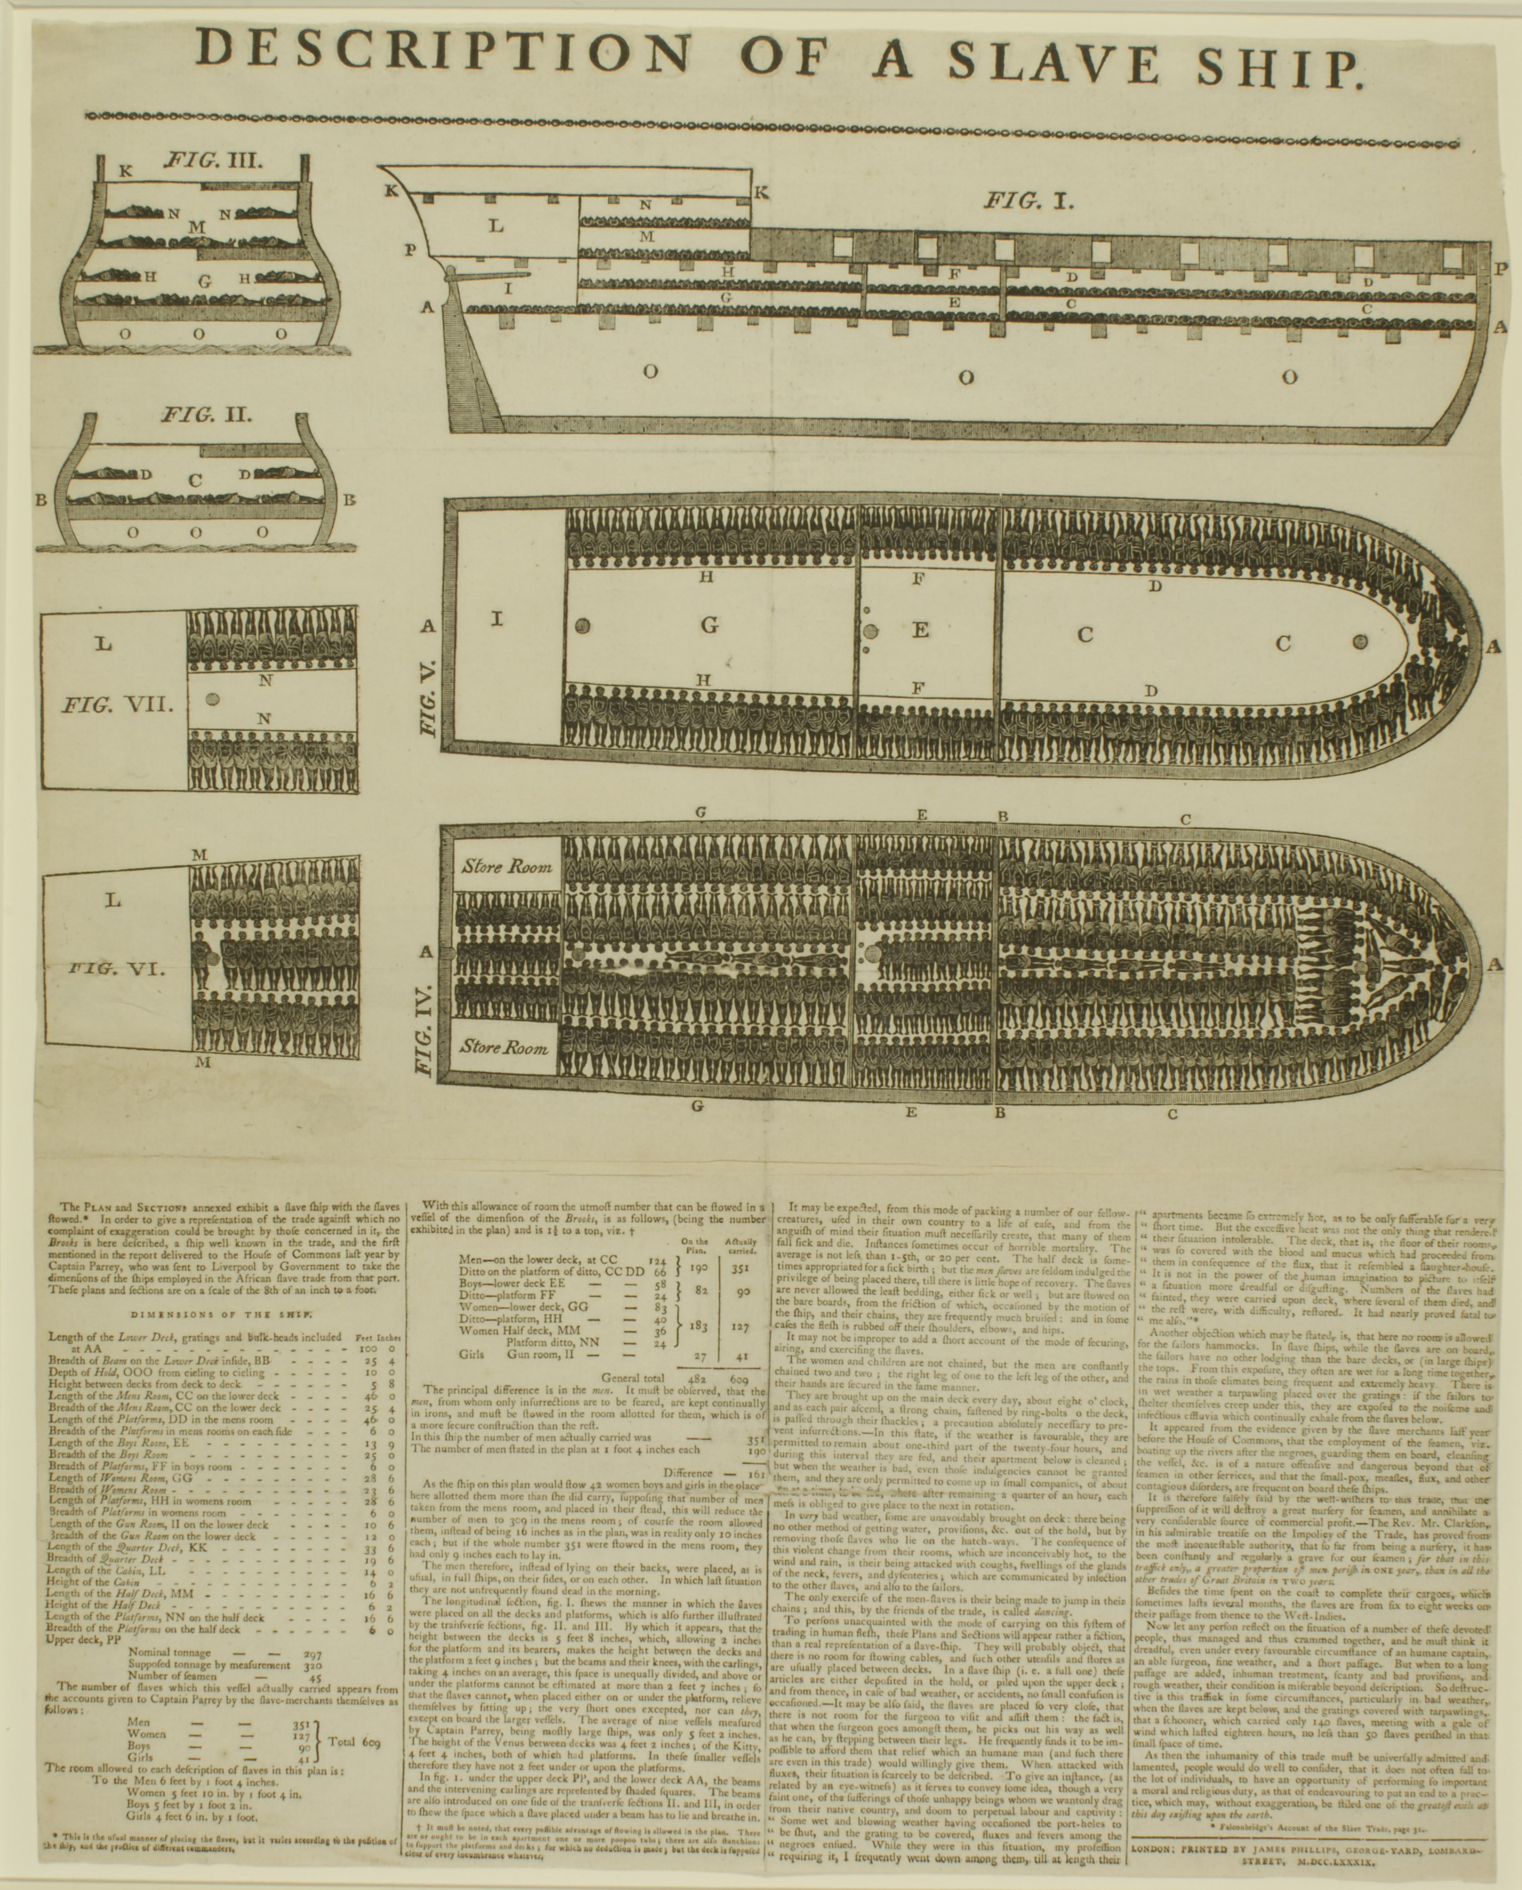
Notes:
The trans-atlantic slave trade was one of the most despicable things people have done to other people. Transport conditions were especially bad, but at the time the public did not know much about the process. The Description of a Slave Ship engravings gave people a visual sense of what had previously only been conveyed orally. Over 10,000 copies of the engravings were created in under a year, giving strong support to the antislavery movement.
1789
http://blog.visual.ly/12-great-visualizations-that-made-history/

Slide 13
Hans Rosling
Notes:
http://www.gapminder.org/videos/200-years-that-changed-the-world-bbc/

Slide 14
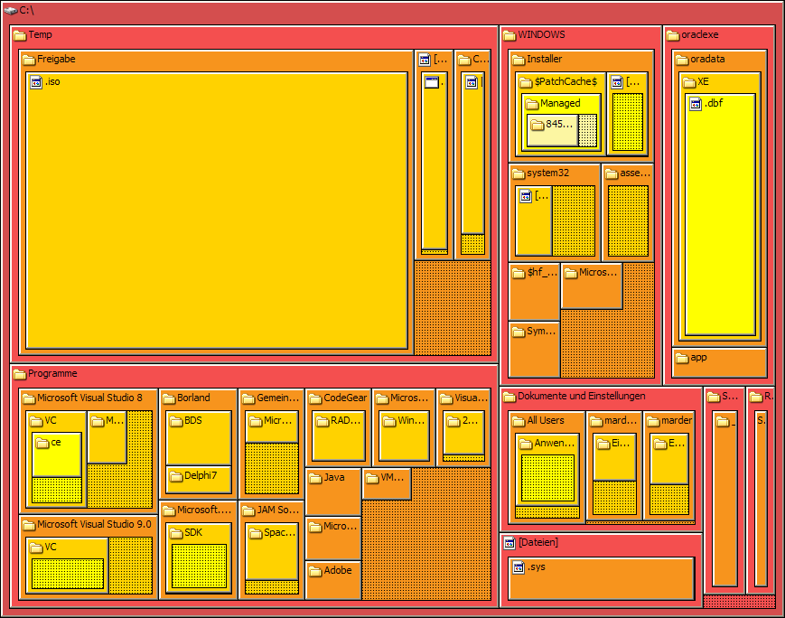
Treemaps

Slide 15
Interactive Visualization Examples
https://github.com/mbostock/d3/wiki/Gallery
http://bost.ocks.org/mike/sankey/
http://mbostock.github.io/d3/talk/20111116/iris-parallel.html
http://mbostock.github.io/d3/talk/20111018/treemap.html
http://bl.ocks.org/mbostock/4060954
Notes:
Overview, filter + zoom, details on demand

