Slide 1
What happens when you don’t choose to follow convention…
Notes:
https://twitter.com/boagworld/status/263829079843811328/photo/1

Slide 2
481 27 information representation exercises

Slide 3
Message
Choosing a representation means deciding what aspects of a dataset are emphasized.
A well-chosen representation can make obvious answers to certain questions.

Slide 4
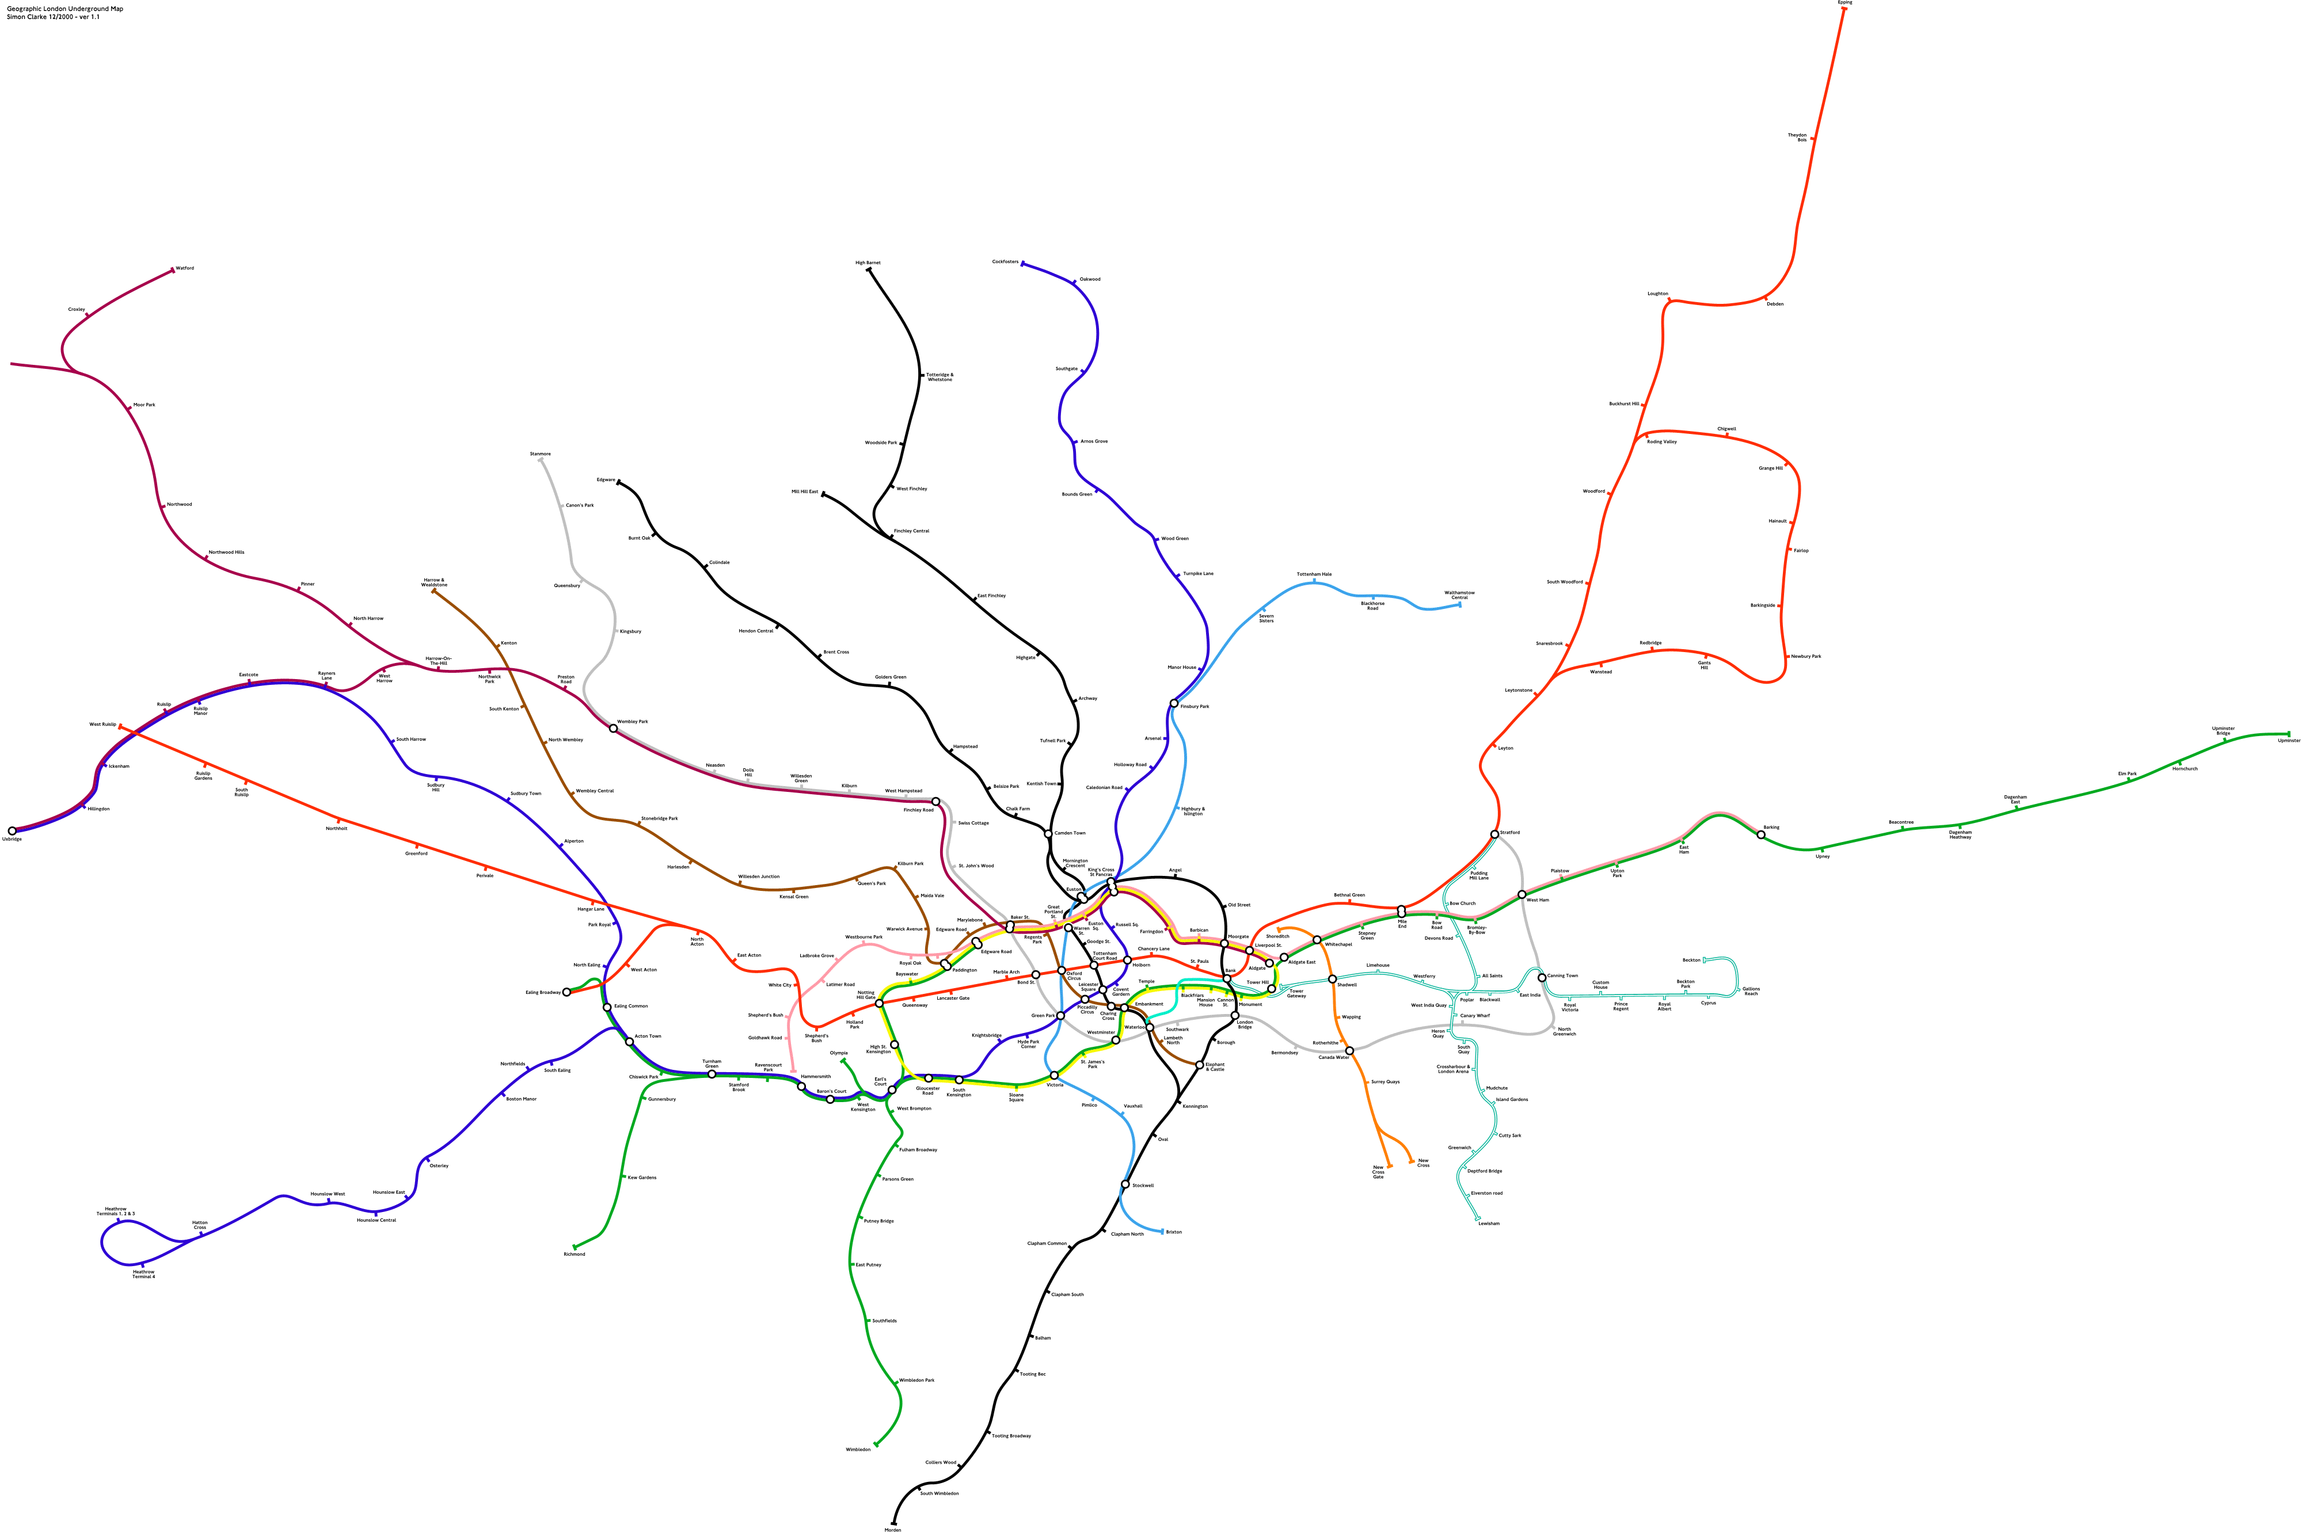
Notes:
http://i.imgur.com/Qxbza.gif
Who recognizes this? – this is the London underground tube, and all the different routes
What does it show?
What does it not show?
Heavy congestion in some parts, hard to make out things
Requires a lot of space, because london is a big place!
Unclear where lines go and intersect, and where they touch one another, etc. how to make transfers, etc.

Slide 5
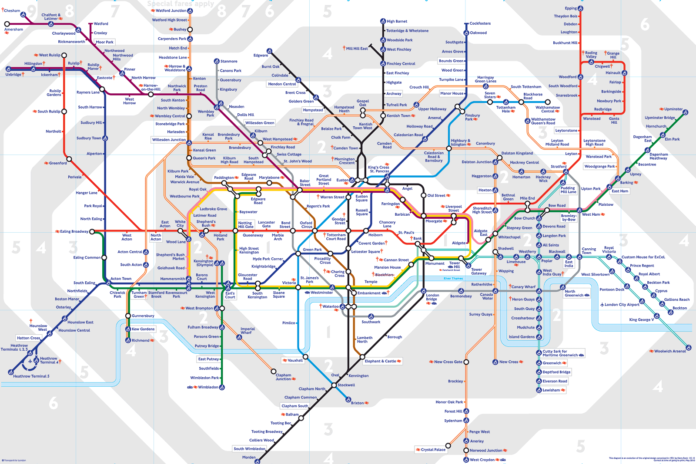
Notes:
http://www.bbc.co.uk/london/travel/downloads/tube_map.gif
Who recognizes this? [London Tube Map]
What does it show?
What does it not show?
Abstracted away many of the distances between stops
Also abstracted away some of the directions between stops
Exaggerate distance between some stops that in the downton core – for the purpose of /showing/
Means that Tony took trains between stops that were no more than five blocks away
Means also that sometimes when it looked like a transfer, Tony had to walk a few blocks underground without knowing it
Neat: overlay of the “zones” – these also give you some sense of distance
Effective for “counting stops”, which is how people give you directions. “Go to blah blah square, it’ll be x stops”

Slide 6
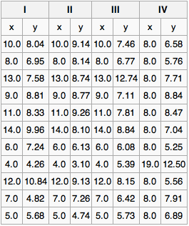
Exercise
Work in small teams (3-4 people).
Analyze and compare these four data sets (each data set is the column of x,y pairs).
How is each data set similar? How is each data set different?
Notes:
http://en.wikipedia.org/wiki/Anscombe's_quartet

Slide 7
Anscombe’s Quartet
How to analyze these four data sets?
» averages
» variances
» correlation
» linear regression
Notes:
http://en.wikipedia.org/wiki/Anscombe's_quartet

Slide 8
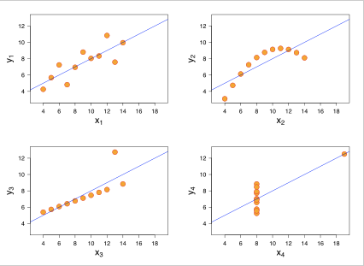
Anscombe’s Quartet
Notes:
http://en.wikipedia.org/wiki/Anscombe's_quartet
Point: a different representation of that tabular data gives us a new way to think about it, and reveals some obvious properties in the data that you would otherwise not see/think of

Slide 9
Choosing what to leave out in a representation is almost as important as choosing what to have in the representation

Slide 10
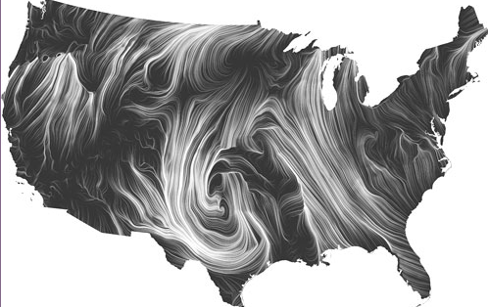
Notes:
http://hint.fm/wind/

Slide 11
Notes:
http://hcitang.org/papers/2006-chi2006-visualizing-social-relationships-in-im.pdf

Slide 12
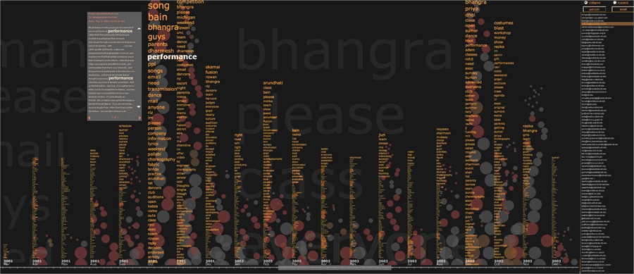
Notes:
http://fernandaviegas.com/themail/
Using the content of exchanged messages, Themail shows the words that characterize one’s correspondence with an individual and how these terms change over the period of the relationship. Each column of words refers to emails exchanged in a given month with the selected person. The more salient and unique a word is in one’s conversation (in comparison to all other conversations in the archive), the bigger that word appears in the visualization. This causes different flavors or conversations to emerge; for example, emails to family members look at lot different from emails exchanged with coworkers. Each circle represents an email message exchanged with the selected person during that month. The size of the circle shows the length of the email. Different colors represent the direction of the email: red- outgoing emails brown- incoming emails to the owner of the archive gray- incoming emails sent to lists the person subscribes to Academic paper: Visualizing Email Content: Portraying Relationships from Conversational Histories

Slide 13
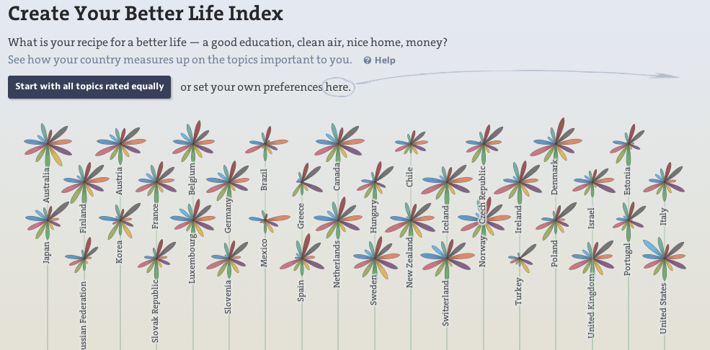
Notes:
http://www.oecdbetterlifeindex.org/

Slide 14
Message
Choosing a representation means deciding what aspects of a dataset are emphasized.
A well-chosen representation can make obvious answers to certain questions.

