Slide 1
Fitts’ Law and Applications
CPSC 481: HCI I
Fall 2014
Anthony Tang

Slide 2
Learning Objectives
By the end of the lecture, you should be able to:
» Describe the original Fitts' law experiments
» Provide an interpretation for Fitt's law
» Identify two ways that Fitts' Law can be used in interaction design
» Critique visual designs using Fitts' Law

Slide 3
Fitts’ Law: The Punchline
Big targets are easier to hit than small targets
+
Close targets are easier to hit than far targets

Slide 4
Paul Fitts’ Experiments
Notes:
Reciprocal tapping task
Varying the distance between these plates
Varying also the width of the target area on the plates
Goal: understand the nature of worker effeciency, sucha s in production line and assembly task

Slide 5
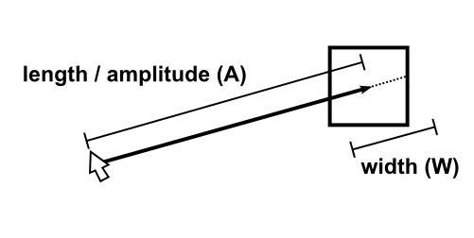
In GUIs, too!
Notes:
http://www.medien.ifi.lmu.de/lehre/ws0809/mmi1/slides/tutorial3.html
Model of human movement
Predicts time for rapid, aimed movemnet
Example: a mouse pointer over a button
Originally, one-dimensional movement, extended by varios researchers

Slide 6
Fitts’ Law as an equation
MT = movement time
A = amplitude (distance to target)
W = width (width of target)
a,b = empirically determined constants

Slide 7
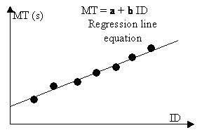
Fitts’ Law as an equation
MT = movement time
A = amplitude (distance to target)
W = width (width of target)
a,b = empirically determined constants
ID = “index of difficulty” in bits
IP = 1/b = “index of performance” – bits/s
Notes:
How to get a and b? let’s actually run a small experiment
What is a: how much time it takes you to realize where you need to go, how much time it takes to click
What is b: device-specific characteristics (e.g. using your arm to move, vs. using your leg to move, vs. using a mouse, vs. using a joystick, vs. using a stylus)

Slide 8
Fitts’ Law
Allows us to design navigation
Allows us to evaluate input devices/techniques

Slide 9
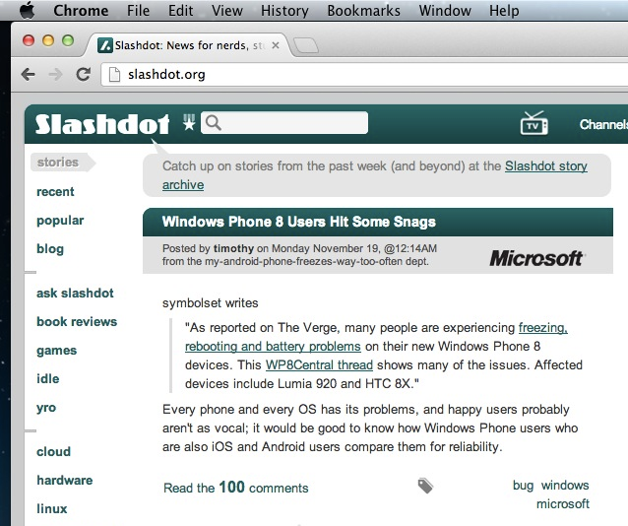
Think about the targets on this screen
Notes:
Think about the targets here
Just list a few of the targets
Which are big?
Which are easy to click?

Slide 10
Discussion Questions
Microsoft Toolbars offer the user the option of displaying a label below each tool. Give two reasons why labeled tools can be access faster. (Assume the user knows the tools, and does not need the labels to identify the tool.)
The label becomes the target, and so it is bigger.
When labels are not used, the tool icons crowd together
Notes:
http://www.asktog.com/columns/022DesignedToGiveFitts.html

Slide 11
Discussion Questions
Assume you will this layout of buttons on the left edge of the screen. Without changing the size of these icons, what can you do to decrease the amount of time it takes to access the tools?
Change the array to 1x12
Ensure you can click the pixels to the left of the button, too!!

Slide 12
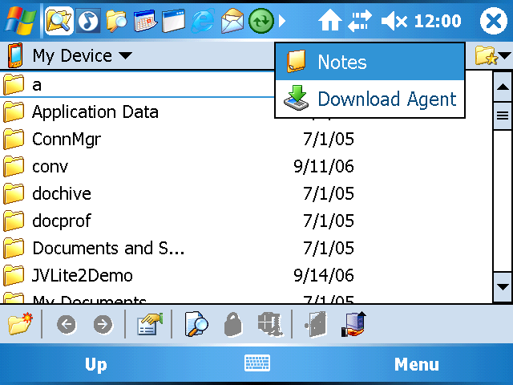
Fitts’ Law and Touch Interfaces
Notes:
http://forums.thoughtsmedia.com/f398/review-teksofts-brand-new-pocket-pc-utility-suite-smart-bar-82474.html
Compact placement of icons
Scrollbar annoyingness
What do we do now?
Discoverability?

Slide 13
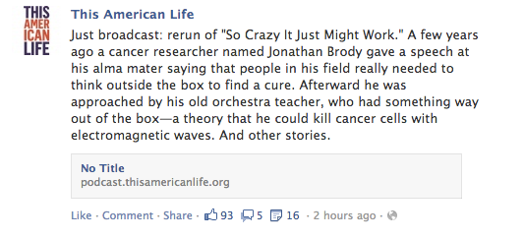
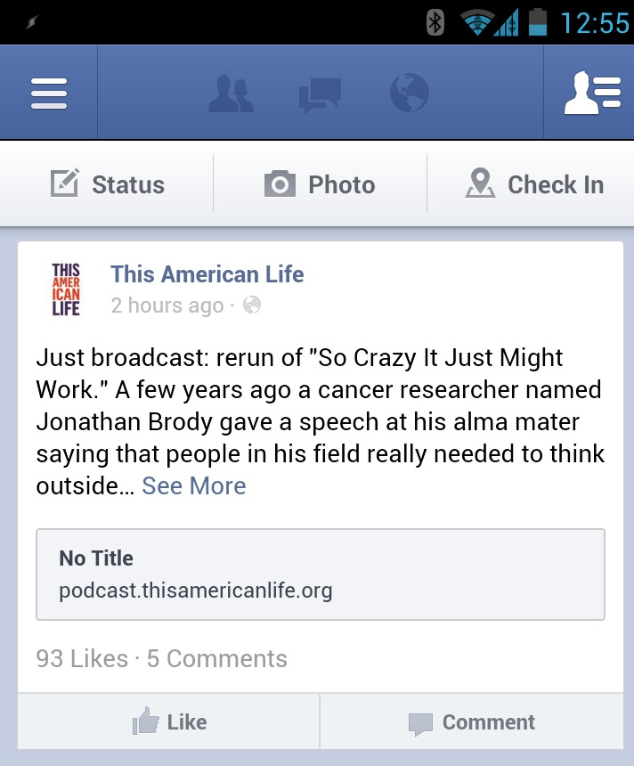
Fitts’ Law and Touch Interfaces
Notes:
Notice the closeness of the comment and thumbs up fields
Think about a mouse: easy to control
Your finger: pretty honking

Slide 14
Learning Objectives
You should now be able to:
» Describe the original Fitts' law experiments
» Provide an interpretation for Fitt's law
» Identify two ways that Fitts' Law can be used in interaction design
» Critique visual designs using Fitts' Law

