Slide 1
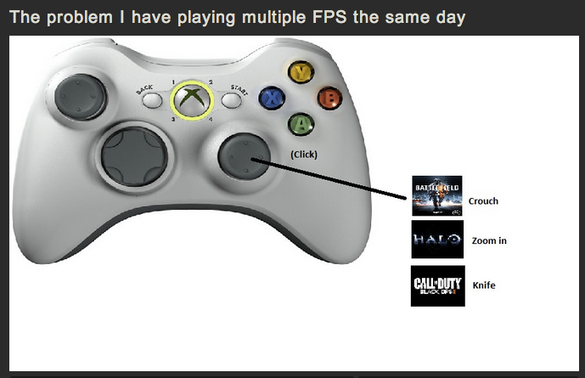
Which heuristic does this violate?
Notes:
http://imgur.com/Ic4pq

Slide 2
P3s due on Monday
Written report due in class
Code + assets available in a zip file, posted to Piazza thread (identify yourself and team)
Presentations next week in tutorial
Presentation (10~15 mins): Strict a system demo. Use your tasks (from P2) as a guide. Show us how you would complete each task in your system. Questions from me, TAs and class.

Slide 3
26 fitts law exercises

Slide 4
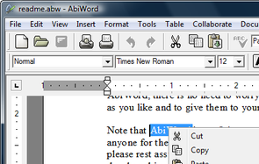
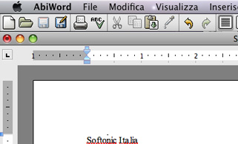
Question
What’s Fitt’s law – that is, what is the main punch line?
Explain why a Macintosh pull-down menu can be accessed at least five times faster than a typical Windows pull-down menu. Suggest why Microsoft made the decision to make their pull-downs the way they did.
Notes:
Screen edge is a “mile-high” target in OS X – this means that the menus are super easy to hit, and very tall targets
One reason why MS did it is maybe b/c it’s closer to the target? Another potential reason: Mac patented the menu bar
This breaks when there is a monitor on top of another monitor

Slide 5
Discussion Question
Explain why a Macintosh pull-down menu can be accessed at least five times faster than a typical Windows pull-down menu. Suggest why Microsoft made the decision to make their pull-downs the way they did.
Notes:
Screen edge is a “mile-high” target in OS X – this means that the menus are super easy to hit, and very tall targets
One reason why MS did it is maybe b/c it’s closer to the target? Another potential reason: Mac patented the menu bar
This breaks when there is a monitor on top of another monitor

Slide 6
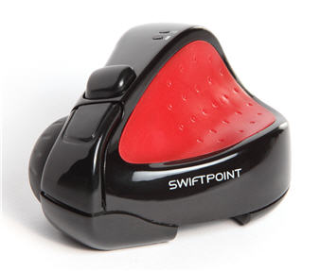
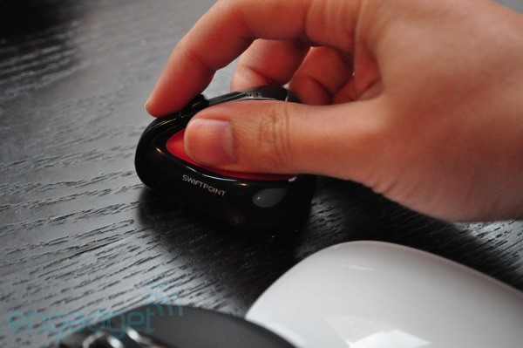
Swiftpoint
http://www.youtube.com/watch?v=nswGDGy599w

Slide 7
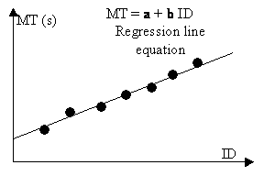
Fitts’ Law as an equation
MT = movement time
A = amplitude (distance to target)
W = width (width of target)
a,b = empirically determined constants
ID = “index of difficulty” in bits
IP = 1/b = “index of performance” – bits/s
Notes:
How to get a and b? let’s actually run a small experiment
What is a: how much time it takes you to realize where you need to go, how much time it takes to click
What is b: device-specific characteristics (e.g. using your arm to move, vs. using your leg to move, vs. using a mouse, vs. using a joystick, vs. using a stylus)

Slide 8
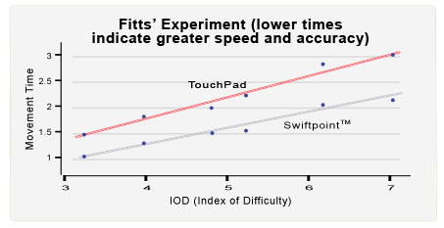
Comparing TouchPad to Swiftpoint

Slide 9
BubbleCursor
Challenge: make it so that it’s easier to click on targets
Original approach: use an area cursor
BubbleCursor approach: use a dynamically resizing area cursor

Slide 10
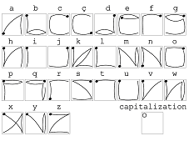
EdgeWrite
Use the corners of a boundary area for super fast text entry.

Slide 11
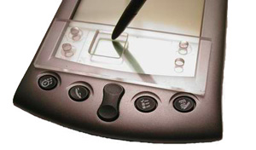
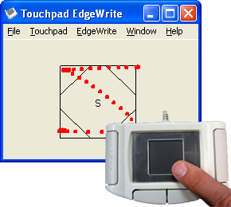
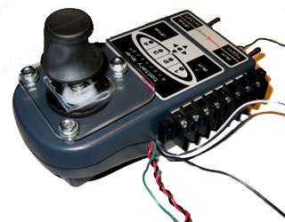
EdgeWrite Contexts..

