Slide 1
25 Personas Exercises

Slide 2
Fight Club
Anti-Establishment
Anti-Authoritarianism
Anarchy
Notes:
Tyler Durden (and the movie spoilers that go along with his name) and his Fight Club minions believe in anything that opposes authority and the status quo that said authority creates.

Slide 3
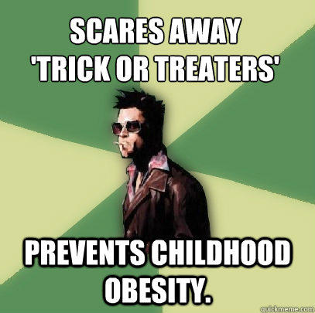
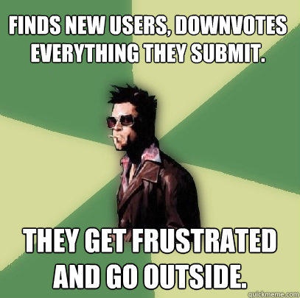
WWTDD?
Notes:
Quickmeme.com
Point: we have a sense of what tyler durden is (because there was a movie)
We know what he is motivated by
We know what he cares about
We know what kinds of tasks he is interested in
Personas are based on this rationale of knowing who a person is

Slide 4
Design a car
Imagine you are designing an automobile to please a wide spectrum of people. You can easily identify at least three subgroups: the soccer mom, the carpenter, and the hot-shot day trader. Take two minutes with a partner to articulate:
What is it that each subgroup wants?
How is this best achieved with a vehicle?
Notes:
Example from “Inmates Running the Asylum, p. 124”

Slide 5
What do they need?
Soccer Mom | Carpenter | Junior Exec
Space Safety – airbags, high crash rating Comfort – padded seats, lots of seats? Distraction for the kids (TV players) Child protective doors and windows Rear end view camera Foldable seats 7 seats Minivan Cheap on gas, efficient – good engine | Space – lots of space for wood – maybe a big van or a pickup Moveable or foldable seats 2 seats Durable Easy to load/unload vehicle – trunk design needs to accommodate big things Roof rack Shelving inside the vehicle for tools Easy to access full-sized spare tire | Mobile enablement – wifi and bluetooth and sattelite radio in the car BMW basically Should be fast (pickup is quick) Things to brag about (e.g. doors that fold upwards, Expensive so can brag V16 engine Agile to cut people off Sunroof for sure Gold plated

Slide 6
What do they need?
Soccer Mom | Carpenter | Junior Exec
Space for storage or seating capacity Safety features – airbags side airbags Automated hands-free features (remote sliding doors) Durability easy to clean Visibility – larger mini-van (back up camera) In-car entertainment for the backseat Childsafe locks or windows | Functionality over how it looks – space for their tools and boxes -truckbed Don’t need lots of seats – just them and maybe an apprentice Durable and easy to clean (maybe) Powerful vehicle (lots of torque; all terrain) A GPS perhaps? | Hands-free stuff inside Sporty and expensive – to show off Tinted windows Coat-hangers for dry cleaning Removable seats (other clients or baggage) Classy interior (leather seats) – looks nice Gotta be fast Cushioned door handles; butt seat warmers

Slide 7
On average, what should the car be like?

Slide 8
Design for everyone or design for one?
Notes:
When we design for everyone, we run into the problem that we annoy them a lot.
Now, a large population is 50% happy.
Whereas, if we took a different approach, where we came up with one car for one kind of user, then we would make them 100% happy, or even better 100% ecstatic.
So, it is often useful to think about designing “for one user”

Slide 9
Major takeaway
Designing for everyone means that everyone is displeased with the result.
Designing for “the average” typically doesn’t work.

Slide 10
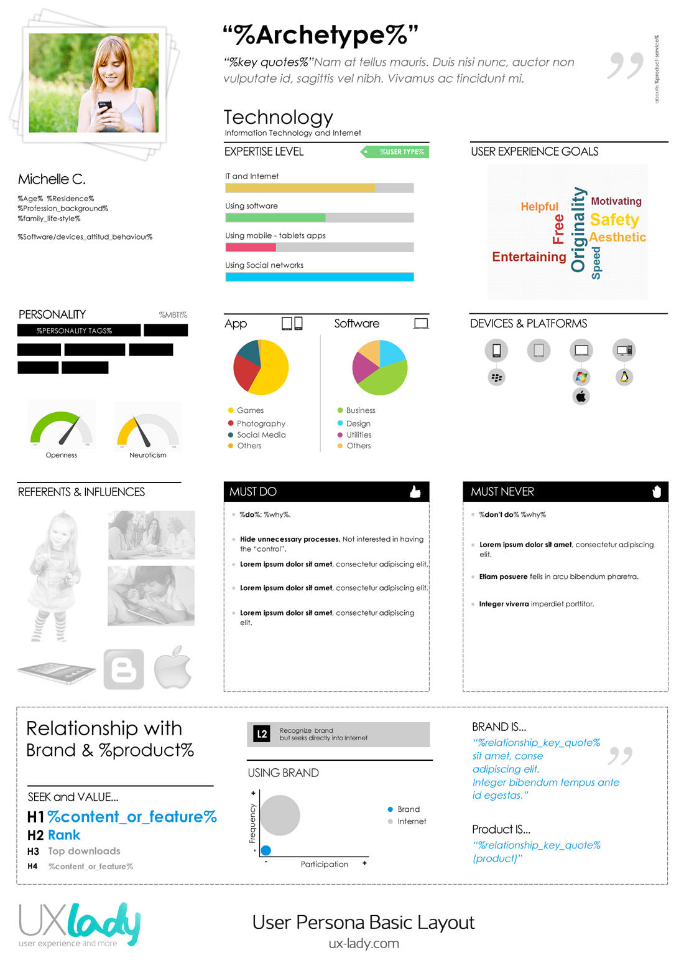
Profile
Personality
Expertise
Must Do/Must Not Do
Devices & Platforms
Used products/services (tasks)
Motivations
Key quotes
Experience Goals
Picture
Etc..

Slide 11
Persona: Roger, User Group: Retirees
Background
HRWeb is a Human Resources (hr) Management web-based application used by Acme Insurance. HRWeb handles hr management such as employee records, compensation, and benefits management. User Groups for HRWeb include: hr managers, hr specialists, hr administrative assistants, non-hr managers, non-hr administrative assistants, employees, retired employees.
Persona
Roger Thompson retired 3 years ago at age 62, after working for 35 years in the Underwriting department of Acme Insurance. At 65 years old, Roger is extremely active. He golfs twice a week in the summer and swims laps three times a week in the winter. He is proud of his garden and spends an hour or two each day maintaining his lawn and flower beds. Roger is also an avid fisherman.
Roger has age-related macular degeneration, which, in Roger's case, causes blurred central vision in his left eye. His vision has gotten progressively worse over the past two years. When reading or doing crossword puzzles, he needs brighter light and sometimes uses a magnifier.
Roger has a slight tremor in his right hand.
He is happy to report that this does not affect his golf game or his gardening. He notices that some activities, such as writing and baiting his hook for fishing, are affected by the tremor.
When he uses the computer he experiences some difficulty in using the mouse, especially if the button or link he's trying to hit is fairly small.
Roger uses the computer at home, where he has set up a home office that he shares with his wife. Roger is comfortable using the computer. As an underwriting manager, he learned to use the Web for job-related research, and he used the company's intranet on a regular basis throughout each workday. After retirement, he upgraded his home computer to a Pentium IV with Windows XP Home Edition. He uses the Web daily.
Roger enjoys researching stock and mutual fund information. He also uses the Web to check the weather and to follow golf tournament results. The feature Roger likes best on HRWeb is the ability to change his stock and mutual fund accounts.
Roger has difficulty seeing small text or text with poor contrast to the background on the computer monitor. His son showed him how to increase the text size in Internet Explorer and that works for some sites. It is frustrating to Roger that on some sites the text size is still small—it does not get larger with his browser settings. He had tried to use screen magnification software, but finds it difficult to get oriented to a new site because he can't see the entire screen at one time.
Notes:
http://www.uiaccess.com/accessucd/personas_eg.html

Slide 13
Office 365 Enterprise Personas
Transforming
Customers with propensity to increase/decrease employee count regularly
E.g. acquisitions, layoffs, temporary seasonal workers
Cost Saver
Interested in moving from capex to opex
Google Compete
Customer in active discussions with Google
Greater focus on collaboration and messaging workloads
Task Worker
Population of structured task workers who don’t have dedicated PCs
Dated Environment
Customers on older versions (N-2+) of Exchange, SharePoint and Office who don’t have new version rights
e.g. Customer deployed on Exchange 2003 without Software Assurance
Prevalent in retail, hospitality, manufacturing and healthcare industries
e.g. Manufacturing Plant Floor worker, Nurse, Barista
Want to adopt new business productivity capabilities and stay current
Customer primarily looking to cut costs, value a focus on TCO
Business Value Deck: Office 365 Transforming Enterprise Customer
Business Value Deck: Office 365 Cost Saver Enterprise Customer
Business Value Deck: Office 365 Google Compete Enterprise Customer
Business Value Deck: Office 365 Task Worker Enterprise Customer
Business Value Deck: Office 365 Dated Environment Enterprise Customer
Require agile scalability and flexibility
Presentation relevant to all: Office 365 Enterprise Core Business Value Deck
Main Resource for Deeper Assessment: Customer Decision Framework

Slide 14
Persona Strategy
Design for a single persona (e.g. Tyler Durden, though in general, pick the persona carefully)
Design strictly for that persona, using the persona as guidance: WWTDD?
Use the persona as a communication tool
Use the persona as a decision-making tool

Slide 19
Construct a persona to use this house-finding application
Be concrete.
Who is it? What is their life situation? What do they care about? Why do they care about it? Who are they living with? How much money do they have? Etc.
MAKE SURE THE PERSONA IS NOT YOU
Then, for each item you put down above, think about: what implication does this have for an application?

Slide 20
