Slide 1
Heuristic Evaluation 3
CPSC 481: HCI I
Fall 2014
Anthony Tang with acknowledgements to Saul Greenberg and Ehud Sharlin

Slide 2
Learning Objectives
By the end of this class, you should be able to:
» understand and describe four heuristics: recognition rather than recall; aesthetic and minimalist design; flexibility and efficiency of use, and help & documentation
» be able to describe the process of, and conduct a heuristic evaluation

Slide 3
7 Recognition rather than recall
Making objects, actions, and options visible to minimize the user’s memory load
The user should not have to remember information from one part of the dialogue to another
Instructions for use of the system should be visible or easily retrievable whenever appropriate
Notes:
Minimize the user's memory load by making objects, actions, and options visible
The user should not have to remember information from one part of the dialogue to another. Instructions for use of the system should be visible or easily retrievable whenever appropriate.

Slide 4
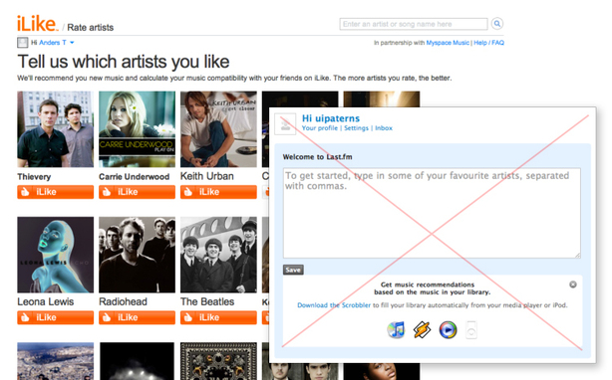
Notes:
http://persuasive-patterns.com/users/1/collections/1640/entry/6798
Rather than forcing you to name artists that you like, ti provides you with a list of things that you can click. This is faster to do, and easier to do.

Slide 5
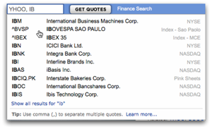
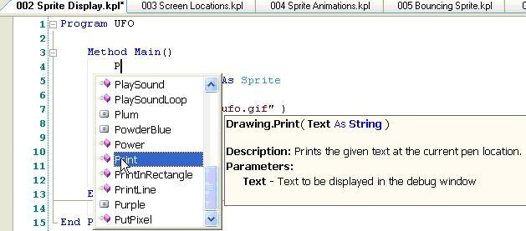
Autocomplete is a nice example of how the system aids you. It is easier to recognize symbols rather than recall them from scratch.

Slide 6
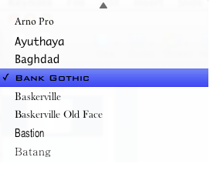
This kind of idea applies at both low-level, and high-level.
It would be great if this was a link, but it’s not.

Slide 7
This kind of idea applies at both low-level, and high-level.

Slide 8
7 Recognition rather than recall
Making objects, actions, and options visible to minimize the user’s memory load
The user should not have to remember information from one part of the dialogue to another
Instructions for use of the system should be visible or easily retrievable whenever appropriate
Notes:
Minimize the user's memory load by making objects, actions, and options visible
The user should not have to remember information from one part of the dialogue to another. Instructions for use of the system should be visible or easily retrievable whenever appropriate.

Slide 9
8 Aesthetic and minimalist design
Dialogues should not contain information which is irrelevant or rarely needed
Every extra unit of information in a dialogue competes with the relevant units of information and diminishes their relative visibility.

Slide 10
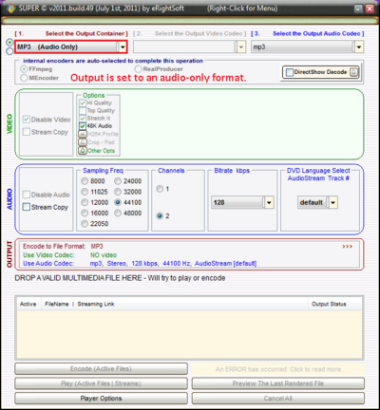
SUPER is an audio/video converter tool
Although I have selected “audio only”, all of the video stuff is still there.
Notes:
http://vis.berkeley.edu/courses/cs160-sp12/wiki/index.php/HeuristicEvaluation-Omar_Ali

Slide 11
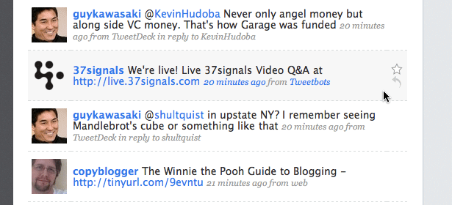
Hover controls only appear when they are likely to be used (i.e. when the mouse is hovering over the activation area).
What is the downside of this approach?
Notes:
http://www.webdesignerdepot.com/2009/02/7-interface-design-techniques-to-simplify-and-de-clutter-your-interfaces/

Slide 12
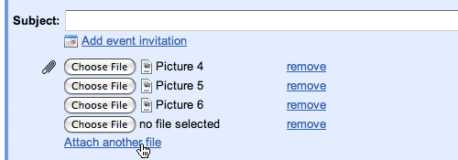
Expanding forms provide interaction only when it is requested.
What is the downside of this approach?
Notes:
http://www.webdesignerdepot.com/2009/02/7-interface-design-techniques-to-simplify-and-de-clutter-your-interfaces/

Slide 13
8 Aesthetic and minimalist design
Dialogues should not contain information which is irrelevant or rarely needed
Every extra unit of information in a dialogue competes with the relevant units of information and diminishes their relative visibility.
Notes:
Is information digestible or focus-dividing? Can the application provide abundant information and action without a cumbersome interface? Can large areas be broken up into parts (when beneficial to the user)?

Slide 14
9 Flexibility and efficiency of use
Accelerators -- unseen by the novice user -- may often speed up the interaction for the expert user such that the system can cater to both inexperienced and experienced users
  » allow existing/common accelerators to work
  » provide accelerators
Allow users to tailor frequent actions
  » macros

Slide 15
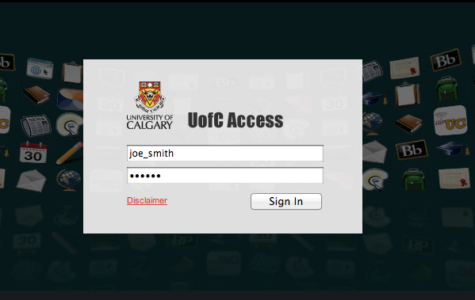
Anyone use tabs when filling out forms?
1
2
3
4
Notes:
Tabbing through puts you on “Disclaimer” rather than “Sign In”
Or, in some browsers, (Safari), puts you right into the address field. Whha…?

Slide 16
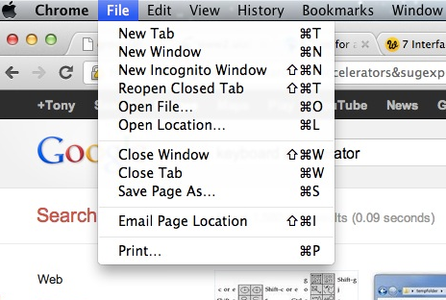
When you’re using an accelerator, you feel and look like a Boss.
Taking these away makes it more annoying to use an interface if you are used to them.
Notes:
Question: what kinds of accelerators do you use in applications that you frequent?
What is the trade-off with the current representation?
How discoverable is this interface?
How cluttered is this interface?

Slide 17
10 Help and documentation
Even though it is better if the system can be used without documentation, it may be necessary to provide help and documentation.
Any such information should be easy to search, focused on the user's task, list concrete steps to be carried out, and not be too large.

Slide 18
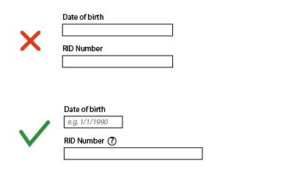
Simple example: width of the field provides a clue about the length of the input.
Contextual help is provided.
Notes:
http://adamkochanowicz.com/?p=664
What did he get wrong here?
Can the user get help at any point? Are my help elements a feature to those needing help but not a burden to those needing not? Does my documentation clearly refer to the elements it documents?

Slide 19
What constitutes help?
Tutorials / get started manuals
Reference manuals
Reminders
Wizards
Tips

Slide 20
Conducting a Heuristic Evaluation
Pre-evaluation training
  » provide evaluators with domain knowledge and information on scenario
Evaluation
  » individuals evaluate and then aggregate results
Severity ratings
  » determine how severe each problem is (priority)
  » perform individually then as a group
Debriefing
  » discuss outcome with design team

Slide 21
Evaluation
Each evaluator performs at least two passes
  » first: get a feel for flow and scope of system
  » second: focus on specific elements
Assistance: for walk-up and use interfaces, no need; otherwise, supply evaluators with scenarios
Each evaluator produces a list of problems
  » explain why with respect to the heuristics or other information
  » be specific and list each problem separately

Slide 22
Examples
Tabbing from password field lands in “Disclaimer” link rather than “Submit”
  Violates “consistency” heuristic, as well as “accelerators” heuristic
  Fix: reorder the tab stops

Slide 23
Evaluation
Why list each violation?
Where problems may be found
  Single location in UI
  Two or more locations that need to be compared
  Overall structure of UI
  Something that is missing
    Hard w/ paper prototypes

Slide 24
Severity Rating
Used to allocate resources to fix problems
Combination of:
  Frequency
  Impact
  Persistence (one time or repeating)
Should be estimated after all problems have been seen
Independently first is good

Slide 25
Severity Ratings
0 – don’t think this is a usability problem
1 – cosmetic problem
2 – minor usability problem
3 – major usability problem; important to fix
4 – usability catastrophe; must fix

Slide 26
Examples - Severity
Tabbing from password field lands in “Disclaimer” link rather than “Submit”
  Violates “consistency” heuristic, as well as “accelerators” heuristic
  Fix: reorder the tab stops

Slide 27
Debriefing
Conduct with evaluators, observers, and development team members
Discuss general characteristics of UI
Suggest potential improvements to address major usability problems
Dev. team rates how hard things are to fix
Make it a brainstorming session
  little criticism until end of session

Slide 28
Learning Objectives
You should now be able to:
» understand and describe three heuristics: recognition rather than recall; aesthetic and minimalist design; flexibility and efficiency of use, and help & documentation
» be able to describe the process of, and conduct a heuristic evaluation

