Slide 1
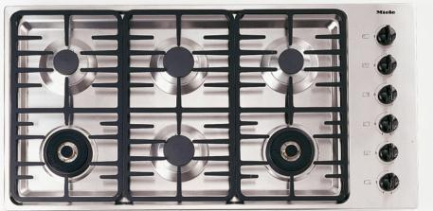
Quick, turn off the burner!!
Notes:
http://www.ssw.com.au/ssw/Standards/Rules/RulesToBetterinterfaces.aspx

Slide 2
Heuristic Evaluation 3 - Exercises

Slide 3
Split class…
Pull out a piece of paper, or something to scrawl something onto.
Half of the class, put your head down.

Slide 4
Write down the answer to this question:
What is the name of the Canadian skip who won gold in the Women’s Curling event at the Sochi 2014 Olympics?
Notes:
Video game example next time!!!

Slide 5
Switch!!!

Slide 6
Write down the answer to this question:
What is the name of the Canadian hockey player who has won gold many times in Women’s hockey at the winter Olympics?
Jennifer Jones
(b) Tessa Virtue
(c) Hayley Wickenheiser
(d) Someone else…

Slide 7
Up!

Slide 8
So…
Who’s confident of their answer?

Slide 9
Recognition rather than recall
Showing people things and allowing them to select is easier than asking them to recall from scratch
“Instructions” (affordances) should be easily visible/retrievable when it is appropriate

Slide 11
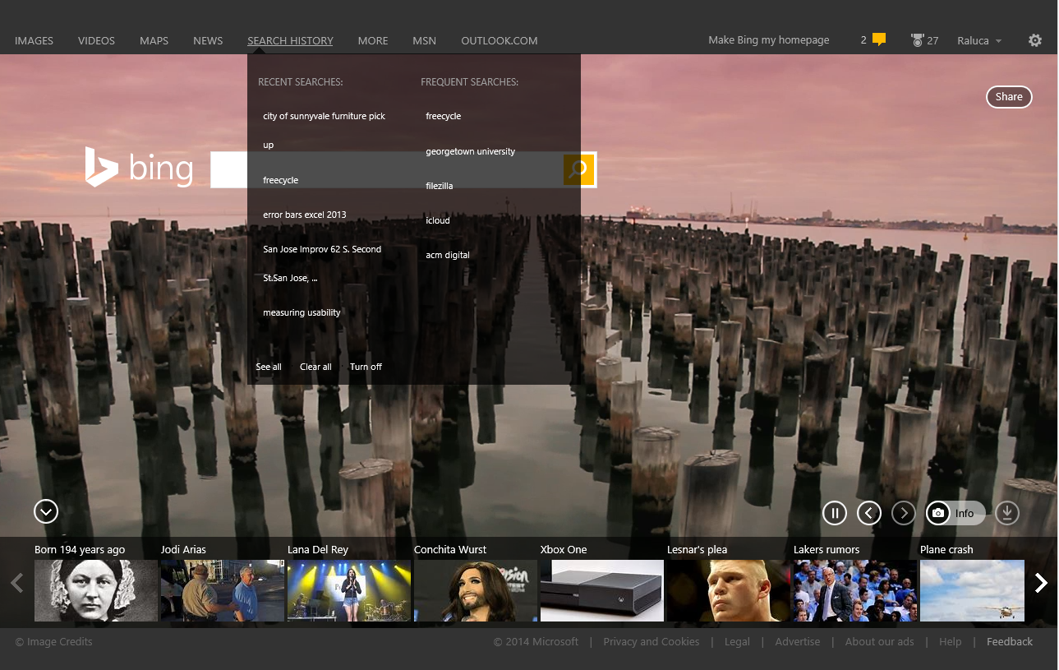
Notes:
http://www.nngroup.com/articles/recognition-and-recall/

Slide 12
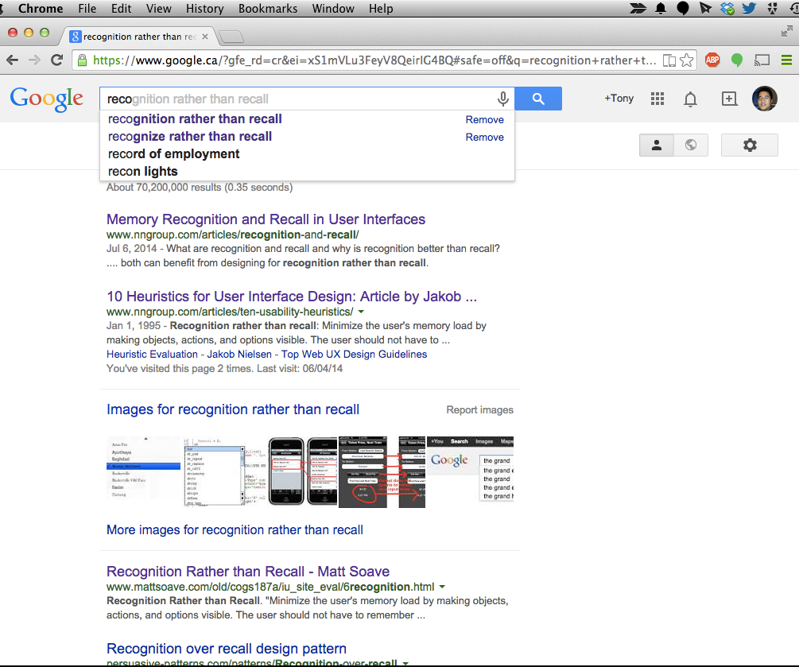

Slide 13
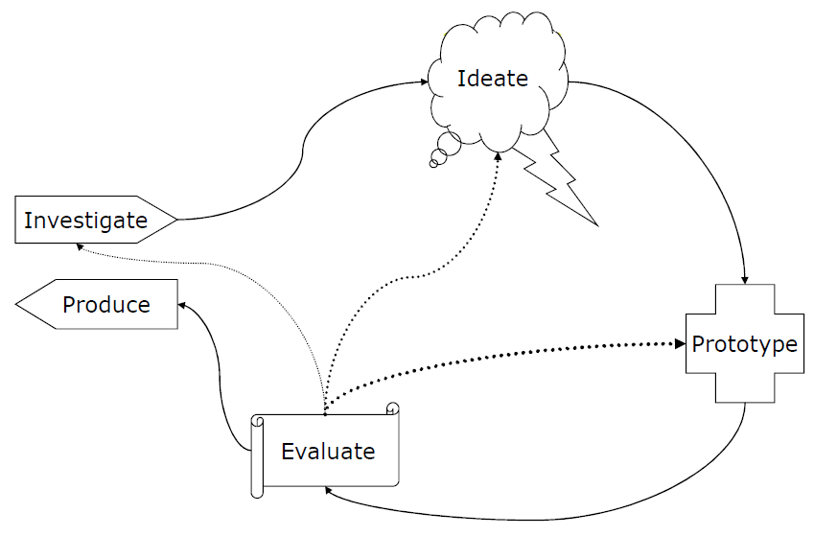
Which question is easier?
List the five phases of a user centered design cycle.
Fill in the five boxes that represent the user centered design cycle
Which labels in this list are part of the user centered design cycle? Understand, investigate, brainstorm, ideate, prototype, sketch, evaluate, test, produce.

Slide 14
Aesthetic and minimalist design

Slide 15
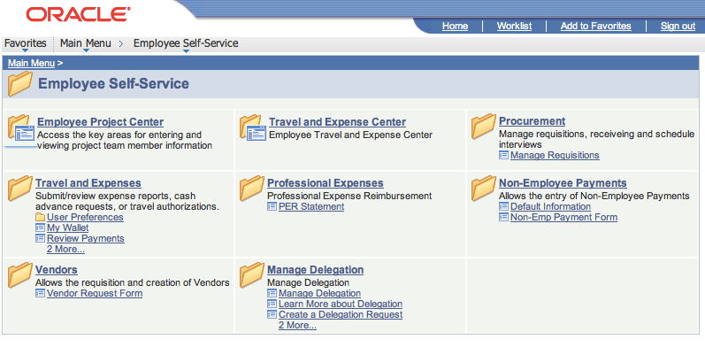
Notes:
I’m going to a conference in Paris to present some research work. This is going to be a fun trip, but I don’t have the money in my bank account to afford a ticket, hotels, registration, etc.
Fortunately, the university has a mechanism, called a “cash advance”, that should allow me to get money in advance to pay for it. It comes out of my grant.

Slide 16
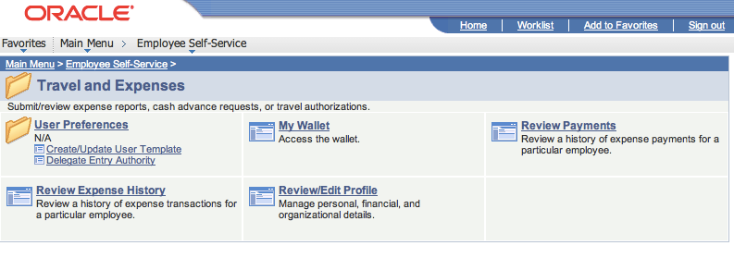
Notes:
Wrong one as usual

Slide 17
Notes:
Back out

Slide 18
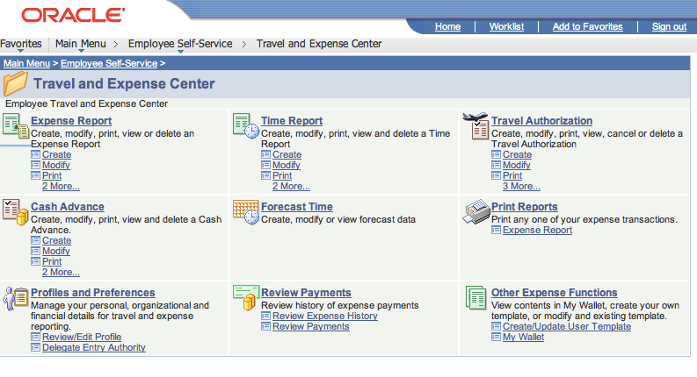
Notes:
Click through… HEY! There’s cash advance!

Slide 19
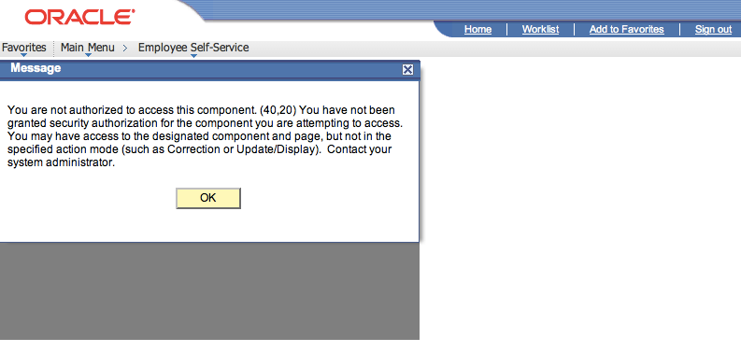
Notes:
W T F

Slide 20
Notes:
Get some instructions…

Slide 21
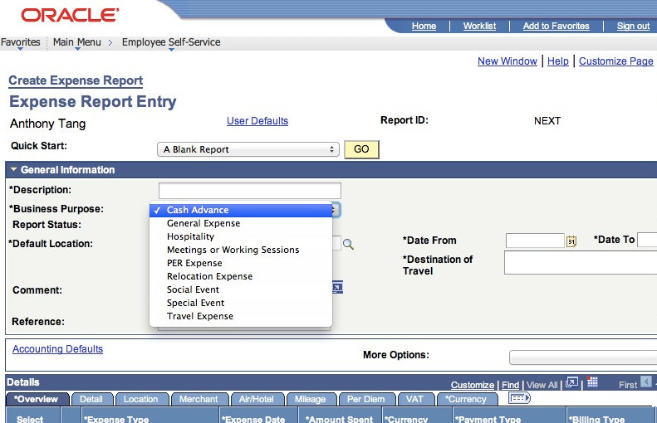
Notes:
Oh… I file an expense report, and ask for a cash advance.
W T F

Slide 22
Link to cash advances doesn’t even work
Violates “aesthetic and minimalist interface”
Fix: remove the link if the user can’t use it
Severity rating?

Slide 23
Aesthetic and minimalist design
Dialogues should not contain information which is irrelevant or rarely needed
Every extra unit of information in a dialogue competes with the relevant units of information and diminishes their relative visibility.
Question: can you get away with less?

Slide 24
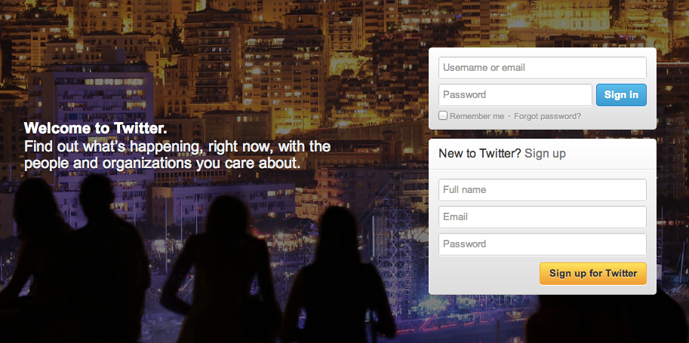
How does Twitter.com’s homepage guide the user’s attention?
In what ways has it used a minimalist design?
Notes:
Labels inside the fields
Contrast
Stands up.

Slide 25
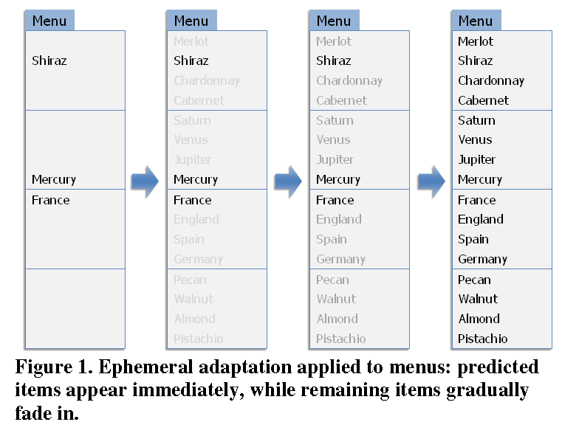
Ephemeral Adaptation

Slide 26
10 Help and documentation
Even though it is better if the system can be used without documentation, it may be necessary to provide help and documentation.
Any such information should be easy to search, focused on the user's task, list concrete steps to be carried out, and not be too large.

Slide 27
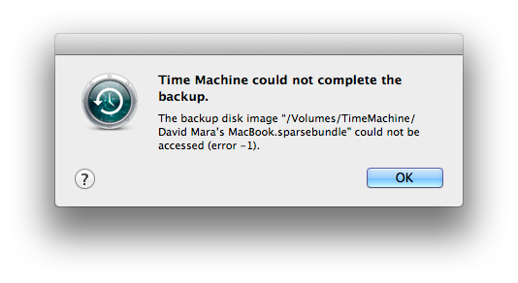
Notes:
http://community.wd.com/t5/image/serverpage/image-id/6671iC86EBD8535AA430C?v=mpbl-1
Even though it is better if the system can be used without documentation, it may be necessary to provide help and documentation.
Any such information should be easy to search, focused on the user's task, list concrete steps to be carried out, and not be too large.

Slide 28
Severity Ratings
0 – don’t think this is a usability problem
1 – cosmetic problem
2 – minor usability problem
3 – major usability problem; important to fix
4 – usability catastrophe; must fix

Slide 29
Severity Rating
Used to allocate resources to fix problems
Combination of:
Frequency
Impact
Persistence (one time or repeating)
Should be estimated after all problems have been seen
Independently first is good

Slide 30
Monday – Guest Lecture by Nancy Lopez from Solium
Title: Usability - Caring About Humans
brief introduction about me
brief intro to Solium, Equity Plan Admin and our flagship product, Shareworks
and then get more into the UX team, and our role, responsibilities and challenges
how we go about engaging users in feedback sessions, usability testing etc.
I am hoping to include some examples of improvements made, the odd stat about successes (e.g. reduction in call volumes), hopefully some video of user testing etc.

