Slide 1
Heuristic Evaluation 2
CPSC 481: HCI I
Fall 2014
Anthony Tang with acknowledgements to Saul Greenberg and Ehud Sharlin

Slide 2
Learning Objectives
By the end of the class, you should be able to:
» Understand and be able to describe components of three heuristics: consistency & standards; error recovery; error prevention
» Distinguish and describe three different types of interface consistency

Slide 3
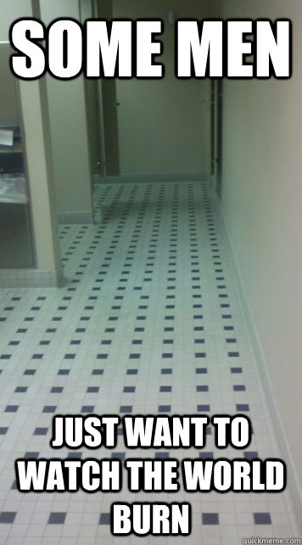
4 Consistency and Standards
Principle of least surprise
» similar things should act similarly
» different things should look different
Adhere to platform guidelines
Consistent language, colour, wording, ordering
Consistent use of input syntax
Notes:
A very important kind of consistency is in wording. Use the same terms throughout your user interface. If your interface says “share price” in one place, “stock price” in another, and “stock quote” in a third, users will wonder whether these are three different things you’re talking about.

Slide 4
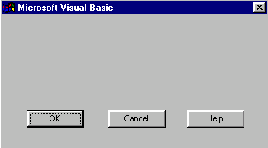
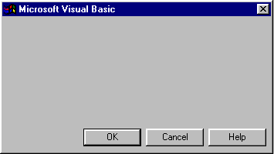
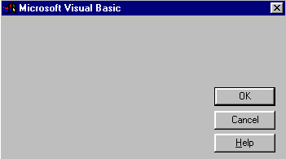
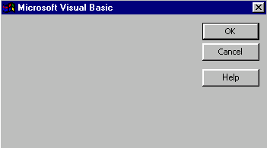
Goal: Predictability

Slide 5
Types of Consistency
internal consistency » is the interface consistent with itself
external consistency » is the design consistent with similar types of applications/applications on the platform
metaphorical consistency » is the design consistent with the similar real-world entity/object
Notes:
How does importance work?
Internal consistency is related to how well the thing just kind of works on its own
External consistency is somewhat related to learnability – if it’s consistent with other things out there, it will be easy to pick up
Metaphorical consistency is a little trickier. Think: ‘phone interfaces’, etc.
External consistency. Ctrl – apple –N creates a new slide in OS X; CTRL-M creates a new slide in Windows W T F

Slide 6
4 Consistency and Standards
Principle of least surprise
» similar things should act similarly
» different things should look different
Adhere to platform guidelines
Consistent language, colour, wording, ordering
Consistent use of input syntax
Notes:
A very important kind of consistency is in wording. Use the same terms throughout your user interface. If your interface says “share price” in one place, “stock price” in another, and “stock quote” in a third, users will wonder whether these are three different things you’re talking about.

Slide 7
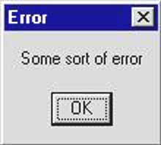
Notes:
http://www.retailshakennotstirred.com/retail-shaken-not-stirred/2009/10/conversion-tip-dont-let-bad-error-messages-cost-you-sales.html

Slide 8
5 Help users recognize, diagnose, and recover from errors
Use plain language
Identify the problem
Constructively suggest a solution
Notes:
Error messages should be expressed in plain language (no codes), precisely indicate the problem, and constructively suggest a solution.

Slide 9

How so?
So which is it?
Still sucks, but I know what to do now.
Notes:
http://www.retailshakennotstirred.com/retail-shaken-not-stirred/2009/10/conversion-tip-dont-let-bad-error-messages-cost-you-sales.html

Slide 10

Nerding out. People know the word “password.”

Slide 11
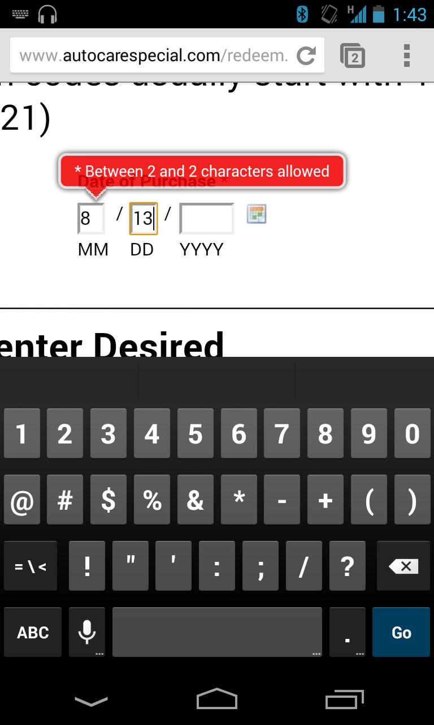

Slide 12
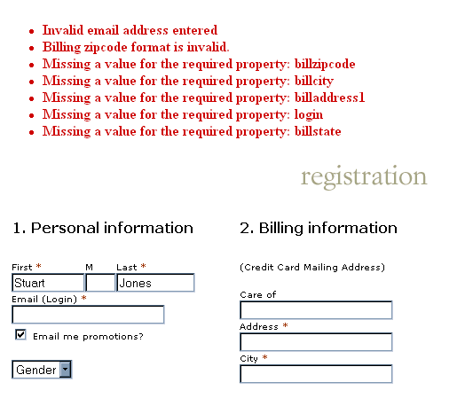
Error messages are too far away from where they can be corrected.
Also, can we say “nerd language” for the error messages themselves?

Slide 13
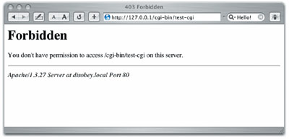
Be polite » don’t blame
ABORTED
FATAL
ILLEGAL
Notes:
The message should be worded
to take as much blame as possible away from the
user and heap the blame instead on the system.
Save the user’s face; don’t worry about the
computer’s. The computer doesn’t feel it, and in
many cases it is the interface’s fault anyway for not
finding a way to prevent the error in the first place.
Many words that are unfortunately common in
technical error messages have emotionally-charged
meanings in ordinary language; examples include
“fatal”, “illegal”, “abort”, etc. Avoid them. Use
neutral language.

Slide 14
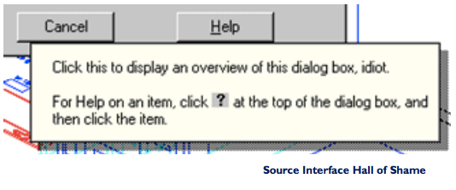
Be polite even when you’re coding for yourself…
Notes:
AutoCAD example!!
The tooltip shown at the bottom isn’t strictly an
error message, but it actually appeared in a
production version of AutoCad! As the story goes,
it was inserted by a programmer as a joke, but
somehow never removed before release. Even as a
joke, it demonstrates a lack of respect for the
intelligence of the human being on the other side of
the screen. That attitude is exactly wrong for user
interface design.

Slide 15

Provide suggestions/examples
Restate the user’s input
» not “cannot open file”, but “cannot open file named paper.doc”

Slide 16
5 Help users recognize, diagnose, and recover from errors
Use plain language
Identify the problem
Constructively suggest a solution
Notes:
Error messages should be expressed in plain language (no codes), precisely indicate the problem, and constructively suggest a solution.

Slide 17
Tony’s Password Creation Protocol
Throwaway: standard
May return site: standardPlus
Super secure site: s!4nd4rdP!u5
May return site (req number): standardPlus1
May return site (req punctuation): standardPlus!
…

Slide 18
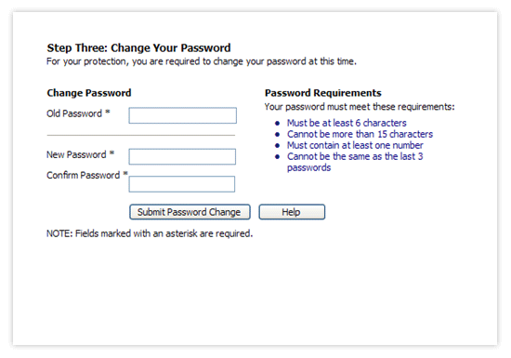

Slide 19
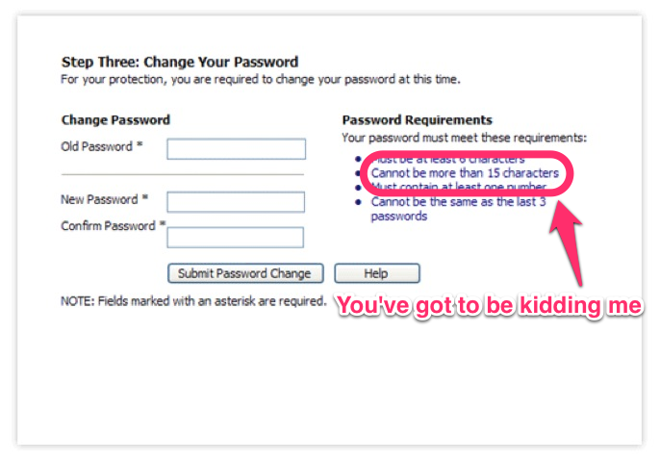
Notes:
Ideal resolution: get rid of this restriction. Why should there be some upper bound? Is storage expensive??

Slide 20

Yes, but mainly because I don’t know what your policy on passwords is.
If you ask me what my email address is, I also don’t remember what dummy email address I gave you.

Slide 21
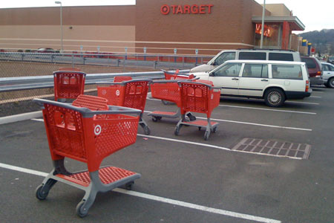
Notes:
http://www.thelifeofbon.com/2012/08/the-ever-important-shopping-cart-debate.html

Slide 22
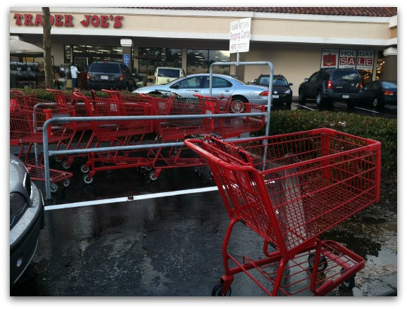
Cart return lane example…
Notes:
http://www.sugarjones.tv/blog/1058/wth-wednesday

Slide 23
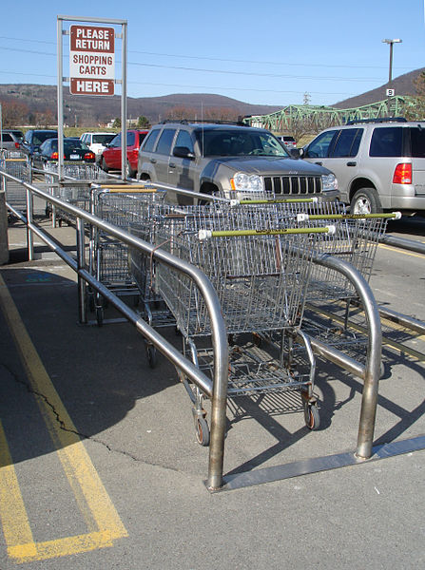
Cart return lane
Constraining width of the lane makes it impossible to “get it wrong”
Notes:
http://upload.wikimedia.org/wikipedia/commons/thumb/0/02/Shopping_Cart_Return.jpg/447px-Shopping_Cart_Return.jpg

Slide 24
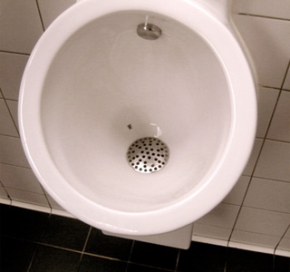
6 Error Prevention
Design to prevent errors from occurring
Eliminate error-prone conditions
Present users with a confirmation option before they commit to the action
Notes:
Imagine a scrollbar that keeps popping up with “too far! Too far!” Nonsense entries can be ignored
http://www.ssw.com.au/ssw/Standards/Rules/RulesToBetterinterfaces.aspx

Slide 25
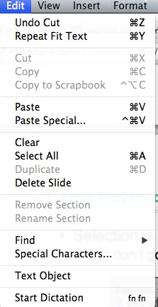
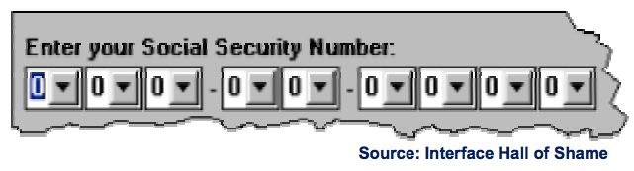
Prevention techniques (on the small)
Grey out illegal commands
Avoid typing errors through selection
Notes:
One way to prevent errors is to allow users to select rather type. Misspellings then become
impossible. This attitude can be taken to an extreme, however, as shown in this example.
If a command is illegal in the current state of the interface – e.g., Copy is impossible if
nothing is selected – then the command should be disabled (“grayed out”) so that it simply
can’t be selected in the first place.

Slide 26
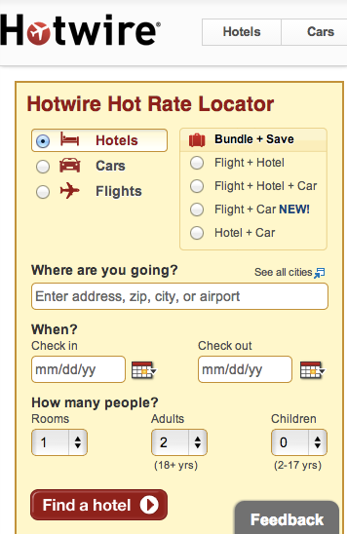
More Error Prevention (on the small)
Provides auto-complete suggestions for city
Date picker for dates (while still allowing for text-entry)
Greys out inappropriate “check out” dates given “check in” dates
…
Notes:
http://www.tingzabraham.com/Information-Architecture/usability/usability-heuristics-part-5-error-prevention/

Slide 27
Error Types
Slips (and lapses)
» failure to correctly execute a procedure
» slip is a failure of execution; lapse is a failure of memory
» typically found in skilled behaviour
Mistakes
» using wrong procedure for goal
» typically found in rule-based behaviour or problem-solving behaviour
Notes:
Slips and lapses are found in skilled behavior –
execution of procedures that the user has already
learned. For example, pressing an onscreen button
– moving the mouse pointer over it, pressing the
mouse button, releasing the mouse button – is a
skill-based procedure for virtually any computer
user. An error in executing this procedure, like
clicking before the mouse pointer is over the
button, is a slip. This is just a low-level example,
of course. We have many higher-level, learned
procedures too – attaching a file to an email,
submitting a search to Google, drawing a rectangle
in a paint program, etc. An error in execution of
any learned procedure would be a slip.
Slips are distinguished from lapses by the source of
the failure. A slip is a failure of execution or
control – for example, substituting one action for
another one in the procedure. A lapse is a failure of
memory – for example, forgetting the overall goal,
or forgetting where you are in the procedure.
A mistake, on the other hand, is an error made in
planning or rule application. One framework for
classifying cognitive behavior divides behavior into
skill-based (learned procedures), rule-based
(application of learned if-then rules), and
knowledge-based (problem solving, logic,
experimentation, etc.) Mistakes are errors in rulebased or knowlege-based behavior; e.g., applying a
rule in a situation where it shouldn’t apply, or using
faulty reasoning. We won’t have much to say
about mistakes in this course, but much research in human error is concerned with this level – e.g.,
suboptimal or even irrational heuristics that people
use for decision making and planning.

Slide 28
Slips (and lapses)
Capture error » frequently done activity takes charge instead of intended one
» leave your house, and end up walking toward school instead of to the grocery store
Description error » intended action similar to others that are possible
» pour orange juice on cereal
» throwing shirt into toilet instead of hamper
Notes:
Here are some examples of common slips. A
capture slip occurs when a person starts executing
one sequence of actions, but then veers off into
another (usually more familiar) sequence that
happened to start the same way. A good mental
picture for this is that you’ve developed a mental
groove from executing the same sequence of
actions repeatedly, and this groove tends to capture
other sequences that start the same way.
A description slip occurs when two actions are
very similar. The user intends to do one action, but
accidentally substitutes the other. A classic
example of a description error is reaching into the
refrigerator for a carton of milk, but instead picking
up a carton of orange juice and pouring it into your
cereal. The actions for pouring milk in cereal and
pouring juice in a glass are nearly identical – open
fridge, pick up half-gallon carton, open it, pour–
but the user’s mental description of the action to
execute has substituted the orange juice for the
milk.

Slide 29
Slips (and lapses)
Loss of intention » forgetting the goal partway
» walking into a room, forgetting why you went there
Omissions due to interruption
» get coat out, interrupted by phone call; then go out without coat
Omissions due to already satisfied goal
» walking away from ATM w/o card
» walking away from copier without originals
Notes:
Lapses are due to failures of memory, particularly
the short-term memory that is managing the
execution of a procedure. A loss of intention lapse
happens when you start executing a procedure and
forget your goal in the interim. For example, when
you walk to another room to fetch something, and
by the time you get there, you no longer remember
what you wanted.
Lapses can also happen because of interruptions,
which disrupt short-term memory and make you
lose track of your place in the interrupted
procedure.
Another common lapse happens when your goal is
actually satisfied in the middle of the procedure.
The remaining steps are cleanup or shutdown
subtasks, which you may forget because you’ve
already discharged your original intention. For
example, if an ATM machine gives you the cash
first, you may walk away from it without taking
your card, because your original goal was getting
cash. This is a clear example of an error that good
user interface design can prevent.

Slide 30
Slips (and lapses)
Mode errors » people do actions in one mode thinking they are in another
» refer to a file that’s in a different directory
» vi
» looking for commands / menu options that are not relevant
Notes:
Another kind of error, clearly due to user interface,
is a mode error. Modes are states in which the same
action has different meanings. For example, when
Caps Lock mode is enabled on a keyboard, the
letter keys produce uppercase letters. The text
editor vi is famous for its modes: in insert mode,
letter keys are inserted into your text file, while in
command mode (the default), the letter keys invoke
editing commands. In the first lecture, we talked
about a mode error in Gimp: accidentally changing
a menu shortcut because your mouse is hovering
over it.
Mode errors occur when the user tries to invoke an
action that doesn’t have the desired effect in the
current mode. For example, if the user means to
type lowercase letters but doesn’t notice that Caps
Lock is enabled, then a mode error occurs.
Mode errors are generally slips, an error in the
execution of a learned procedure, caused by failing
to correctly evaluate the state of the interface.

Slide 31
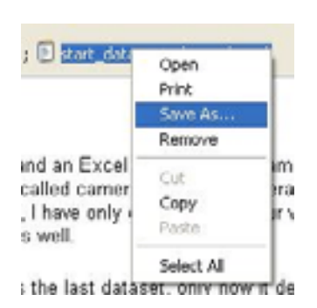
Preventing Capture and Description Slips
Avoiding habitual action sequences with identical prefixes
Avoid actions with very similar descriptions
Keep dangerous commands away from common ones
Notes:
Let’s discuss how to prevent errors of these sorts.
In a computer interface, you can deal with capture
errors by avoiding very common action sequences
that have identical prefixes.
Description errors can be fought off by applying
the converse of the Consistency heuristic: different
things should look and act different, so that it will
be harder to make description errors between them.
Avoid actions with very similar descriptions, like
long rows of identical buttons.
You can also reduce description errors by making
sure that dangerous functions (hard to recover from
if invoked accidentally) are well-separated from
frequently-used commands. Outlook 2003 makes
this mistake: when you right-click on an email
attachment, you get a menu that mixes common
commands (Open, Save As) with less common and
less recoverable ones – if you print that big file by
mistake, you can’t get the paper back. And if you
Remove the attachment, it’s even worse – undo
won’t bring it back! (Thanks to Amir Karger for
this example.)

Slide 32
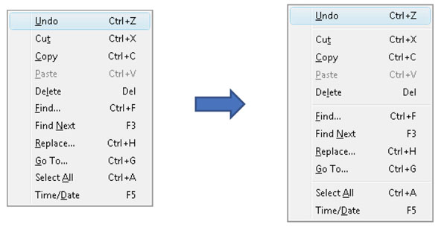
What do you think of this redesign?
Notes:
http://www.ssw.com.au/ssw/Standards/Rules/RulesToBetterinterfaces.aspx

Slide 33
Preventing Mode Errors
Eliminate modes
Increase visibility of mode
Spring-loaded or temporary modes
Disjoint action sets in different modes
Notes:
There are many ways to avoid or mitigate mode
errors. Eliminating the modes entirely is best,
although not always possible. Modes do have some
uses – they make command sets smaller, for
example. When modes are necessary, it’s essential
to make the mode visible. But visibility is a much
harder problem for mode status than it is for
affordances. When mode errors occur, the user isn’t
actively looking for the mode, like they might
actively look for a control. As a result, mode status
indicators must be visible in the user’s locus of
attention. That’s why the Caps Lock light, which
displays the status of the Caps Lock mode on a
keyboard, doesn’t really work.
Other solutions are spring-loaded or temporary
modes. With a spring-loaded mode, the user has to
do something active to stay in the alternate mode,
essentially eliminating the chance that they’ll forget
what mode they’re in. The Shift key is a springloaded version of the uppercase mode. Drag-anddrop is another spring-loaded mode; you’re only
dragging as long as you hold down the mouse
button. Temporary modes are similarly short-term.
For example, in many graphics programs, when
you select a drawing object like a rectangle or line
from the palette, that drawing mode is active only
for one mouse gesture. Once you’ve drawn one
rectangle, the mode automatically reverts to
ordinary pointer selection.
Finally, you can also mitigate the effects of mode
errors by designing action sets so that no two
modes share any actions. Mode errors may still
occur, when the user invokes an action in the
wrong mode, but the action can simply be ignored
rather than triggering any undesired effect.

Slide 34
Avoiding Lapses
Keep procedures short
Minimize interruptions
Use forcing functions
» automatic transmission: you must hold down brake to shift out of Park
» must take card out of ATM before you get your money
Notes:
One way to avoid lapses in procedure execution is
to keep procedures short, so that users have fewer
steps to potentially forget. (Striving for simplicity
often does this as a side-effect.) It’s also helpful to
put more obvious structure on the procedure, a
technique called dialog closure (Shneiderman,
Designing the User Interface). Action sequences
should be designed with a beginning, a middle, and
an end. For example, think about drag and drop:
At the beginning, you press the mouse button and
see the object picked up with your cursor.
In the middle, you move the object across the
screen towards your target, getting feedback that
it’s coming along.
At the end, you release the mouse button, and see
the effects of the drop.
The key feature of closure is the feedback you get
at the end of the operation. This assurance that the
operation completed provides the user with a sense
of accomplishment, some relief, and an opportunity
to clear their working memory of the details of the
task in preparation for another.
Some lapses can be addressed by designing forcing
functions into the interface. A forcing function is a
feature that forces one step to be performed before
another step. For example, many cash machines
require you to take your card back before they
dispense any cash to you. Forcing functions should
be used sparingly, since they reduce user control
and freedom, but when the forced step would be a
costly lapse (like leaving your ATM card behind),
then a forcing function may be worth it.

Slide 35
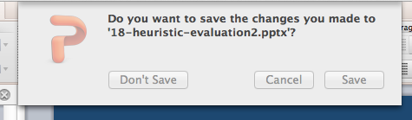
Confirmation Dialogs
Notes:
An unfortunately common strategy for error
prevention is the confirmation dialog, or “Are you
sure?” dialog. It’s not a good approach, and should
be used only sparingly, for several reasons:
•Confirmation dialogs can substantially reduce the
efficiency of the interface. In the example above, a
confirmation dialog pops up whenever the user
deletes something, forcing the user to make two
button presses for every delete, instead of just one.
Frequent commands should avoid confirmations.
•If a confirmation dialog is frequently seen – for
example, every time the Delete button is pressed –
then the expert users will learn to expect it, and will
start to include it in their habitual procedure. In
other words, to delete something, the user will learn
to push Delete and then OK, without reading or
even thinking about the confirmation dialog! The
dialog has then completely lost its effectiveness,
serving only to slow down the interface without
actually preventing any errors.
In general, reversibility (i.e. undo) is a far better
solution than confirmation. Even a web interface
can provide at least single-level undo (undoing the
last operation). Operations that are very hard to
reverse may deserve confirmation, however. For
example, quitting an application with unsaved work
is hard to undo – but a well-designed application
could make even this undoable, using automatic
save or keeping unsaved drafts in a special
directory.

Slide 36
6 Error Prevention
Design to prevent errors from occurring
Eliminate error-prone conditions
Present users with a confirmation option before they commit to the action
Notes:
Imagine a scrollbar that keeps popping up with “too far! Too far!” Nonsense entries can be ignored

Slide 37
Learning Objectives
You should now be able to:
» Understand and be able to describe components of three heuristics: consistency & standards; error recovery; error prevention
» Distinguish and describe three different types of interface consistency

