Slide 1
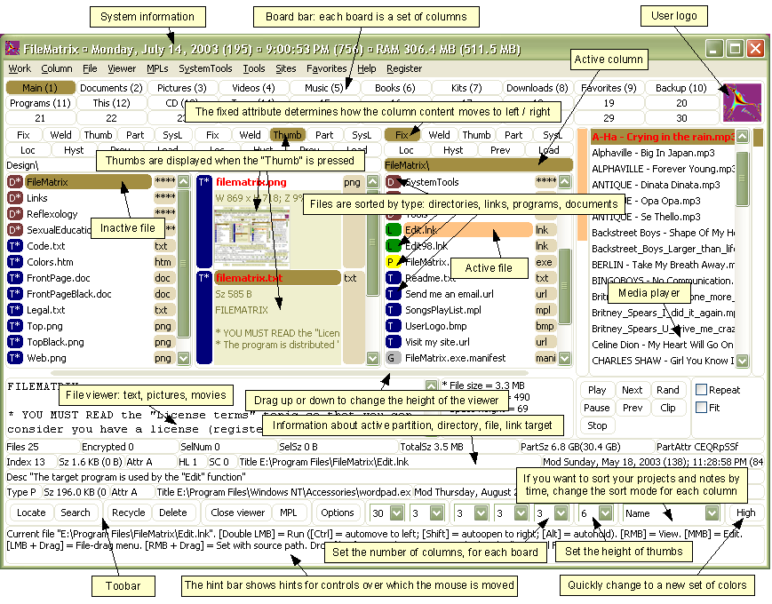
Everyone’s a designer…
Notes:
http://thedailywtf.com/Articles/Enter_The_Matrix.aspx

Slide 2
Heuristic Evaluation 2 - Exercises

Slide 3
Questions
Distinguish between three types of interface consistency.
Provide an example where an interface breaks each of these types of consistency.
Distinguish between a capture error, a description error. Provide an example of each.
Notes:
Internal
External
Metaphorical

Slide 4
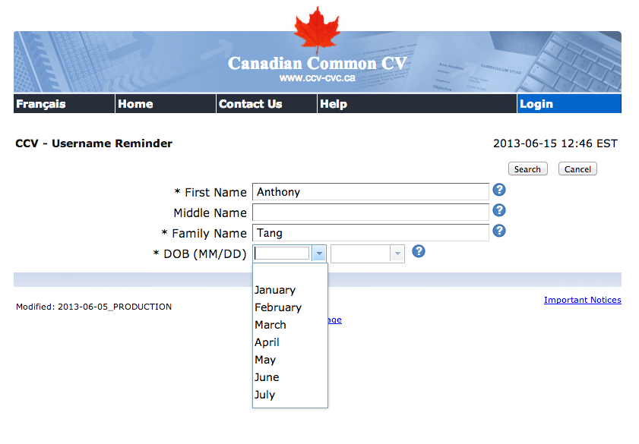
Notes:
Internal consistency is missing here…

Slide 5
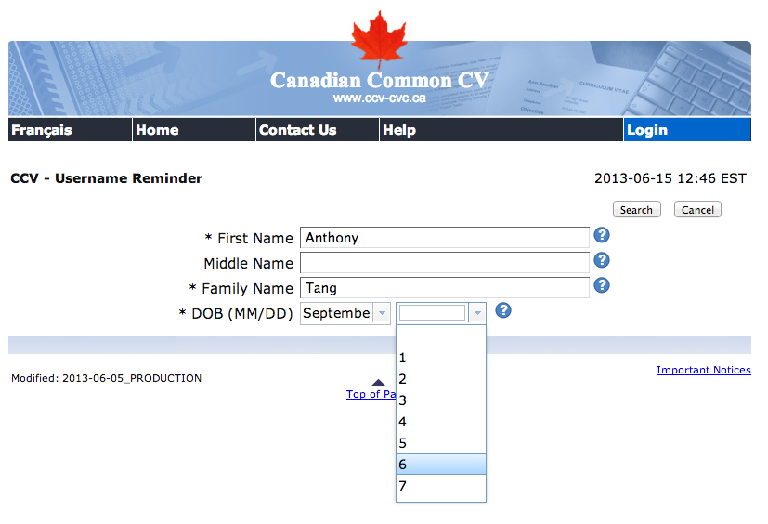
Notes:
And here, too!!
Broken shortcut mechanism, too… (can’t use keyboard shortcuts)

Slide 6
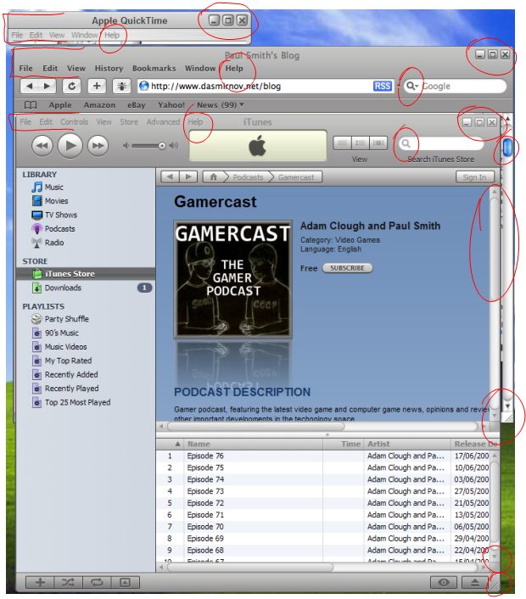
Apple hates Windows users
Notes:
http://www.dasmirnov.net/blog/apple_s_inconsistent_user_interface
1) Different shades of grey.
2) Different fonts, Safari is all blurry.
3) Different shading of fonts, Safari looks in focus when it's not.
4) Different sliders, Safari is the bright gel, yet iTunes is gray when not focused and just a plain blue when focused.
5) Different size and colour arrows on the sliders.
6) Window controls (close, maximise, etc) are different colours, and different sizes.
7) The resize icons in the bottom-right are different colours and sizes.
8) Search icons are different shades.
9) File menu is in line with the title in iTunes, yet a line lower in QuickTime and Safari.
10) Apple is used in the QuickTime title, yet not in the other applications.
11) The buttons between applications are completely different styles.

Slide 7
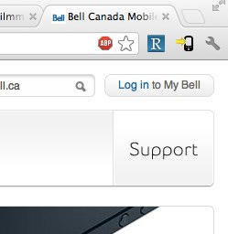
Drives me nuts every time I try to play my bill
Silly Tony, did you really think that whole thing was a button?

Slide 8
Slips (and lapses)
Capture error » frequently done activity takes charge instead of intended one
» leave your house, and end up walking toward school instead of to the grocery store
Description error » correct action on the wrong object due to insufficient specification
» pour orange juice on cereal
» throwing shirt into toilet instead of hamper
autopilot
similarity
Notes:
Here are some examples of common slips. A
capture slip occurs when a person starts executing
one sequence of actions, but then veers off into
another (usually more familiar) sequence that
happened to start the same way. A good mental
picture for this is that you’ve developed a mental
groove from executing the same sequence of
actions repeatedly, and this groove tends to capture
other sequences that start the same way.
A description slip occurs when two actions are
very similar. The user intends to do one action, but
accidentally substitutes the other. A classic
example of a description error is reaching into the
refrigerator for a carton of milk, but instead picking
up a carton of orange juice and pouring it into your
cereal. The actions for pouring milk in cereal and
pouring juice in a glass are nearly identical – open
fridge, pick up half-gallon carton, open it, pour–
but the user’s mental description of the action to
execute has substituted the orange juice for the
milk.

Slide 9
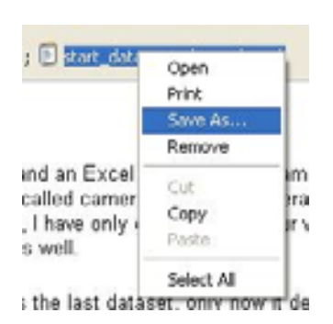
Preventing Capture and Description Slips
Avoiding habitual action sequences with identical prefixes
Avoid actions with very similar descriptions
Keep dangerous commands away from common ones
Notes:
Let’s discuss how to prevent errors of these sorts.
In a computer interface, you can deal with capture
errors by avoiding very common action sequences
that have identical prefixes.
Description errors can be fought off by applying
the converse of the Consistency heuristic: different
things should look and act different, so that it will
be harder to make description errors between them.
Avoid actions with very similar descriptions, like
long rows of identical buttons.
You can also reduce description errors by making
sure that dangerous functions (hard to recover from
if invoked accidentally) are well-separated from
frequently-used commands. Outlook 2003 makes
this mistake: when you right-click on an email
attachment, you get a menu that mixes common
commands (Open, Save As) with less common and
less recoverable ones – if you print that big file by
mistake, you can’t get the paper back. And if you
Remove the attachment, it’s even worse – undo
won’t bring it back! (Thanks to Amir Karger for
this example.)

Slide 10
Lapses
Loss of intention » forgetting the goal partway
» walking into a room, forgetting why you went there
Omissions due to interruption
» get coat out, interrupted by phone call; then go out without coat
Omissions due to already satisfied goal
» walking away from ATM w/o card
» walking away from copier without originals
Notes:
Lapses are due to failures of memory, particularly
the short-term memory that is managing the
execution of a procedure. A loss of intention lapse
happens when you start executing a procedure and
forget your goal in the interim. For example, when
you walk to another room to fetch something, and
by the time you get there, you no longer remember
what you wanted.
Lapses can also happen because of interruptions,
which disrupt short-term memory and make you
lose track of your place in the interrupted
procedure.
Another common lapse happens when your goal is
actually satisfied in the middle of the procedure.
The remaining steps are cleanup or shutdown
subtasks, which you may forget because you’ve
already discharged your original intention. For
example, if an ATM machine gives you the cash
first, you may walk away from it without taking
your card, because your original goal was getting
cash. This is a clear example of an error that good
user interface design can prevent.

Slide 11
Avoiding Lapses
Keep procedures short
Minimize interruptions
Use forcing functions
» automatic transmission: you must hold down brake to shift out of Park
» must take card out of ATM before you get your money
Notes:
One way to avoid lapses in procedure execution is
to keep procedures short, so that users have fewer
steps to potentially forget. (Striving for simplicity
often does this as a side-effect.) It’s also helpful to
put more obvious structure on the procedure, a
technique called dialog closure (Shneiderman,
Designing the User Interface). Action sequences
should be designed with a beginning, a middle, and
an end. For example, think about drag and drop:
At the beginning, you press the mouse button and
see the object picked up with your cursor.
In the middle, you move the object across the
screen towards your target, getting feedback that
it’s coming along.
At the end, you release the mouse button, and see
the effects of the drop.
The key feature of closure is the feedback you get
at the end of the operation. This assurance that the
operation completed provides the user with a sense
of accomplishment, some relief, and an opportunity
to clear their working memory of the details of the
task in preparation for another.
Some lapses can be addressed by designing forcing
functions into the interface. A forcing function is a
feature that forces one step to be performed before
another step. For example, many cash machines
require you to take your card back before they
dispense any cash to you. Forcing functions should
be used sparingly, since they reduce user control
and freedom, but when the forced step would be a
costly lapse (like leaving your ATM card behind),
then a forcing function may be worth it.

