Slide 1
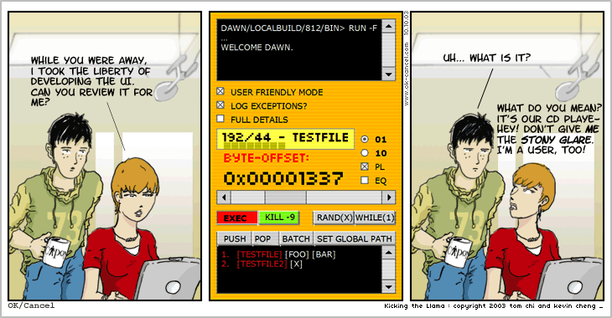
Everyone’s a designer…
Notes:
http://okcancel.com/comic/4.html

Slide 2
Reminders
Complete peer evaluations:
http://itpteammetrics.com/
Reading days: no class Monday
Tutorials on Mon & Tue canceled. Please visit one of the other tutorials:
Wed 2-3:50
Fri 12-1:50

Slide 3
Heuristic Evaluation 1
Exercises

Slide 4
Questions
Describe how visibility of system status works as a heuristic.
Provide an example where a system provides insufficient visibility of system status.

Slide 5
wget
GNU Wget is a free software package for retrieving files using HTTP, HTTPS and FTP, the most widely-used Internet protocols. It is a non-interactive commandline tool, so it may easily be called from scripts, cron jobs, terminals without X-Windows support, etc.
GNU Wget has many features to make retrieving large files or mirroring entire web or FTP sites easy, including:
Can resume aborted downloads, using REST and RANGE
Can use filename wild cards and recursively mirror directories
NLS-based message files for many different languages
Optionally converts absolute links in downloaded documents to relative, so that downloaded documents may link to each other locally
…
Notes:
Open up wget, show that it has a lot of options

Slide 6
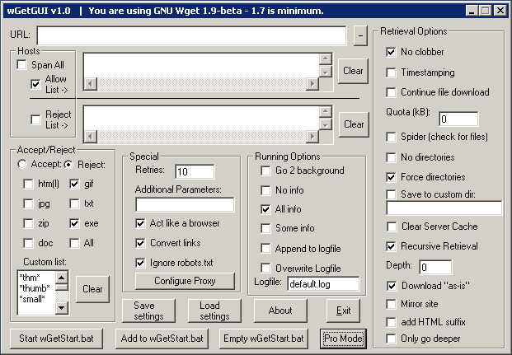
wGetGUI v1.0
Notes:
http://www.jensroesner.de/wgetgui/
Would you run a study on this?
What are you hoping to find?
What would you do?
What’s wrong with this?!!

Slide 7
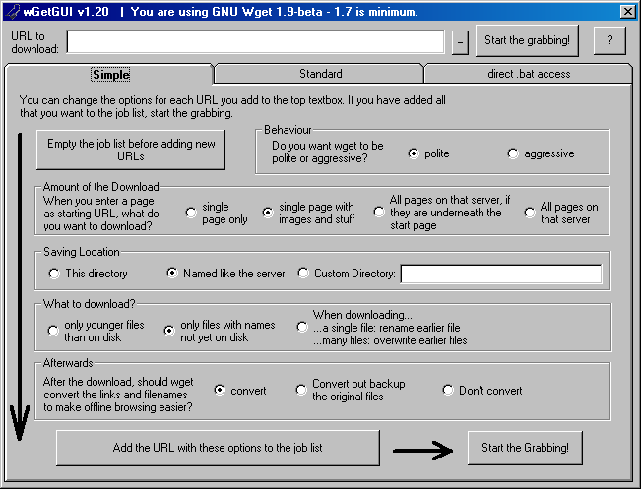
wGetGUI v1.2
Notes:
Does this improve things?

Slide 8
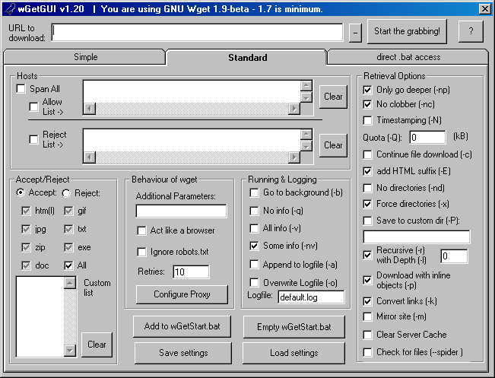

Slide 9
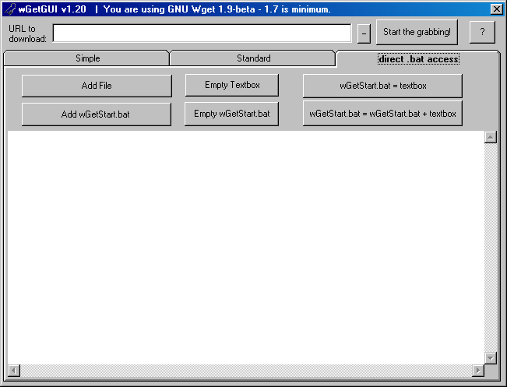

Slide 10
Question
Which of the three heuristics does wgetgui fail? In what way? [visibility of system status; match between system and real-world; user control & freedom]

Slide 11
Visibility of system status

Slide 12
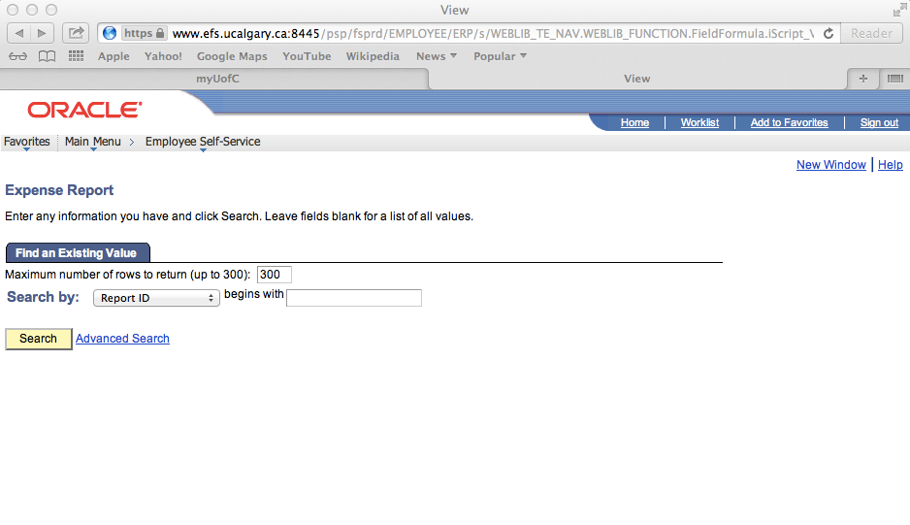

Slide 13
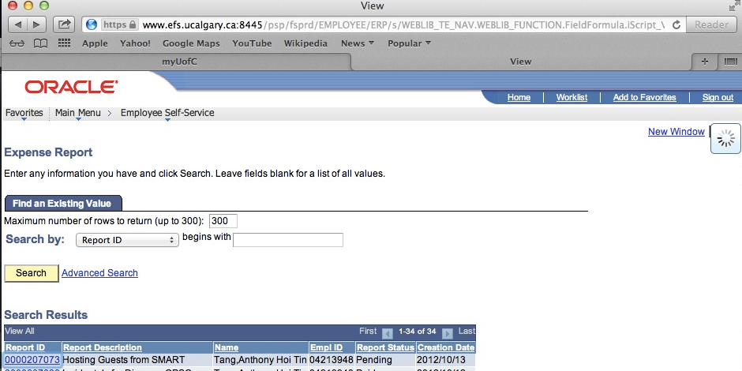

Slide 14
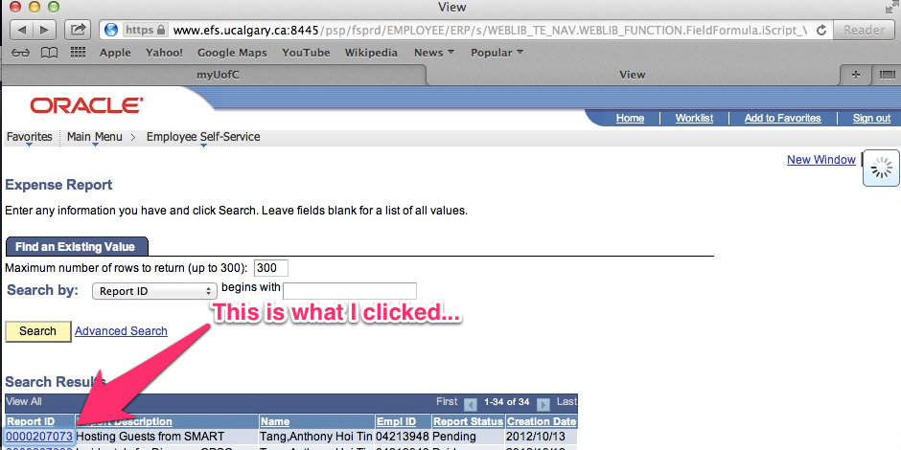

Slide 15
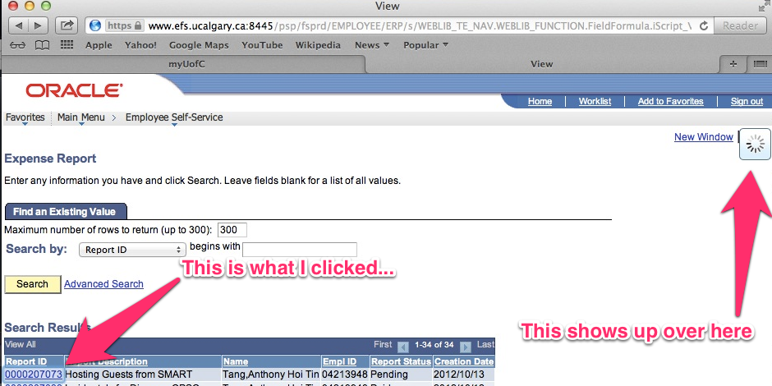

Slide 16
Match between system and real world

Slide 17
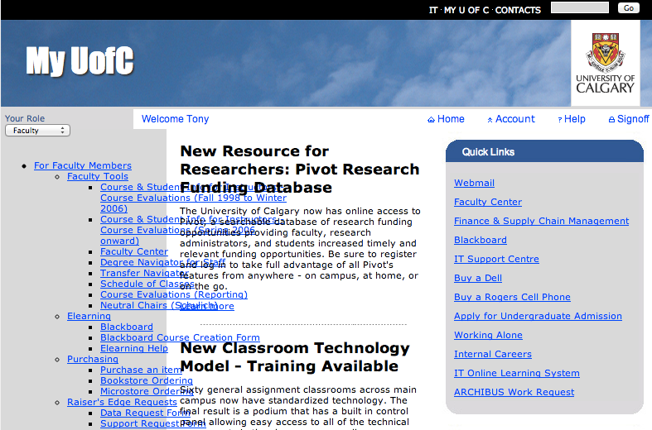

Slide 18
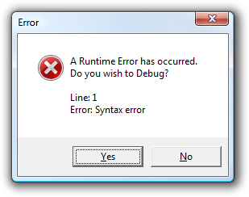

Slide 20
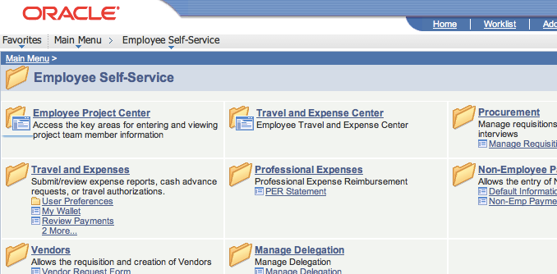

Slide 21
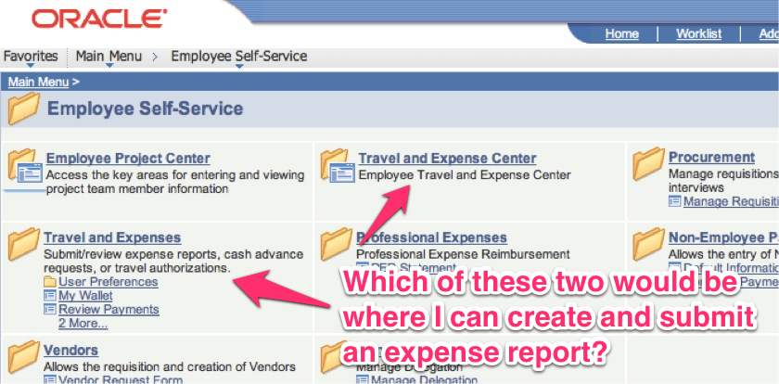

Slide 22
User control and freedom

Slide 23
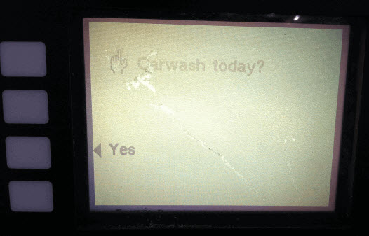
Notes:
http://thedailywtf.com/Articles/Numerically-Nonnumeric.aspx

