Slide 1
Usability Testing 3
CPSC 481: HCI I
Fall 2014
Anthony Tang

Slide 2
Learning Objectives
By the end of this lecture, you should be able to:
» Identify and label several types of biases as they relate to internal validity in experiments
» Describe several methods of addressing internal validity by changing how a study is run
» Understand how this usability testing framework can be applied in research

Slide 3
Experimental Validity
External validity » realism
  Across situations
  Across people
Internal validity » integrity
  Confound
  Selection bias
  Learning effects
  Priming
  Experimenter bias

Slide 4
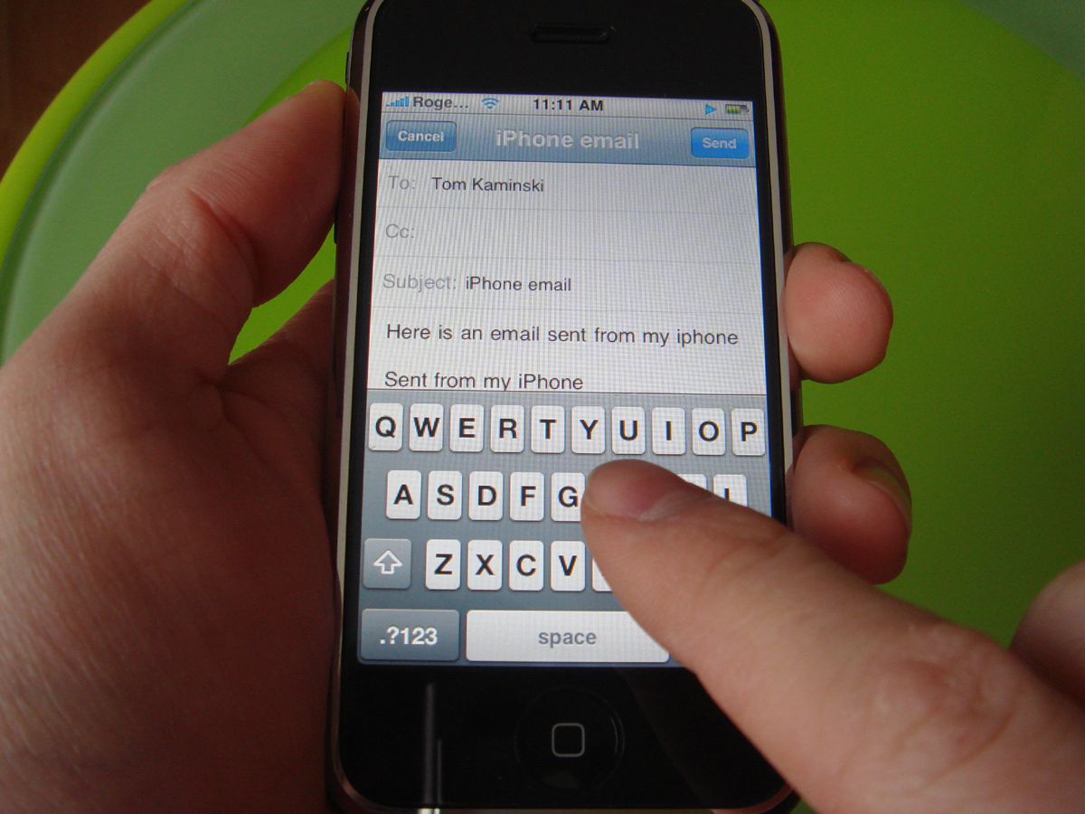
Imagine this test…
Design a typing interface for use while driving cars.
Bring people into the lab, put them at a desk.
Ask them to write an email, and time how long it takes.
Notes:
http://crackberry.com/files/u3/roundrobin/iphone/iphone6.jpg
At least one hand needed to drive!
What about attention and distractedness?
How will the device be held?

Slide 5
External Validity » Across Situations
Does the test situation match the situation that the design will be used in?
Does it match at least in critical ways?
What are aspects that are different?
Artificiality

Slide 6
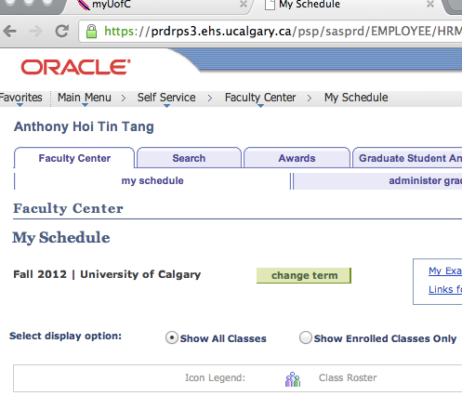
Imagine this test…
Recruiting developers of PeopleSoft, ask them to register for courses.
Because they can register for their courses within 5 minutes, the interface is deemed usable.

Slide 7
External Validity » Across People
Are test subjects representative of the target user population?
Is it a randomly selected group, or are there constraints on how the group is selected that may affect test results?
Generalizability across a population.

Slide 8
Experimental Validity
External validity » realism
  Across situations
  Across people
Internal validity » integrity
  Confound
  Selection bias
  Learning effects
  Priming
  Experimenter bias

Slide 9

Imagine this test…
You are designing a colour scheme for your interface, and recruit participants for the entire day. For morning participants, you use interface A; for afternoon participants, you use interface B.
Morning participants seem to have no problems with the interface, but participants take a lot more time to complete the task
Notes:
http://3.bp.blogspot.com/-d3Z2sX-Dv60/UDFDEUwe4pI/AAAAAAAAIM4/Dj8dMzS9jfI/s1600/2012+08+family+room+office+area9.jpg

Slide 10
Internal Validity » Confound
When you are testing something, and changing one aspect of the test (i.e. a variable), if something else changes along with that variable, then you have a confound.
This means that you cannot tell what is causing the difference.

Slide 11
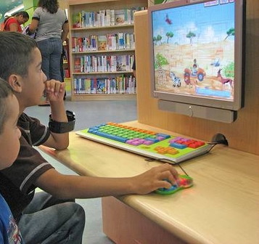
Imagine this test…
You design two computer games for children, and bring it to a school to test.
The first 10 students that complete their homework are sent to your testing office for the first game.
The next 10 students that complete their homework are sent to play the second game.

Slide 12
Imagine this test…
You design two computer games for children, and bring it to a school to test.
The first 10 students that complete their homework are sent to your testing office.
They find both games very easy to play.

Slide 13
Internal Validity » Selection Bias
Systematic, non-random sampling of the population distorts your ability to generalize from the results.
Notes:
http://c.suite101.com/files/styles/article_full/public/000/105/000105936.jpg

Slide 14
Imagine this test…
You have designed two new interfaces for PeopleSoft. You recruit students to test your interface.
For each participant, you give them your least favourite interface first to complete the task, and then you give them your favourite interface second.

Slide 15
Internal Validity » Learning | Fatigue Effects
Experience gained from using the first interface (to conceptual model) affects how they think about and use the second interface.
Too much testing means participants get tired of testing.
Mix it up: for some participants, A then B; for others, B then A.

Slide 16
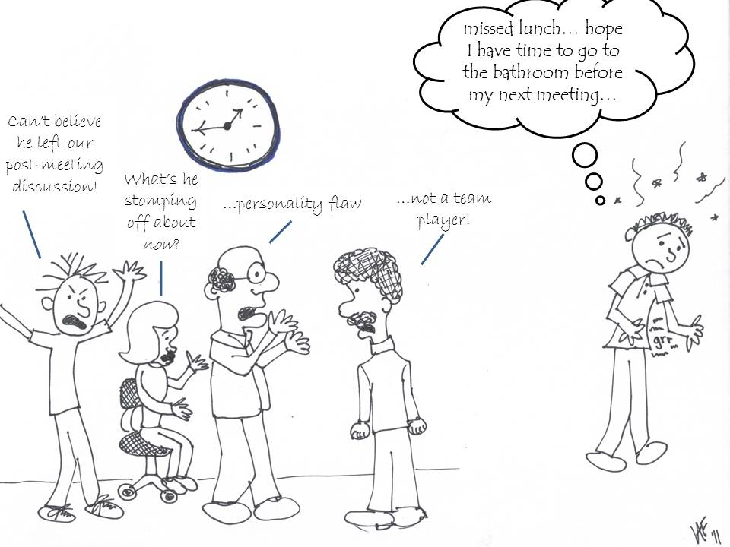
Internal Validity » Experimenter Bias
Notes:
http://blog.lib.umn.edu/paldr001/myblog/2011/12/

Slide 17
Internal Validity » Demand Characteristics
If participants know what your hypothesis is, they will actively try to be “good participants” and help you.
Notes:
Pepsi Challenge?

Slide 18
Experimental Validity
External validity » realism
  Across situations
  Across people
Internal validity » integrity
  Confound
  Selection bias
  Learning effects
  Priming
  Experimenter bias

Slide 19
Ways to improve validity

Slide 20
Ways to improve validity
“Double-blind” experiment
  » neither participant nor experimenter know the hypothesis
Active deception
  » tell participants you’re expecting the opposite of what you expect

Slide 21
Ways to improve validity
Randomized assignment to conditions
  » reduces systematic assignment biases
Randomized ordering of conditions
  » normalizes the effect of order/learning/fatigue
Large sample size
  » reduces effect of “randomness”

Slide 22
Experimental Validity Summary
External validity » realism
  confidence that results applies to real situations
Internal validity » integrity
  confidence in our explanation of experimental results

Slide 23
Recording Observations
We risk forgetting, missing, or misinterpreting events if we do not record user actions for later analysis.
Lots of different methods for doing this with various pros and cons:
  » paper and pencil (2nd observer helps)
  » audio recording
  » video recording
  » system recording (user actions w/ system, user actions)
Notes:
This is in the wrong slot. Should be in slide deck 14
– paper and pencil
• primitive but cheap
• observer records events, comments, and interpretations
• hard to get detail (writing is slow)
• 2nd
observer helps…
– audio recording
• good for recording think aloud talk
• hard to tie into on-screen user actions
– video recording
• can see and hear what a user is doing
• one camera for screen, rear view mirror useful…
• initially intrusive

Slide 24
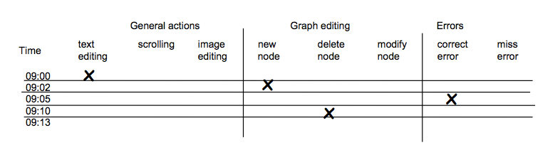
Coding sheet example…
Tracking a person’s use of an editor…

Slide 25
Usability Tests: HOWTO
Determine goals of usability test
Determine testing timeframe
Determine target audience & recruitment plan
Develop testing plan
  What are the most important things you want to know?
  Conceptual model extraction
  Provide non-leading questions
  Simple/realistic scenarios
  Prepare any written materials (audience-specific, if necessary)
Run a pilot study
Run your test with real participants
Notes:
Also, testing location and context

Slide 26
When should I use a usability test?
Any time.
Early:
  Exploring potential possible designs
Late:
  Close to end stage to determine possible showstoppers
After:
  Investigate reported problems
Notes:
My emphasis: earlier
It’s cheaper, but still possible to do it late
You can figure out what needs to be fixed for next time around, or determine what kind of documentation is required/information for support people

Slide 27
Learning Objectives
You should now be able to:
» Identify and label several types of biases as they relate to internal validity in experiments
» Describe several methods of addressing internal validity by changing how a study is run
» Understand how this usability testing framework can be applied in research

