Slide 1
Usability Testing 3 Exercises

Slide 2
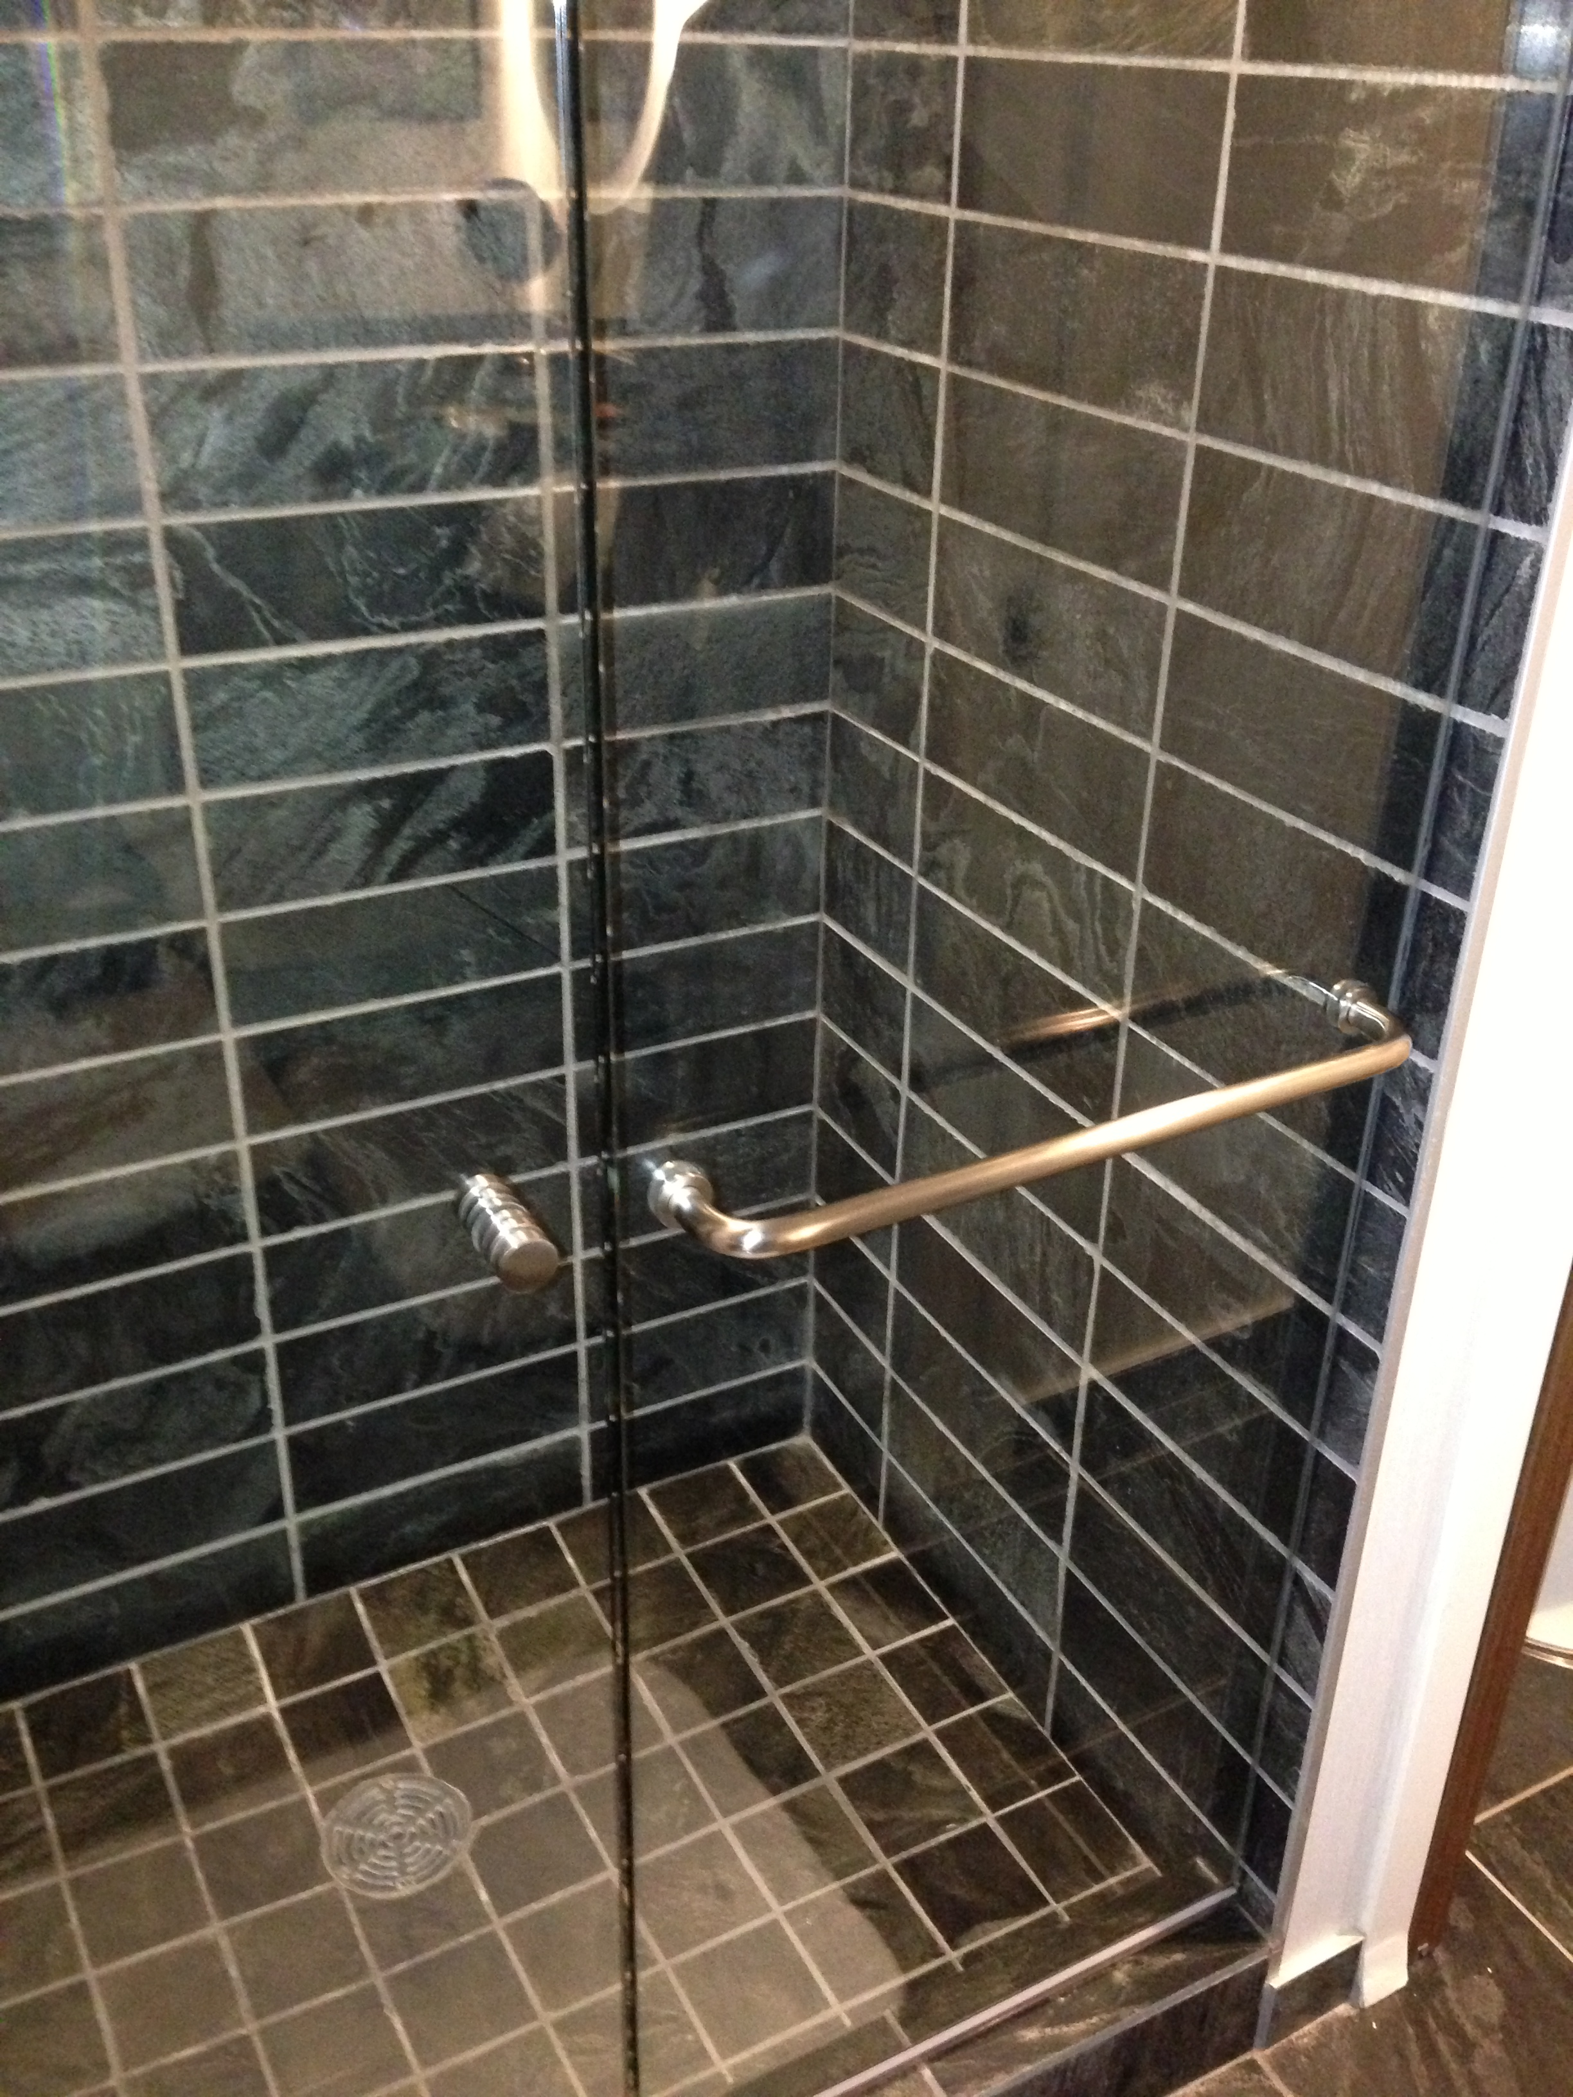
Hotel stay cost us
>$500

Slide 3
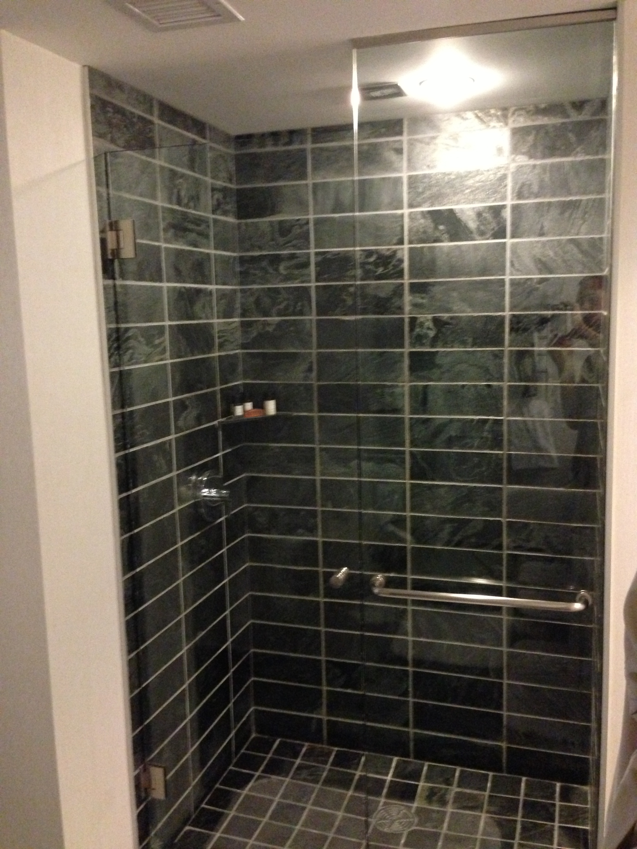
“Towel handle”

Slide 4
Study Design Exercise
Take 5 minutes to design a study by yourself
Find a partner, and explain your study design; critique partner’s study design (5 mins)

Slide 5
The Context
Company produces kiosks.
walk-up and use situations
Touch input
end-customers vary in typing ability;
text entry must be quick to avoid line-ups
errors costly (e.g., banking)
small displays preferred due to cost, but…

Slide 6
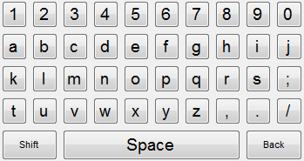
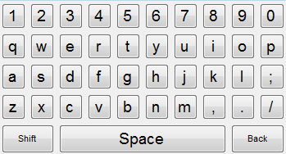
The Idea
Qwerty vs Alphabetic, two sizes possible

Slide 7
Design the study to figure out which keyboard to use
Alphabetic vs. QWERTY; big vs. small
Walk-up and use (touch)
end-customers vary in typing ability;
text entry must be quick to avoid line-ups
errors costly (e.g., banking)
small displays preferred due to cost, but…
Who to participate? How do you get them?
Where do you run the study? When?
What do you have them do?
What do you measure?

Slide 8
Study Design Exercise
Take 5 minutes to design a study by yourself
Find a partner, and explain your study design; critique partner’s study design (5 mins)

Slide 9
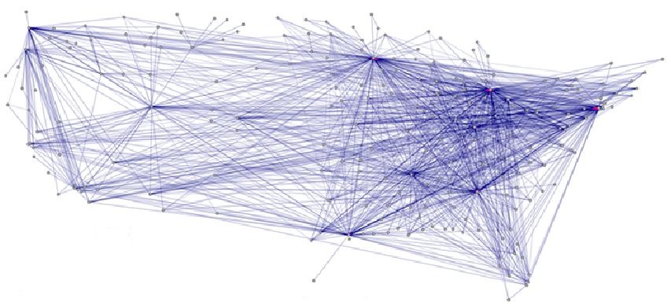
Research Example » EdgeLens
Notes:
http://innovis.cpsc.ucalgary.ca/innovis/uploads/Publications/Publications/EdgeLens-finalversion.pdf
http://innovis.cpsc.ucalgary.ca/innovis/uploads/Research/EdgeLens/EdgeLens.avi
http://blog.visualmotive.com/2009/graph-visualization-edge-bundling/

Slide 10
EdgeLens Video
http://innovis.cpsc.ucalgary.ca/innovis/uploads/Research/EdgeLens/EdgeLens.avi

Slide 11
EdgeLens » Usability Study

Slide 12
EdgeLens » Usability Study Details
16 participants (8 males, 8 females)
Route finding task (varying difficulty)
» Canadian cities, varying number of hops req
Collecting
» path
» certainty of correctness
» time to complete task
» preference
» comments

Slide 13
EdgeLens Test » Results: Correctness

Slide 14
EdgeLens Test » Results: Certainty

Slide 15
EdgeLens Test » Results: Speed

