Slide 1
Usability Testing 2
CPSC 481: HCI I
Fall 2014
Anthony Tang

Slide 2
Learning Objectives
At the end of this lecture, you should be able to:
» Know how to select users for a usability test, and how many
» Be able to describe how to analyze data
» Describe three different usability test protocols, and their pros and cons

Slide 3
Usability Testing: Users
Who?
  Depends on your needs
  Goal: get the people that will be using it, or people that represent those that will be using it
How many?
  Considerable debate in the community. Rule of thumb: ~5

Slide 4
Usability Tests: How many users?
Main argument: If you have 15 people, it’s better to test three designs with 5 users each, rather than one design with 15 people. ➔ Pragmatics, bang for buck
Notes:
Nielsen & Landaurer (1993)
http://heb.freeshell.org/ie662/lecture7small.pdf
Only equation in the class
Rationale: you learn almost right away what is working well and what isn’t. if the first three people can’t login, you’re probably better off fixing the login page, rather than testing another 12 people on it
Most usability tests will help show you obvious problems, and those are the ones you want to get rid of right away

Slide 5
Making sense of your data
Look for:
  Big obvious problems
  Error trends
  Trends in comments
Group issues in terms of severity/priority
  1: must fix/brick wall
  2: should fix/okay to wait
  3: okay as is/could be improved
Notes:
http://www.how-to-kiss.us/get-to-know-someone.html

Slide 6
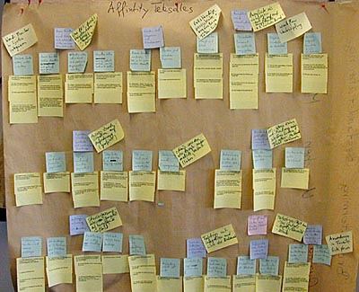
Making sense of your data
Affinity diagrams
Notes:
http://www.baran-systems.com/Products/Affinity%20Diagram%20for%20Excel/index_concept.htm
You’re doing this type of thing this week in tutorial. The main idea is to cluster ideas and observations so that you can make sense of what’s going on

Slide 7

Making sense of your data
Discussion with others who watched with you
Notes:
http://www.how-to-kiss.us/get-to-know-someone.html
Part of affinity diagramming.

Slide 8
Usability Testing: Providing Feedback
Based on your list of issues, provide a small handful of suggestions on how to address the issue
Depending on the part of the design cycle you are in (early, middle, late), these should be bigger or smaller suggestions
Provide video “proof” of people encountering issues
ITERATE ON THE DESIGN!!?!?!?
Sample final report:
  http://www.utexas.edu/learn/usability/report.html
Notes:
http://www.utexas.edu/learn/usability/report.html

Slide 9
Three Basic Usability Test Protocols
Think-Aloud Protocol
Co-Discovery Protocol
Conceptual Model Extraction

Slide 10
Think-aloud protocol
As participants complete a task, you ask them to report
  » what they are thinking
  » what they are feeling
  » rationale for their actions and decisions
Idea: rather than interpret their actions/lack of action, you can actually understand why they are doing what they are doing

Slide 11
Think-aloud protocol
What’s weird:
People are not normally used to saying things out loud as they work.
They may also be embarassed to say things out loud.

Slide 12
Co-discovery Learning prototcol
Main idea: remove the awkwardness of think-aloud
Two people sit down to complete tasks
Only one person is allowed to touch the interface
Monitor their conversation
Variation: use a semi-knowledgable “coach” and a novice (only the novice gets to touch the design)

Slide 13
Conceptual Model Extraction
Show the design, but don’t say how it works
Ask the user to explain
  » function of each element
  » how they would perform a particular task

Slide 14
Conceptual Model Extraction
Initial conceptual model (before they use it)
Formative conceptual model (after they’ve used it)
Good for: eliciting a user’s understanding before and after use
Bad for: understanding exploration and learning

Slide 15
Three Basic Usability Test Protocols
Think-Aloud Protocol
Co-Discovery Protocol
Conceptual Model Extraction

Slide 16
Variations on Usability Tests
How well do people learn the interface?
Does the interface work with people’s actual real-life interactions?
How well does this interface work when people are busy with other things?
How well does this interface work with only a few seconds of interaction at a time?

Slide 17
Learning Objectives
You should now be able to:
» Know how to select users for a usability test, and how many
» Be able to describe how to analyze data
» Describe three different usability test protocols, and their pros and cons

