Slide 1
Lecture 2 Exercises

Slide 2
Characteristics of a good interface?
How does design differ from engineering? How does it differ from art?
Why is design hard?
What is a slip? What is a mistake?

Slide 3
Why is design hard?
http://vimeo.com/2229299
G-speak video
We’ve never “seen” it before
We aren’t the people using it
We can’t anticipate how people will use it

Slide 4
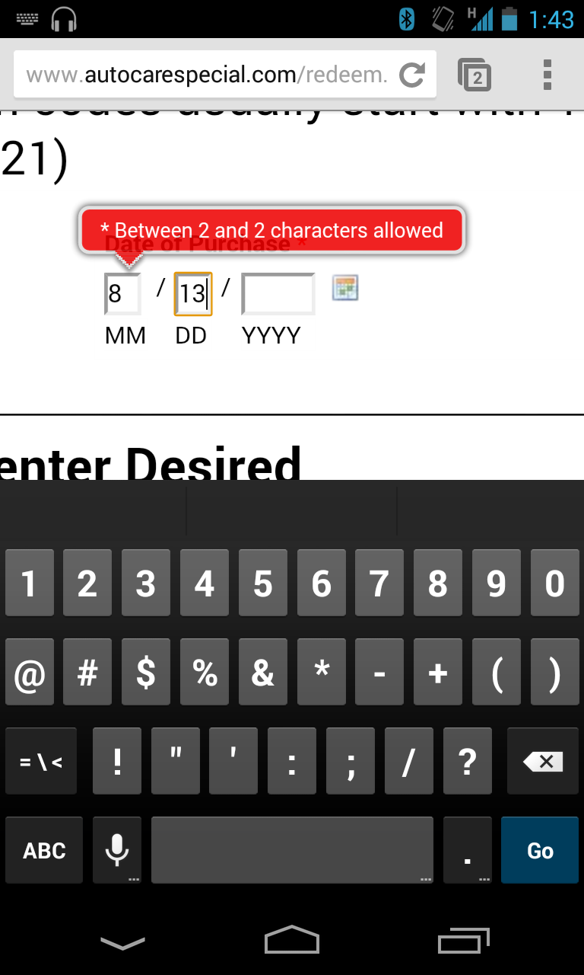
What happened here?
What is stupid?
How might you fix it?

Slide 5
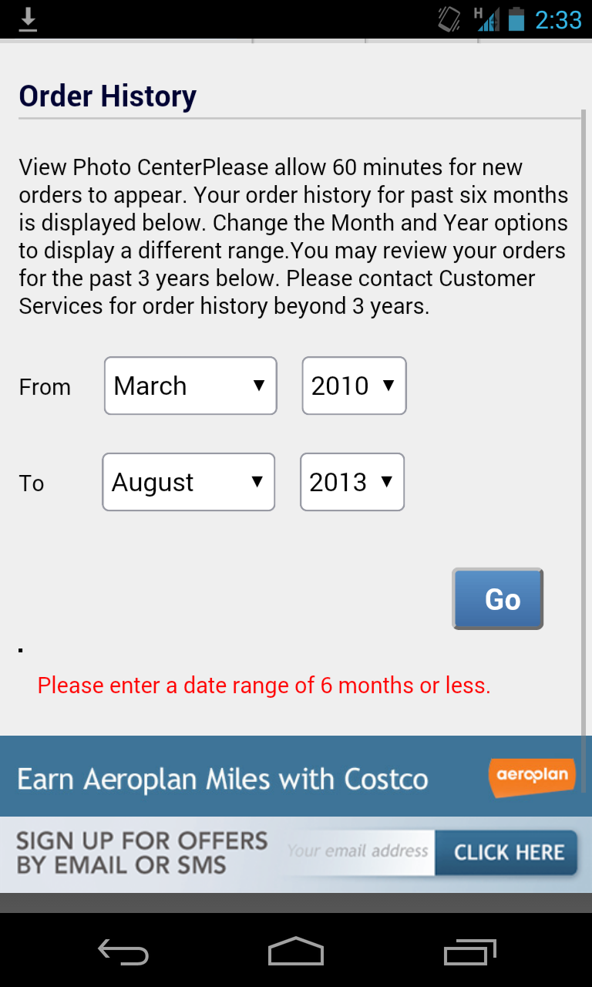
What happened here?
What is stupid?
How might you fix it?
Notes:
Notice: lots of possible solutions – how do you know what the “right one” is??

Slide 7
Is the error you’d make a slip or a mistake?
How would you solve the problem?

Slide 8
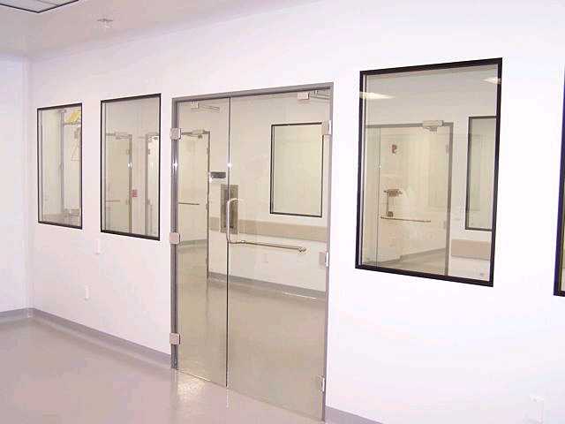

Slide 9
A1 Posted: Thinking about design
http://hcitang.org/CPSC481 -> Assignments -> A1
Due: Sep 22, beginning of class
Print out grading rubric, and use it as your cover sheet
Roughly 3~4 pages

