Slide 1
Usability Testing
CPSC 481: HCI I
Fall 2016
Anthony Tang

Slide 2
Learning Objectives
At the end of this lecture, you should be able to:
» Discuss the goals of the “evaluate” phase, and understand how this plays out in an organization
» Understand the role of a usability experiment
» Describe five testable aspects of interfaces in usability experiments
» Understand how to pick good usability tasks
» Describe five testable metrics in usability experiments

Slide 3
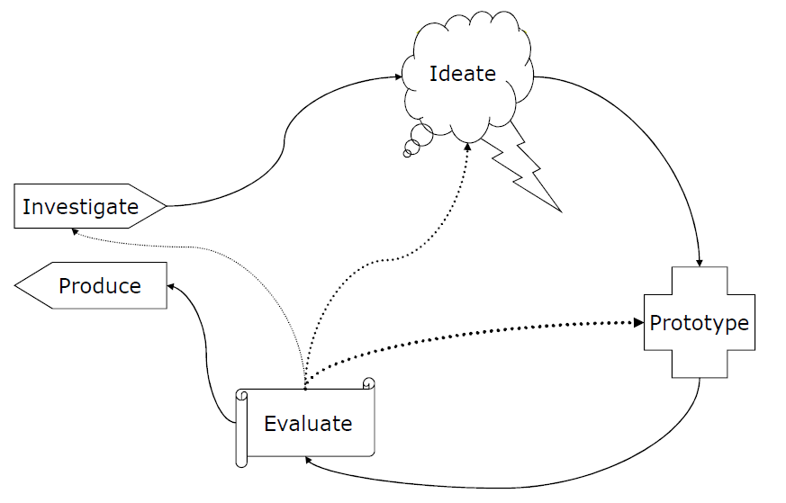
User Centered Design Cycle
Discover problems
Assess progress
Determine next steps

Slide 4
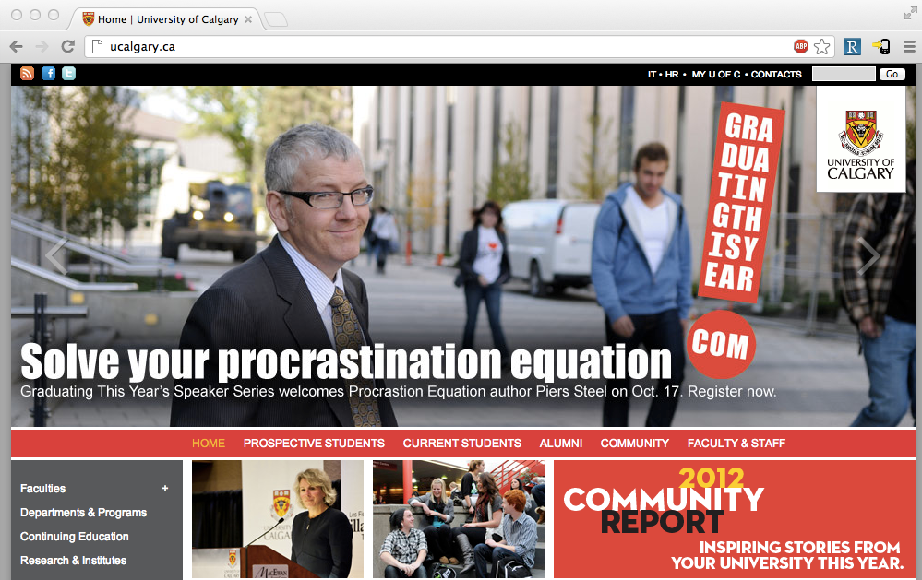
Notes:
Let’s suppose you were part of the design team for ucalgary.ca
What now? You have a design
What will you evaluate?
How will you evaluate this?

Slide 5
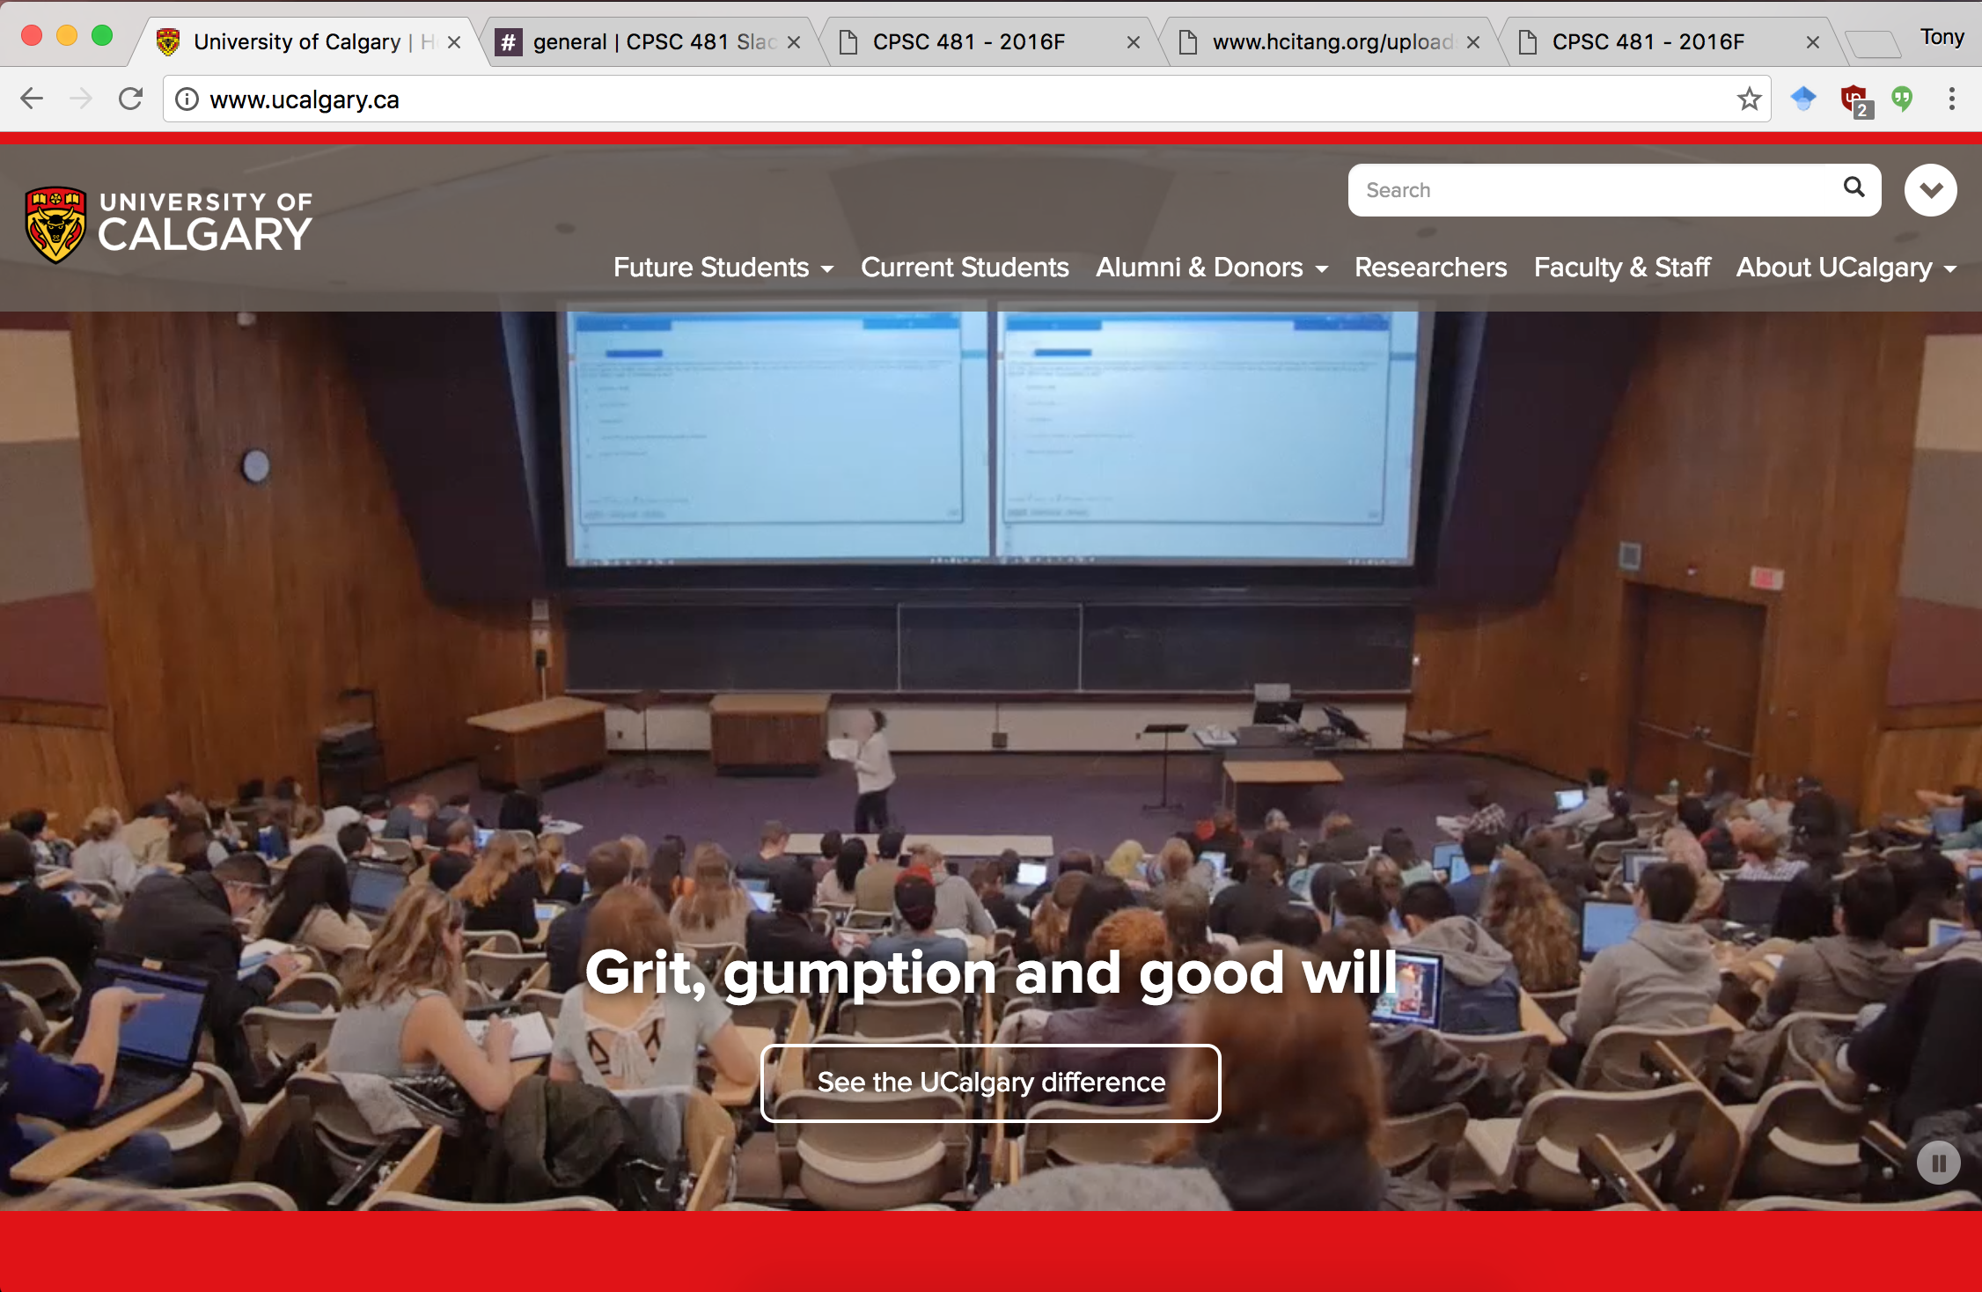

Slide 6
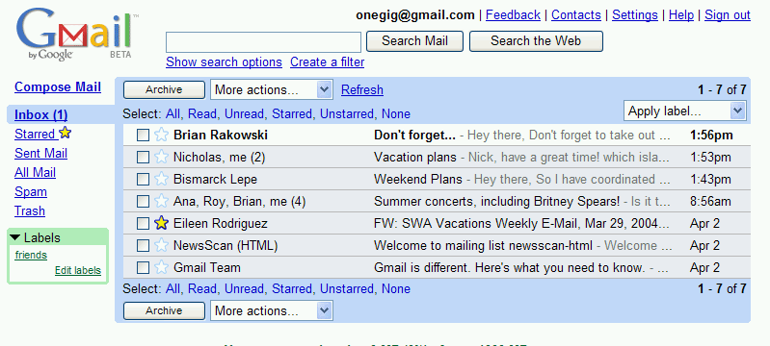
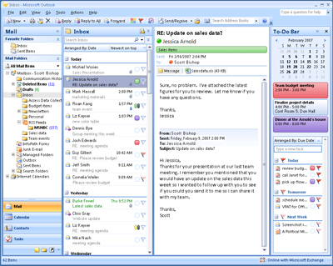
Which is better?
Notes:
Which of these would be easier to use?

Slide 7
In most organizations, you have three major options:
1. “Inspection” Evaluations
  Task Centered System Evaluation
  Heuristic Analysis
  Idea: a principled “by myself” walkthrough of an interface
2. Usability Test
  Formal method of evaluation that asks (potential) users to complete tasks
3. Field Deployment
  Give a prototype to users in the field, and watch their usage/ask for feedback

Slide 8
Within an organizational context
Reviews with stakeholders
  Usually, fairly cursory as a presentation / part of a meeting
  General flow, look/layout/feel
  Useful for: getting people on board
Tests with users
  See whether it actually works with real people
  Looking for the problems that people encounter
  In organizations w/ poor design: part of “quality assurance” (aka “testing”)
Reviews with stakeholders
  Usually, fairly cursory as a presentation / part of a meeting
  General flow, look/layout/feel
  Useful for: getting people on board
Tests with users
  See whether it actually works with real people
  Looking for the problems that people encounter
  In organizations w/ poor design culture: part of “quality assurance” (aka “testing”)

Slide 9
Usability Test
A usability test is a “formal” method for evaluating whether a design is learnable, efficient, memorable, can reduce errors, and meets users’ expectations.
  Users are not being evaluated
  The design is being evaluated
Notes:
This is an important point—that users are not the ones being evaluated. Although we recruit them, and ask them to complete tasks for us, and we watch them fail, the key is that what we are evaluating Is whether the design is making it something that they can do

Slide 10

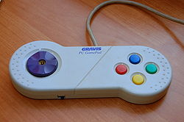
Learnable, memorable, but inefficient
Notes:
Next few sets of slides – imagine you were evaluating the interfaces, and what would you say about whether they were good or bad
Intuitively, these ideas are what we are trying to capture in a usability test… learnable? Efficient? Satisified? Reduces errors (playing errors)? Some of these ideas are obvious with interfaces that we know well, but they get really tricky when it’s interfaces that people DON’T know well.
Easy to learn, but less task coverage (and perhaps inefficient)

Slide 11
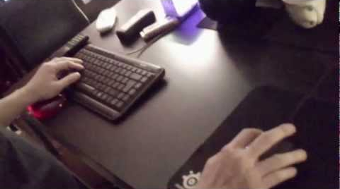
Difficult to learn, but efficient
Mouse left
Mouse right
W
A
D
S
Notes:
Difficult to learn, but efficient

Slide 12
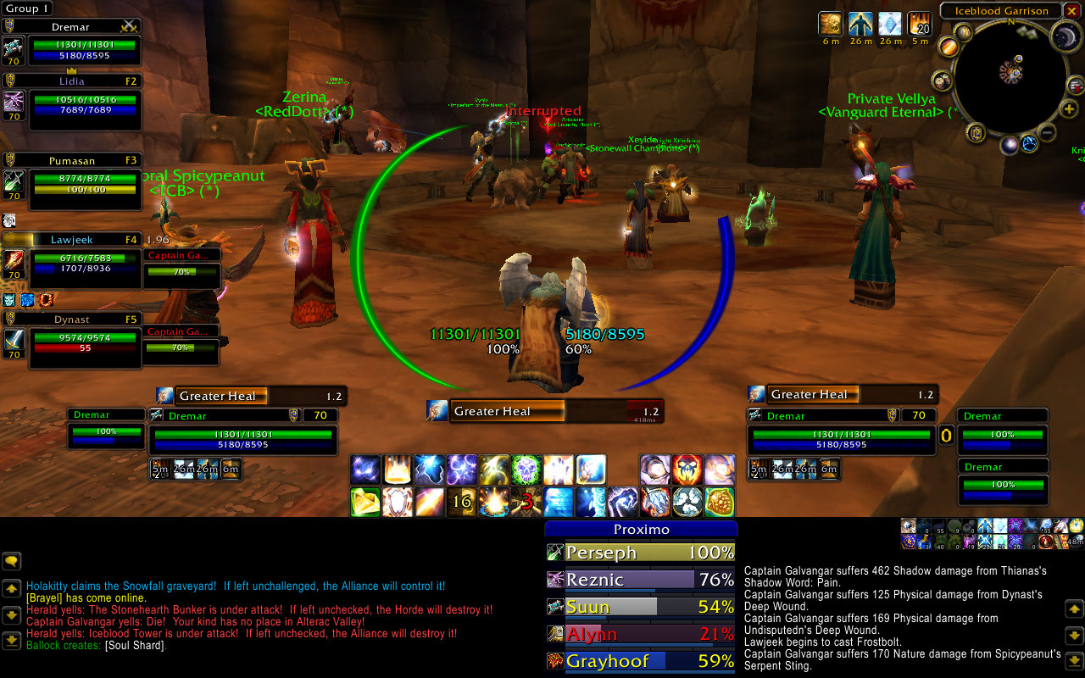
Difficult to learn, efficient?
Reduces errors? Satisfaction?
Notes:
Crazy to look at, difficult to learn, but efficient

Slide 13
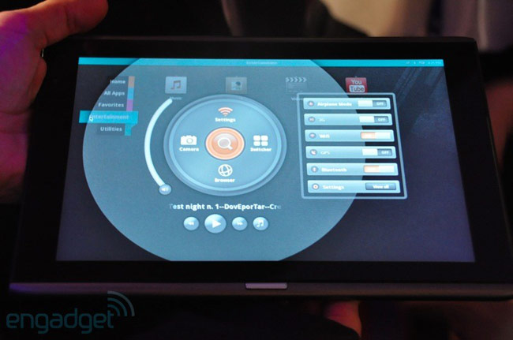
Interfaces with less well-known elements…
Notes:
http://droid-n.com/wp-content/uploads/2011/06/wpid-acer-m500-circular-ui.jpg
Can they learn this interface if they’ve never seen it before? Are there familiar elements? Is it using the language they expect?

Slide 14
Usability Test: Essentially…
Bring in real users
Have them complete tasks with your design, while you watch with your entire team
Use a think-aloud protocol, so you can “hear what they are thinking”
Measure
  Task completion, task time
  Satisfaction, problem points, etc.
Identify problems (major ones | minor ones)
Provide design suggestions to design/engineering team
Iterate on the design, repeat
Notes:
This is an “in English” variation of a slide that comes in slide deck 16 that talks about a “HOWTO”
They complement each other in that this talks about things in a grounded, “real life” way without any specialized terms, whereas the howto uses language and vocabulary that you will know by then.
You’ve already seen this in action with the “RealPhone” test

Slide 15
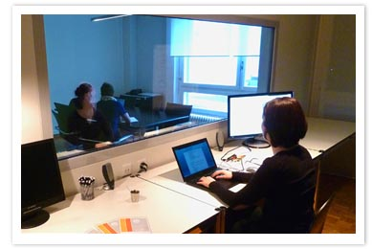
Testing Environments…
Notes:
http://lynnewatanabe.wordpress.com/2011/08/24/could-usability-testing-of-websites-help-non-profits-heck-yeah/
http://www.telono.com/en/lelab/fixed-lab
http://www.clockwork.net/blog/2009/11/04/291/our_usability_lab_keepin_it_simple
http://www.experiencelabstudios.com/studio_small.html
Formal test studio

Slide 16
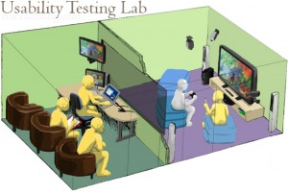
Testing Environments…
Notes:
http://lynnewatanabe.wordpress.com/2011/08/24/could-usability-testing-of-websites-help-non-profits-heck-yeah/
Mimicking the environment that people will be using the system

Slide 17
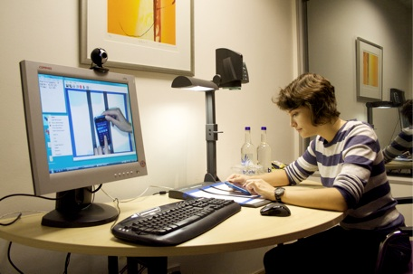
Testing Environments…
Notes:
http://lynnewatanabe.wordpress.com/2011/08/24/could-usability-testing-of-websites-help-non-profits-heck-yeah/
For interaction with mobile devices we may care actually how someone is holding a device, and so on.
What else about their interactions might we care about capturing?

Slide 18
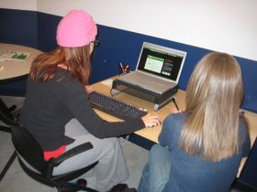
Testing Environments…
Notes:
http://lynnewatanabe.wordpress.com/2011/08/24/could-usability-testing-of-websites-help-non-profits-heck-yeah/
And you can do this in far more constrained settings

Slide 19
Testing Environments…
Best environment depends on pragmatic considerations, as well as what you’re looking for
  Do you want your whole team to be able to view?
  Do you want to be able to review a test?
  Are interruptions important?
  Repeat use systems, or one-time use systems?

Slide 20
Things you care about in a usability test (aspects of usability)
Learnability/Discoverability: How easy is it for users to accomplish basic tasks the first time they encounter the design?
Efficiency: Once users have learned the design, how quickly can they perform the tasks?
Memorability: When users return to a design after a period of not using it, how easily can they reestablish proficiency?
Errors: How many errors do users make, where are these errors occurring, and how easy is it to recover from these errors?
Satisfaction: How pleasant is it to use?
Notes:
http://www.useit.com/alertbox/20030825.html
Some of these require “repeat visits”, and so may not always be practical

Slide 21
Corel Paper Prototype Test
Notes:
Intro to video:
-- A system built by Corel to help web designers to structure websites
-- Evaluating a paper prototype to explore whether or not people can do basic tasks (e.g. “create a new page”)
-- What you will see is: you can use a paper prototype to do this; people have different language than what the designers expected
http://www.youtube.com/watch?v=ppnRQD06ggY
What is striking about this video?
Site settings -> use of terminology
Notions of mental models, and how design can push one or another
You can evaluate some things just with paper prototypes!
What are they evaluating here? (flow)
What can you not evaluate with a paper prototype?

Slide 22
What tasks should we test?
Tasks are surprisingly challenging to “get right.” A lot of this depends on context.
TCSD gives you a way of thinking about this: specifically, focus on user goals rather than system functionality.
Keywords to good task selection: specific, concrete user goals that describe a complete job (or interaction)

Slide 23
Usability Tasks: IKEA Example
“Find a bookcase”
  Search for “bookcase.”
“You have 200+ books in your fiction collection, currently strewn around your living room. Find a way to organize them.”
  Clicking on catalogues looking for a storage solution
  Searches (a few) were for “shelves” and “storage systems”
Notes:
http://www.uie.com/events/roadshow/know_your_users/articles/usability_testing_mistakes/
The latter is far better

Slide 24
Usability Tasks
Again, depends a lot on what you’re looking for
  Specific: does a task flow work?
  Broad: does your language match the user’s mental model/language?
Consider “the context of use”
  What would someone need to do with your tool?
  Under what circumstances would they be in? (relaxed vs. under pressure; non-interrupted vs. interrupted constantly)
  etc.

Slide 25
Usability Tasks: Netflix.com
“Rate a few movies”
“It’s a Friday night, and you’re looking for a movie to watch. What do you do?”
“You’re about to watch `Batman 3’, but want to watch the first two, first. How do you do this?”
“You want to watch Batman 1 through Netflix in your living room with your xbox. How do you set that up?”
“What do you think about the site?”

Slide 26
Usability Testing Metrics
Performance
  Task success, time on task, errors, efficiency
Issue Metrics
  Identify issue, issue severity
Behavioural
  Observe verbal behaviour, issue severity
Self-reported
  Ease, satisfaction, clarity, comprehension, etc.
Notes:
These are things you can really drill down on, and consider carefully

Slide 27
Learning Objectives
At the end of this lecture, you should be able to:
» Discuss the goals of the “evaluate” phase, and understand how this plays out in an organization
» Understand the role of a usability experiment
» Describe five testable aspects of interfaces in usability experiments
» Understand how to pick good usability tasks
» Describe five testable metrics in usability experiments

