Slide 1
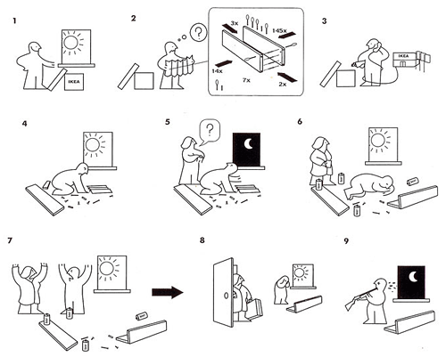
Notes:
http://m-gregory1013-dc.blogspot.ca/2010/10/sequence-3-ikea-instructions.html
www.johnnyholland.org

Slide 2
Design of everyday things 4
exercises

Slide 3
Mental models
Think of a system for which you have a structural mental model.
How did you develop this mental model?
How would you teach someone this structural mental model?
Think of a system for which you have a functional mental model?
Why do you have a functional mental model for this system?
Think, pair, share

Slide 4
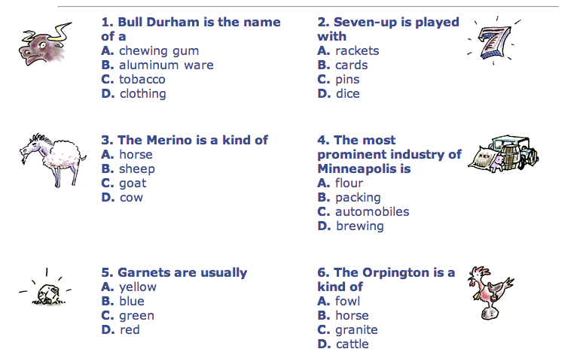
IQ – Intelligence Quotient
1 (C), 2 (B), 3 (B), 4 (A), 5 (D), 6 (A)
Notes:
http://historymatters.gmu.edu/d/5293

Slide 5
IQ – Intelligence Quotient
Early tests were clearly bound to the (then) current culture—white, urban, middle-class culture
» African-Americans tested poorly
» non-English speakers tested poorly
» illiterate tested poorly
Since then, early assumptions about IQ have been questioned:
» general ‘g’ factor intelligence?
» mental age?
» heritability?
» IQ fixed?
Point: be aware that you are often making cultural assumptions in your designs.

Slide 6
Why design is hard
Hard to describe an experience vs. easy to talk about features
Bad design isn’t visible
People are too quick to blame themselves

Slide 7
Some thoughts…
Designers help by providing a good conceptual model
affordances
causality
constraints
mapping
positive transfer
population stereotypes and idioms
Design to accommodate individual differences
decide on the range of users

