Slide 1

Conceptual Models
Users see and understand the system through mental models
Users rely on mental models during usage
Your interpretation of what the system is doing is different if you:
  (a) Think that turning it far enough turns it off, vs.
  (b) Think that you can press (click) the knob to turn it off.

Slide 2
Lessons from the Design of Everyday Things 4
CPSC 481: HCI I
Fall 2014
Anthony Tang with acknowledgements to Saul Greenberg, Ehud Sharlin, Joanna McGrenere and Karon MacLean

Slide 3
Lessons from the Design of Everyday Things
We’ve seen that a lot of things are designed poorly, be it computer interfaces, or physical objects
Formally, there is a vocabulary around these concepts that we have discussed
  » perceived affordances
  » visible constraints
  » causality
  » mapping
  » transfer effects
  » idioms & population stereotypes
  » conceptual models
  » individual differences

Slide 4
Learning Objectives
By the end of this lecture, you should be able to:
» Discuss the role of individual differences in design; describe a good “rule of thumb”, and the consequences of that rule of thumb
» Identify and discuss factors that make design difficult that are unrelated to design itself

Slide 5
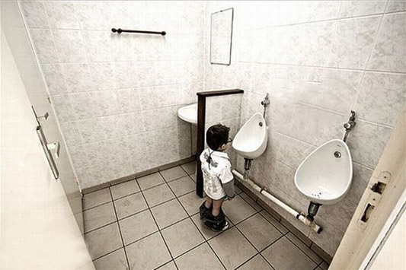
Who should you design for?
Notes:
http://mnearents.com/usability.php
A.k.a. why Tony doesn’t live in England

Slide 6
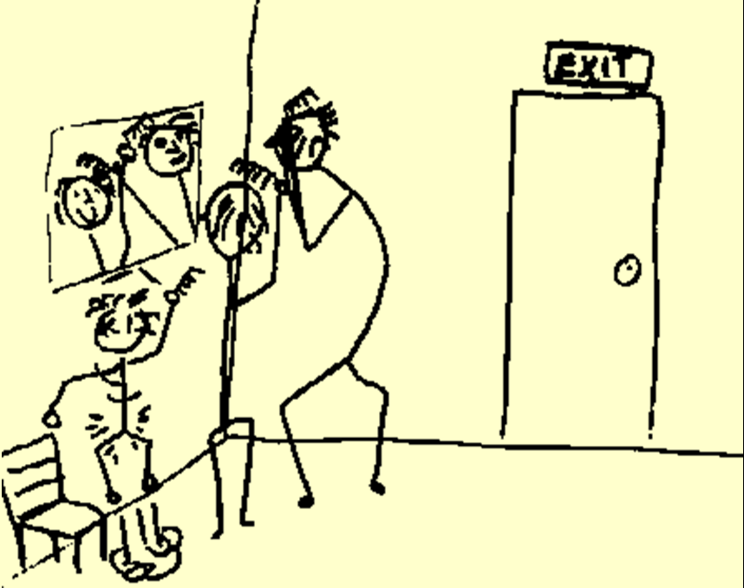
Who should you design for?

Slide 7
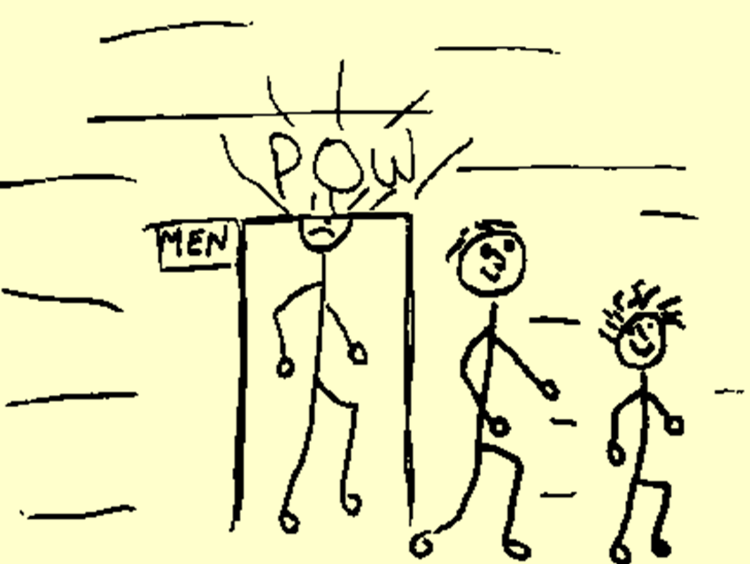
Who should you design for?

Slide 8
Who should you design for?
People are different
It is rarely possible to accommodate everyone perfectly
  » design is often a compromise
    standard ceiling height: 8’
    but the tallest man: 8’ 11”!
People vary as much in how they think and perceive things as much as they vary physically!

Slide 9
Who should you design for?
Question: Design for the average?
  » Often considered a mistake: you may exclude half the audience
Rule of thumb:
  » design for 95% of audience (5th or 95th percentile)
  » note: 5% of population may be seriously compromised
Examples
  » cars and height: headroom, seat size
  » computers and visibility: font size, line thickness, colour for colour-blind people?

Slide 10
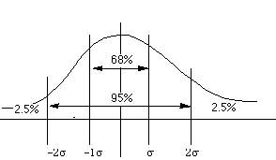
Gaussian (“Normal”) Distribution
Mean and
50th percentile
Notes:
Height, weight, body fat percentage, blood pressure
Cognitive ability

Slide 11
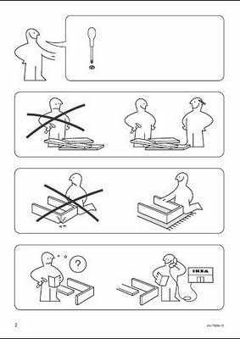
IKEA Instructions
What 95% means is up to you:
  » 95% of local population?
  » 95% of world population?
IKEA instructions
  » “universally” understandable

Slide 12
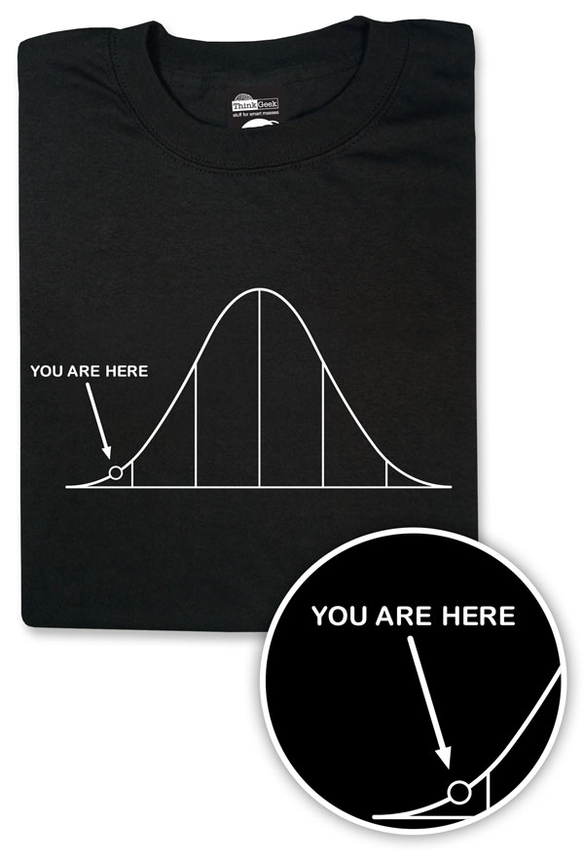
You vs. 95%
You do not necessarily represent a good average user of equipment or systems you design
Do not expect others to think and behave as you do, or as you might like them to
People vary in thought and behaviour just as they do physically
  » life experiences are different
  » cultural expectations are different
thinkgeek.com
Notes:
http://www.thinkgeek.com/product/ea53/

Slide 13
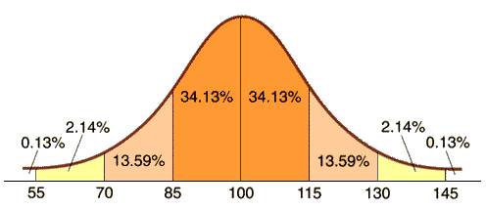
IQ – Intelligence Quotient
WW1 US troops: notion of IQ and mass testing
  » idea was to separate groups for training
  » designed as a bell curve, with average being 100
Notes:
http://www.school-psychology.com.au/wp-content/uploads/2009/06/IQ_test_graph.gif

Slide 14
IQ – Intelligence Quotient
Assumptions:
  » innate
  » constant
  » correlated with performance on everything
How was it designed?

Slide 15
IQ – Intelligence Quotient
Assumptions:
  » innate
  » constant
  » correlated with performance on everything
How was it designed?
  » primarily with white, english-speaking US citizens
  » how generalizable was this test?

Slide 16
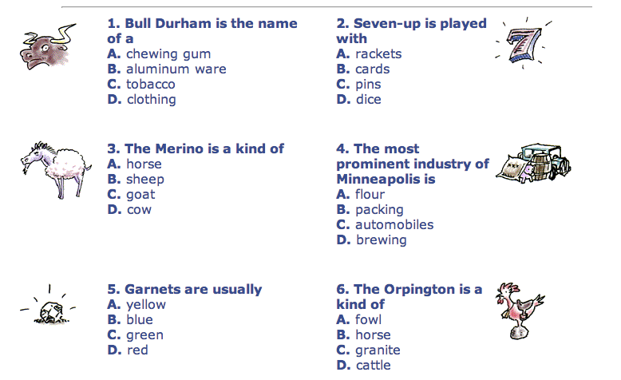
IQ – Intelligence Quotient
1 (C), 2 (B), 3 (B), 4 (A), 5 (D), 6 (A)
Notes:
http://historymatters.gmu.edu/d/5293

Slide 17
IQ – Intelligence Quotient
Early tests were clearly bound to the (then) current culture—white, urban, middle-class culture
  » African-Americans tested poorly
  » non-English speakers tested poorly
  » illiterate tested poorly
Since then, early assumptions about IQ have been questioned:
  » general ‘g’ factor intelligence?
  » mental age?
  » heritability?
  » IQ fixed?
Point: be aware that you are often making cultural assumptions in your designs.

Slide 18
Designing for experience & style of use?
  novices walk up and use systems
      interface affords restricted set of tasks
      introductory tutorials to more complex uses
  casual standard idioms
  recognition (visual affordances) over recall
  reference guides
  interface affords basic task structure
  intermediate advanced idioms
  complex controls
  reminders and tips
  interface affords advanced tasks
  expert shortcuts for power use
  interface affords full task + task customization
most kiosk + internet systems
most shrink-
wrapped
systems
custom software

Slide 19
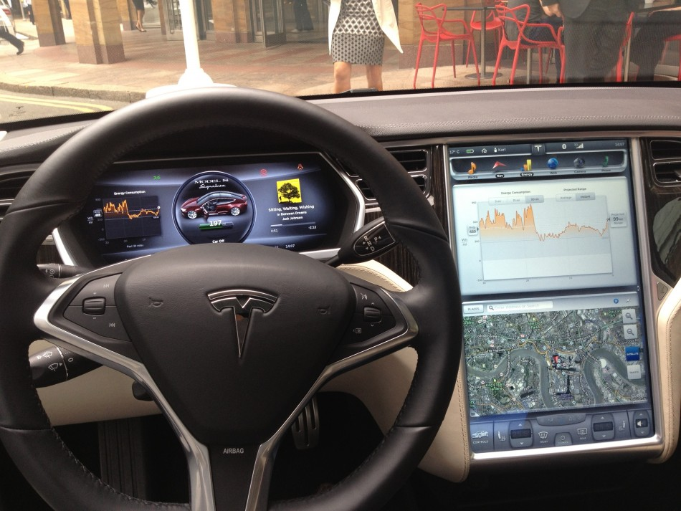

Slide 20
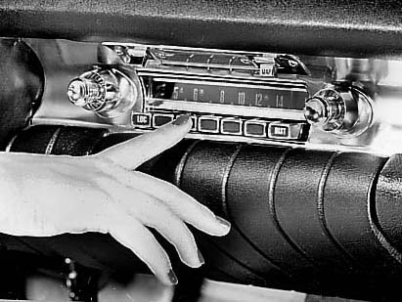

Slide 21
Why design is hard
Over the last century
  the number of things to control has increased dramatically
    car radio/CD player/DVD player/MP3 player/ipod connector or dock/AUX input…: AM, FM1, FM2, 5 pre-sets, station selection, balance, fader, bass, treble, distance, mono/stereo, dolby, tape eject, fast forward and reverse, etc (while driving at night!)
  display is increasingly artificial
    red lights in car indicate problems vs flames for fire
  feedback more complex, subtle, and less natural
    On your phone(?) is your alarm on and set correctly?
  errors increasing serious and/or costly
    airplane crashes, losing days of work...

Slide 22
Why design is hard
Marketplace pressures
  adding functionality (complexity) now easy and cheap
    computers
  adding controls/feedback expensive
    physical buttons on calculator, microwave oven
    widgets consume screen real estate
  design usually requires several iterations before success
    product pulled if not immediately successful

Slide 23
Why design is hard
People consider cost and appearance over design
  bad design not always visible
  people tend to blame themselves when errors occur
    “I was never very good with machines”
    “I knew I should have read the manual!”
    “Look at what I did! Do I feel stupid!”

Slide 24
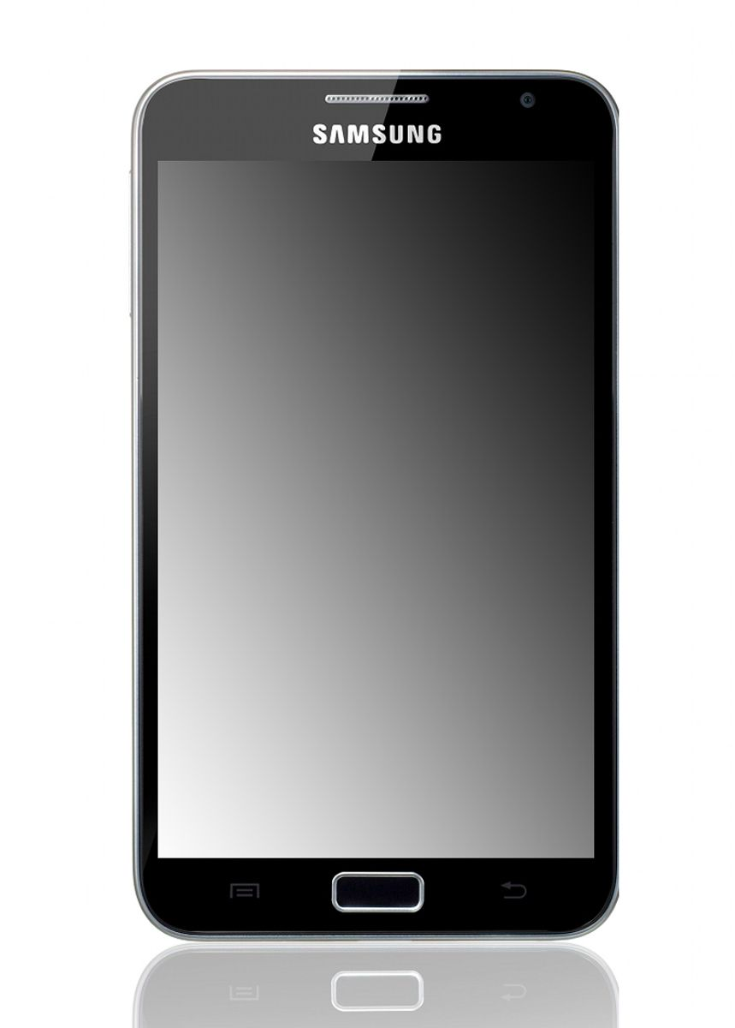
Human factors in computing systems
What do these do?
  computers far more complex to control than everyday devices
  general purpose computer contains no natural conceptual model
  completely up to the designer to craft a conceptual model

Slide 25
Lessons from the Design of Everyday Things
Many human errors are actually errors in design
  don’t blame the user!
Designers help by providing a good conceptual model
  affordances
  causality
  constraints
  mapping
  positive transfer
  population stereotypes and idioms
Design to accommodate individual differences
  decide on the range of users
Design is difficult for reasons that go beyond design

Slide 26
Learning Objectives
You should now be able to:
» Discuss the role of individual differences in design; describe a good “rule of thumb”, and the consequences of that rule of thumb
» Identify and discuss factors that make design difficult that are unrelated to design itself

