Slide 1
Design of Everyday Things 3
Exercises

Slide 2
Quiz Questions
Whose conceptual model are we primarily concerned about? As a designer, what is your role?
When are mental models used? How are they formed?
What are some problems caused by mismatches between a mental model and a system?
How would you distinguish between a structural vs. functional model?
What are some tradeoffs between helping people to develop a structural vs. functional mental model?

Slide 3
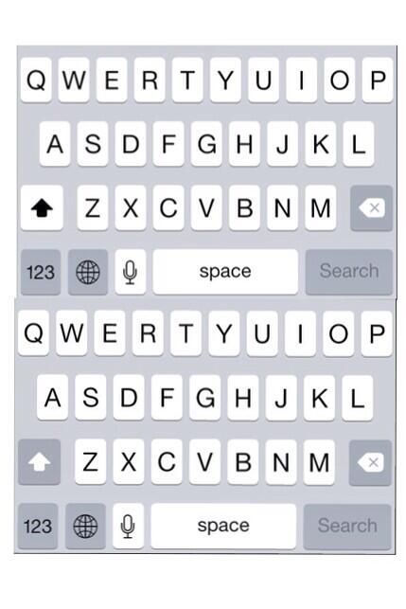
In which of these two screenshots is the shift key pressed down?
What is causing the problem?
Possible design solutions?
From: Jesse Marlatt

Slide 4
Paper by 53
Notes:
http://vimeo.com/37254322

Slide 5
Think about your early experiences coding in C…
somefile.o(address): undefined reference to `Foo(void)’
file.c:8:5: error: lvalue required as left operand of assignment
Notes:
An lvalue (locator value) represents an object that occupies some identifiable location in memory (i.e. has an address).

Slide 6
Mental models
Think of a system for which you have a structural mental model.
How did you develop this mental model?
How would you teach someone this structural mental model?
Think of a system for which you have a functional mental model?
Why do you have a functional mental model for this system?

Slide 7
Hiding System Complexity
Water faucet
» the system has independent hot & cold
» system image provides variable temperature
» some taps allow separate temperature and volume control
» both “hot & cold” and “temperature & volume” are 2 degrees of freedom
Audio-video conferencing link
» real system model has four independent channels
» users may consider standard ways of combining these:
glance – two way video only
office share – two way audio and video
phone – two way audio only

