Slide 1
Lessons from the Design of Everyday Things 3
CPSC 481: HCI I
Fall 2014
Anthony Tang with acknowledgements to Saul Greenberg, Ehud Sharlin, Joanna McGrenere and Karon MacLean

Slide 2
Learning Objectives
By the end of the lecture, you should be able to:
» Describe why mismatches between user model and system model can cause problems
» Identify four ways that people arrive at/develop their mental models
» Describe two different kinds of mental models (and discuss the differences between them); discuss pros and cons of each
» Identify principles in the design of effective system images

Slide 3
Conceptual Models
"In interacting with the environment, with others, and with the artifacts of technology, people form internal, mental models of themselves and of the things with which they are interacting.
These models provide predictive and explanatory power for understanding the interaction."
- Don Norman

Slide 4
Conceptual Models vs. Conceptual Design
Conceptual models: something the user has (or forms)
» users see and understand the system through mental models
» users rely on mental models during usage
Conceptual design: something the designer does
» defining the intended mental model (hiding the technology of the system)
» designing a suitable system image (applying appropriate design guidelines)

Slide 5
Conceptual Design
A designer’s role is to provide a meaningful, useful system image so that a user’s model matches the design model
User’s model
Design model
User
Designer
System Image
System
Notes:
Why is there no arrow between the user and the designer?
Why is there a double arrow between the user and system image?

Slide 6
Some terms…
Design model: what a designer intends to convey
System image: what the user “sees” – the UI, documentation, labels, etc.
User’s model: the user’s mental model developed by the user through interaction with the system
» i.e. a belief system about the system model

Slide 7
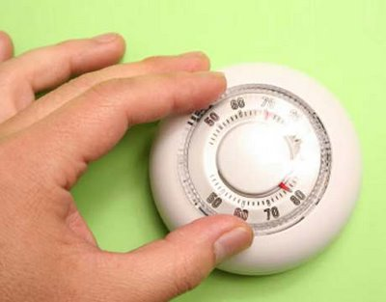
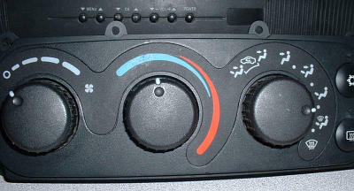
Mismatches between user’s model and system model
Sometimes a poor model is fostered deliberately (consider a fridge or the heating system in a house vs. the heating/cooling system in a car)
Notes:
http://www.nachi.org/images10/thermostat.jpg
http://www.carmedix.net/static/images/content/auto-service-heating-and-air-conditioning.jpg

Slide 8
Mismatches between user’s model and system model
Sometimes, it’s a representation problem
» document sizes measured in bytes, not pages or words
» dates may be in non-standard formats
» error messages may use system specific codes
Other times, it’s a “the designer is not the user” problem (and the design model uses terms/concepts that are non-existent in the user’s model) – remember the main lesson from day 1: YOU ARE NOT THE USER

Slide 9
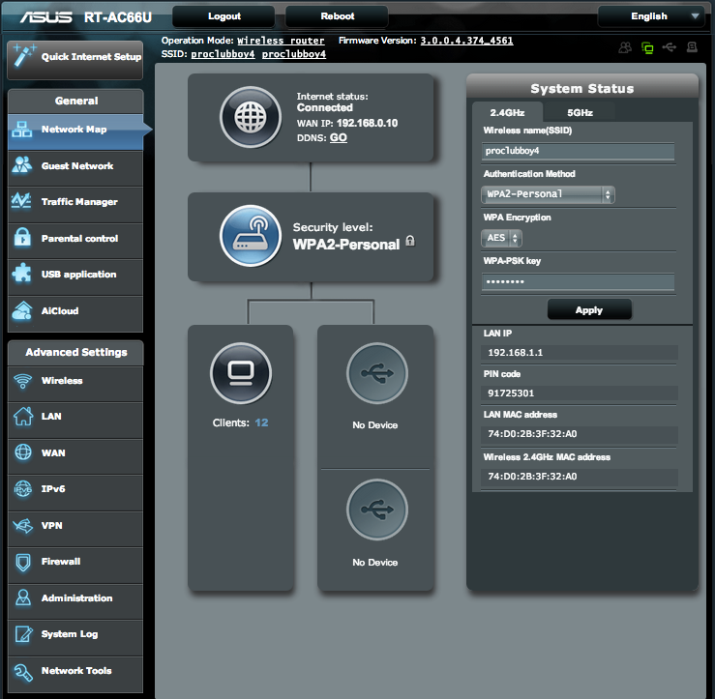
Notes:
Real-time bandwidth use viewer? [right answer: Traffic Manager -> QoS; Traffic Monitor]
What does the little buddy guy in the top right do? [Opens up the “guest network” screen]
Open up some ports for games/DMZ? [WAN]; Firewall → URL filter, Keyword filter, IPv6 Filter, Network services filter (by hour/day)
Currently open flows/sockets? [network tools]

Slide 10
Where do mental models come from?
During system usage:
» user’s own activity leads to a mental model
» explanatory theory, developed by the user
» often used to predict the future behaviour of the system
Observing others use the system:
» casual observation of others working
» asking someone else to “do this for me”
» formal training
Reading about a system:
» documentation, help screens, “for dummies” books
Previous understanding
» experiences with related (or unrelated) systems/concepts
This is done by the user (not the designer)

Slide 11
Mental models are “runnable”
Includes a notion of causality: “doing this will result in this”
Used for explanation
» to understand why the system responds as it does
Used for prediction
» to select an appropriate action in a given situation

Slide 12
Types of Mental Models
Structural: an image of what the system is
» descriptive of what the system is
» user may need additional knowledge to actually use it
» often more powerful/flexible, though harder to use
» road map: may show a particular type of information, but isn’t customized to your particular use of that information
Functional: action-based; describes how it is used
» prescriptive; specific; step-by-step
» does not assume global or system knowledge
» easier to use, but not helpful for problem-solving or dealing with the unexpected
» google directions: great when everything’s there; not so great when the road is closed

Slide 13
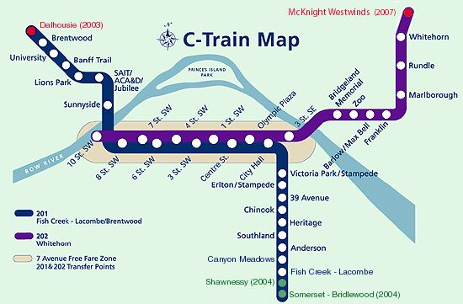
Structural Models » “what the system is”
Maps and schematics
Notes:
• provide a specific view of the system; “use as needed”
• different views: street, bus, bike maps of same region are
customized to drivers, bus riders and bikers. All are structural
models.

Slide 14
Structural Models » “what the system is”
Object-action models
» users think in terms of concrete or abstract objects
» system supports actions on the objects
What are some programs that you think of as having “objects that act”, or that we can act on objects?
Unix: files are objects, commands act on them, etc.
Powerpoint: text, images, etc.
Notes:
• provide a specific view of the system; “use as needed”
• different views: street, bus, bike maps of same region are
customized to drivers, bus riders and bikers. All are structural
models.

Slide 15
Structural Models » “what the system is”
Analogies/metaphors
» a new system (closely) resembles an old system
» (usually) intent is to help transfer existing system knowledge
» e.g. desktop metaphor; spreadsheets
Notes:
• provide a specific view of the system; “use as needed”
• different views: street, bus, bike maps of same region are
customized to drivers, bus riders and bikers. All are structural
models.

Slide 16
Functional Models » “how the system is used”
Many kinds of user manuals and step-by-step and “howto” guides
» U of C’s “job aids”
» http://www.ucalgary.ca/hr/system/files/JOR%20Initiator%20Guide%20-%20Project.pdf

Slide 17
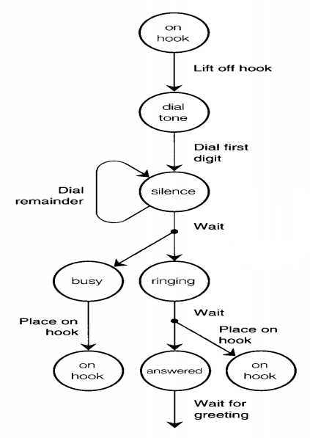
Functional Models » “how the system is used”
State transition model
» how most of us think of how phones work (what you see on the right is a representation of that model)
» changes in state need to be visible, otherwise, this kind of model doesn’t form

Slide 18
Functional Models » “how the system is used”
Functional “mapping” models
» users learn a sequence of actions to accomplish tasks
» mappings need to be “rote-learned”; often arbitrary
» hand-held calculator maps “math” to key presses; keyboard shortcuts

Slide 19
System Image
Designers control what the users see (i.e. the system image). That’s it.
» choose a system image to foster a good mental model
Some interfaces actually display the system!
» all objects and actions may be visible at all times
» e.g. automobile dashboard (system image) that is literal—this is your car!*
Some principles for designing this system image:
» currency (up-to-date-ness) is important
» consistency (contributes to learnability)
» feedback

Slide 20
Where a simple model might be better (to hide system complexity)
Many systems have messy low-level details
» irrelevant to a user’s activity
» full functionality may not be required
Example: MS Word has hundreds (thousands?) of commands
» most users only use a small subset of these
» users can hide complexity through customization
» IT admins can provide macro capabilities (bundling low-level commands into a single concept) → ‘submit’ program
» wizards allow a user to “do what’s right”, skipping details

Slide 21
Lessons from the Design of Everyday Things
We’ve seen that a lot of things are designed poorly, be it computer interfaces, or physical objects
Formally, there is a vocabulary around these concepts that we have discussed
» perceived affordances
» visible constraints
» causality
» mapping
» transfer effects
» idioms & population stereotypes
» conceptual models
» individual differences

Slide 22
Learning Objectives
You should now be able to:
» Describe why mismatches between user model and system model can cause problems
» Identify four ways that people arrive at/develop their mental models
» Describe two different kinds of mental models (and discuss the differences between them); discuss pros and cons of each
» Identify principles in the design of effective system images

