Slide 1
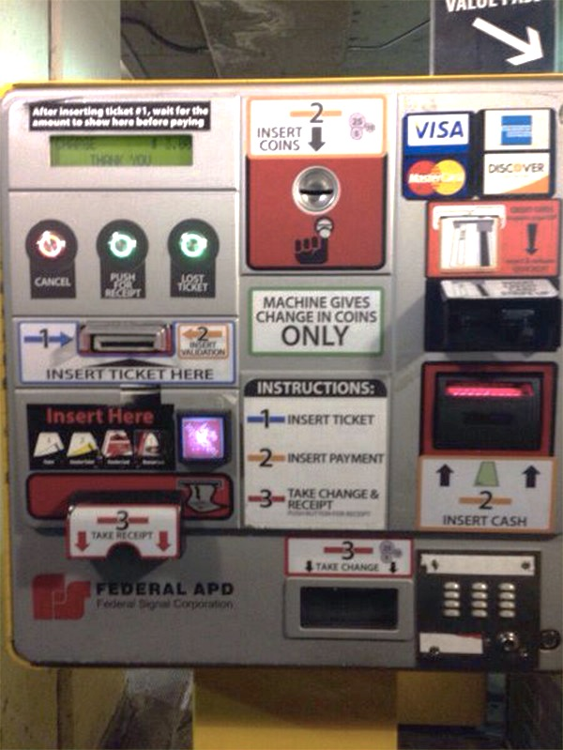

Slide 2
Design of Everyday Things 1
Exercises

Slide 3
Peer Evaluation Stuff
https://www.itpteammetrics.com/

Slide 4
Questions
Define “affordance” in the context of HCI.
Provide an example of a visible constraint in a computer example.
In relation to the concept of mapping, explain “control-display compatibility”
Using the concept of causality, provide an explanation as to why wireless routers are the most frequently returned piece of consumer electronics.

Slide 5
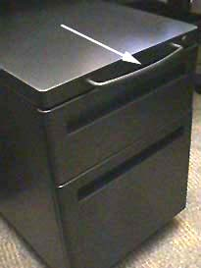
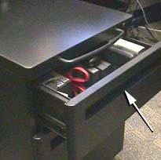
Open the top drawer…
Move cabinet
Photograph courtesy of www.baddesigns.com

Slide 6
Quick example from my youth

Slide 7
Quick example from my youth

Slide 8
Quick example from my youth

Slide 9
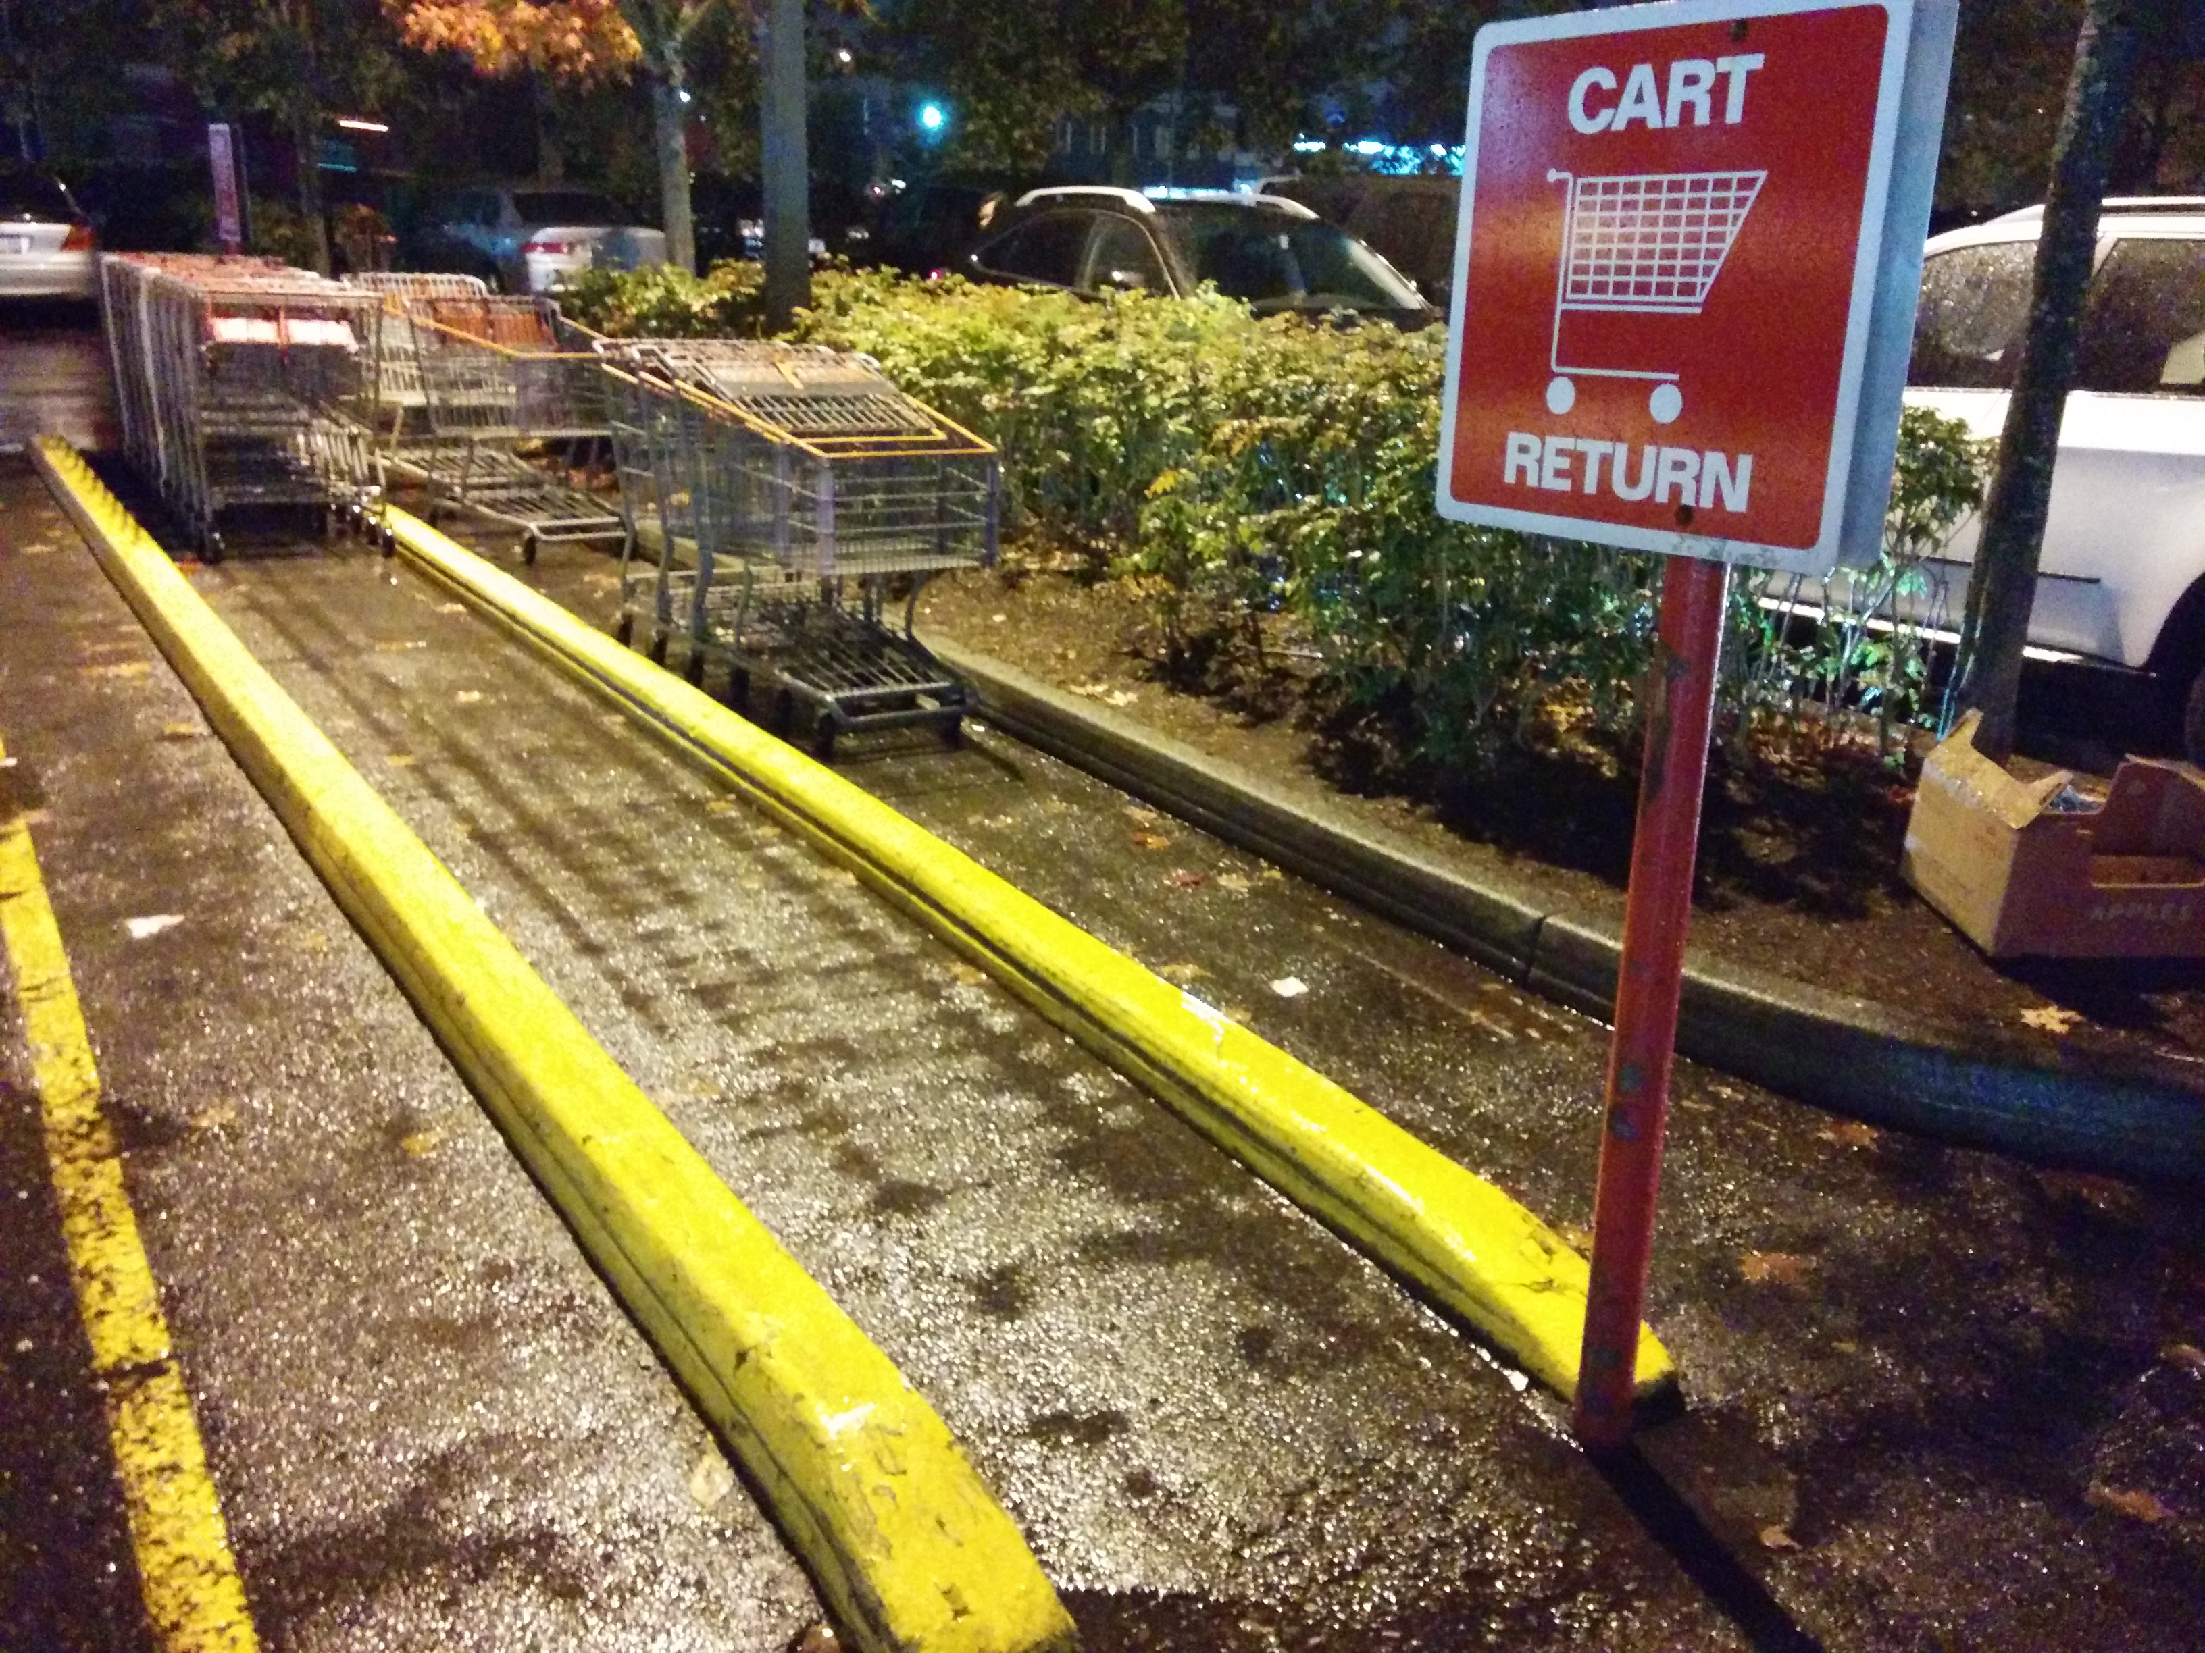
Visible constraints

Slide 10
Visible Constraints
Notes:
System provides no meaningful constraint, so this suggests I can enter it however I like

Slide 11
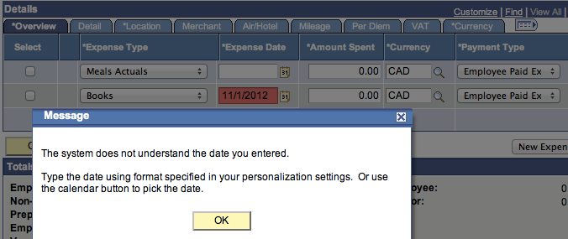
Visible Constraints
Notes:
Noooope…

Slide 12
Visible Constraints
Notes:
Noooope…

Slide 13
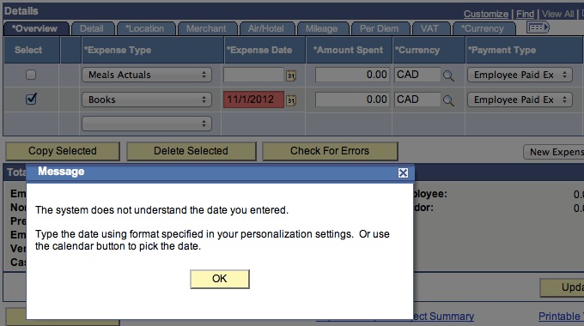
Visible Constraints
Notes:
Awesome

Slide 14
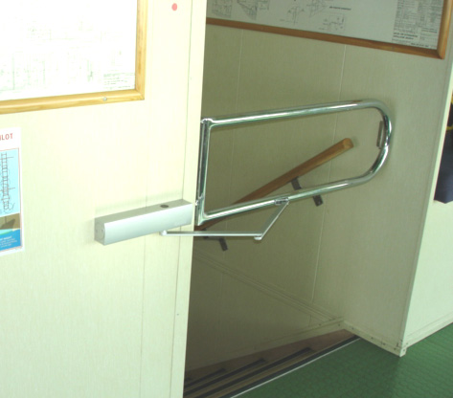
Visible constraints
Notes:
http://www.ukpandi.com/fileadmin/uploads/uk-pi/Photos/On%20board%20advice/stairwell%20gate%201.jpg

Slide 15
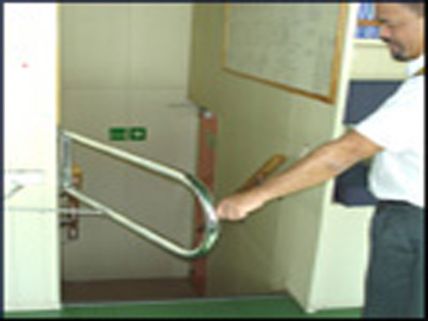
Visible constraints

Slide 16
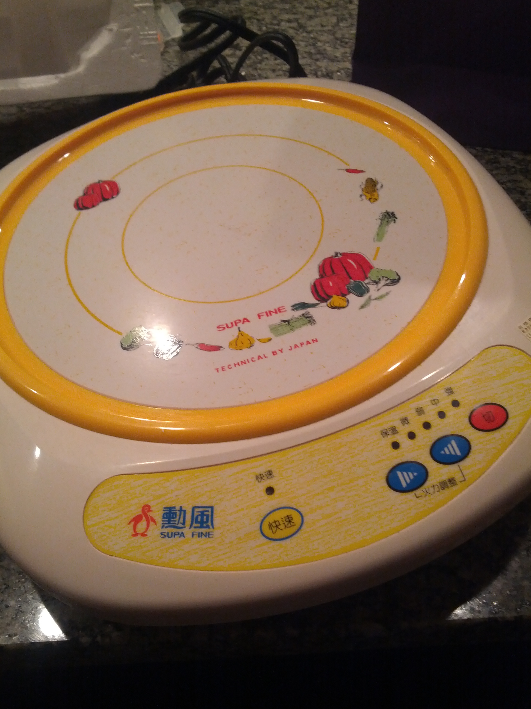
Hot Plate Example…

Slide 17
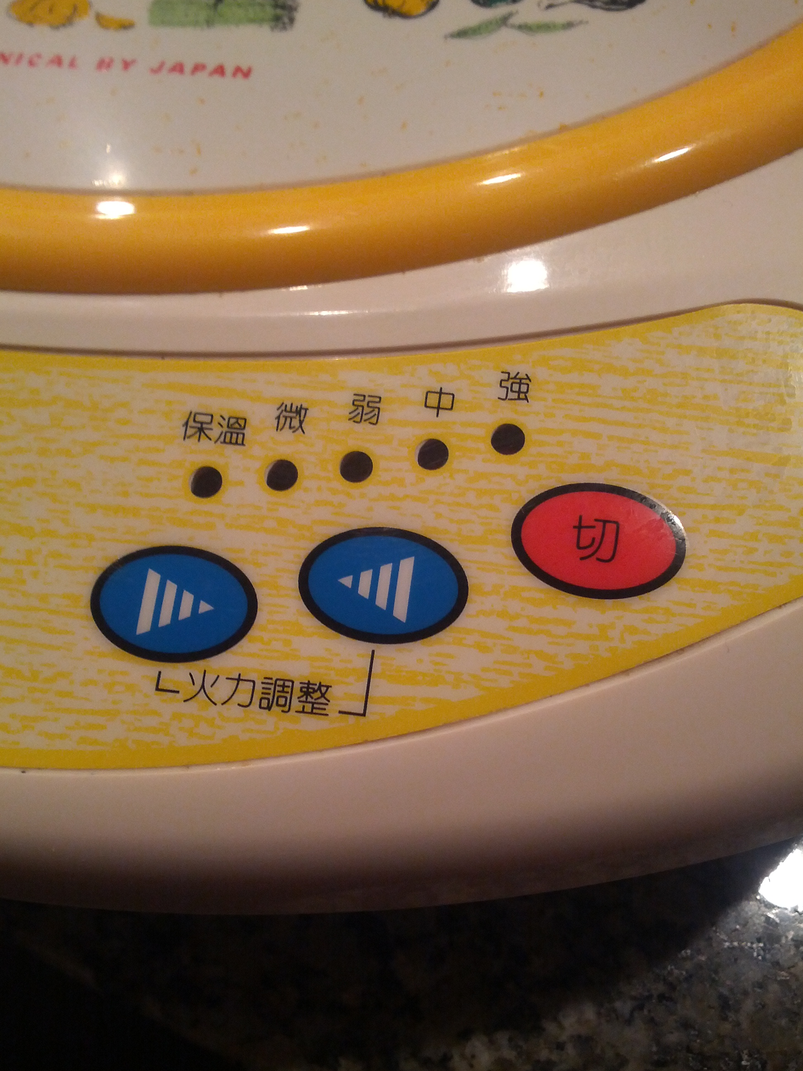
Insane Mapping Conflict…

Slide 18
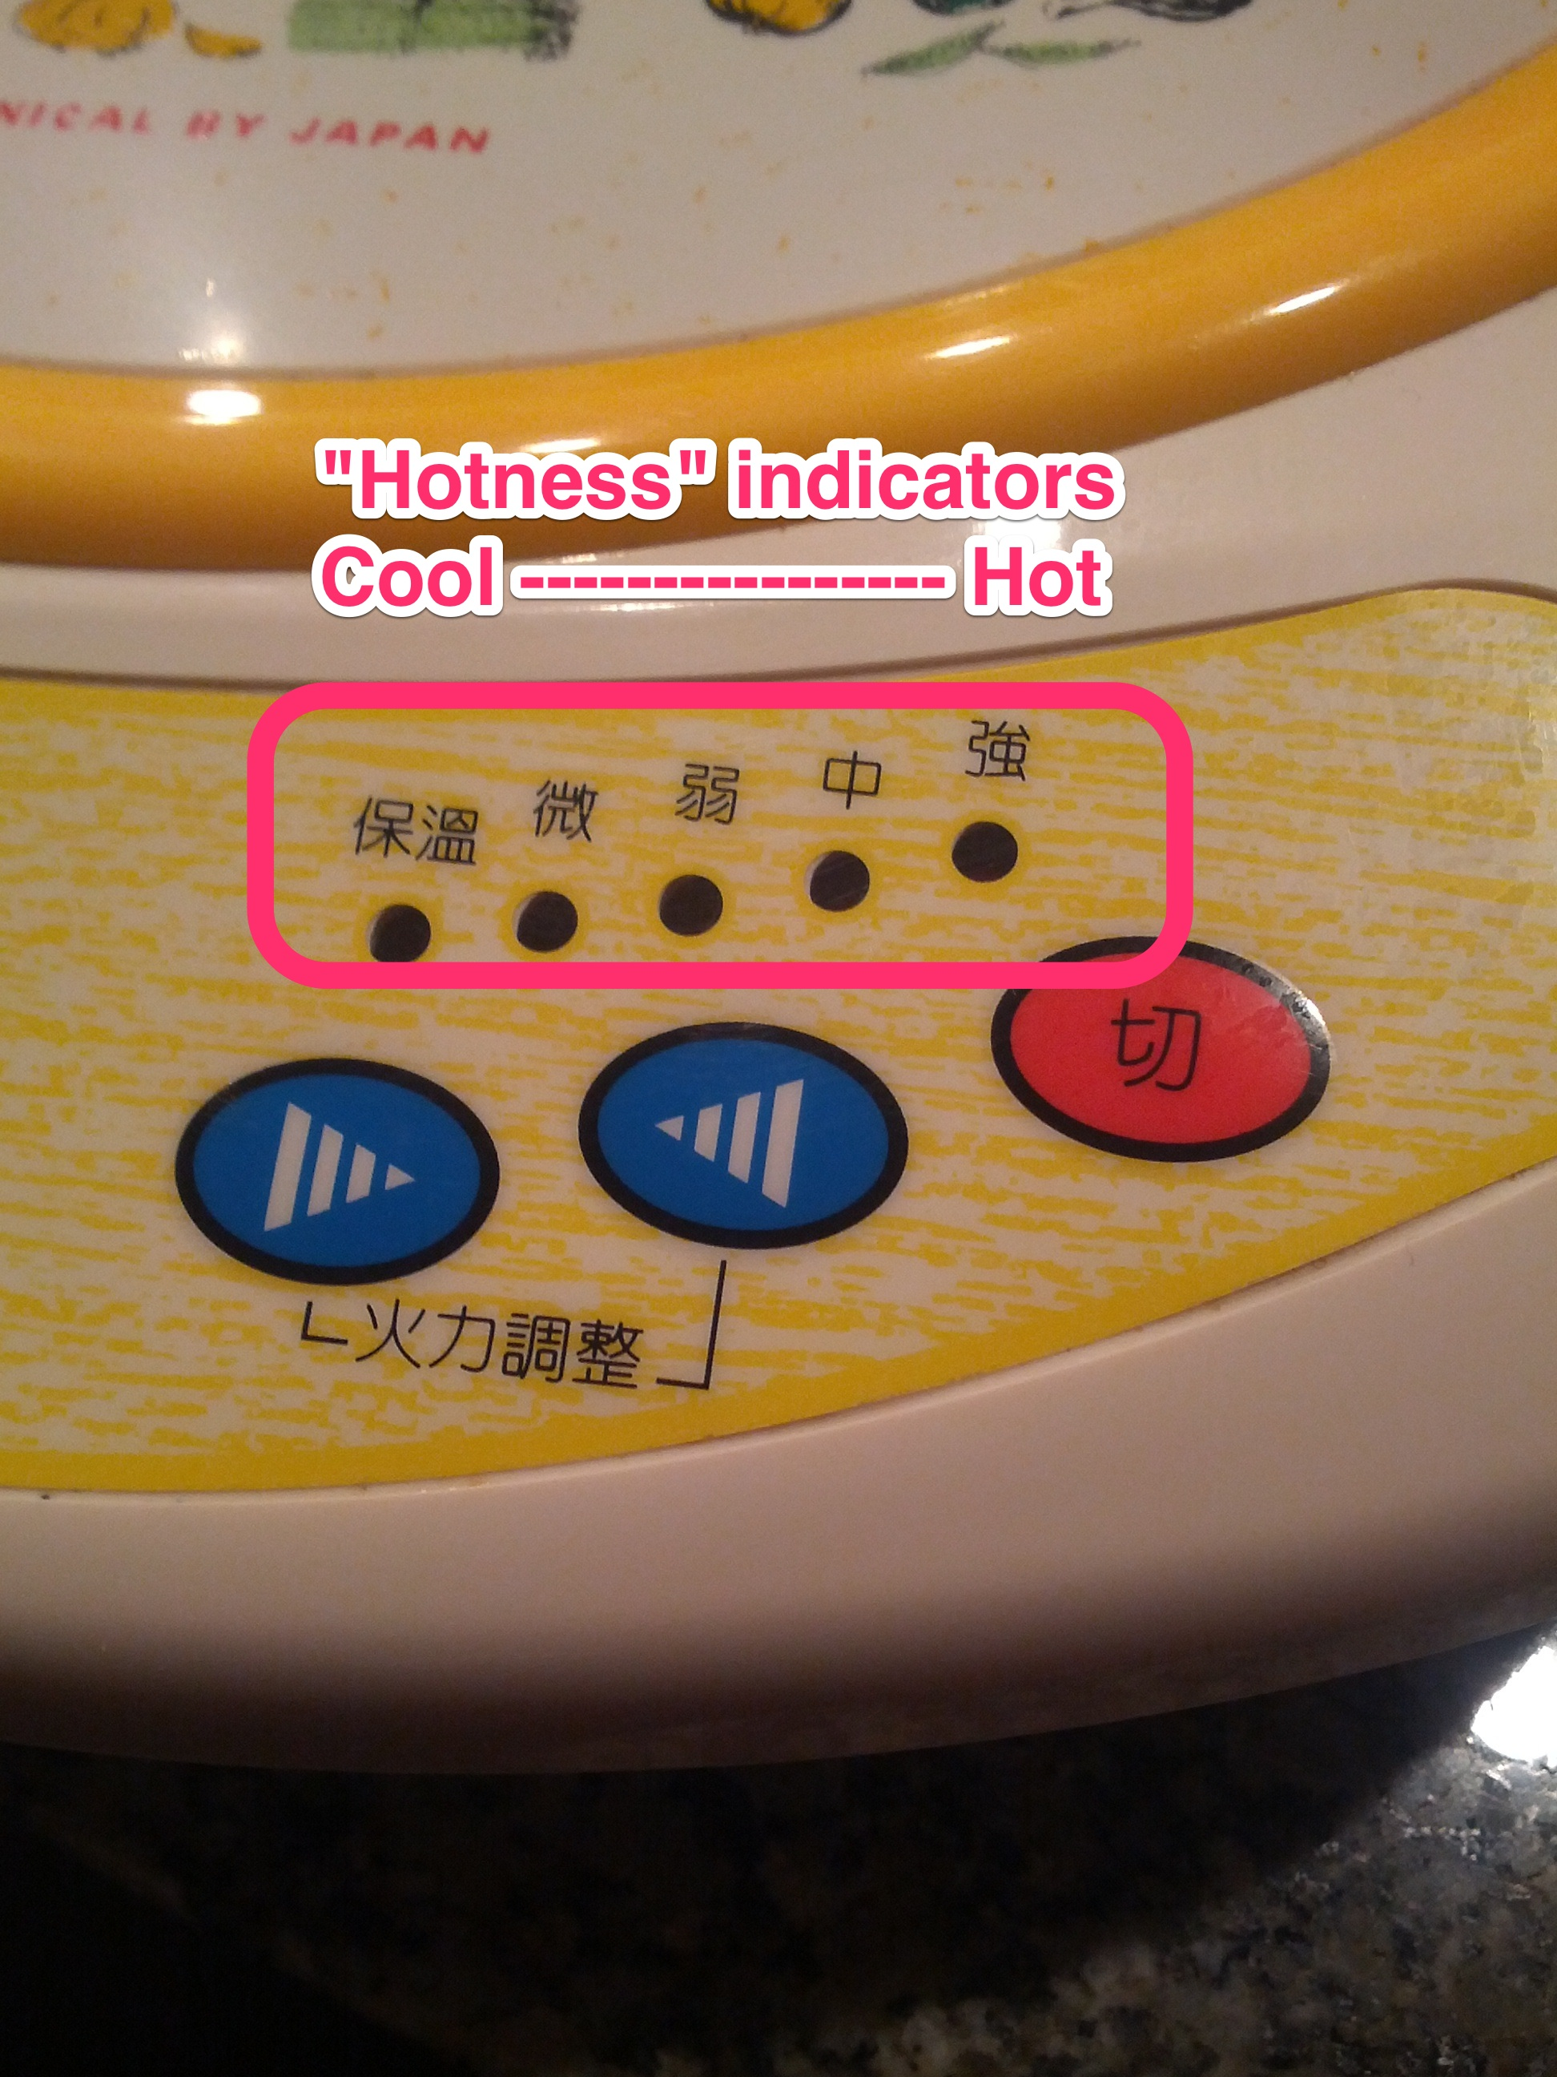
Insane Mapping Conflict…

Slide 19
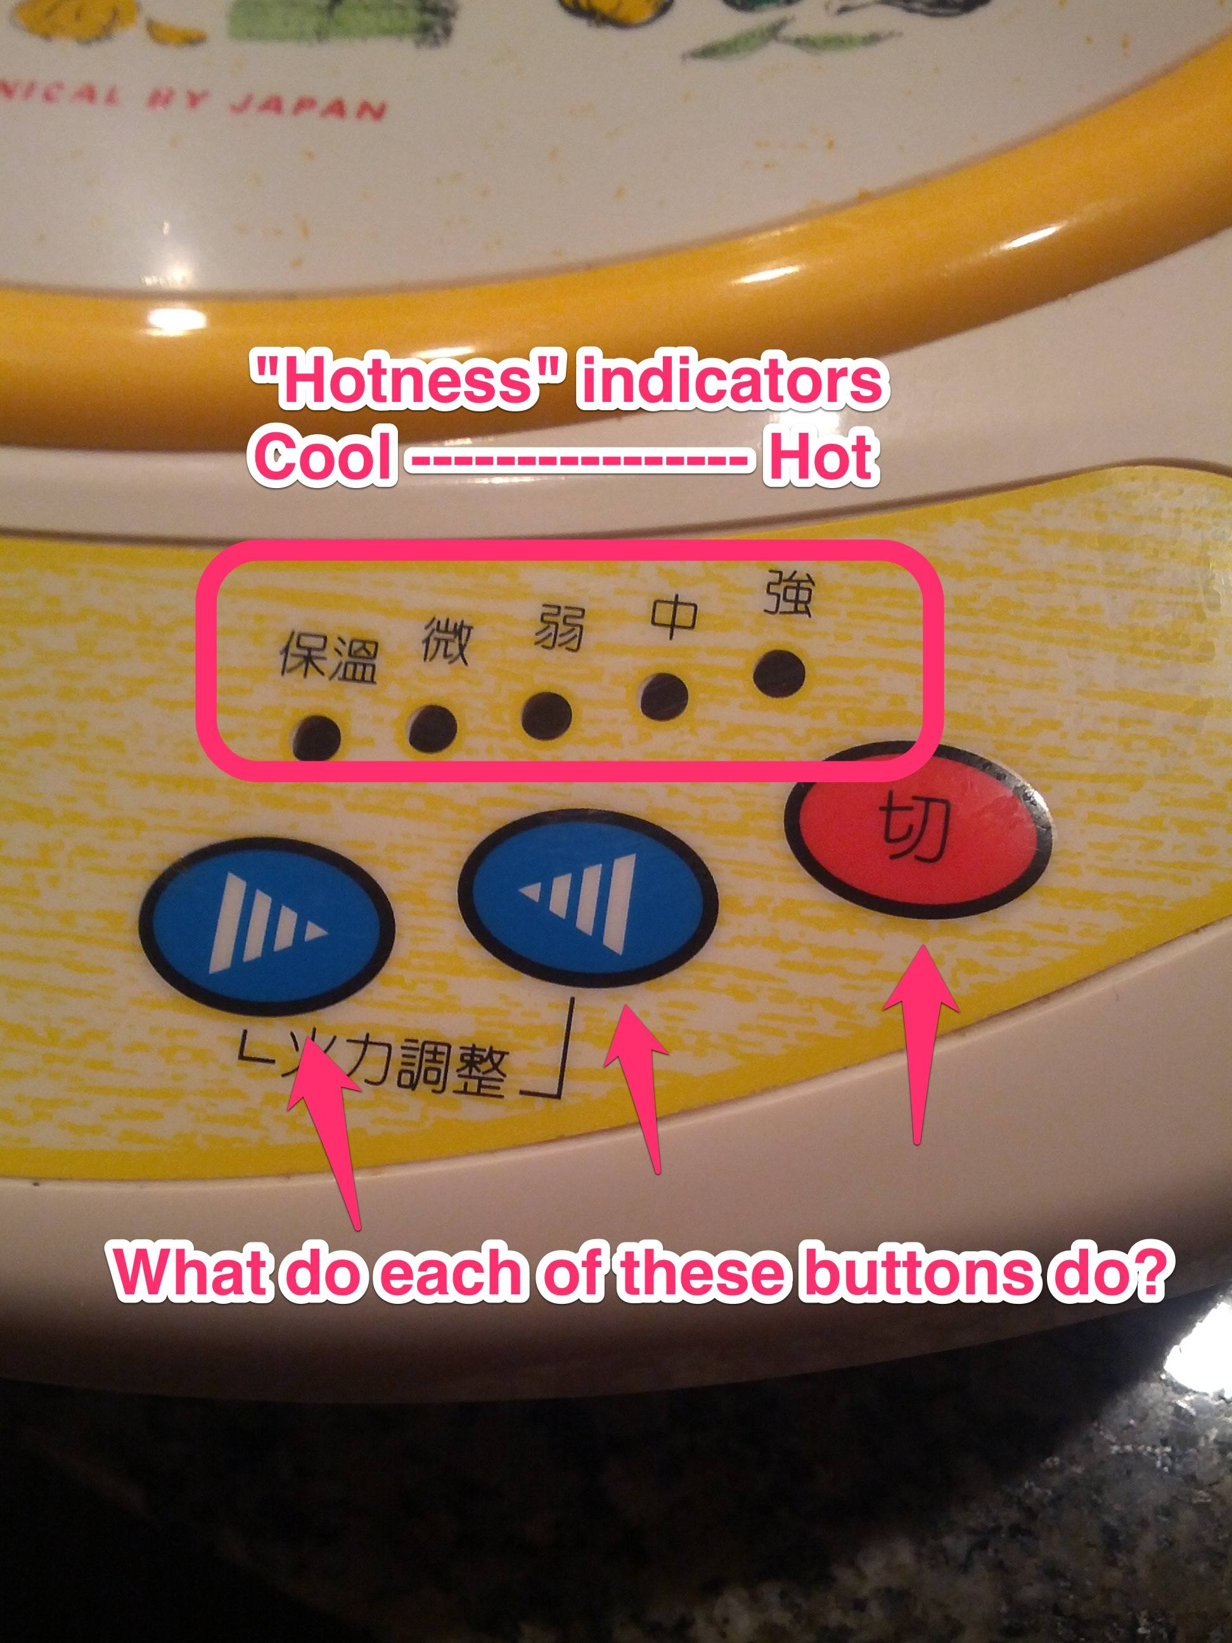
Insane Mapping Conflict…

Slide 20
Causality: Impressing your friends, 1998 Edition
“Trunk activation area”

Slide 21
Causality: Impressing your friends, 1998 Edition
“Trunk activation area”

Slide 22
Causality: Impressing your friends, 1998 Edition
“Trunk activation area” » false causality

