Slide 1
Task-Centered System Design - Walkthrough
Lecture /slide deck produced by Saul Greenberg modified by Tony Tang
Notice: some material in this deck is used from other sources without permission. Credit to the original source is given if it is known,

Slide 2
Learning Objectives
By the end of this lecture, you should be able to:
» conduct a walkthrough using task-centered design method
» discuss what a task-centered design method is good for, and why you might use it

Slide 3
Recap: Task Centered System Design
Phase 1: Identifying users and developing task descriptions
Phase 2: User-centered requirements analysis
Phase 3: Design using scenarios
Phase 4: Evaluate using task-centered walkthroughs

Slide 4
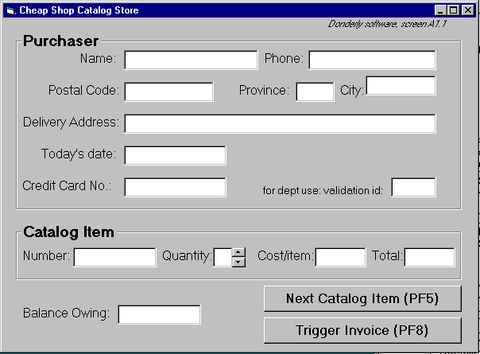
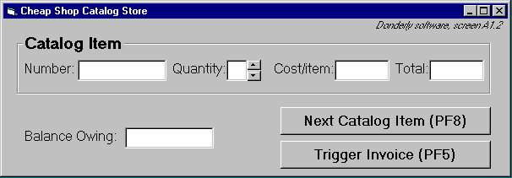
Cheap Shop
Screen 1
Screen 2

Slide 5
Specifications
To create an order
  On screen 1, shoppers enter their personal information and their first order
  text is entered via keyboard
  the tab or mouse is used to go between fields.
Further orders
  shoppers go to the 2nd screen by pressing the Next Catalog Item button
Order completion
  shoppers select ‘Trigger Invoice’.
  the system automatically tells shipping and billing about the order
  the system returns to a blank screen #1

Slide 6
Specifications
To cancel order
  Shoppers do not enter input for 30 seconds (as if they walk away)
  The system will then clear all screens and return to the main screen
Input checking
  all input fields checked when either button is pressed.
  erroneous fields will blink for 3 seconds, and will then be cleared.
  the shopper can then re-enter the correct values in those fields.

Slide 7
Task example: Fred Johnson
  Fred Johnson, who is caring for his demanding toddler son, wants a good quality umbrella stroller (red is preferred, but blue is acceptable).
  He browses the catalog and chooses the JPG stroller
  (cost $98. item code 323 066 697).
  He pays for it in cash, and uses it immediately.
  Fred is a first-time customer to this store, has little computer experience, and says he types very slowly with one finger. He lives nearby on Dear Bottom Avenue NW.
JPG Stroller. This well made but affordable Canadian stroller fits children between 1-3 years old. Its wheels roll well in light snow and mud.
…$98.
Red: 323 066 697
Blue: 323 066 698
Notes:
Discussion
Fred has many properties of our typical expected user:
many customers are first time shoppers,
a good number have no computer experience
a good number are poor typists.
The task type is routine and important.
many people often purchase only one item
a goaod number of those pay by cash
as with Fred, people often have a general sense of what they want to buy, but decide on the actual product only after seeing what is available.

Slide 8
Phase 4: Walk-through Evaluation
Good for debugging an interface
Process
1 Select one of the task scenarios
2 For each user’s step/action in the task:
  can you build a believable story that motivates the user’s actions?
  can you rely on user’s expected knowledge and training about system?
  if you cannot:
    you’ve located a problem in the interface!
    note the problem, including any comments
    assume it has been repaired
  go to the next step in the task

Slide 9
Walkthrough template
Task number: ____
Description of
Step
Does the user have the knowledge/training to do this?
Is it believable that they would do it?
Are they motivated?
Comment / solution
An example walkthrough for this exercise is found in Greenberg, S. “Working through Task-Centered System Design. in Diaper, D. and Stanton, N. (Eds) The Handbook of Task Analysis for Human-Computer Interaction. Lawrence Erlbaum Associates.

Slide 10
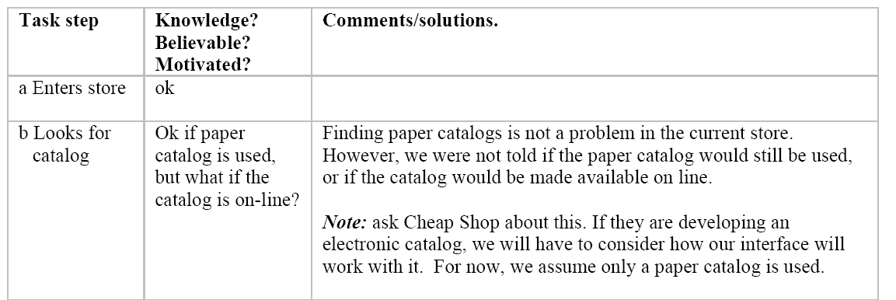
Fred: entering shop, finding a computer (1)

Slide 11
Fred: entering shop, finding a computer (1)

Slide 12
Fred: entering shop, finding a computer (1)

Slide 13
Fred: entering shop, finding a computer (1)

Slide 14
Fred: entering shop, finding a computer (1)

Slide 15
Specifications
To cancel order
  Shoppers do not enter input for 30 seconds (as if they walk away)
  The system will then clear all screens and return to the main screen
Input checking
  all input fields checked when either button is pressed.
  erroneous fields will blink for 3 seconds, and will then be cleared.
  the shopper can then re-enter the correct values in those fields.

Slide 16
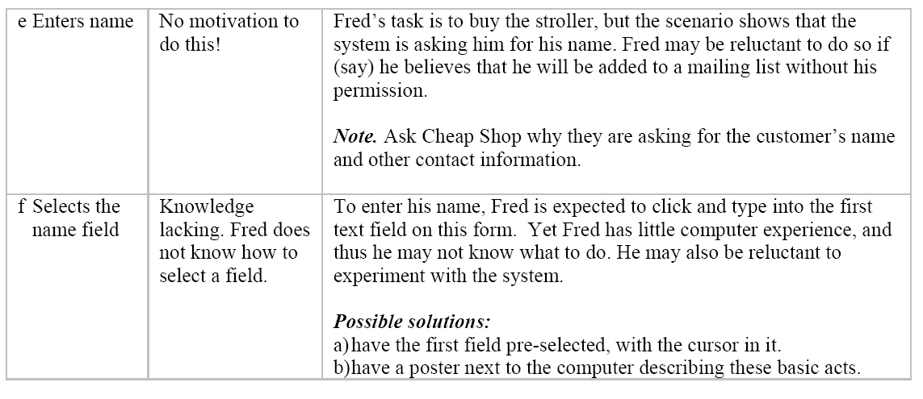
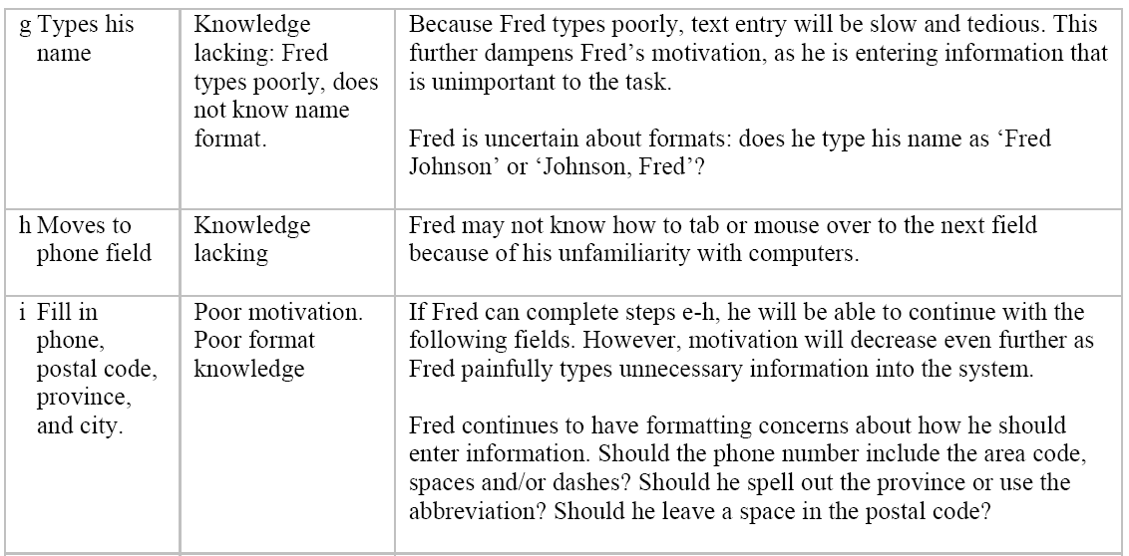
Fred: entering personal information (2)

Slide 17
Fred: entering personal information (2)

Slide 18
Fred: entering personal information (2)

Slide 19
Fred: entering personal information (2)

Slide 20
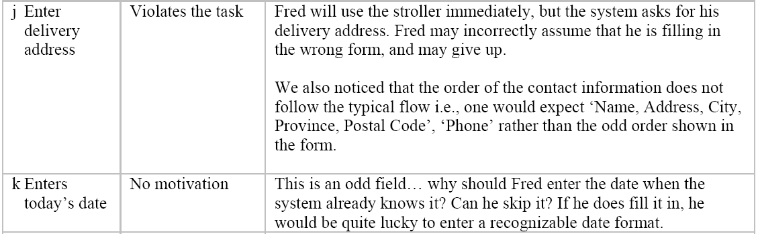
Fred: entering personal information (2)

Slide 21
Fred: entering personal information (2)

Slide 22
Fred: entering personal information (2)

Slide 23
Fred: entering personal information (2)

Slide 24
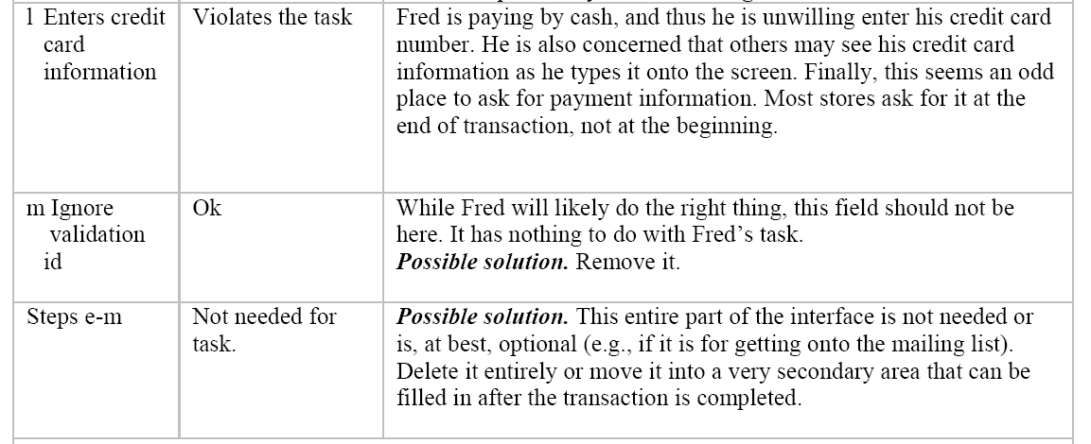
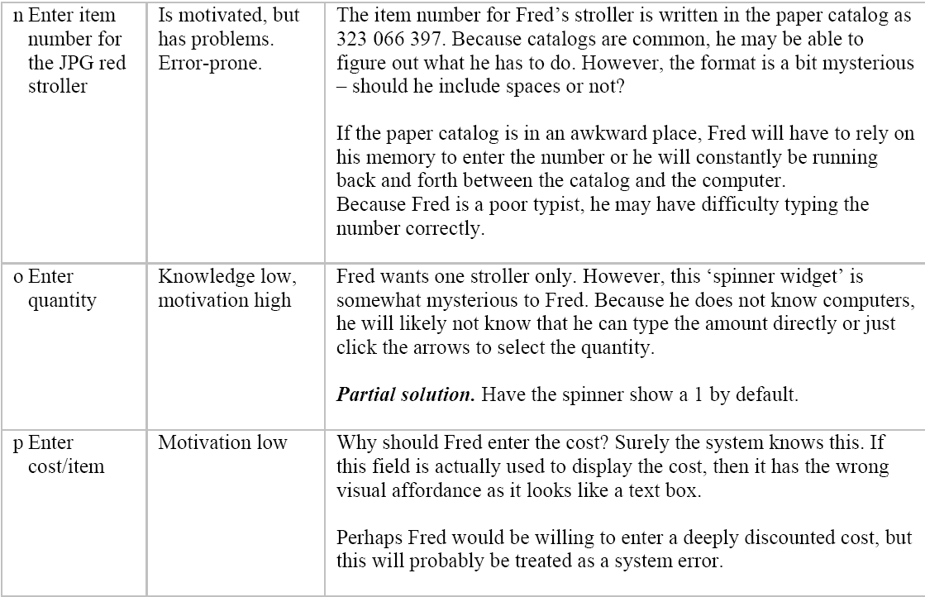
Fred: entering personal information (2)

Slide 25
Fred: entering personal information (2)

Slide 26
Fred: entering personal information (2)

Slide 27
Fred: entering personal information (2)

Slide 28
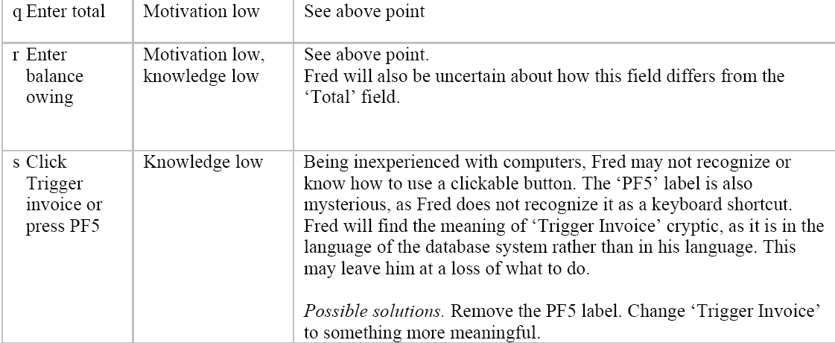
Fred: entering item information (3)

Slide 29
Fred: entering item information (3)

Slide 30
Fred: entering item information (3)

Slide 31
Fred: entering item information (3)

Slide 32
Fred: entering item information (3)

Slide 33
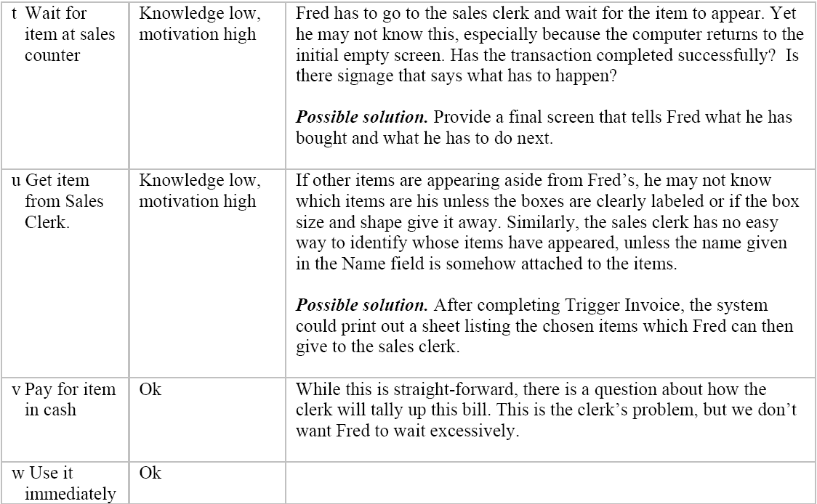
Fred: Picking up and paying for the stroller (4)

Slide 34
Thoughts…?
You can evaluate an interface without a user
Forces us to be systematic: Useful to think about the significance of each field to the user (and how they might/might not use it)
Flow-based technique: May leave out some issues – error cases, and exception cases
Because we’re going into the minutiae – really low level, allows us to see things that we might have ignored if we were just glancing
Takes a long time -- tedious
How low-level do we go
As a designer, I may not know what a “bird-watcher is like”
We may forget to take a high-level view of the whole situation

Slide 35
Also consider exceptional cases…
The previous step would have explored all the tasks as you’ve spelled them out in your first phase
Also consider error, failure, exception cases, just to see how well your interface would do.

Slide 36
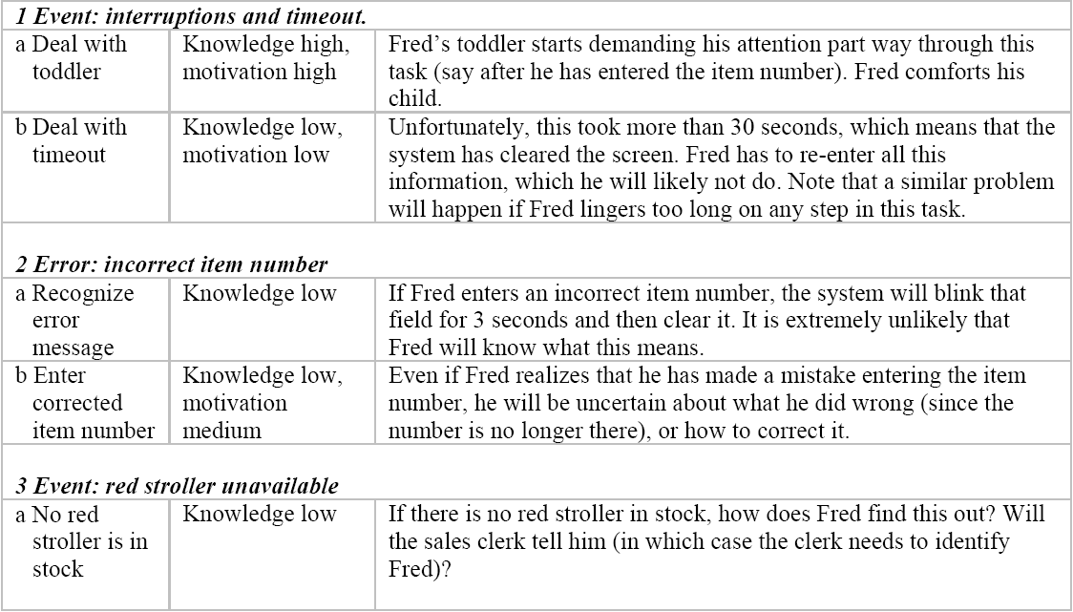
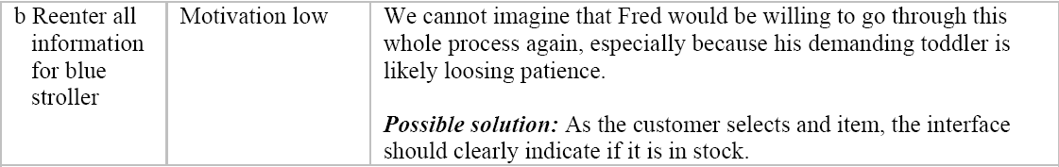
Fred: interruptions, errors and exceptions

Slide 37
Fred: interruptions, errors and exceptions

Slide 38
Fred: interruptions, errors and exceptions

Slide 39
Fred: interruptions, errors and exceptions

Slide 40
Fred: interruptions, errors and exceptions

Slide 41
Fred: interruptions, errors and exceptions

Slide 42
Fred: interruptions, errors and exceptions

Slide 43
Regarding John… (walkthrough in a nutshell)
Changes in order are not supported well
Slow items entry
Slow reaction time will result in more customers waiting in line (not good).

Slide 44
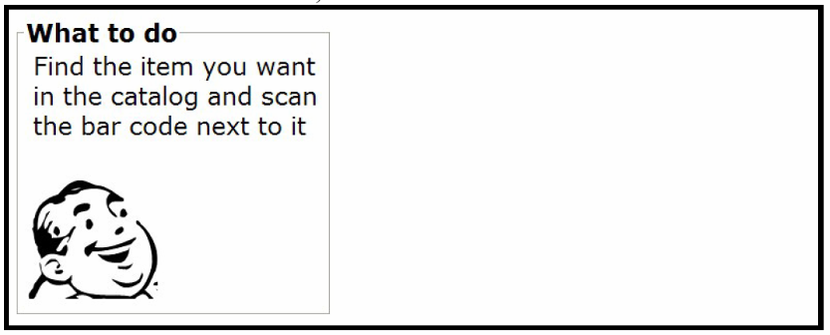
Are there better ways to do it?
Barcode reader
Touch screen
“Wizard” guidance

Slide 45
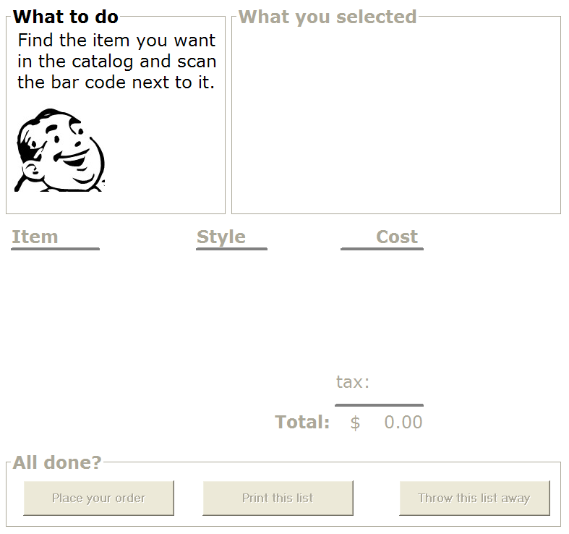
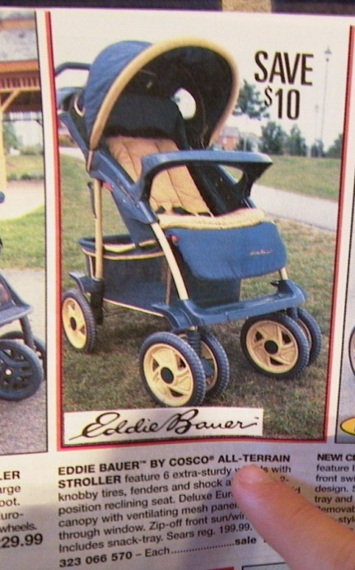

Slide 46
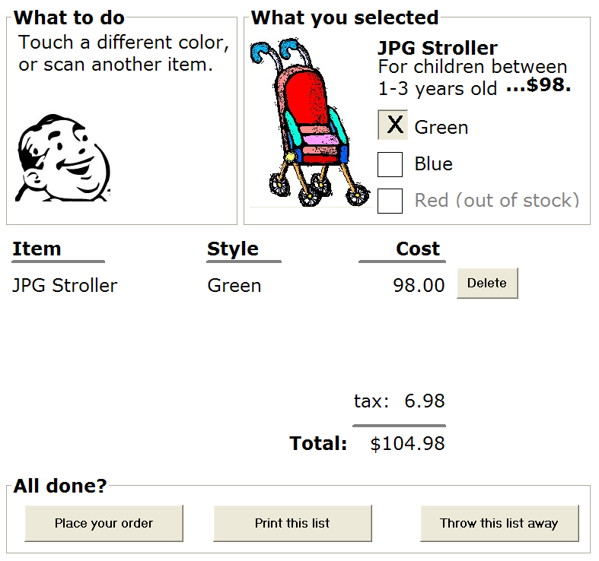

Slide 47


Slide 48


Slide 49
Printing…
To recall this order, scan the bar code on the printout

Slide 50
Task-Centered System Design: Summary
Formulaic method of designing systems based on user needs
Provides a systematic mechanism evaluate interfaces without users (pedantic, tedious)
Provides a method of identifying bugs, and to iteratively improve an interface → may be good at getting the design right, but maybe not the right design
Simple to use, and effective in many cases

Slide 51
Learning Objectives
You should now be able to:
» conduct a walkthrough using task-centered design method
» describe what a task-centered design method is good for, and why you might use it

