Slide 1
Task-Centered System Design
Lecture /slide deck produced by Saul Greenberg modified by Tony Tang
Notice: some material in this deck is used from other sources without permission. Credit to the original source is given if it is known,

Slide 2
Learning Objectives
By the end of this lecture, you should be able to:
» understand how you can use task-centered design
» understand and articulate the four phases of task-centered design
» understand how to develop good task examples

Slide 3
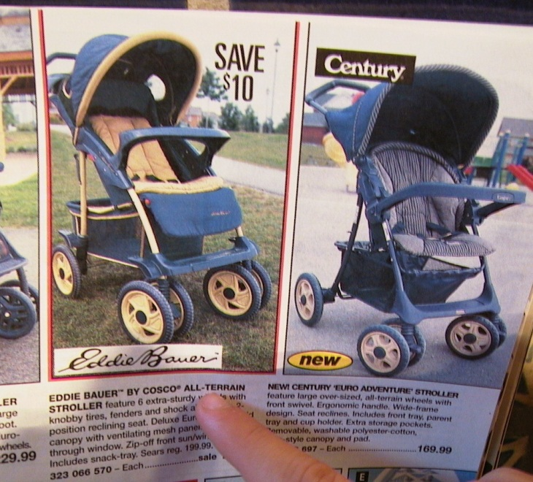
The Cheap Shop Catalog Store
  In Cheap Shop, people shop by browsing paper catalogs scattered around the store.
  When people see an item they want, they enter its item code from the catalog onto a form.
  People give this form to a clerk, who brings the item(s) from the back room to the front counter.
  People then pay for the items they want.
Item code Amount

Slide 4
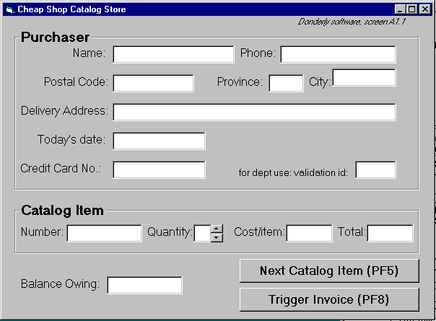
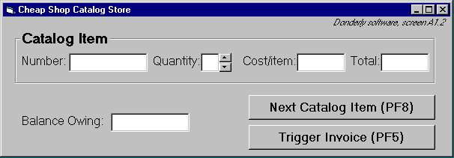
Cheap Shop
Screen 1
Screen 2
Notes:
Is cheap shop a good or bad interface?
do you go by gut feel?
do you go by how it looks?
do you judge it by familiarity to other interfaces?
if there are problems, are they minor or serious?
did you miss anything that you really shouldn’t have?
is your opinion correct?
how can you tell?

Slide 5
Seat-of-your-pants interface design
Is cheap shop a good or bad interface?
  do you go by gut feel?
  do you go by how it looks?
  do you judge it by familiarity to other interfaces?
  if there are problems, are they minor or serious?
  did you miss anything that you really shouldn’t have?
  is your opinion correct?
  how can you tell?
Alternative: are there methods where you can
  systematically determine if this interface matches the needs of its end users?
  systematically discover the usability bugs?

Slide 6
Requirements analysis
A software perspective
  exactly what functions should the system have?
The User
a person who will mould themselves to fit your system

Slide 7
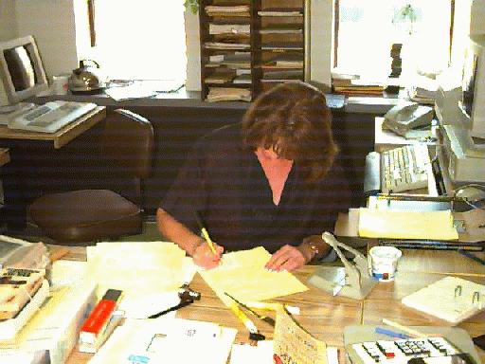
Requirements analysis
An end-user’s perspective
  exactly who would use the system to do exactly what?
Mary Franklin
a real person with real constraints trying to get her job done

Slide 8
Task Centered System Design
An end-users perspective
  exactly who would use the system to do exactly what?
Phases:
1. Identification
  identify specific users and articulate their concrete tasks
2. Requirements
  decide which of these tasks and users the design will support
3. Design
  base design representation & dialog sequences on these tasks
4. Walkthrough Evaluations
  using your design, walk through these tasks to test the interface
Adapted from Lewis, C. and Rieman, J. (1993) Task-Centered User Interface Design: A Practical Introduction. http://hcibib.org/tcuid/

Slide 9
Foreshadowing…
JPG Stroller. This well made but affordable Canadian stroller fits children between 1-3 years old. Its wheels roll well in light snow and mud.
…$98.
Red: 323 066 697
Blue: 323 066 698
Task example 1
  Fred Johnson, who is caring for his demanding toddler son, wants a good quality umbrella stroller (red is preferred, but blue is acceptable).
  He browses the catalog and chooses the JPG stroller
  (cost $98. item code 323 066 697).
  He pays for it in cash, and uses it immediately.
  Fred is a first-time customer to this store.
  He has little computer experience.
  He types very slowly with one finger.
  He lives nearby on Dear Bottom Avenue NW.

Slide 10
Foreshadowing…
Discussion
  Fred has many properties of our typical expected user:
    many customers are first time shoppers,
    a good number have no computer experience
    a good number are poor typists.
  The task type is routine and important.
    many people often purchase only one item
    a good number of those pay by cash
    as with Fred, people often have a general sense of what they want to buy, but decide on the actual product only after seeing what is available.

Slide 11
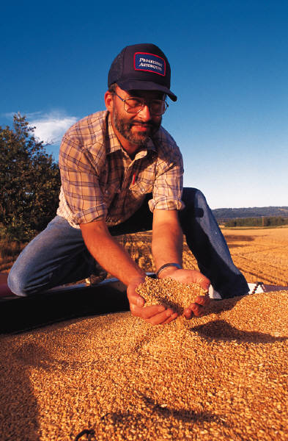

Phase 1: Identify users + tasks
Get in touch with real people who will be
potential users of your system
    prototypical categories
    extremes
Learn about their real tasks
  articulate concrete, detailed examples of tasks they
  perform or want to perform that your system should
  support
    routine
    infrequent but important
    infrequent and incidental

Slide 12
Phase 1: Identify users + tasks
How do you identify tasks?
  Immerse yourself in a real person’s environment
  Observe people in their actual work context
  Interview people as they do their work
  Shadow a person over the course of his or her day
  Serve people’s requests
  …

Slide 13
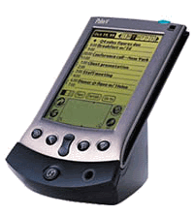
Phase 1: Identify users + tasks
If there are no real users or tasks…
  think again, there probably are!
  Jeff Hawkins, the inventor of the Palm Pilot, was said to
  have carried a small block of wood around in his shirt pocket … As various everyday situations arose, he would take out the block of wood and imagine how he would use the device.¹
    The same technique can be used to evoke a response from expected end-users
¹see Sato and Salvador, interactions 6(5)

Slide 14
Phase 1: Identify users + tasks
If all else fails…
  describe your expected set of users,
  describe your expected set of tasks
These will become your ‘assumed users and tasks’
  verify them later as information comes in
  modify them as needed

Slide 15
Phase 1: Developing good task examples
Says what the user wants to do but does not say how they would do it
  no assumptions made about the interface
  can be used to compare design alternatives in a fair way
Are very specific
  says exactly what the user wants to do
  specifies actual items the user would somehow want to input

Slide 16
Phase 1: Developing good task examples
3. Describes a complete job
  forces designer to consider how interface features work together
  contrasts how information input / output flows through the dialog
    where does information come from?
    where does it go?
    what has to happen next?
  Do not
    create a list of simple things the system should do

Slide 17
Phase 1: Developing good task examples
4. Says who the users are
  name names, if possible
  says what they know
  Why?
    design success strongly influenced by what users know
    can go back and ask them questions later
    reflects real interests of real users
    helps you find tasks that illustrate functionality in that person’s real work context

Slide 18
Phase 1: Developing good task examples
Are evaluated
  Circulate descriptions to users, and rewrite if needed
    ask users for
      omissions
      corrections
      clarifications
      suggestions
As a set, identifies a broad coverage of users and task types
  the typical ‘expected’ user, typical routine tasks
  the occasional but important user, infrequent but important tasks
  the unusual user unexpected or odd tasks

Slide 19
Phase 2: Requirements
Which user types will be addressed by the interface?
  designs can rarely handle everyone!
  includes why particular users are included / excluded
Which tasks will be addressed by the interface?
  designs can rarely handle all tasks
  requirements listed in terms of how they address tasks
    Absolutely must include:
    Should include
    Could include:
    Exclude:
  Discussion includes why items are in those categories
Notes:
We’re doing well if we cover 90% of the tasks and/or 90% of the users.
This means that we miss out on about 10% of people/tasks
Most of the time, this is actually quite okay

Slide 20
Phase 3: Design through Scenarios
Create scenarios (stories) with (thin) plots that capture the tasks that a person would engage in.
Develop designs to fit users and specific tasks
  ground interfaces in reality
Use tasks to
  get specific about possible designs (i.e. generate ideas)
  consider the real world contexts of real users
  consider how design features work together
    what would the user do / see step-by-step when performing this task?

Slide 21
Phase 4: Walk-through Evaluation
Good for debugging an interface
Process
1 Select one of the task scenarios
2 For each user’s step/action in the task:
  can you build a believable story that motivates the user’s actions?
  can you rely on user’s expected knowledge and training about system?
  if you cannot:
    you’ve located a problem in the interface!
    note the problem, including any comments
    assume it has been repaired
  go to the next step in the task

Slide 22
The Cheap Shop Catalog Store
  In Cheap Shop, people shop by browsing paper catalogs scattered around the store.
  When people see an item they want, they enter its item code from the catalog onto a form.
  People give this form to a clerk, who brings the item(s) from the back room to the front counter.
  People then pay for the items they want.
Item code Amount

Slide 23
Developing task examples: Cheap Shop
Task example 1
  Fred Johnson, who is caring for his demanding toddler son, wants a good quality umbrella stroller (red is preferred, but blue is acceptable).
  He browses the catalog and chooses the JPG stroller
  (cost $98. item code 323 066 697).
  He pays for it in cash, and uses it immediately.
  Fred is a first-time customer to this store, has little computer experience, and says he types very slowly with one finger. He lives nearby on Dear Bottom Avenue NW.
JPG Stroller. This well made but affordable Canadian stroller fits children between 1-3 years old. Its wheels roll well in light snow and mud.
…$98.
Red: 323 066 697
Blue: 323 066 698

Slide 24
Developing task examples: Cheap Shop
Discussion
  Fred has many properties of our typical expected user:
    many customers are first time shoppers,
    a good number have no computer experience
    a good number are poor typists.
  The task type is routine and important.
    many people often purchase only one item
    a good number of those pay by cash
    as with Fred, people often have a general sense of what they want to buy, but decide on the actual product only after seeing what is available.

Slide 25
Developing task examples: Cheap Shop
Task example 2
  Mary Vornushia is price-comparing the costs of a child’s bedroom set, consisting of a wooden desk, a chair, a single bed, a mattress, a bedspread, and a pillow all made by Furnons Inc.
  She takes the description and total cost away with her to check against other stores.
  Three hours later, she returns and decides to buy everything but the chair.
  She pays by credit card,
  She asks for the items to be delivered to her daughter’s home at 31247 Lucinda Drive, in the basement suite at the back of the house.
  Mary is elderly and arthritic.

Slide 26
Developing task examples: Cheap Shop
Discussion
  Like Mary,
    a reasonable number of store customers are elderly, with infirmities that inhibit their physical abilities.
    a modest number of them also enjoy comparison shopping, perhaps because they have more time on their hands or because they are on low income.
  The task type is less frequent, but still important.
    although this would be considered a ‘major’ purchase in terms of the total cost, the number of items purchased is not unusual.
    delivery of large items is the norm
    most customers pay by credit card for larger orders.

Slide 27
Developing task examples: Cheap Shop
Task example 3
  John Forham, the sole salesperson in the store, is given a list of 10 items by a customer who does not want to use the computer.
  The items are:
    4 pine chairs, 1 pine table, 6 blue place mats, 6 “lor” forks, 6 “lor” table spoons, 6 “lor” teaspoons, 6 “lor” knives, 1 “tot” tricycle, 1 red ball, 1 “silva” croquet set
  After seeing the total, the customer tells John he will take all but the silverware
  The customer then decides to add 1 blue ball to the list.
  The customer starts paying by credit card, but then decides to pay cash. The customer tells John he wants the items delivered to his home the day after tomorrow. While this is occurring, 6 other customers are waiting for John.
  John has been on staff for 1 week, and is only partway through his training program

Slide 28
Developing task examples: Cheap Shop
Discussion
  This task introduces the clerk as a system user.
    Because the store has a high turnover in its staff, new employees such as John are also common.
    Thus John reflects a ‘rare’ but important group of users.
  The task type is less frequent, but still important
    The task, while complex, is fairly typical i.e., people making large numbers of purchases often ask the clerk to help them.
    Similarly, clerks mention that customers often change their mind partway through a transaction i.e., by changing what they want to buy and/or by changing how they want to pay for it.
    Customers, however, rarely give specific delivery dates, with most wanting delivery as soon as possible.
    Lineups for clerks are common during busy times.

Slide 29
Learning Objectives
You should be able to:
» understand how you can use task-centered design
» understand and articulate the four phases of task-centered design
» understand how to develop good task examples
Next time:
» Designing scenarios and engaging in walkthroughs

Slide 30



Permissions
You are free:
  to Share — to copy, distribute and transmit the work
  to Remix — to adapt the work
Under the following conditions:
Attribution — You must attribute the work in the manner specified by the author (but not in any way that suggests that they endorse you or your use of the work) by citing:
  “Lecture materials by Saul Greenberg, University of Calgary, AB, Canada. http://saul.cpsc.ucalgary.ca/saul/pmwiki.php/HCIResources/HCILectures”
Noncommercial — You may not use this work for commercial purposes, except to assist one’s own teaching and training within commercial organizations.
Share Alike — If you alter, transform, or build upon this work, you may distribute the resulting work only under the same or similar license to this one.
With the understanding that:
Not all material have transferable rights — materials from other sources which are included here are cited
Waiver — Any of the above conditions can be waived if you get permission from the copyright holder.
Public Domain — Where the work or any of its elements is in the public domain under applicable law, that status is in no way affected by the license.
Other Rights — In no way are any of the following rights affected by the license:
  Your fair dealing or fair use rights, or other applicable copyright exceptions and limitations;
  The author's moral rights;
  Rights other persons may have either in the work itself or in how the work is used, such as publicity or privacy rights.
Notice — For any reuse or distribution, you must make clear to others the license terms of this work. The best way to do this is with a link to this web page.

