Slide 1
Prototyping 2
CPSC 481: HCI I
Fall 2014
Anthony Tang, with acknowledgements to Julie Kientz, Saul Greenberg, Nicolai Marquardt, Ehud Sharlin

Slide 2
Learning Objectives
By the end of this lecture, you should be able to:
— describe the difference between horizontal and vertical prototypes
— contrast several methods for prototyping functionality (e.g. wizard-of-oz; video prototyping)
— contrast three ways of integrating prototyping into an organization’s software engineering process

Slide 3
Prototype “Types”: Two Dimension Classification Scheme
High --- Low Fidelity
» Choice of medium is close to or far from that of the final design
» e.g. high = software; low = paper prototype
Horizontal vs. Vertical (generally for software prototypes)
» Range of capabilities in the prototype
» horizontal = wide range of features without full “implementation” of any
» vertical = select features are “implemented” all the way through
Notes:
-=-=
Horizontal prototypes are appropriate for understanding relationships across a broad system and for showing the range of abilities of a system.
Vertical prototypes are most appropriate when a certain complex feature of a system is poorly-understood and needs to be explored, e.g. as a proof-of-concept.

Slide 4
Vertical vs. Horizontal Prototypes
Different Features
Horizontal prototype
Scenario
Functionality
Full interface
Vertical prototype
Notes:
Arrow on functionality
Take out the paper prototype/ photoshop mock up thing
• Two common types of compromise
- horizontal prototype: provide a wide range of
functions but with little detail
- vertical prototype: provide a lot of detail for only a
few functions

Slide 5
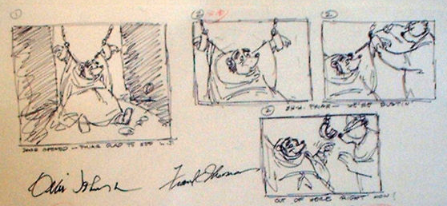
Prototyping through Storyboards
“comic book” approach, a series of keyframes as sketches—illustrates a sequence
originally from film; used to get the idea of a scene
snapshots of the interface at particular key points in the interaction
users can evaluate quickly the direction the interface is heading

Slide 6
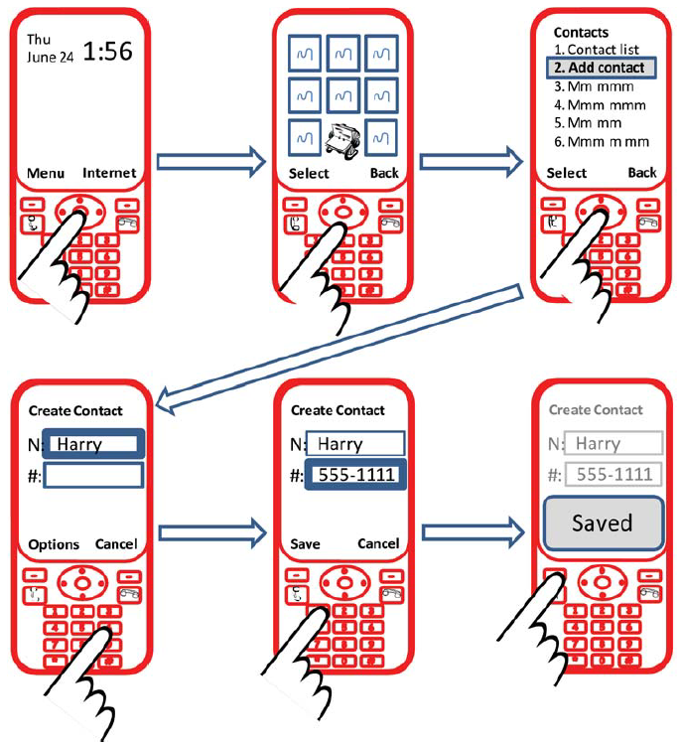

Slide 7
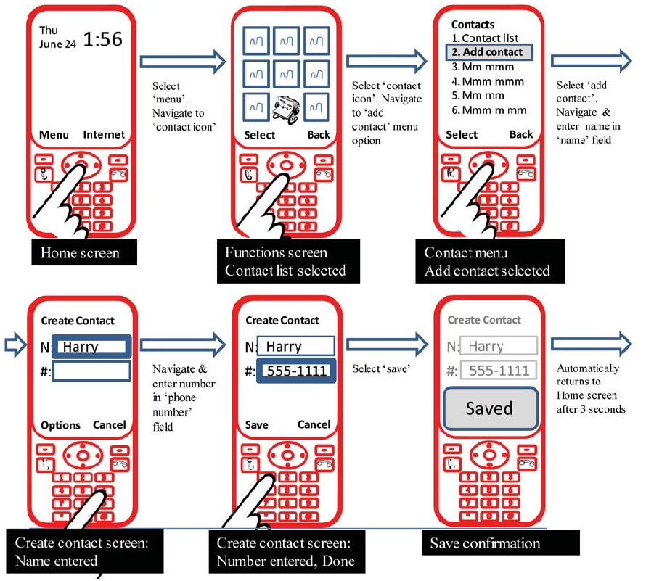

Slide 8
Prototyping with PICTIVE
PICTIVE: Plastic Interface for Collaborative Technology Initiatives through Video Exploration
Designing with customers using office supplies
» multiple layers of sticky notes and plastic overlays
» different sized stickies represent icons, menus, windows etc.
Interaction demonstrated by manipulating notes
» new interfaces built on the fly
Session videotaped for later analysis
» usually end up with mess of paper and plastic!

Slide 9
PICTIVE, designing with office supplies
Can pre-make paper interface components
buttons
menu
alert box
combo box
tabs
list box
entries

Slide 10
Prototyping with PowerPoint
PowerPoint can also be used to simulate very specific interaction scenarios
Problem: People give me gifts I don’t want
Solution: Maybe a web-based gift-list social networking site could help
Notes:
http://www.boxesandarrows.com/files/banda/interactive/SamplePrototype.ppt

Slide 11
Prototyping Functionality: Wizard-of-Oz
Common problem: it’s difficult to prototype some piece of functionality
Need: test whether it is actually good
Solution: fake it with a person controlling the interface! Make the interaction as authentic as possible
Key: user has no idea that the interaction is being faked

Slide 12
Wizard of Oz
A method of testing a system that does not exist
the listening typewriter, IBM 1983
Dear Henry
Speech Computer
What the user sees

Slide 13
Wizard of Oz
A method of testing a system that does not exist
the listening typewriter, IBM 1984
Dear Henry
Dear Henry
Speech Computer
What the user sees
The wizard

Slide 14
Name Origin: Wizard-of-Oz
The Wizard of Oz: book and movie
clip

Slide 15
Wizard of Oz: The Point
Up until the point the wizard is discovered, the thoughts, feelings, and actions of Dorothy and the others were all genuine
They were genuinely experiencing what it would be like to talk to a powerful and terrible wizard

Slide 16
Wizard of Oz: Anti-Gravity Bar
http://www.youtube.com/watch?v=DL9cAcQ-gKQd

Slide 17
Prototyping Functionality: Video Prototyping
Video prototyping allows you to prototype functionality without needing to be physically present.
Paper prototypes and wizard-of-oz require you to be around to simulate functionality.
A video prototype frees you from that, but constrains you to a limited scenario.
You can also simulate this through a stitched together set of images (slow-mation).

Slide 18
iPhone paper+video prototype
Notes:
http://www.youtube.com/watch?v=6TbyXq3XHSc

Slide 19
Body Centric Interaction
New design concept. Realized as a medium-fidelity prototype, and captured as a video prototype.
Notes:
http://grouplab.cpsc.ucalgary.ca/grouplab/uploads/Publications/Publications/2012-BodyCentricInteraction.TEI.mp4

Slide 20
Fat-Thumb
High fidelity prototype, but very much a vertical one
Fat-Thumb video example w/ maps
Notes:
http://grouplab.cpsc.ucalgary.ca/grouplab/uploads/Publications/Publications/2012-FatThumb.MobileHCI.mp4

Slide 21
More specific narrow scenarios
VideoDraw

Slide 22
Prototypes in an Organization
Question: How do we integrate the philosophy of prototyping into an organization?
Three methods for managing this integration:
Evolutionary
Modular (incremental)
Throw-away

Slide 23
Evolutionary Approach to Prototype Integration
Iteratively change the prototype to incorporate changes
Eventually, the reworked prototype becomes the final system
Design prototype
Implement prototype
Test prototype
System

Slide 24
Modular (Incremental) Approach to Prototype Integration
Build the system as separate modules/components
Each module is designed, prototyped and build separately before being combined into a final system
Design component
Implement component
Test component
Design component
Implement component
Test component
Design component
Implement component
Test component
System

Slide 25
Throw-away Approach to Prototype Integration
Design prototype
Implement prototype
Test prototype
Prototype is used to get rapid feedback (i.e. to learn lessons)
Prototype is built, tested, and deployed (or discarded)
Design prototype
Implement prototype
Test prototype
Design prototype
Implement prototype
Test prototype

Slide 26
Integrating Prototypes in Organizations
evolutionary
» prototype is altered to incorporate design changes
» eventually becomes the final product
2. modular (incremental)
» product is built as separate components (modules)
» each component is prototyped and tested, then added to final system
3. throwaway
» prototype serves to reveal user reach, then discarded
» creating prototype should be rapid, otherwise can be expensive
Notes:
-- Many large systems (e.g. Twitter/Facebook) can be considered to be built with an evolutionary approach (timeline feed): modern SCRUM techniques
-- On the other hand, many of the feature areas are often designed somewhat independently of one another (Ebay: automobiles site is independent of rest of site; Yahoo: cars, mail, calendar, etc.):: traditional SENG
-- Modular is suitable for very large products with a lot of component pieces. The downside is trying to come up with a unifying interaction metaphor or theme. The U of Calgary website (as a whole) is a good example. There are published guidelines, etc., but these are rarely followed.
-- HCI research often gets to take a throw-away approach. This is more suitable for products where the main learnings are in the process of development, rather than being the end-goal itself

Slide 27
Learning Objectives
You now know how to :
— describe the difference between horizontal and vertical prototypes
— contrast several methods for prototyping functionality (e.g. wizard-of-oz; video prototyping)
— contrast three ways of integrating prototyping into an organization’s software engineering process

