Slide 1
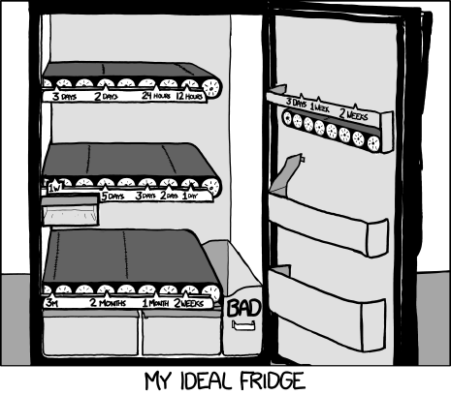
Source: xkcd.com
Notes:
Xkcd

Slide 2
Midterm –
Coverage: everything up to the end of Prototyping
Focus: I am mainly interested that you understand the concepts, and can apply them in a logical way. You should be able to explain the main concepts and/or rationalize them.
How to study: review notes from lecture, the reading that I assigned you, as well as your assignments.
Exam: Closed book. Arrive early. Be concise. Mostly: short-answer questions.

Slide 3
481 – 11 Exercises

Slide 4
Pros and Cons (lo-fi vs. hi-fi)
 | Lo-Fi | Hi-Fi
Advantages
Disadvantages
Notes:
Fill it in!

Slide 5
Nordstrom video
What did you see?
Notes:
http://www.youtube.com/watch?v=szr0ezLyQHY
Prototyping and user feedback in a tight loop

Slide 6
Prototype of a prototyping environment
Illuminating light video
Notes:
https://vimeo.com/48600709

Slide 7
Video prototype
Login page video prototype
Notes:
http://e102.co.uk/?p=3
This is a paper prototype tat has been made into a video prototype.
As you will see in tutorial, the problem with paper prototypes is that you need someone there to “run it”
A video prototype, once you make it, can sort of “run itself.” Obviously, there’s only one user flow, but you get to see all the functionality that’s in it
A video prototype takes some time to develop, but it is actually often quite effective

Slide 8
“Tangible Prototypes”
URP video
Notes:
This is obviously a very very slick prototype, and it works
What did you see in there?
What does the video show?
What are the key ideas that are there?
Going beyond exactly the application they showed, what are they trying to tell us?

Slide 9
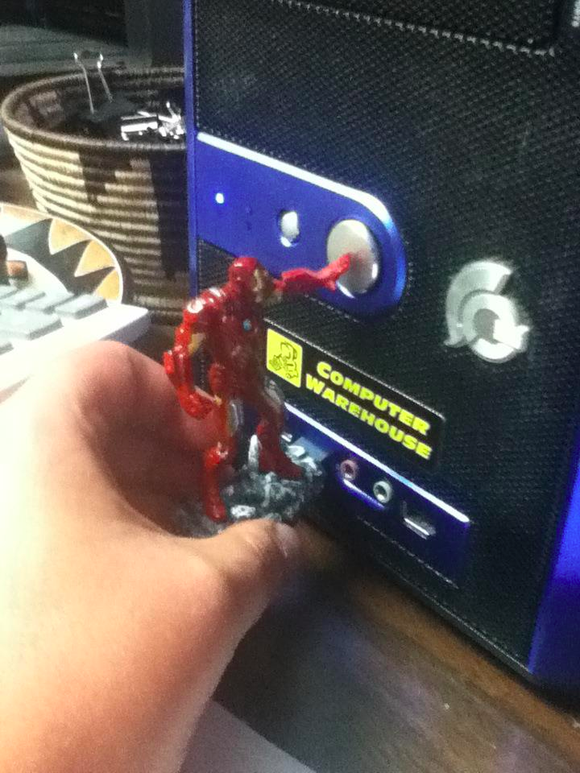
reddit.com
Notes:
http://www.reddit.com/r/funny/comments/10zcr2/i_just_got_trolled_by_the_iron_man_avengers_usb/

Slide 10
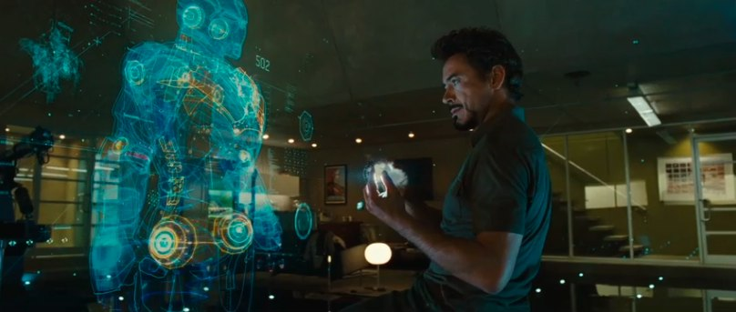
Cool video prototype
Notes:
Xkcd

