Slide 1
Prototyping
CPSC 481: HCI I
Fall 2014
Anthony Tang, with acknowledgements to Julie Kientz, Saul Greenberg, Nicolai Marquardt, Ehud Sharlin
Notes:
http://www.gamasutra.com/blogs/HeatherChandler/20140731/222312/How_Prototyping_Saved_Our_Game.php

Slide 2
Learning Objectives
By the end of this lecture, you should be able to:
— argue for the value of having prototypes
— identify the properties of a prototype
— describe different types of prototypes (lo- and hi- prototypes)
— understand what should actually be prototyped

Slide 3
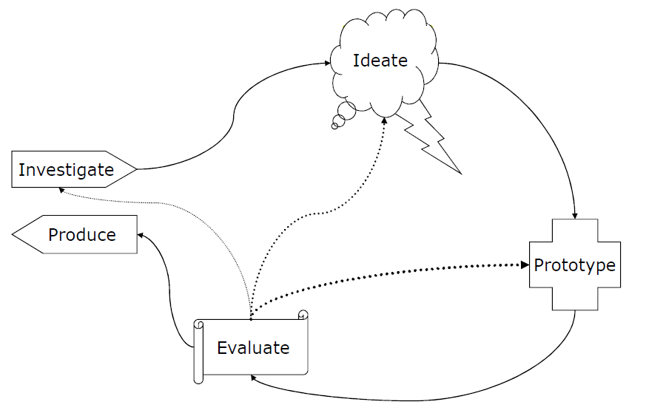
User Centered Design Process
Produce something tangible
Identify challenges
Uncover subtleties

Slide 4
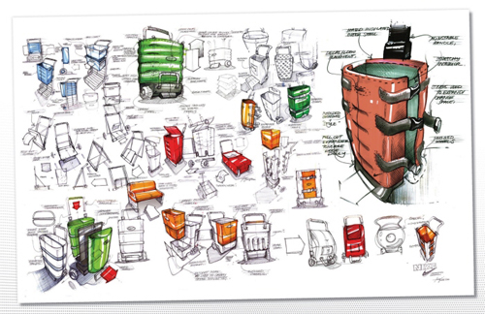
How to pick good ideas?
Notes:
http://www.idsketching.com/toolbox/toolbox-levels-of-sketching/
So, if you’ve been doing the ideate part right, then you should have a boatload of ideas and a ton of different design ideas.
Now, what? How do you select what to go with?

Slide 5
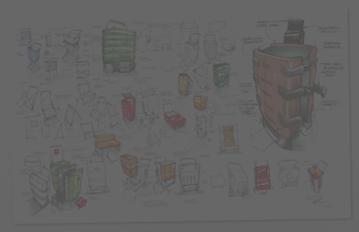
How to pick good ideas?
Try them out! Prototype multiple, and test them out with your users!
Quality metrics:
Ease of use
Utility vs. superfluous features
Effectiveness (task coverage)
Efficiency/performance
Notes:
http://www.idsketching.com/toolbox/toolbox-levels-of-sketching/
So, if you’ve been doing the ideate part right, then you should have a boatload of ideas and a ton of different design ideas.
Now, what? How do you select what to go with?
My suggestion: rather than choosing based on your gut, try it out! Your gut may be wrong, but you’d never know if you just went with your gut. If you can prototype several, then do it.

Slide 6
Why prototype?
Evaluation and user feedback is central in good design
Stakeholders can see, hold and interact with a prototype (but can’t with a stack of documents)
Aids communication of an idea, and provides focus for a team
You can test out your ideas
Encourages reflection
Answers questions, and helps you make choices between different alternatives
On paper, it is too easy to punt decisions for later

Slide 7
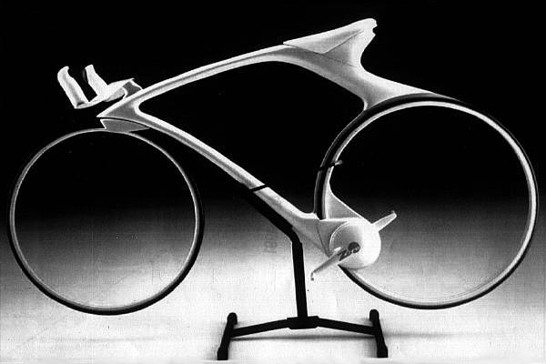
What is a prototype?
Notes:
http://www.csse.monash.edu.au/~aland/cycling.html
This is a concept bike. The idea is to have hubless, magnetically suspended wheels, and a magnetic drive.
Very cool idea, and this is perhaps a real prototype, or a vision prototype

Slide 8
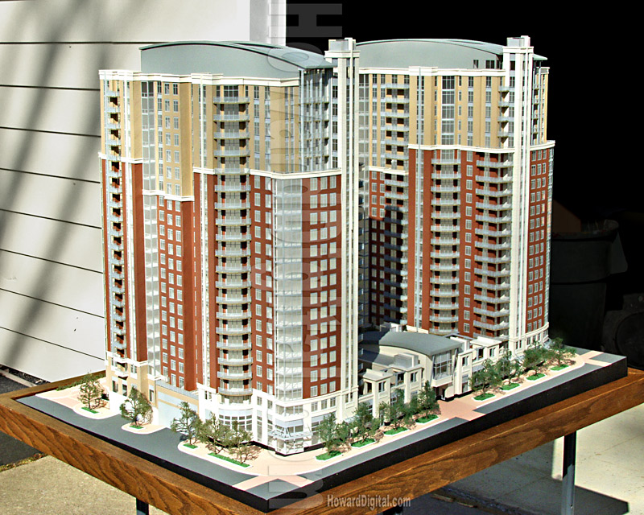
What is a prototype?
Notes:
http://www.howardmodels.com/architectural-models-07/reston/index.html
This is an architectural prototype. I used to love looking at these things.
Anyway, in it, you cansee to scale what things would look like – sidewalk to doors, windows to building height,

Slide 9
What is a prototype?
Notes:
http://www.kmuise.com/design/portfolio/kurio.php
This is a storyboard that expresses how people would interact in a new type of museum. IN it, what they do is to use these tangible objects that are like microphones, speakesr and cameras. There are digital tabletops and PDAs that work with these objects to help people better understand all the things that are going on in the museum

Slide 10
What is a prototype?
To me, a prototype is defined less by form, and more by its function:
A prototype expresses and realizes a design concept for the purpose of communication.
Prototype qualities
Fast
Disposable
Focused
Role of prototypes
Test | Get feedback
Communicate
Persuade
Notes:
So, while sketches are used to provoke, and to express a general idea, or to elicit response, a prototype is used to actually depict what is going on as someone imagines it. In some sense, it is more or less concrete

Slide 11
Many different kinds of prototypes
Storyboards » museum example | your tutorial
PowerPoint slideshow » you’ll see one Monday
Video prototype » login page video
Paper prototype » email system video
Physical model » little apartment building
Software with limited functionality » your project
…

Slide 12
What should be prototyped?
Task design & user flow
Based on expected tasks, what will the users see, what will they do?
Screen layouts and information display
How should information be laid out to provide information as users need it? How can this be optimized?
Graphic design and look & feel
What should it look like?
Technical aspects
Can we actually make this go?!
* Start with controversial and critical areas (e.g. security)

Slide 13
Which prototyping method to choose?
Choose the method that works best for what you are trying to achieve (pragmatics).
For example:
User flow » storyboard
Screen layouts/page flow » paper prototypes
Overall experience » video prototype
Look and feel » PowerPoint or PSD
Functionality » software
… etc.
Alternately, maybe you are at different stages in the design. Early on, use techniques that are cheap and quick; later on, use techniques that give a stronger sense of finished idea.

Slide 14
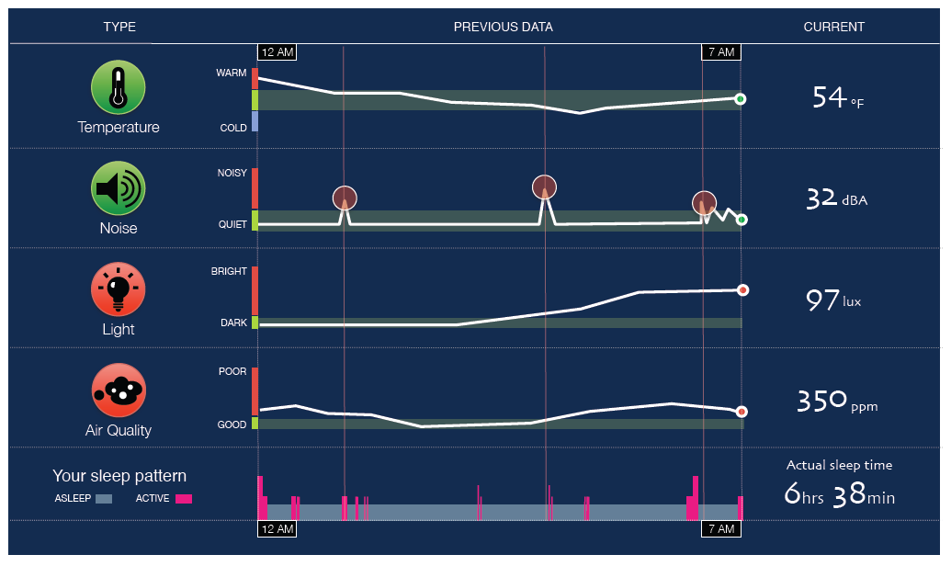
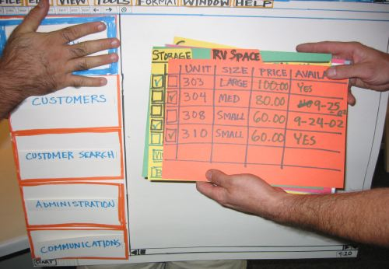
Hi vs. Lo Fidelity Prototypes
Distinction: is the choice of medium close or far from that of final design? (e.g., high = software; low = paper prototype)
Hi fidelity
Lo fidelity

Slide 15
Hi-fi vs. Lo-fi: “From the experts…”
 | Lo-Fi | Hi-Fi
Advantages | » ***fast*** » cheap » easy – kindergarten skills! » can simulate actual product » great way to get feedback from stakeholders | » better sense of finished product » can judge aesthetic appeal » more realistic experience » can evaluate the experience better » probably more convincing for stakeholders
Disadvantages | » slow response time » can’t get feedback about aesthetics » user may question design quality | » users may focus on unnecessary details » takes a lot of time to make » users may lose track of big picture

Slide 16
Hi Fidelity Prototypes: More
Big part: prototyping the visual design
With the right tools, hi-fi prototypes can be done very quickly
Requires very little client imagination
Communicates the form very well
Very effective in persuasion
Typically, can be used to gather usability metrics (e.g. performance)

Slide 17
Dose of reality
Choices here may not be just “what makes the best experience.” Remember that design is about trade-offs.
Some design trade-offs you will need to deal with:
Technical constraints
Commercial feasibility
Resources (e.g. developer)
Notes:
http://en.wikipedia.org/wiki/Pointy-haired_Boss
BUT, prototypes still give us an opportunity to at least shape the direction of things, certainly if not for this iteration, then to at least shape mindshare moving forward (i.e. move resources to your project/design idea for the future)

Slide 18
Learning Objectives
You can now:
— argue for the value of having prototypes
— identify the properties of a prototype
— describe different types of prototypes
— understand what should actually be prototyped

