Slide 1
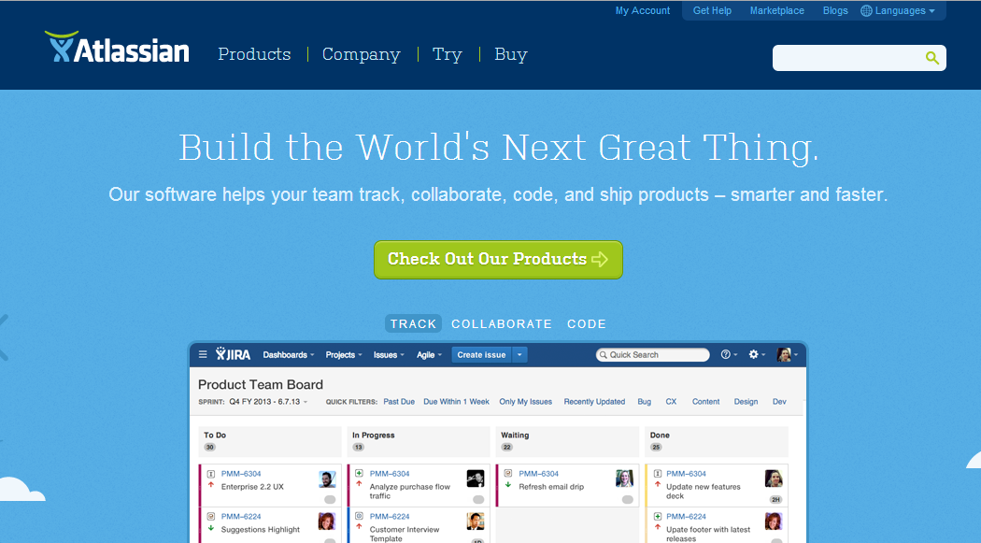
Notes:
http://blogs.atlassian.com/2011/10/behind-the-scenes-of-the-atlassian-logo-redesign/

Slide 2
Notes:
http://blogs.atlassian.com/2011/10/behind-the-scenes-of-the-atlassian-logo-redesign/

Slide 3
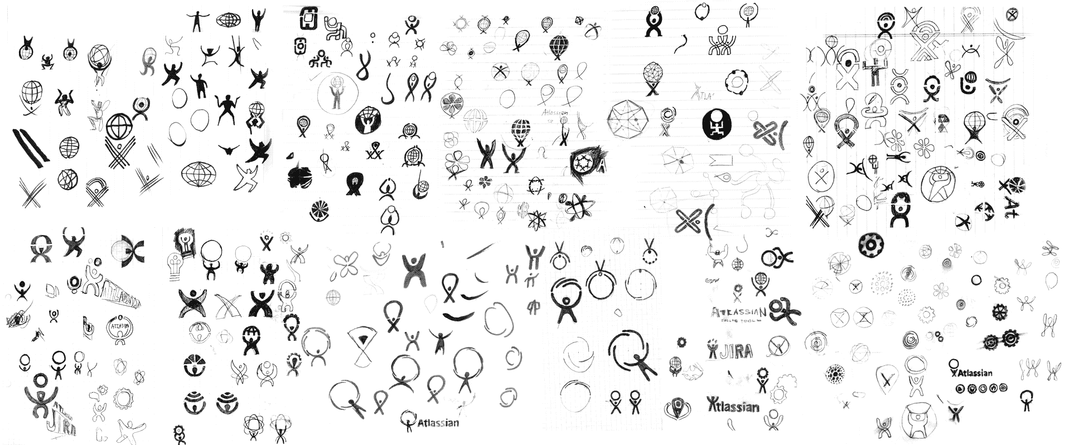

Slide 7
Sketching
CPSC 481: HCI I
Fall 2014
Anthony Tang, with acknowledgements to Julie Kientz, Saul Greenberg, Nicolai Marquardt, Ehud Sharlin

Slide 8
Sketching - Overview
Why should we sketch?
Getting the design right vs. getting the right design
What is sketching?
Properties of sketches
What is and what isn’t a sketch
Sketching vs. prototyping

Slide 9
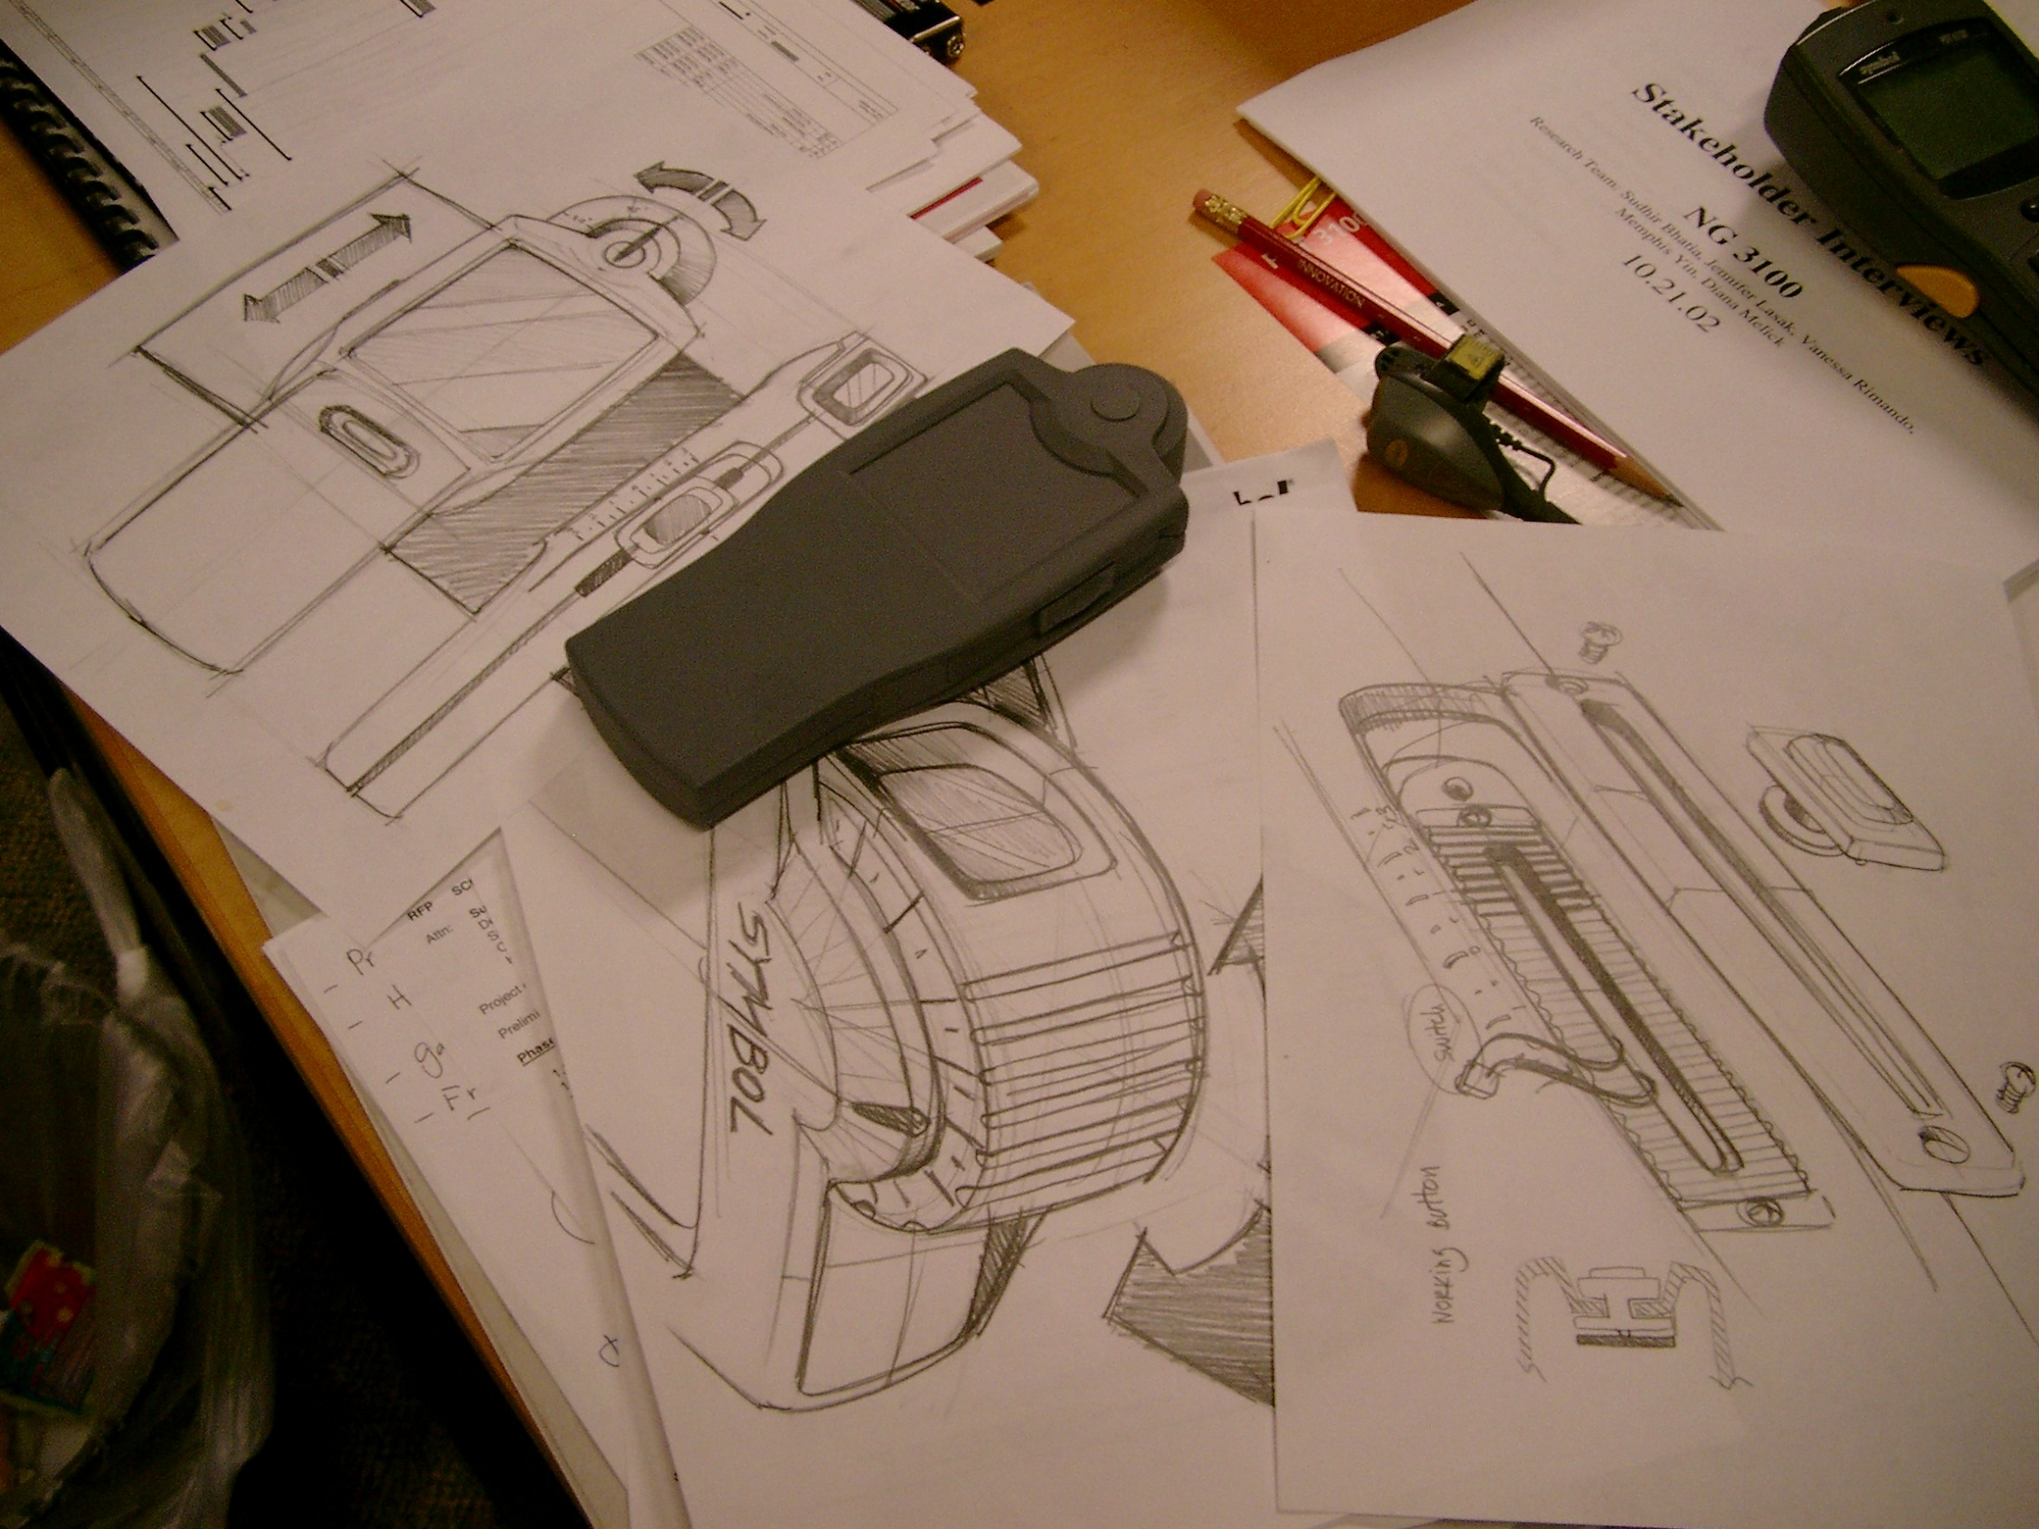
Sketching is about Design
Notes:
Fundamental idea:
Sketching is about design.
It is a fundamental tool that helps designers express, develop and communicate design ideas
It is a critical part of a process that begins with idea generation, to idea design, to design choices, to engineering
Sketching is not about drawing
It is about design.
Sketching is a tool to help you:
express
develop, and
communicate design ideas
Sketching is part of a process:
idea generation,
design elaboration
design choices,
engineering

Slide 10
Why Sketch?
  Create
    early ideation
    think openly about ideas
    think through ideas
    force you to visualize how things come together
    brainstorming: generate abundant ideas without worrying about quality
    invent and explore concepts
  Record
    ideas you develop
    ideas that you come across
    archive ideas for later reflection
  Reflect, share, critique, decide
    communicate ideas to others
    invite responses, criticisms, and alternatives;
    choose ideas worth pursuing

Slide 11
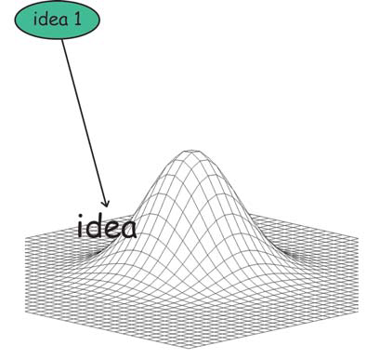
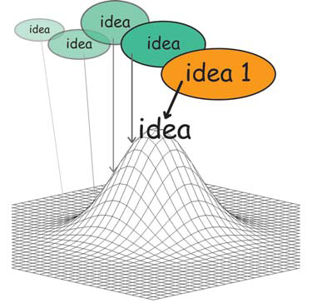
Getting the design right
Generate an idea
Iterate on the idea

Slide 12
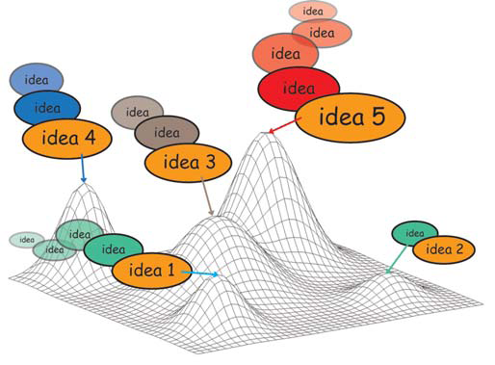
Problem
Is it the best idea? Issue: we often fixate on the first idea. Local maximum: hill climbing issue

Slide 13
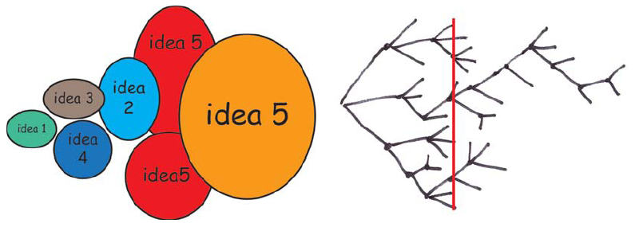
Getting the right design
  generate many ideas and variations
  reflect on all ideas
  choose the ones that look most promisting
  develop them in parallel
  add new ideas as they come up
  then iterate your final choice

Slide 14
Exploring alternatives
Getting the Right Design¹
… a designer that pitched three ideas would probably be fired. I'd say 5 is an entry point for an early formal review (distilled from 100's) … if you are pushing one you will be found out, and also fired … it is about open mindedness, humility, discovery, and learning. If you aren't authentically dedicated to that approach you are just doing it wrong!
Alistair Hamilton
VP Design
Symbol Technologies
¹Bill Buxton coined the expression ‘Getting the Design Right vs. Getting the Right Design’
Notes:
With alternatives, you can compare multiple solutions at any point in time, and choose one or more branches to follow

Slide 15
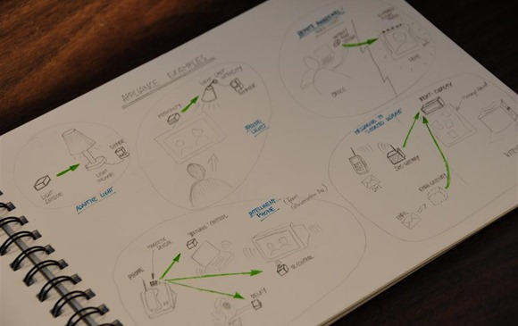
Sketching
A process that enables you to think through ideas and variations, and convey design ideas to others early in the design phase.
Notes:
http://www.nicolaimarquardt.com/blog/wp-content/uploads/2009/07/dsc0644large.jpg

Slide 16
Why sketching?
Early ideation that allows risk-taking and explorations of variations
Allows you to think through ideas
Active form of brainstorming

Slide 17
Why sketching?
Forces you to visualize how things come together
Communicates ideas to others (and oneself) to inspire new designs

Slide 18
Sketching as a dialog
Mind
(new knowledge)
Create
Sketch
(representation)
Read
Buxton, pp. 114

Slide 19
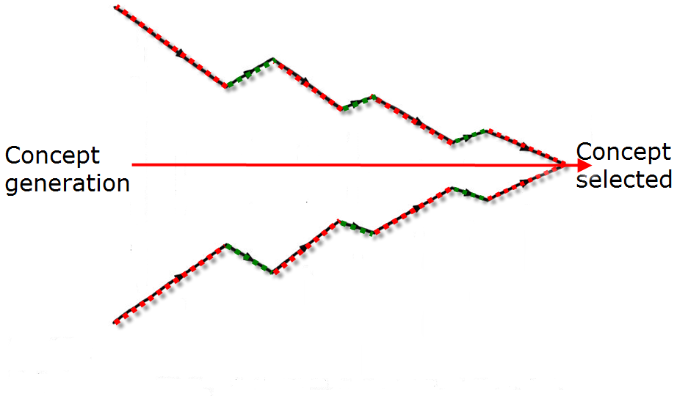
Elaboration and Reduction
  Elaborate - generate solutions. These are the opportunities
  Reduce - decide on the ones worth pursuing
  Repeat - elaborate and reduce again on those solutions
reduce
elaborate
elaborate
reduce
reduce
elaborate
reduce
repeat
repeat
repeat
Source: Laseau,P. (1980) Graphic Thinking for Architects & Designers. John Wiley and Sons

Slide 20
Elaboration and Reduction
Design is choice.
There are two places where there is room for creativity
creativity you bring to enumerating meaningfully distinct options from which to choose
creativity you bring to defining the criteria, or heuristics, according to which you make your choices.
Source: Laseau,P. (1980) Graphic Thinking for Architects & Designers. John Wiley and Sons

Slide 21
Buxton’s Properties of Sketches
Quick
Timely
Inexpensive
Disposable
Plentiful
Clear vocabulary
Distinct gesture
Minimal detail
Appropriate degree of refinement
Suggest and explore vs. confirm
Ambiguity

Slide 22
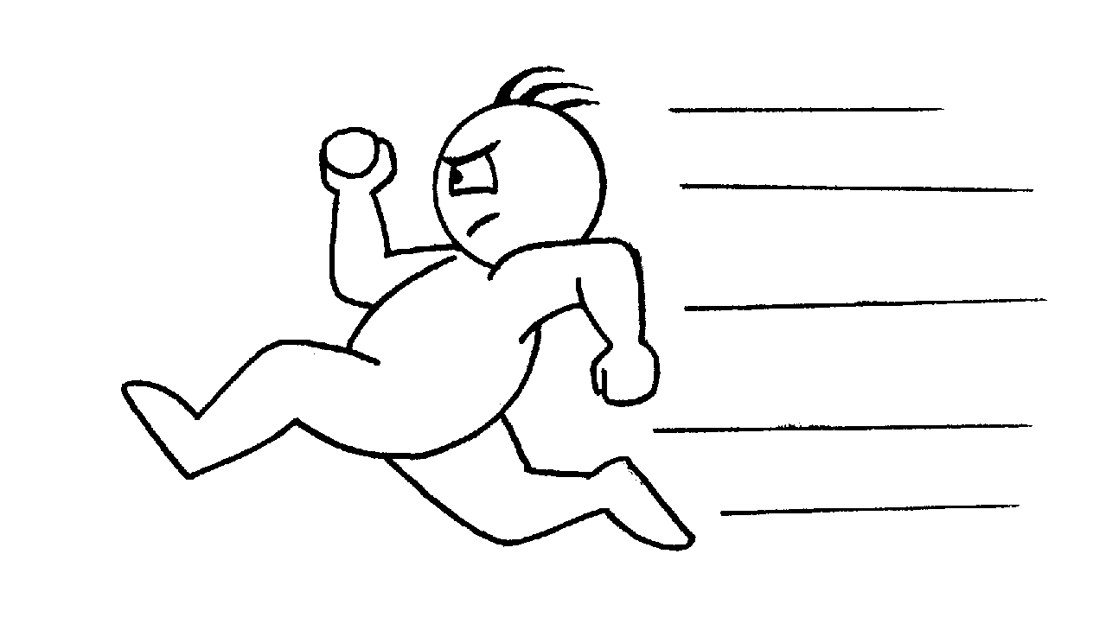

Quick
A sketch is quick to make, or at least gives that impression

Slide 23
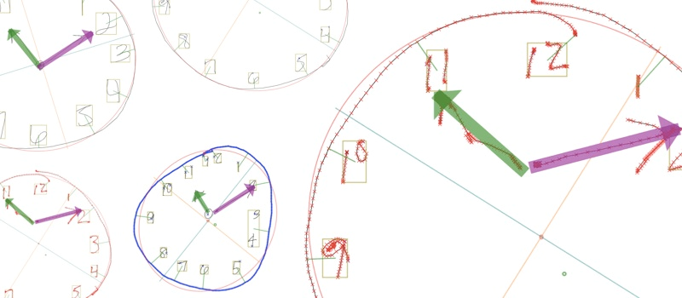
Timely
A sketch can be provided when needed

Slide 24
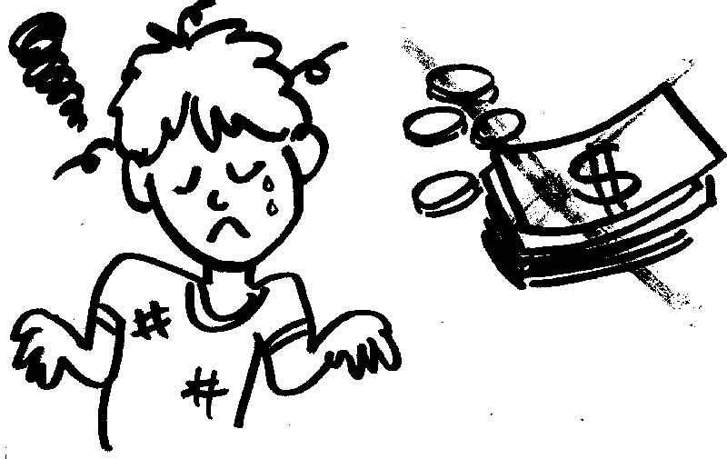
Inexpensive
Cost must not inhibit the ability to explore a concept, especially early in design

Slide 25

Disposable
If you can’t afford to throw it away, it’s not a sketch
Investment is in the process,
not the physical sketch
However, sketches are
not “worthless”

Slide 26
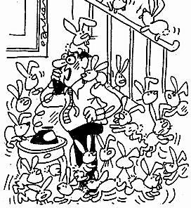
Plentiful
They don’t exist in isolation
Meaning & relevance is in the context of a collection or series

Slide 28
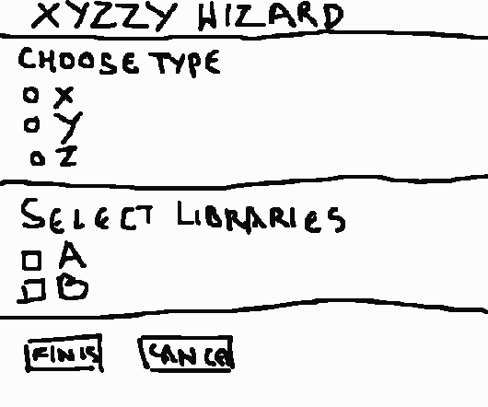
Clear vocabulary
The way it’s rendered (e.g., style, form, signals) makes it distinctive that it is a sketch
  Could be the way that a line extends through endpoints

Slide 29
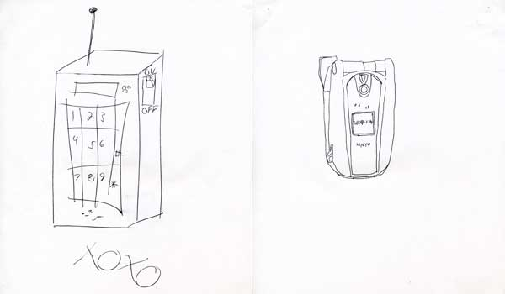
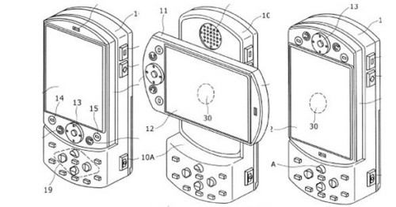
Distinct Gesture
Fluidity of sketches gives them a sense of openness and freedom
Opposite of engineering drawing, which is tight and precise
vs.

Slide 30
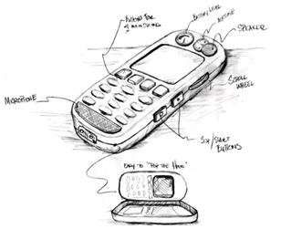
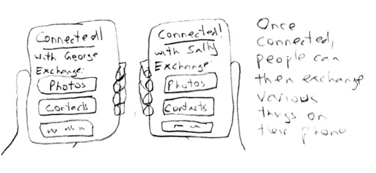
Minimal Detail
Include only what is required to render the intended purpose or concept

Slide 31
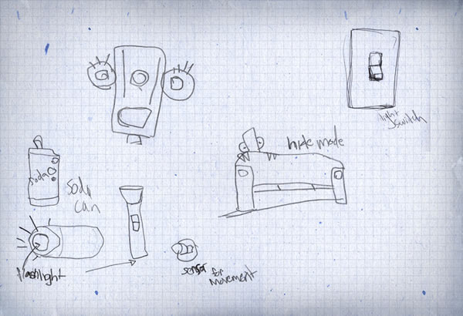
Appropriate Degree of Refinement
Make the sketch be as refined as the idea
  If you have a solid idea,
  make the sketch look
  more defined
  If you have a hazy idea,
  the sketch will look much
  rougher and less defined

Slide 32
Suggest and explore rather than confirm
Sketch should act as a catalyst to the desired and appropriate behaviors, conversations, and interactions

Slide 33
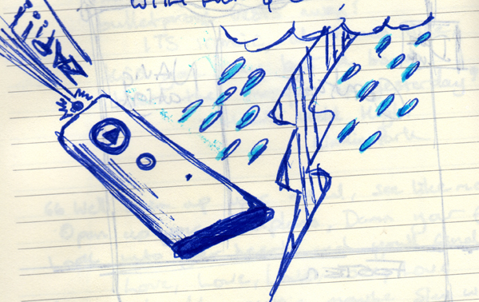
Ambiguity
Intentionally ambiguous
Value comes from being able to be interpreted
in different ways, even
by the person who
created them

Slide 34
Forms of Sketching?
Can be pencil/pen drawing on paper (my preference)
Something scraped together in Photoshop
Quick-and-dirty prototyping
Magazine cut-outs
Modifications to existing objects

Slide 35
You now know…
Why we need to sketch
  getting the design right vs. getting the right design
Properties of sketches
  Quick; Timely; Inexpensive; Disposable; Plentiful; Clear vocabulary; Distinct gesture; Minimal detail; Appropriate degree of refinement; Suggest and explore vs. confirm; Ambiguity
Next time: Prototypes!

